Slide 1
PRESERVING VALUE OF
DIGITAL ASSETS by means of Agents and Distributed Ledger Technologies
Peplluis de la Rosa @peplluis7 peplluis@eia.udg.edu
TECNIO Centre EASY
Advisor of LICENS3D.com

Slide 2
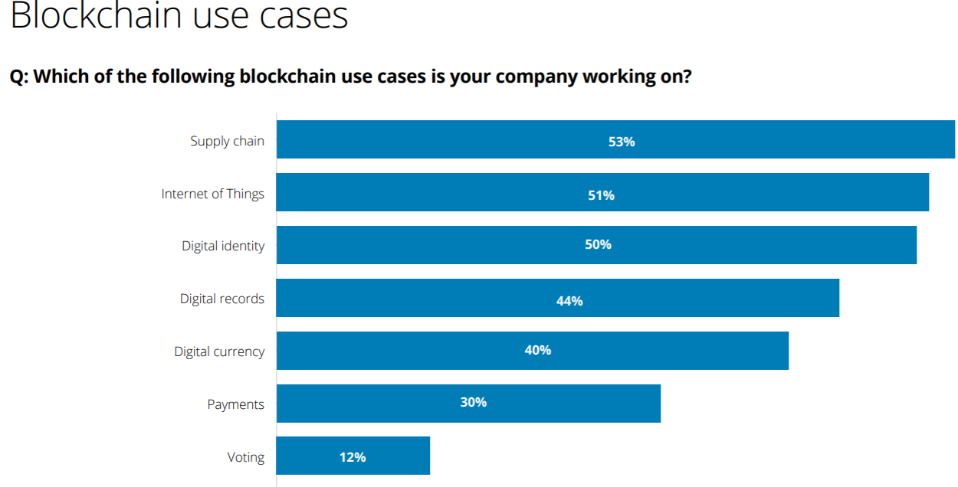
Fig. Deloitte’s 2018 global blockchain survey | Findings and insights

Slide 3
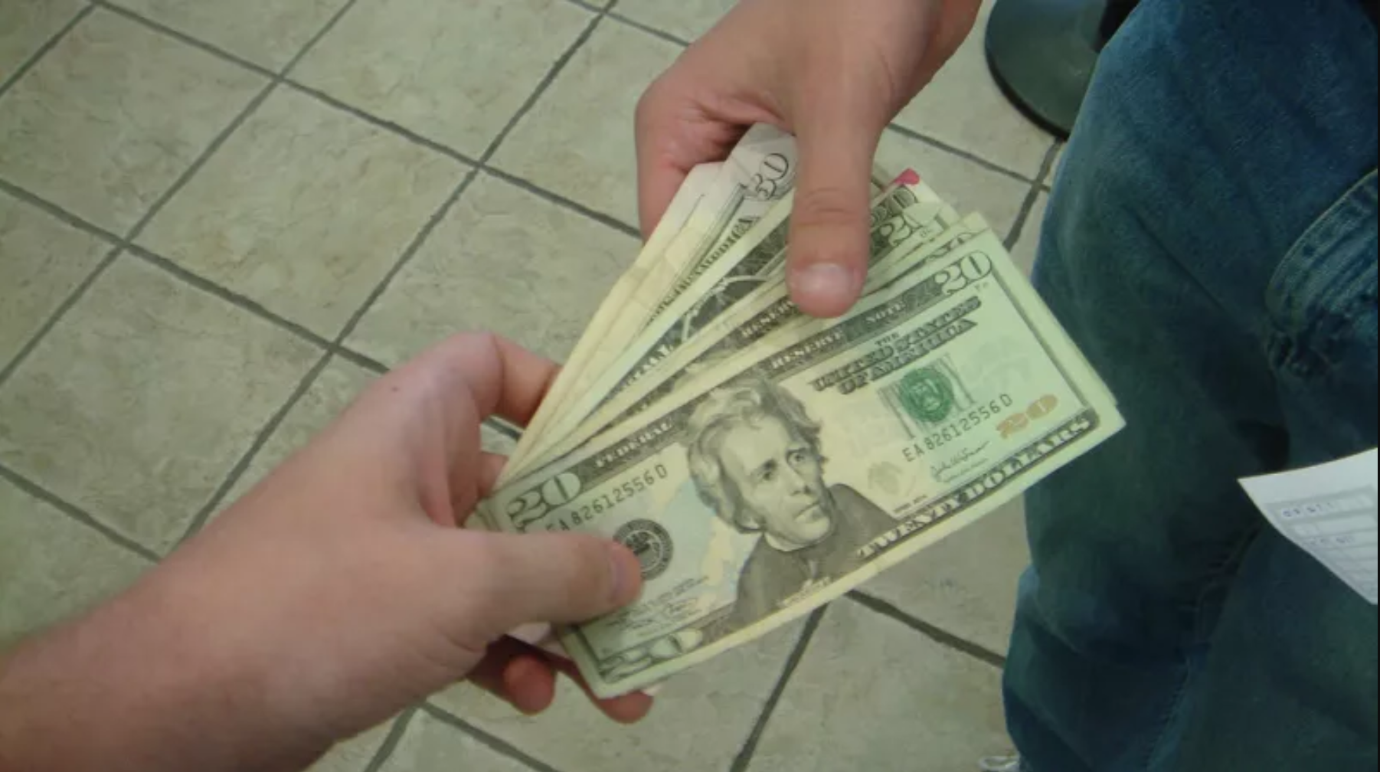
Blockchain enables peer to peer digital payments as good as cash, without intermediaries
1

Slide 4
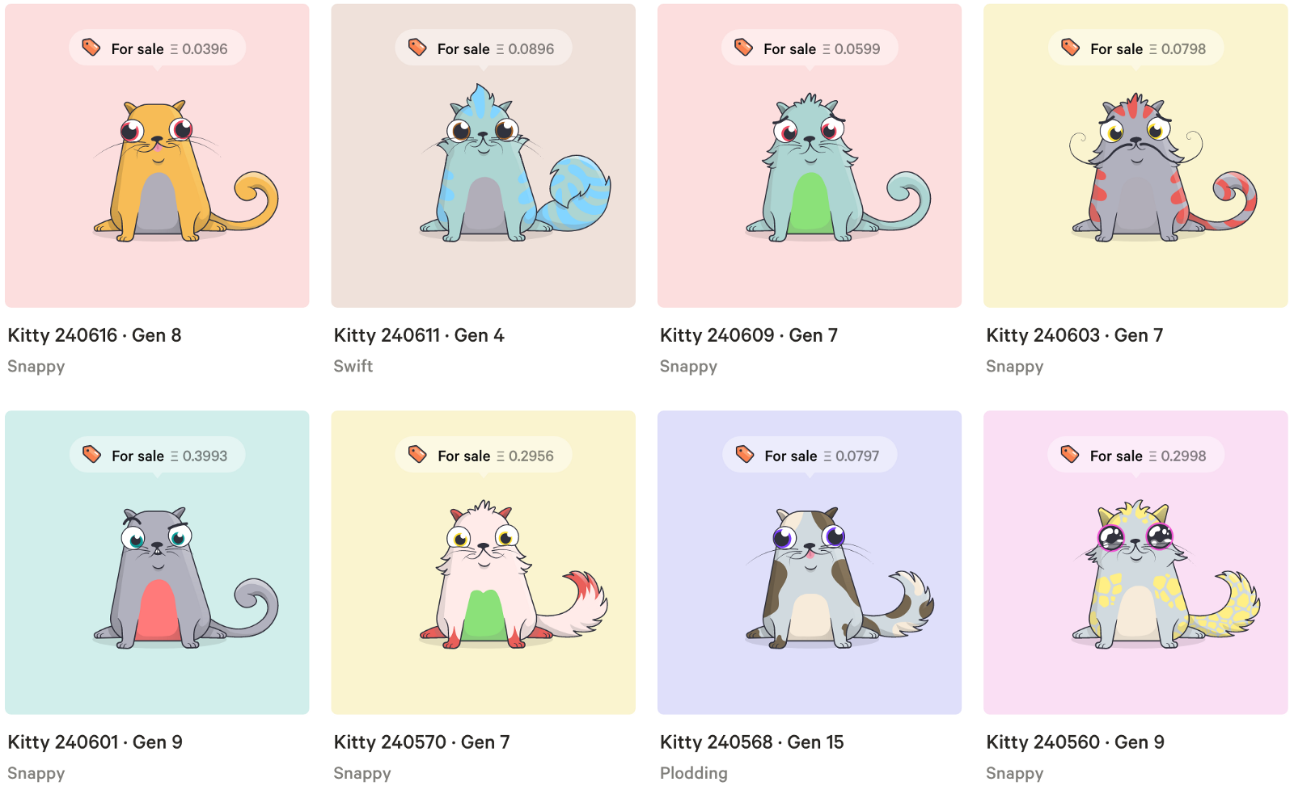
Assets Transfer
2

Slide 5
3
Voting
Switzerland - Zug

Slide 6
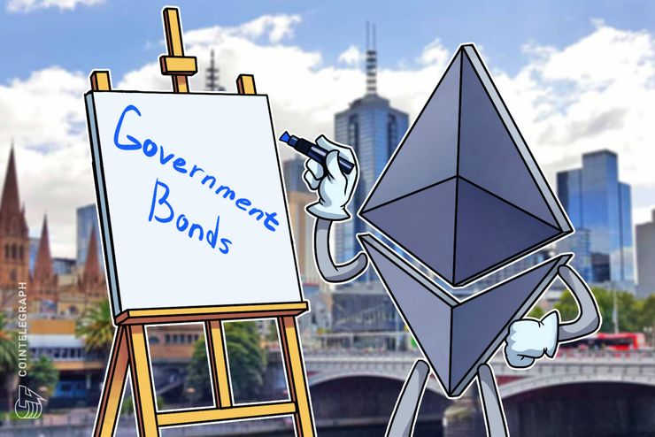
4
Tokenization - 2018
The government of Austria decided to use Ethereum (ETH) to issue around €1.15 billion bonds, October 2, 2018
Notes:
the government of Austria decided to use Ethereum (ETH) to issue around €1.15 billion, which translates to approximately, of government bonds, according to a report released by Kleine Zeitung on September 25.
The bonds will be issued in an auction scheduled for October 2. One of the biggest banks in the country with more than $26 billion in assets, OeKB, Oesterreichische Kontrollbank, will be operating the blockchain notarization service and will issue the bonds on behalf of OeBFA, the Austrian Treasury.

Slide 7
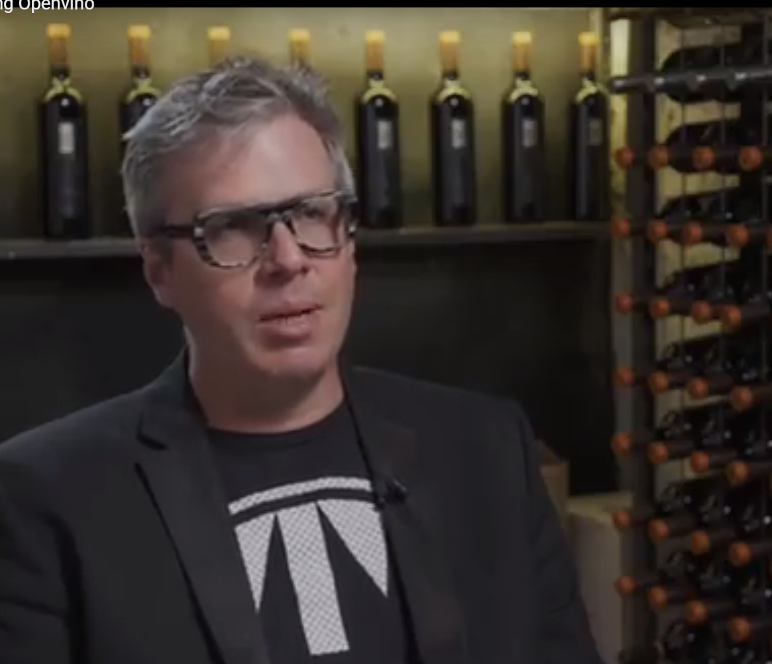
5
Tokenization – 2018 - OpenVino
1 token
= 1 bottle of wine
Cash-in in advance
Direct Sales
Automatic Pricing
New Loyalty scheme

Slide 8
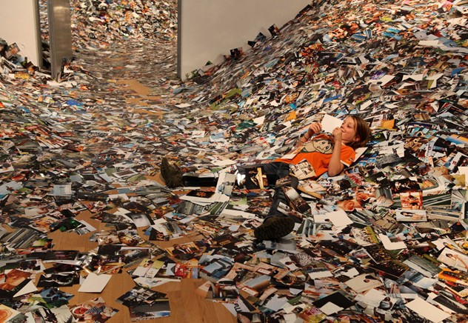

Slide 9
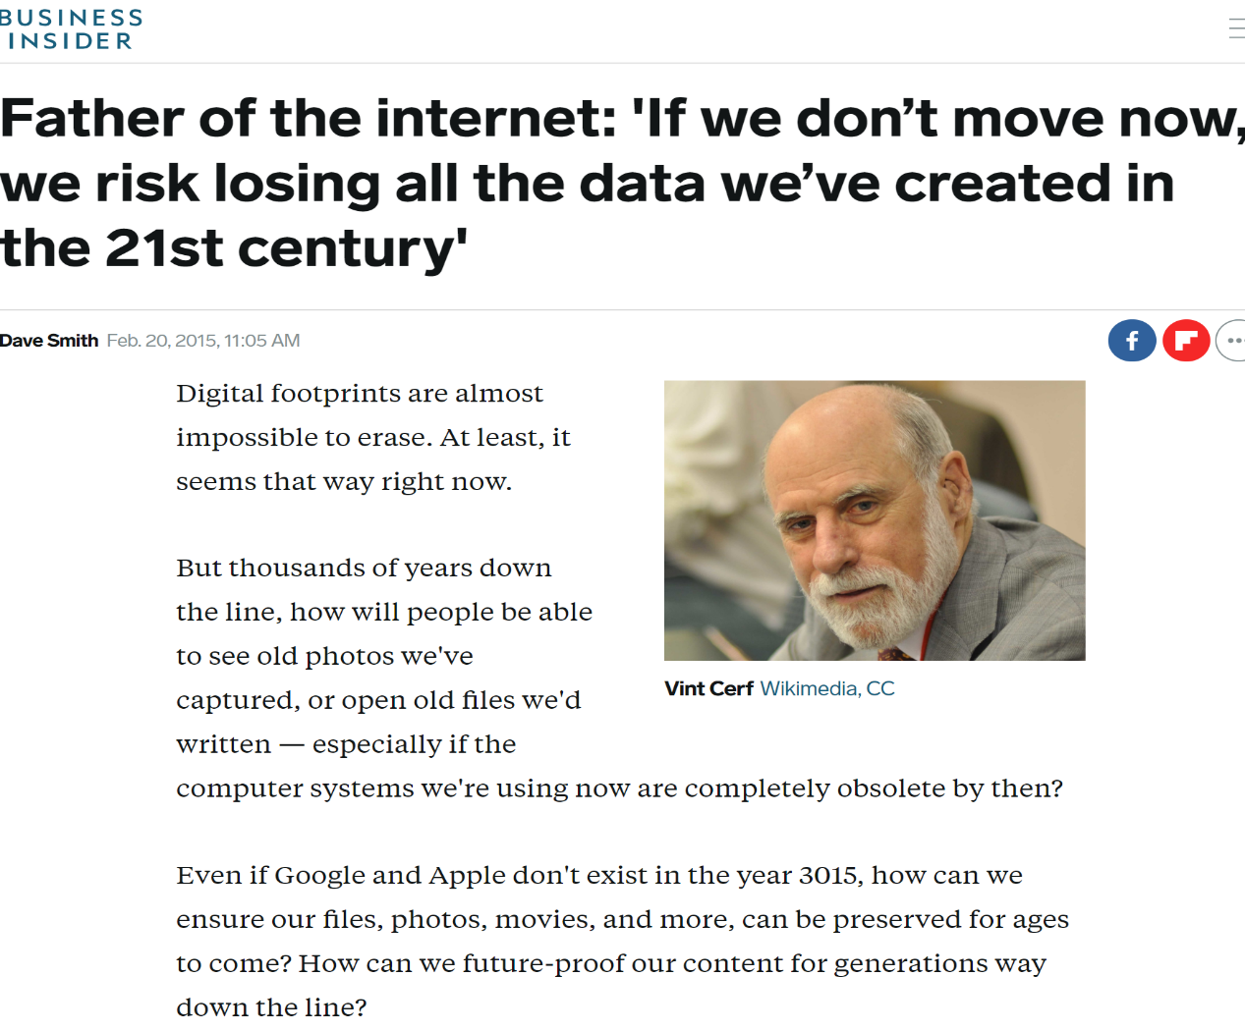

Slide 10
It should be clear by now that archives will have to have privileges to acquire and execute applications and the necessary operating system(s) so that acquired artifacts can live for long time periods. Moreover, a long-lived archive must rely on a business model that matches the desired longevity that might extend 100 years or more. Think of archives housing 1,000-year-old vellum codices, for example. In addition to the extensible standardization of digital representation, then, we will need legal and financial frameworks that assist long-term preservation. We must pursue these objectives lest our digital history be lost in a mist of uninterpretable bits.

Slide 11
VALUE

Slide 13
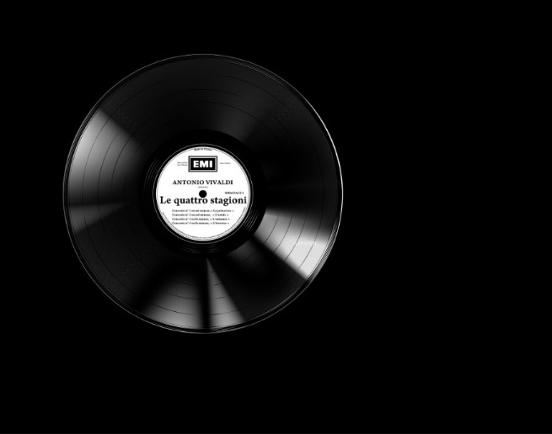
Post digital services will blossom with AI and Blockchain
Digital support substitution
Transformation into a service
Value Management
Flexibility

Slide 14
Forecast
Massive migration of value onto the Ledgers

Slide 15
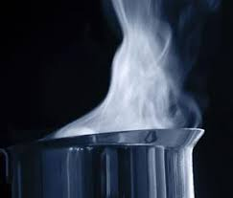
Value can fade, evaporate, demurrage

Slide 16
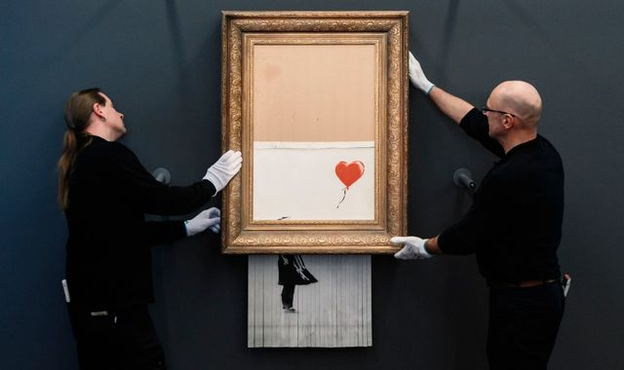

Slide 17
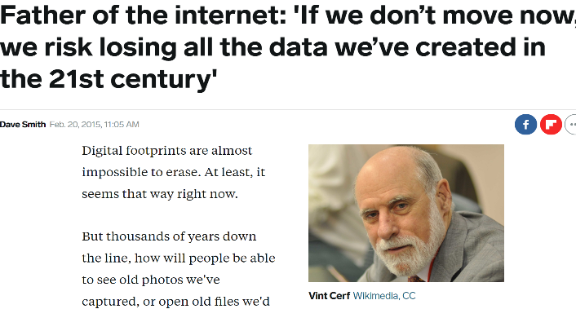
Value vs Digital Preservation
Data Deluge
Problem
Digital Blackout (Vincent Cerf 2017)
Bigger Problem
{assets} Deluge
(de la Rosa 2019)
Risk of Value
Blackout

Slide 18
Digital Preservation
> 15 years

Slide 19
On Value
“Value preservation is connecting digital assets to the future”
“Digital assets: The better preserved, the more potential for value creation”
“The more connected or exposed, the more value is achieved”

Slide 20
This is a general problem
Value Pres ⊇ Digital Pres ⊇ Backup/Custody

Slide 21
(Value vs Digital) Preservation
“Digital preservation comes from archives and libraries. It fights the digital obsolescence”
“Value preservation comes from the Internet of value created by DLT: It fights the value demurrage caused by bad property management or bad digital preservation”

Slide 23
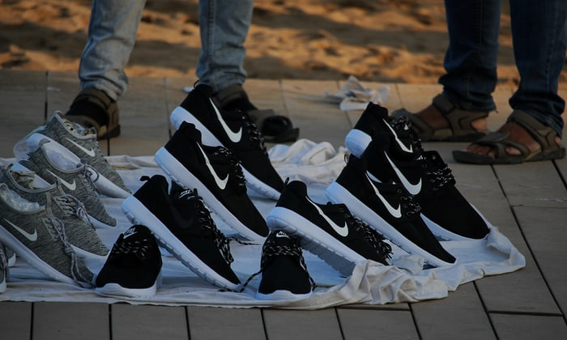
Are they on Blockchain?
Yes, Yes!
Pure Blockchain & Cotton stuff!
Are you sure…???

Slide 24
Value Preservation
> 1 to 5 hands/exchanges

Slide 25
Value Preservation with DLT
Duality of data and property:
Data doesn’t move: property does

Slide 26
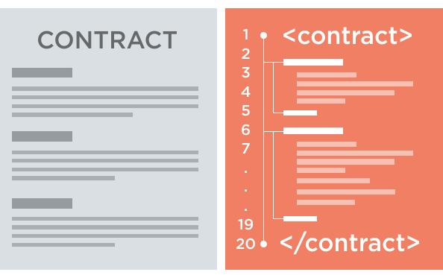
A smart contract is a digital contract between two or more parties that is created and stored in a ledger

Slide 27
Types of Value/Dig. Preservation
Productive-Economic → short term
Speculative-Economic short/mid term
Legal → mid term
Artistic mid/long term
Historic → long term

Slide 28
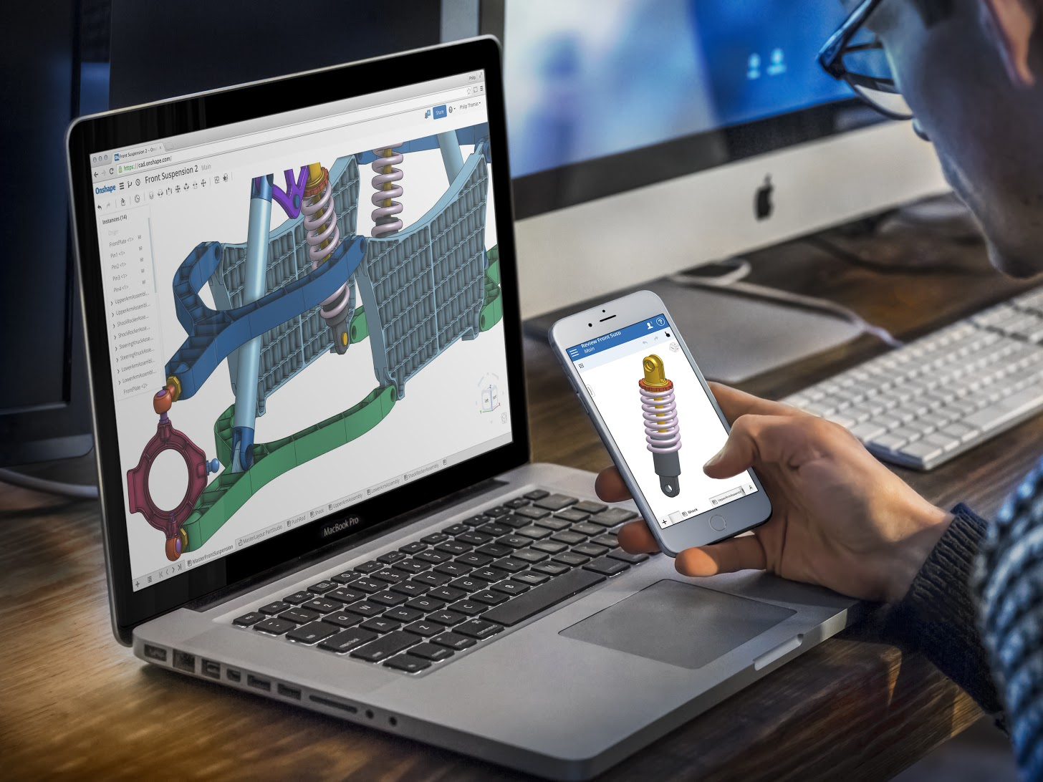
3D files, like all digital assets, can easily be shared making design theft easier than ever before.

Slide 29
Types of Threat
INTERNAL
96% of staff actively bypassing security
EXTERNAL
21% of manufacturers hacked

Slide 30
Scientific questions
a) Novel ways of protecting expensive digital assets
Tokenization for access grant (and custody)
+
Realigning interests for avoiding copies

Slide 31
Scientific questions
Tokenization for custody (storage)
Accenture (double signature patent)
Siacoin, Storj, Filecoin, Filenation
Our Patent: multisignature and sherding addresses
Next steps, hypothesis
“make users shareholders of the IP of the consumed or used products and services”

Slide 32
First Research axe
You use it, you own it
Tokenization, smartcontracts over custody, etc…
Target Market: Manufacturing Enterprise Companies

Slide 33
Scientific questions
b) Platform from digital preservation to value preservation
Self preserving objects (SPDO),
Curation markets (e-auctions),
Preservation currencies (PRESERVA)
Value preservation formats & standards

Slide 34
Self-Preserving Object
Instead of the prevailing top down approach apply agents as a bottom up …
Object centric w/ Intelligence and Budget approach

Slide 35
The Currency of Preservation
An agent handles its preservation by purchases in a curation market meeting its individual budget
1 Preserva = preservation cost for 100 years
(PRE / ₱)
(in experiments, we use mPRE / m₱)

Slide 36
E-auctions
The tested algorithms are
Multiunit auctions
Combinatorial auctions
Baseline : best price at every moment

Slide 37
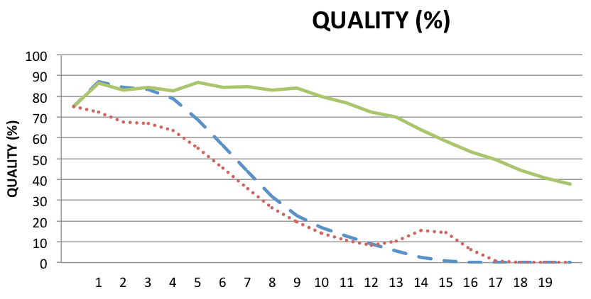
Self-Preserving Object

Slide 38
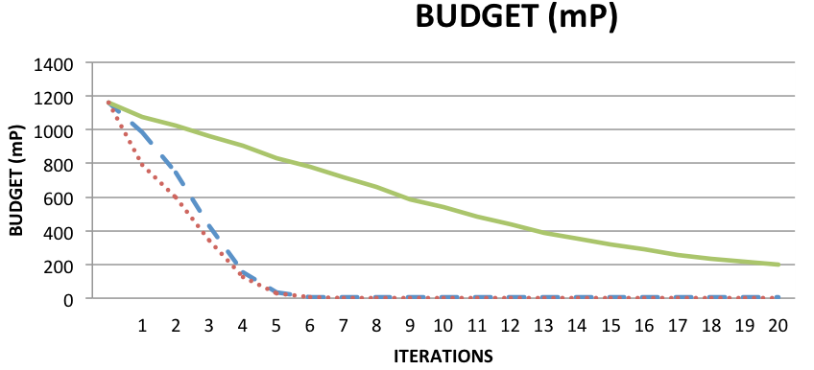

Slide 39
Second Research axe
How to work on preserving value with a bottom-up approach??
Target Market: Manufacturing Enterprise Companies

Slide 40
Let the value be with you…
Target Market: Manufacturing Enterprise Companies

Slide 41
I’m Peplluis de la Rosa.
Feel free to contact me to KNOW MORE!
Contact
Parc Científic i Tecnològic de la Universitat de Girona Edifici Narcís Monturiol, Emili Grahit 91, 17003 Girona www.centreeasy.com peplluis@eia.udg.edu
@CentreEasy centreeasyinnova
@peplluis7
TECNIO Centre EASY
http://dltai.udg.edu

Slide 42
Value doesn't make me happy…
I need it
Target Market: Manufacturing Enterprise Companies

