Slide 1
A New Mixed MNP Model Accommodating a Variety of Dependent Non-Normal Coefficient Distributions
Chandra R. Bhat and Patricia Lavieri
July 3rd, 2017

Slide 2
Introduction
Econometric discrete choice analysis is underlying framework for analyzing demand for a variety of consumer commodities and services.
Traditionally: multinomial logit (MNL) model.
  assumes a single composite independently and identically distributed (across alternatives) random utility error term with a Gumbel (or Type I extreme-value) distribution.
Over the past two decades:
  acknowledge the presence of unobserved taste sensitivity in response to variables, as well as
  accommodate non-IID kernel error terms across alternatives.
A general approach to do so: multivariate normal kernel mixed with an appropriately distributed random coefficients vector, labeled as the mixed multinomial probit (or mixed MNP) model

Slide 3
Random multivariate mixing distribution needs to be consistent with theoretical notions!
For example
  The analyst may want to specify a naturally bounded distribution for cost and time coefficients in a travel choice model, so that the coefficients are strictly negative.
  Using an unbounded distribution that straddles the zero value for the cost coefficient leads to a breakdown of the willingness to pay calculations.
  Several studies have underscored the potentially serious mis-specification consequences (in terms of theoretical considerations, data fit, as well as trade-off evaluations) of using an unbounded distribution.

Slide 4
The current paper
Develops a general copula-based mixed random coefficients version of the MNP model.
The model allows a multivariate mixing distribution that can combine any continuous distributional shape for each coefficient:
Univariate continuous coefficient distributions
+
Gaussian Copula
=
Multivariate continuous distribution
Univariate distributions can be different for different coefficients!
Estimation: hybrid of the of the maximum simulated likelihood (MSL) and the maximum approximate composite marginal likelihood (MACML) inference approach.
Examines the performance of the approach through simulation exercises and empirical application.

Slide 5
Copula Basics
Copula: to tie, bond, or connect
Basic idea: a joint distribution can always be factored into marginal distributions tied together by a dependence function called the copula.
Joint multivariate stochastic dependence relationship generated by wrapping pre-specified marginal distributions together using a dependence structure called the copula.
The copulas themselves are multivariate distribution functions defined over the unit cube linking uniformly distributed marginal distributions
  Remember: any prespecified marginal distribution can be translated into an equivalent uniform distribution using the integral transform result.

Slide 6
Let C be a K-dimensional copula of uniformly distributed random variables U₁, U₂, U₃, …, U_{K} with support contained in [0,1]^{K}. Then,
where θ is the dependence parameter vector of the copula.
Now, consider K random variables Y₁, Y₂, Y₃, …, Y_{K}, each with univariate continuous marginal distribution functions , k =1, 2, 3, …, K. Then, by the integral transform result, for each k (k = 1, 2, 3, …, K):
A joint K-dimensional distribution function of the random variables with the continuous marginal distribution functions can then be generated, using Sklar’s (1973) theorem, as follows:

Slide 7
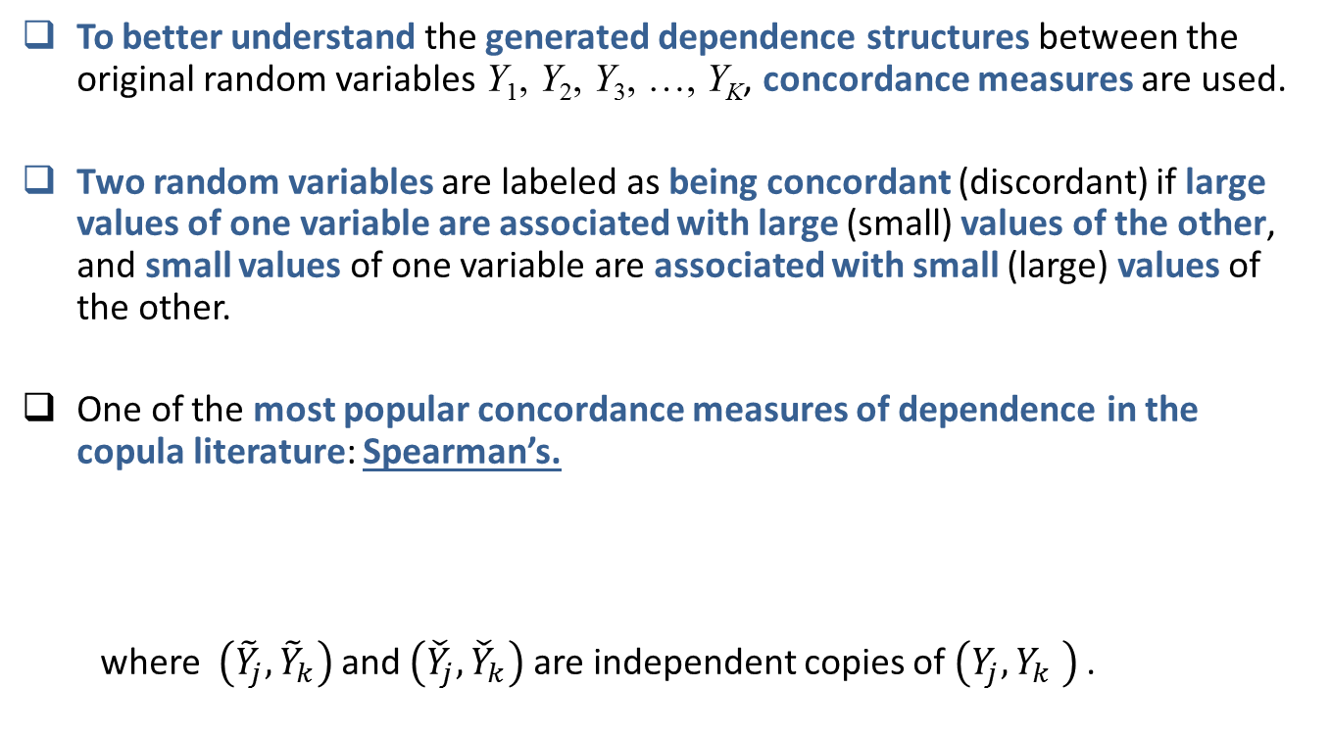
To better understand the generated dependence structures between the original random variables Y₁, Y₂, Y₃, …, Y_{K}, concordance measures are used.
Two random variables are labeled as being concordant (discordant) if large values of one variable are associated with large (small) values of the other, and small values of one variable are associated with small (large) values of the other.
One of the most popular concordance measures of dependence in the copula literature: Spearman’s.
where and are independent copies of .

Slide 8
The Copula functions are generated in one of several ways:
  method of inversion, geometric methods, and algebraic methods
Most common: the inversion method
  starts with a known multivariate distribution and derives a copula function
To generate the Gaussian copula: consider the multivariate standard normal distribution function with continuous marginal univariate standard normal distribution functions and a correlation matrix Γ . Then,

Slide 9
The multivariate distribution with arbitrary marginal distribution functions and a Gaussian copula takes the following form:
The Spearman’s measures for the Gaussian copula above can be written in terms of the dependence (correlation) parameters embedded in the matrix Γ .

Slide 10
The Gaussian copula is particularly appealing because: parameterizes the full range of dependence from perfect negative dependence to zero dependence to perfect positive dependence.
Other advantages
  Includes the case of independence across specific coefficients.
  Allows a flexible and wide range of dependence across coefficients.
  Is relatively easy to simulate relative to other copula types.
  Allows dependence across the random coefficients, even if the random coefficients take different marginal distributions.
  Is the best copula to work with in situations where the analyst is prepared to accept a normal density function for many coefficients, with only a few selected coefficients specified to have a non-normal parametric univariate density function.
Note: It may be quite acceptable to use a normal density function as a default, simply because the central limit theorem indicates that the cumulative effect of a large number of unobserved factors that affect sensitivity should collapse to a normal distribution.
For example, in many cases, the only coefficient considered non-normal is the cost coefficient

Slide 11
The proposed model
Consider the random-coefficients formulation in which the utility that an individual q associates at time period t with alternative i is written as:
: (Ex1)-column vector of exogenous attributes (without including constants),
: (Lx1)- column vector of exogenous attributes (including dummy variables for constants, except in one alternative)
: (Ex1)- column vector of coefficients that varies across individuals based on unobserved individual attributes and with each element having a non-normal univariate distribution function
: (Lx1)- column vector of MVN-distributed coefficients that varies across individuals based on unobserved individual attributes, with each it its elements having a normal univariate distribution function

Slide 12
Using the properties of the Gaussian copula:
The (I×1)-vector of kernel error terms, , at each choice occasion is assumed to have a general covariance structure subject to identifiability considerations so that
Since only utility differences matter in discrete choice models, appropriate identification conditions need to be maintained.
Take the differences of the error terms with respect to the first error term. Let and let . Then, up to a scaling factor, the covariance matrix of is identifiable.

Slide 13
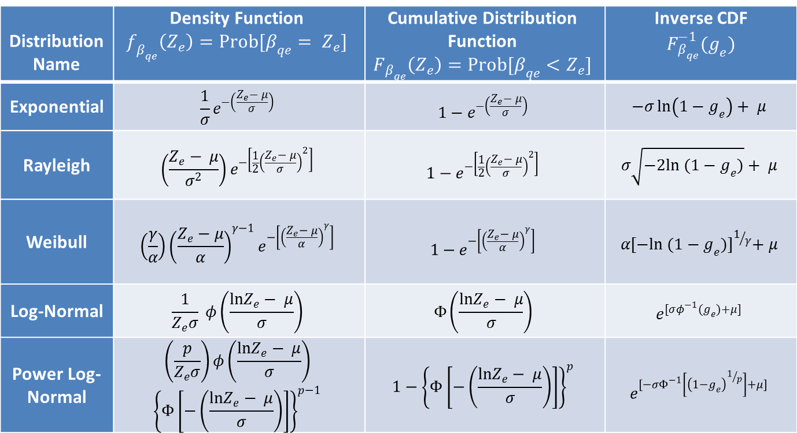
List of univariate marginal distributions that may be considered as they
  are strictly restricted to the positive half-line,
  have at least the first and second inverse moments exist (important for willingness to pay computations where an element appears in the denominator of a ratio),
  and have closed-form inverse (or quantile) functions.
Distribution Name | Density Function | Cumulative Distribution Function | Inverse CDF
Exponential
Rayleigh
Weibull
Log-Normal
Power Log-Normal
Distribution Name
Exponential
Rayleigh
Weibull
Log-Normal
Power Log-Normal

Slide 14
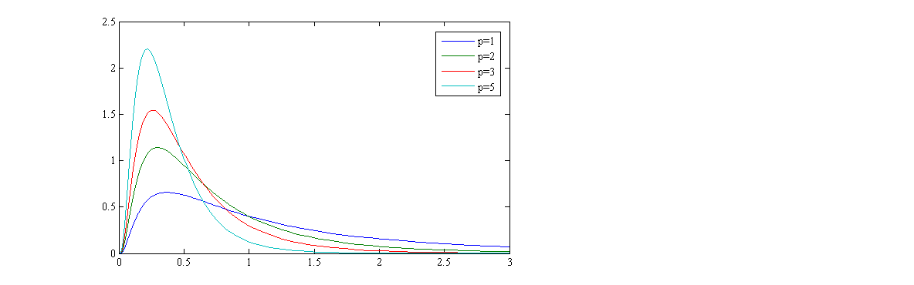
Power Log-normal
Allows for substantial heterogeneity (large variance parameter) while also ensuring that the skewed tail is relatively thin.
Thin tails make convergence during estimation much easier.
Comparison of the log-normal (p=1) and the power log-normal distributions for identical values of µ and σ (µ=0 and σ=1)

Slide 15
Estimation Approach
Hybrid MSL-MACML
WHY?
MACML
  ADVANTAGE: simple, computationally very efficient, and simulation-free
    Smooth analytically-approximated likelihood function
    Ensures convergence during maximization
    Smooth second derivative functions to compute the covariance matrix of the estimator
  LIMITATION: restricted to normally distributed coefficients
MSL
  ADVANTAGE: works for any type of coefficient distribution
  LIMITATION: Can be computationally expensive
    Estimation of high number of random coefficients is practically infeasible

Slide 16
When does the Hybrid MSL-MACML work best?
Few non-normally distributed coefficients
  So that the simulation does not involve very high dimensions
Many normally distributed coefficients
  So that the MACML computational accuracy and efficiency can be realized

Slide 17
Model Estimation using the Hybrid MSL-MACML Approach
We can write in matrix form:
and :
where and
The likelihood contribution of individual q has the form, with
where is the E-variate multivariate standard normal density function.

Slide 18
The simulation approaches for evaluating the full likelihood function involve integration of dimension which can explode quickly as the number of choice occasions of the same individual increases.
The high dimensionality of the integrand can lead to very small probabilities for the chosen alternative, leading to additional convergence problems.
However, one can consider the following (pairwise) composite marginal likelihood function formed by taking the products (across the T choice occasions) of the joint pairwise probability of the chosen alternatives for the t^{th} choice occasion and for the t’^{th} choice occasion for individual q.

Slide 19
The statistical test for a single parameter of a model may be pursued using the usual t-statistic based on the inverse of the Godambe information matrix.
Nested models may be compared with one another in the CML approach using the composite likelihood ratio test (CLRT) statistic. Consider the null hypothesis against , where is a subvector of of dimension . The statistic takes the familiar form shown below:
where is the composite marginal likelihood estimator under the null hypothesis.
The following adjusted CLRT statistic, ADCLRT, may be considered to be asymptotically chi-squared distributed with degrees of freedom:
For model selection between two competing non-nested models the composite likelihood information criterion (CLIC) . The CLIC takes the following form:
The model that provides a higher value of CLIC is preferred.

Slide 20
Alternative Estimation Procedure
An alternative estimation procedure is to develop the likelihood function for each individual conditional on both the vectors, and then integrate both out at the end.
The individual-level likelihood function has the form:
The above function involves the evaluation of an E+L-dimensional outer integral followed by evaluations of (I-1)-dimensional orthant inner integrals.
In the cross-sectional case, the conditional estimation procedure from earlier is much more computationally efficient (note that the CML and the ML functions are the same for the cross-sectional case)
The estimation procedure from earlier exploits the fact that the conditional distribution of a subset of multivariate normally distributed coefficients involved in a Gaussian copula-generated larger multivariate distribution, given the subset of non-normally distributed coefficients, is also multivariate normally distributed.

Slide 21
In the panel case, the full information (conditional) likelihood procedure becomes difficult to impractical as the number of choice occasions per individual increases. The alternative just discussed is better
However, the CML combined with the conditional estimation procedure still retains substantial advantages compared to this alternative estimation technique.
  When the number of choice occasions increases, the result is that the integrand in the MSL procedure becomes smaller and smaller (because it is the product of probabilities over all choice occasions), leading to potential problems in convergence.
The CML does not have the above problem, because the logarithm of the CML function leads to summations outside the (I-1)x2-dimensional integral.
But the CML also involves more and more pairings as the number of choice occasions increases.
Fortunately, one can use a different CML function: instead of taking all pairings, one can develop a CML function that only includes a specified number of randomly chosen choice occasions to form the pairings, while leaving the others independent

Slide 22
Simulation Evaluation
Cross-sectional mixed MNP model with four alternatives and 3 independent variables
  Each of the 3 independent variables are drawn from a standard univariate normal distribution
  Once drawn, the exogenous variables are held fixed for the data set
  Sample of 3000 realizations of the three independent variables
  200 samples
We allow random coefficients on all the 3 independent variables
  Two set-ups: different distributional configurations
Set-up 1:
  The first and second elements are realizations from identical power log-normal distributions
  The third element is a realization from an normal distribution
Set-up 2:
  The first element is a realizations from a power log-normal distribution
  The second element is a realizations from a exponential distribution
  The third element is a realization from an normal distribution
All of these coefficients are tied together through the dependency (correlation) matrix of the Gaussian copula

Slide 23
For set-up 1, a draw of is obtained as follows:
  First draw a three-variate realization of from the multivariate standard normal distribution of (E+L) dimensions with a mean vector with all zero elements and correlation matrix Γ,
  Obtain the realization of as
  Obtain the realization of the one-dimensional vector as ,where is the one-dimensional diagonal matrix with the element η at the l^{th} diagonal, and r is the one-dimensional mean location parameter.
We allow a general covariance matrix for the kernel error term vector
To generate the dependent variable values in the simulation for given independent variable values for each individual (that is, for given values), we track back to the matrix equation and write:
Once the multivariate realizations of and are drawn, the utility of each alternative at each choice occasion is computed, and the alternative with the highest utility at each choice occasion is then identified as the chosen alternative.

Slide 24
Performance measures for the Hybrid MSL-MACML approach
Estimate the standard errors of parameters for each data set using the Godambe (sandwich) estimator.
Compute the mean estimate for each model parameter across the 100 data sets. Compute the absolute percentage bias (APB) as:
Compute the standard deviation of each parameter estimate across the 100 datasets, and label this as the finite sample standard deviation or FSSD (essentially, this is the empirical standard error).

Slide 25
Compute the mean standard error for each model parameter across the 100 datasets, and label this as the asymptotic standard error or ASE (essentially this is the standard error of the distribution of the estimator as the sample size gets large, and is a theoretical approximation to the FSSD).
Next, to evaluate the accuracy of the asymptotic standard error formula for the finite sample size used, compute the absolute percentage bias of the asymptotic standard error (APBASE) for each parameter relative to the corresponding finite sample standard deviation.

Slide 26
Set-up 1: Two power log-normal and one normal random parameter
Parameter |  | True value | Parameter Estimates | Standard Error
 |  |  | Mean Estimate | APB | ASE | FSSD | APBASE
Power log-normal |  | 0.500 | 0.475 | 5.09% | 0.163 | 0.164 | 0.92%
 |  | 0.500 | 0.467 | 6.53% | 0.165 | 0.164 | 1.02%
 | 1.000 | 0.986 | 1.38% | 0.178 | 0.171 | 4.51%
 | 1.000 | 0.972 | 2.82% | 0.184 | 0.169 | 8.54%
Normal | r | 0.500 | 0.491 | 1.75% | 0.070 | 0.065 | 7.29%
 | 1.500 | 1.495 | 0.37% | 0.139 | 0.128 | 8.63%
Copula Correlation |  | 0.600 | 0.592 | 1.34% | 0.184 | 0.160 | 15.44%
 | 0.400 | 0.381 | 4.63% | 0.111 | 0.129 | 14.07%
 | 0.200 | 0.236 | 18.19% | 0.158 | 0.132 | 19.72%
Kernel Covariance |  | 0.404 | 0.413 | 2.29% | 0.149 | 0.168 | 11.27%
 | 0.998 | 0.980 | 1.80% | 0.101 | 0.094 | 7.42%
Overall Average |  | - | - | 4.20% | 0.146 | 0.140 | 8.98%

Slide 27
Set-up 2: Power Log-normal, Exponential and Normal Random Parameters
Parameter |  | True Value | Parameter Estimates | Standard Error
 |  |  | Mean Estimate | APB | ASE | FSSD | APBASE
Power log-normal |  | 0.500 | 0.502 | 0.45% | 0.156 | 0.152 | 2.82%
 | 1.000 | 1.000 | 0.00% | 0.167 | 0.162 | 3.29%
Exponential |  | 1.000 | 1.013 | 1.28% | 0.119 | 0.126 | 6.09%
 | 0.800 | 0.792 | 1.05% | 0.281 | 0.209 | 34.48%
Normal | r | 0.500 | 0.498 | 0.47% | 0.074 | 0.070 | 5.95%
 | 1.500 | 1.504 | 0.26% | 0.138 | 0.139 | 0.25%
Copula Correlation |  | 0.400 | 0.441 | 10.22% | 0.213 | 0.178 | 19.65%
 | 0.600 | 0.604 | 0.60% | 0.095 | 0.101 | 6.18%
 | 0.393 | 0.394 | 0.20% | 0.155 | 0.141 | 9.99%
Kernel Covariance |  | 0.404 | 0.393 | 2.66% | 0.164 | 0.165 | 0.64%
 | 0.998 | 0.973 | 2.54% | 0.106 | 0.100 | 5.99%
Overall Average |  | - | - | 1.80% | 0.152 | 0.140 | 8.67%

Slide 28

Empirical Application
Data
  Web-based stated preference survey
    Austin Area, 2004
  Four commuting options
  Each respondent chooses a mode in four occasions under alternative travel times and cost scenarios
  322 individuals and 1288 choice occasions

Slide 29
Valuation of Travel Time Savings
No one would be interested in wasting money on daily travel
BUT it is quite possible that individuals would want to extend their travel time on at least some travel occasions
  Secondary activities conducted during travel may bring positive utility
Theoretical considerations require
  Cost coefficient negative = bounded distribution
  Time coefficient not necessarily negative = bounded or unbounded distribution

Slide 30
Data fit and Value of Travel Time Savings (VTTS) for different models
Model | Coefficient distribution | CLIC statistic | Median VTTS Value
 | Cost | Time |  | Low income | Medium income | High income
1 | Fixed | Fixed | -4420.11 | 8.72 | 29.08 | 87.24
2 | Fixed | Normal | -4387.57 | 10.47 | 34.89 | 104.67
3 | Fixed | Log-normal | -4376.27 | 4.68 | 15.59 | 46.78
4 | Fixed | Power log-normal | -4375.73 | 4.56 | 15.19 | 45.59
5 | Log-normal | Fixed | -4330.32 | 4.47 | 14.89 | 44.68
6 | Log-normal | Normal | -4294.56 | 2.91 | 9.79 | 29.14
7 | Log-normal | Log-normal | -4313.22 | 2.44 | 8.15 | 24.45
8 | Log-normal | Power log-normal | -4312.79 | 2.32 | 7.73 | 23.18
9 | Power log-normal | Fixed | -4326.65 | 4.59 | 15.31 | 45.92
10 | Power log-normal | Normal | -4290.96 | 2.47 | 8.23 | 24.69
11 | Power log-normal | Log-normal | -4309.71 | 2.48 | 8.28 | 24.85
12 | Power log-normal | Power log-normal | -4309.09 | 2.30 | 7.68 | 23.04
Cost variable: cost/personal income
Annual incomes: low = 15k, medium = 50k and high = 150k
Power log-normal: p = 5

Slide 32
Discussion of Empirical Results
The model with fixed cost and time coefficients (Model 1) is rejected soundly relative to random coefficients: clear presence of random individual-level heterogeneity in taste to cost/time.
  Model 1 and Model 2 (cost is fixed and time is normally distributed): VTTS are higher than the implied wage rate for each income category (low, medium, and high income categories are $7.2 per hour, $24 per hour and $72)
Models with a fixed coefficient on one of the travel time or travel cost variables (Models 2, 3, 4, 5, and 9) have worse performance than those with both coefficients randomly distributed (Models 6, 7, 8, 10, 11, 12)
  Models 2, 3, 4, 5, and 9 VTTS = two thirds of wage rate
  Models 6, 7, 8, 10, 11, 12 produce lowest VTTS = one-third of wage rate
Models with a fixed coefficient on travel time and a bounded distribution on travel cost are superior from a data fit standpoint relative to those that specify a fixed coefficient on cost and a random coefficient on travel time

Slide 33
Group 1
Model 7: Log-normal cost coefficient, Log-normal time coefficient
Model 8: Log-normal cost coefficient, Power log-normal time coefficient
Model 11: Power log-normal cost coefficient, Log-normal time coefficient
Group 2
Model 6: Log-normal time coefficient, Normal time coefficient
Model 10: Power log-normal cost coefficient, Normal time coefficient
Group 3
Model 3:Fixed cost coefficient, Log-normal time coefficient
Model 5: Log-normal cost coefficient, Fixed time coefficient
Model 9: Power log-normal cost coefficient, Fixed time coefficient
Model 4
Fixed cost coefficient, Power log-normal time coefficient
Model 12
Power log-normal cost coefficient, Power log-normal time coefficient

Slide 34
Discussion of Empirical Results (cont.)
Between any pair of models with the same distributional assumption for the travel time coefficient, a power log-normal distribution for the cost coefficient does better than the traditional log-normal distribution.
The model with a power log-normal cost coefficient distribution and a normal time coefficient distribution (model 10) provides the best data fit.
  BUT 29% of individuals are predicted to have a negative VTTS
We believe that Model 12 represents the best combination of data fit, median VTTS value as a percentage of wage rate, and the shape of the VTTS profile
Notes:
<number>

Slide 35
Conclusions
The simulation results indicate that the proposed method allows for accurate parameter recovery.
It is more difficult to recover the copula parameters characterizing the dependence between pairs of univariate margins, especially between pairs of non-normal univariate margins.
Distributions with very long tails (such as the exponential and lognormal) make it particularly difficult to recover variance parameters and corresponding copula parameters of dependence with other margins.
Power log-normal is a relevant alternative to the log-normal.

Slide 36
NEED: much more emphasis in the literature on VTTS profiles, rather than simply statistics of the VTTS values such as means, medians, and standard deviations!
Much still needs to be done in terms of
  Procedures for obtaining good starting parameters
  Developing structured optimization algorithms
Additional research is necessary to compare the performance and effectiveness of the proposed copula-based model with non-parametric ways to introduce taste heterogeneity.

Slide 37
Thank you!

