Slide 1
MACROSCOPIC ESTIMATION OF BI-MODAL TRAFFIC USING LOOP DETECTORS, FLOATING CARS, AND PUBLIC TRANSPORT DATA
Igor Dakic
ETH Zurich
work in collaboration with Prof. Monica Menendez
IVT-Alumni-Seminar: Verkehrsingenieurtag
March 2018, Zurich

Slide 2
Why macroscopic?
1

Slide 3
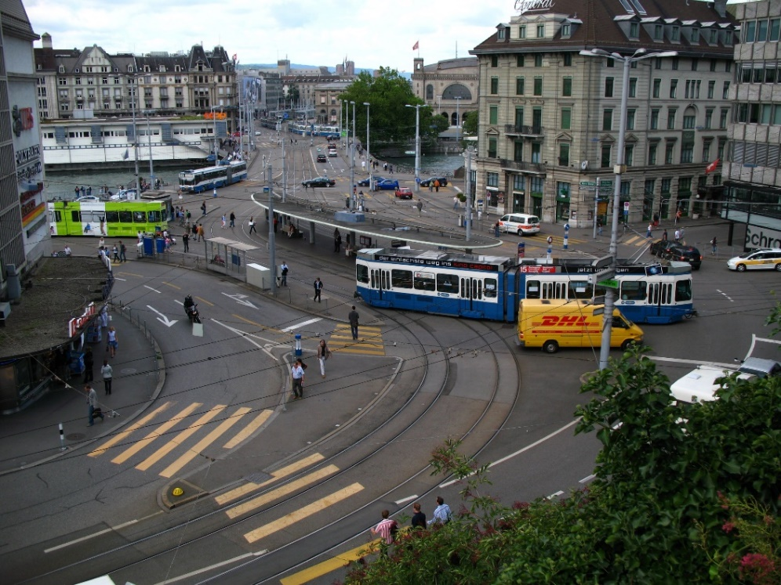
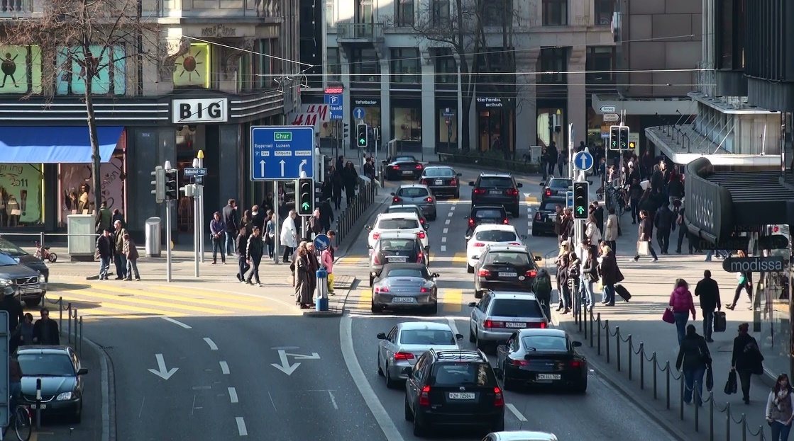
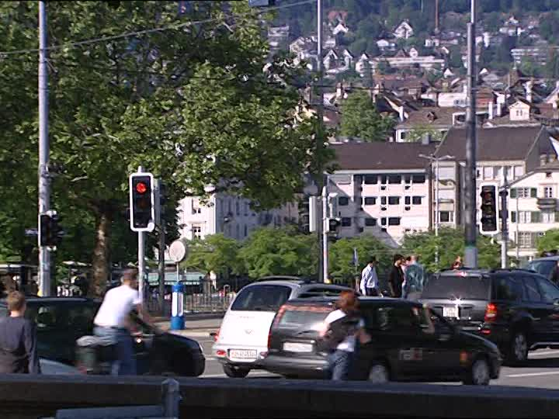
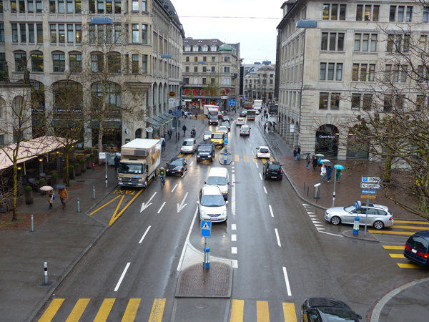
2

Slide 4
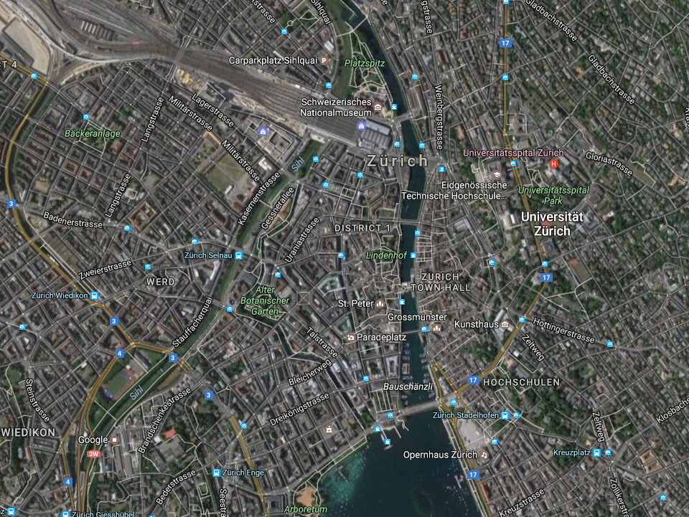

3

Slide 5
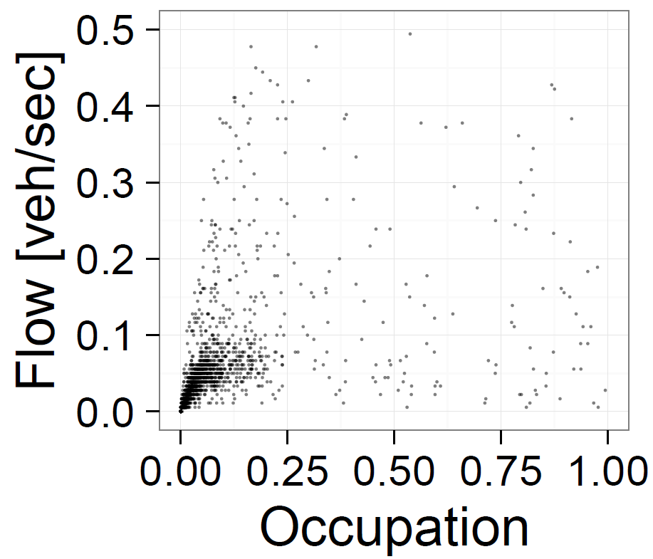
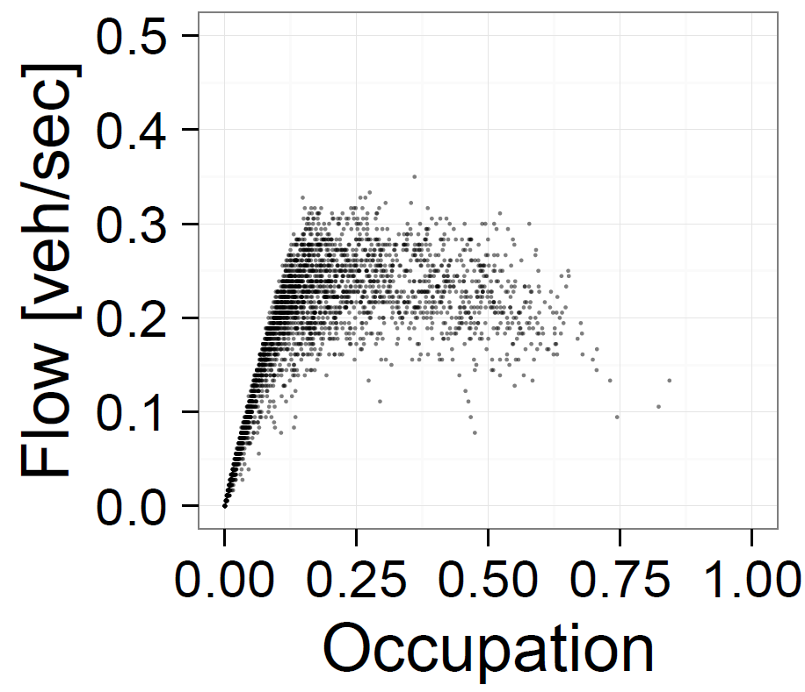
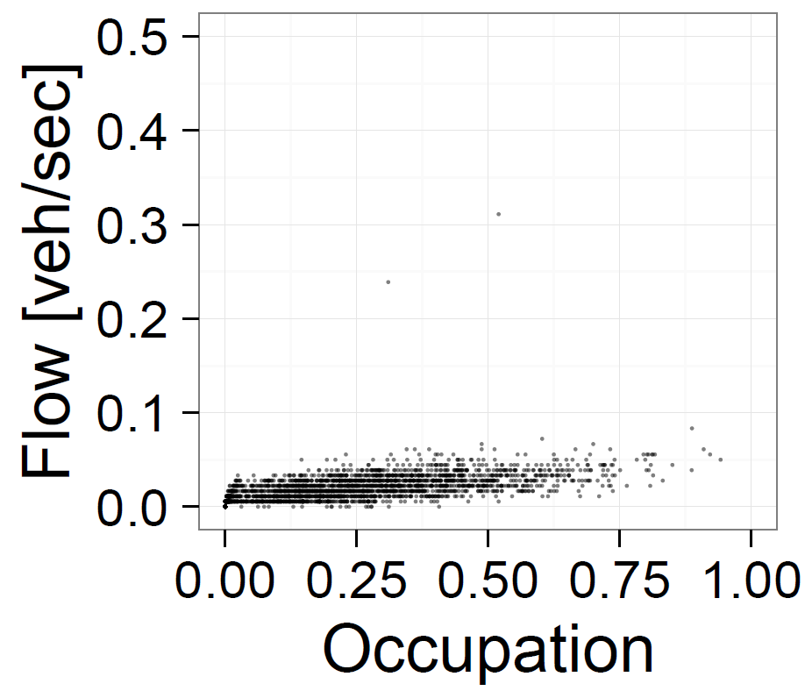
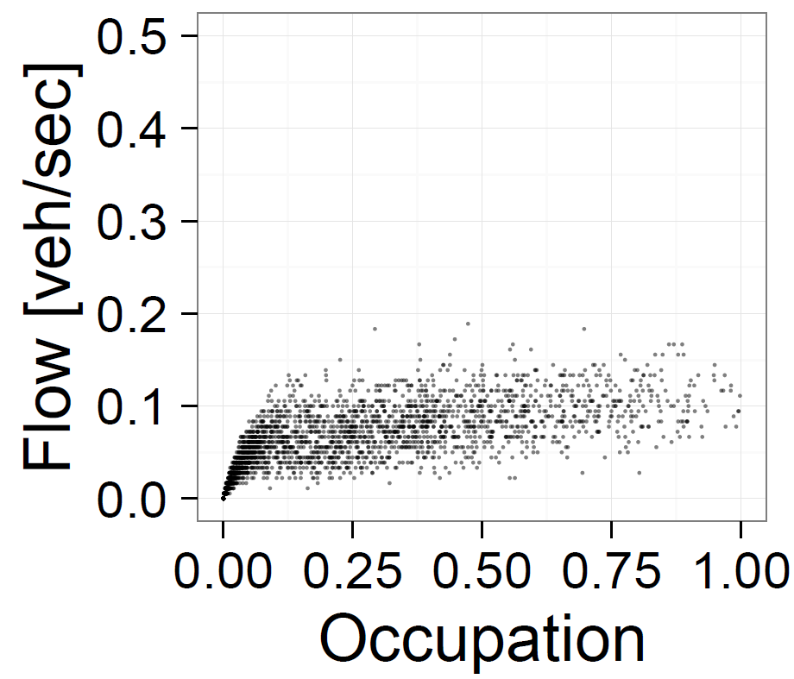
Fundamental Diagram
(FD)
K439.D12
K374.D11
Average flow [veh/h-lane]
K155.D12
K202.D14
4
Average density [veh/km-lane]

Slide 6
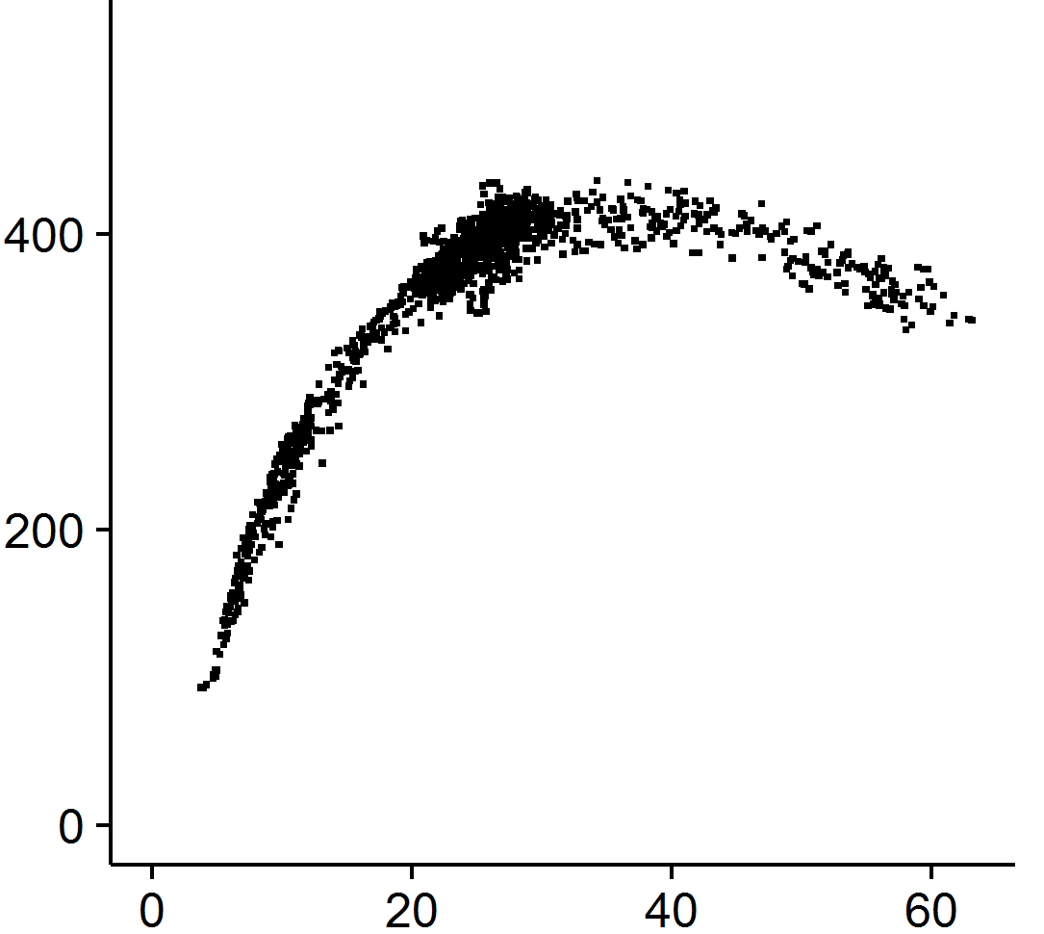
Fundamental Diagram
(FD)
Macroscopic Fundamental Diagram
(MFD)
K439.D12
K374.D11
Average flow [veh/h-lane]
K155.D12
K202.D14
5
Average density [veh/km-lane]

Slide 7
How do we (empirically) estimate an MFD?
6

Slide 8

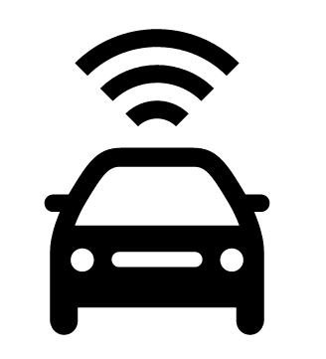
Common Data Sources
LDD
FCD
7

Slide 9
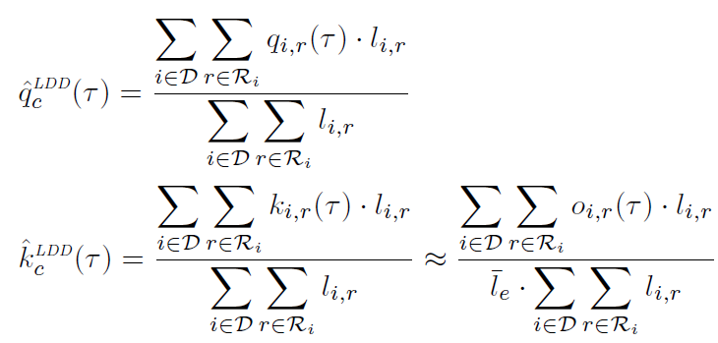
Common Data Sources
LDD
FCD
7

Slide 10
8

Slide 11
Loop detectors
Incomplete coverage
Non-representative coverage
Bias density
9

Slide 12
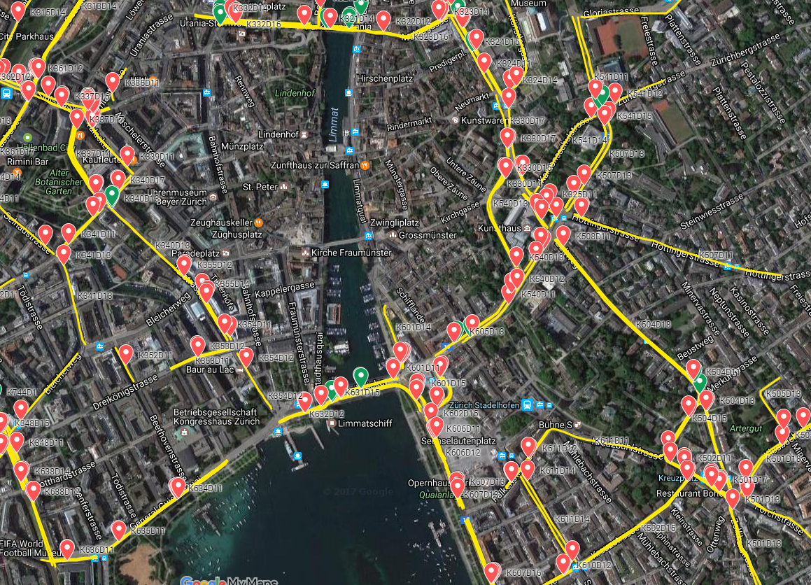
Loop detectors
10

Slide 13
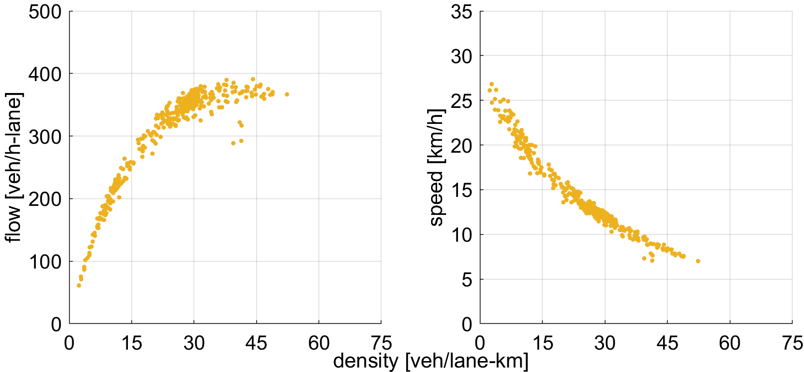
Loop detectors
11

Slide 14
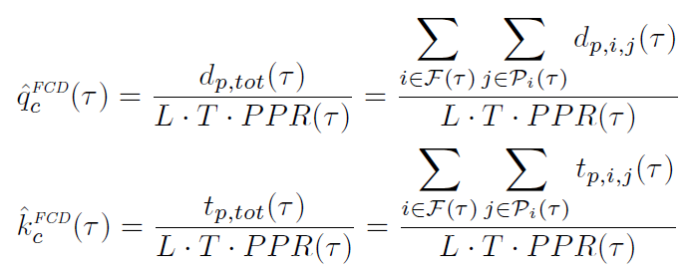
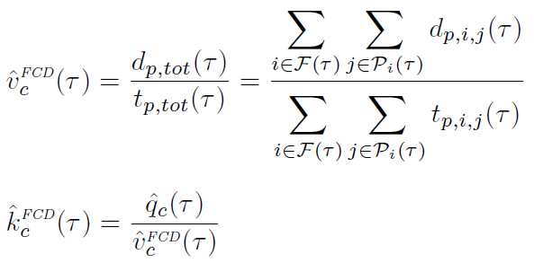
Common Data Sources
LDD
FCD
12

Slide 15
Incomplete coverage
Inhomogeneous distribution
Unknown penetration rate
FCD - Probe vehicles
Conventional vehicles
13

Slide 16
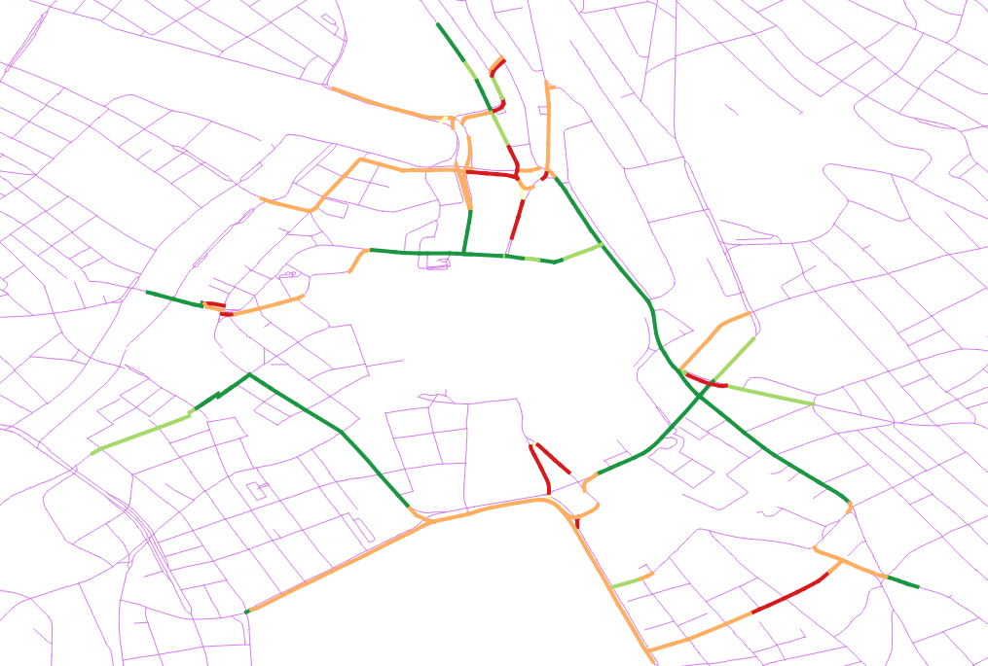
FCD - Probe vehicles
Conventional vehicles
14

Slide 17
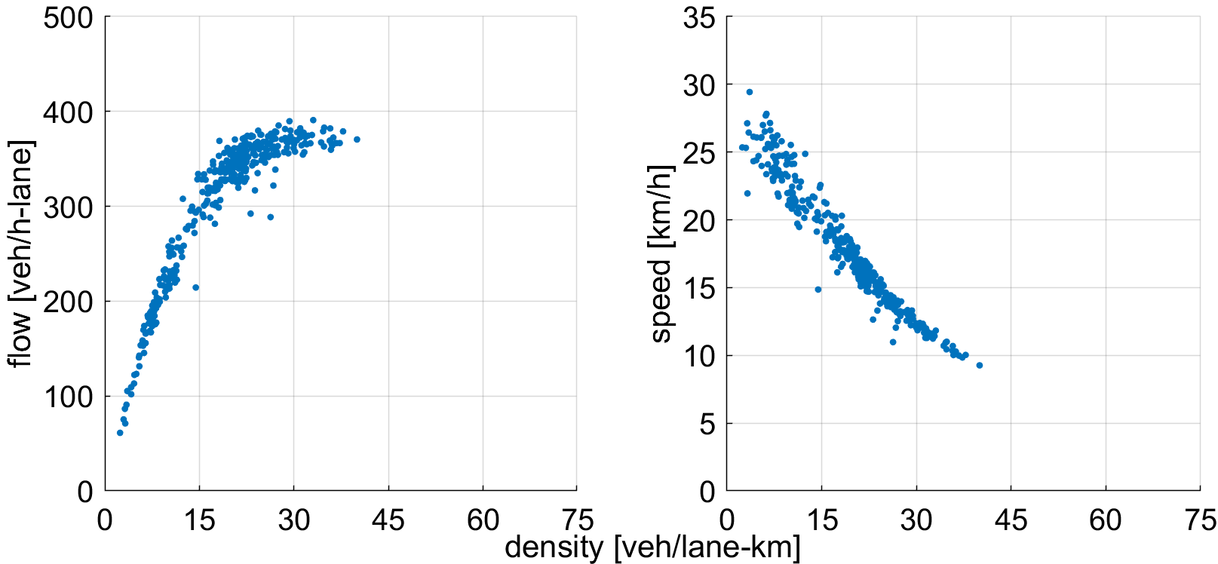
FCD - Probe vehicles
Conventional vehicles
15

Slide 18
How can we deal with a lack of information?
How can we infer the current traffic state when no LDD nor FCD exist?
16

Slide 19
Equipped with AVL devices
Interact with cars along mixed-lane links
FCD - Probe vehicles
Conventional vehicles
Buses
17

Slide 20


Common Data Sources
LDD
FCD
AVL
18

Slide 21
How can we use this information?
19

Slide 22
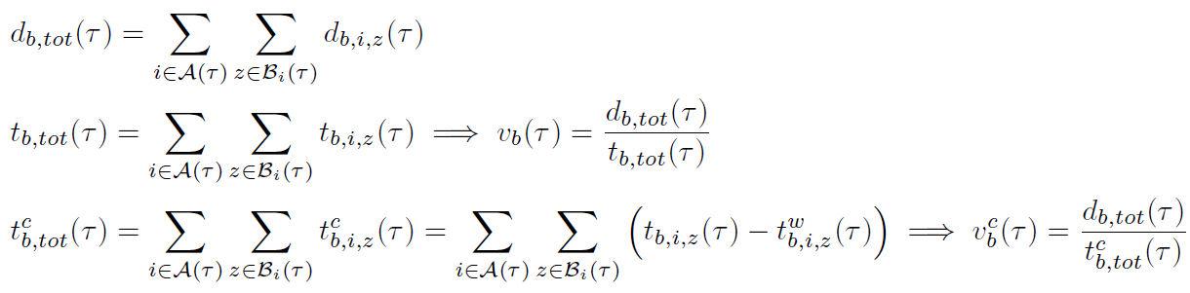
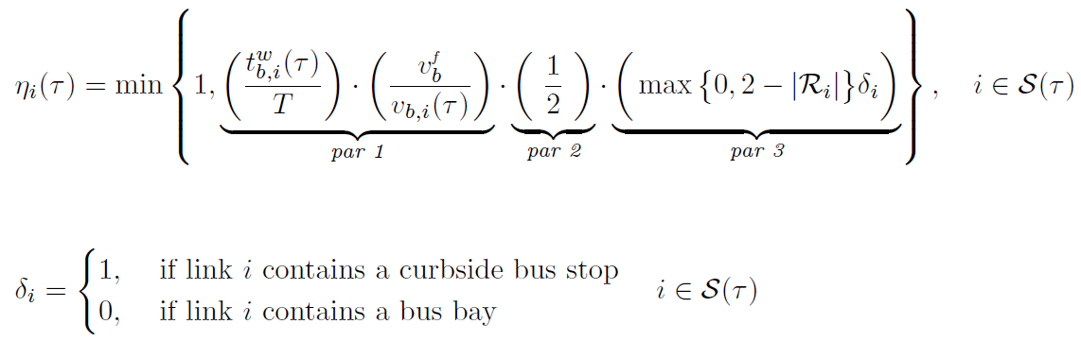
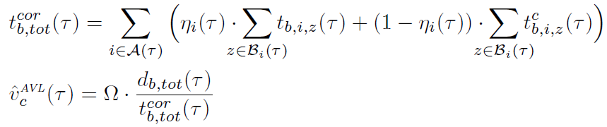
Proposed AVL-based Estimation Method
20

Slide 23
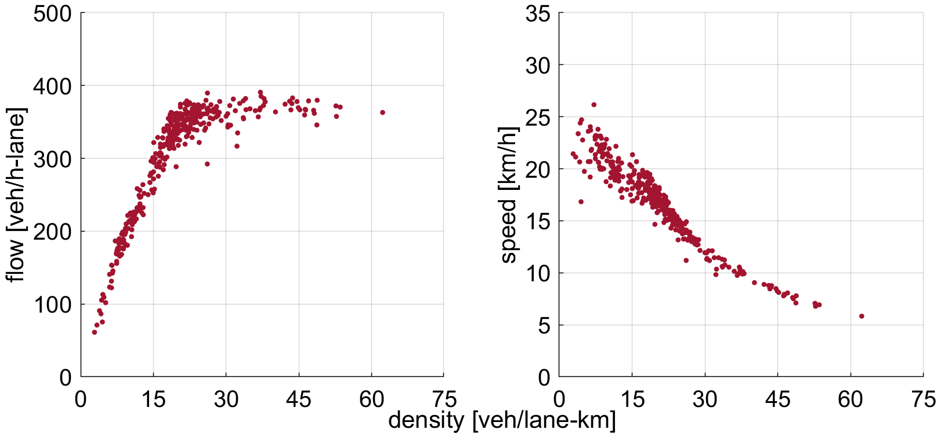
Buses
21

Slide 24
How good the are the results?
22

Slide 25
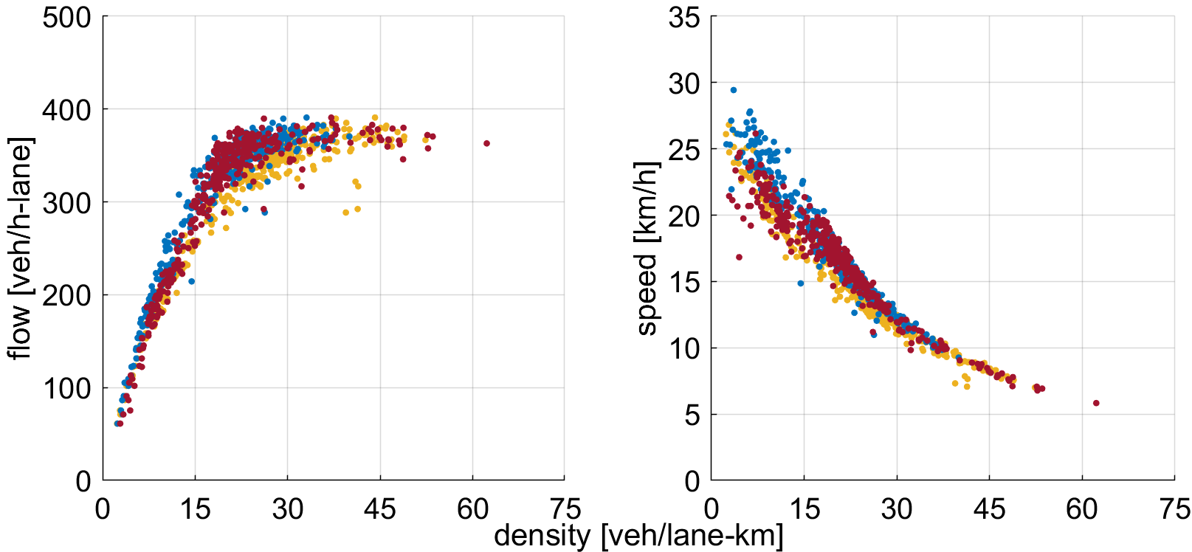
MFD Comparison
LDD
FCD
AVL
23

Slide 26
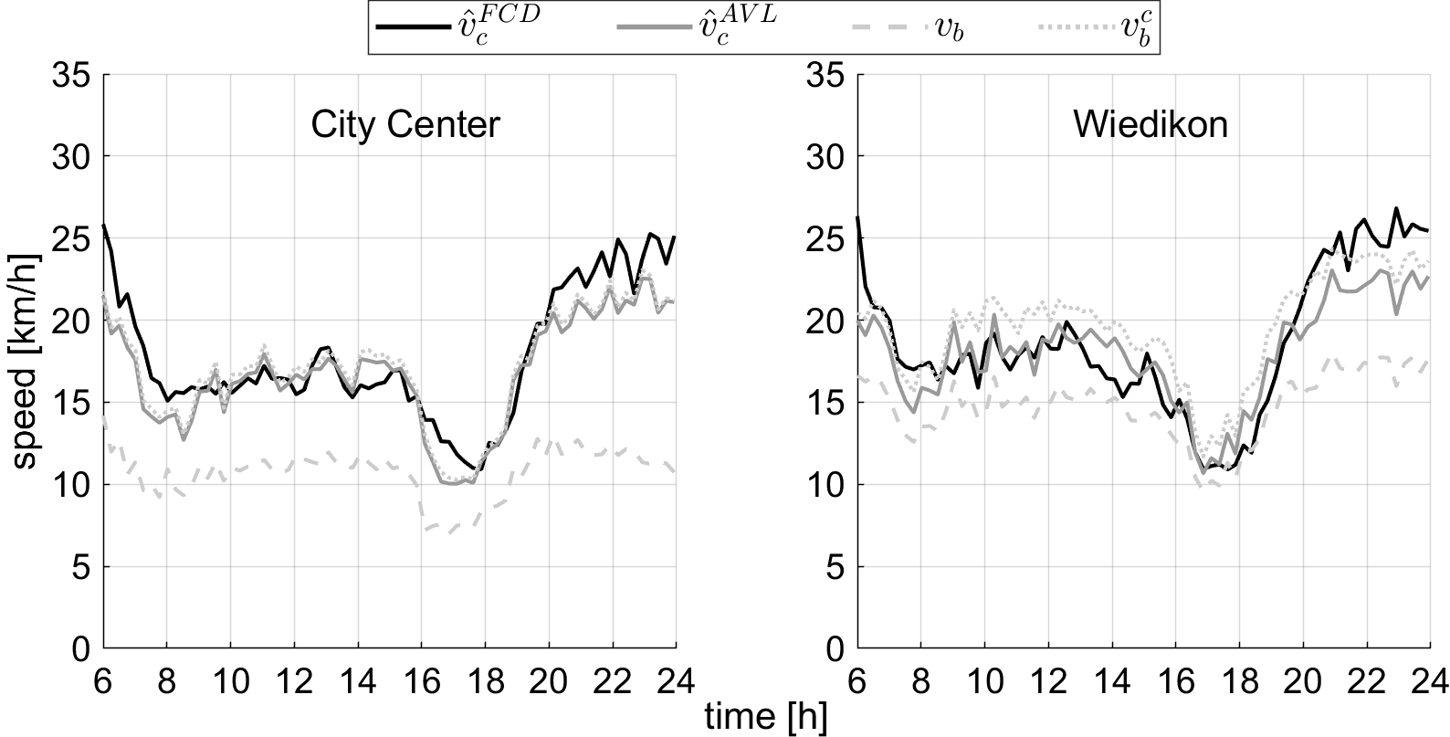
Space-mean Speed Comparison
24

Slide 27
Can we do any better than this?
25

Slide 28
FCD - Probe vehicles
Buses
26

Slide 29
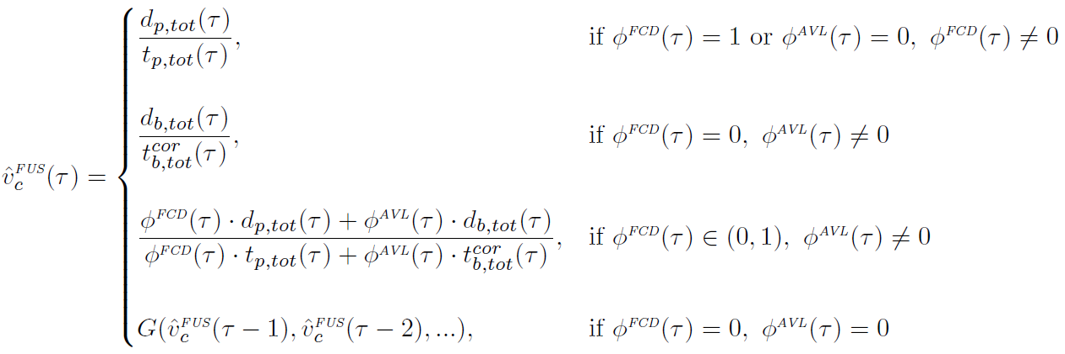
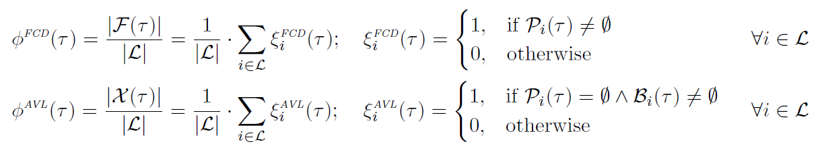

Proposed Fusion Algorithm
27

Slide 30
Do we achieve improvements?
28

Slide 31
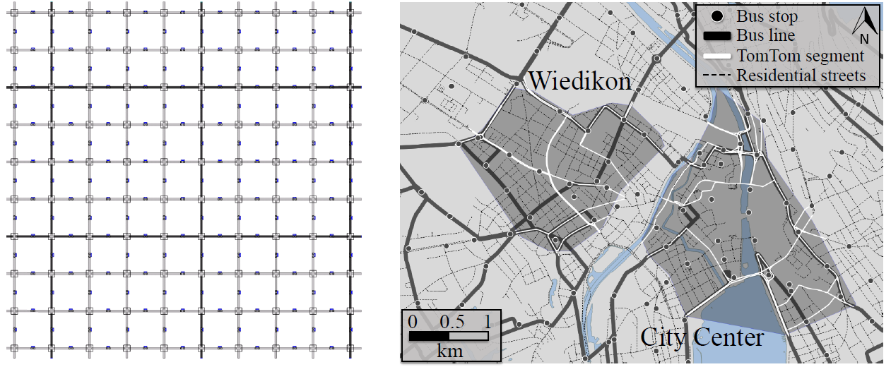
Fusion – Case studies
29

Slide 32
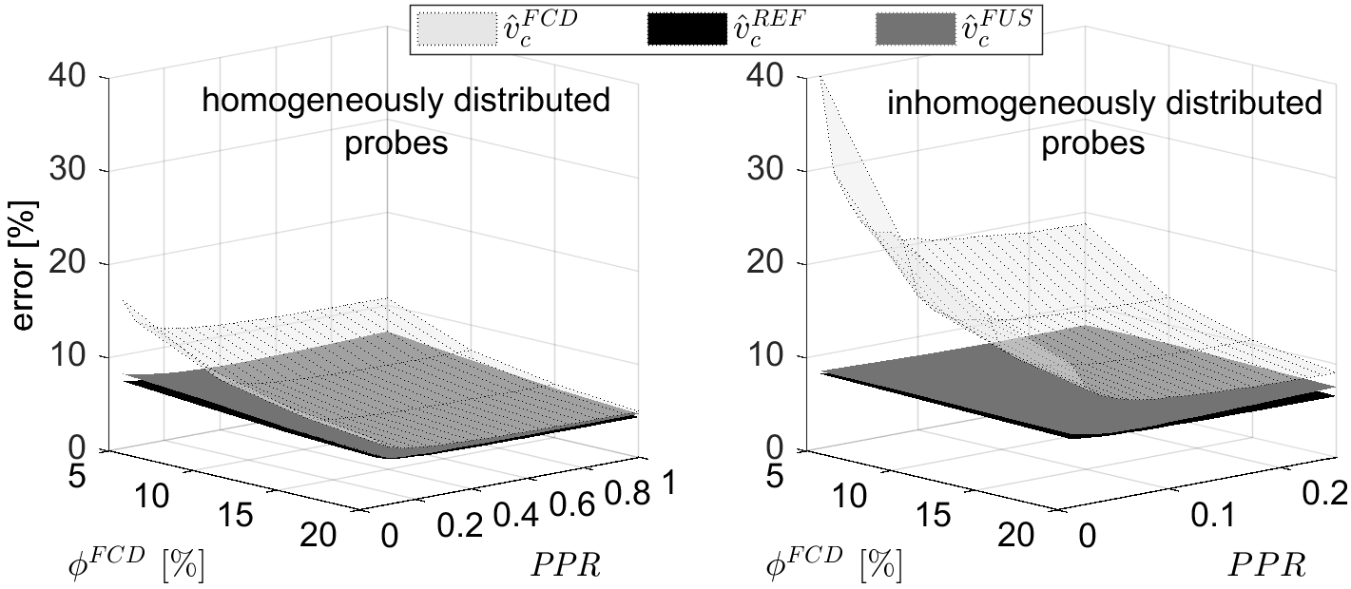
Fusion - Simulation Results
37.5 % mixed-lanes; bus frequency 7.5 min
30

Slide 33
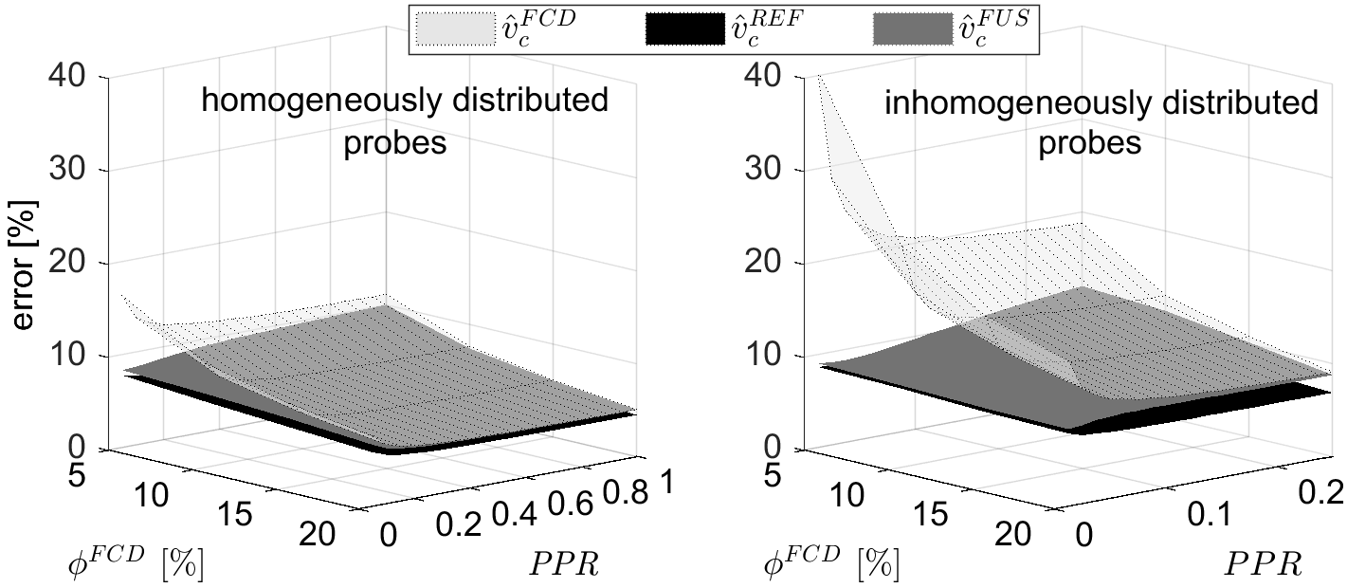
Fusion - Simulation Results
12.5 % mixed-lanes; bus frequency 7.5 min
31

Slide 34
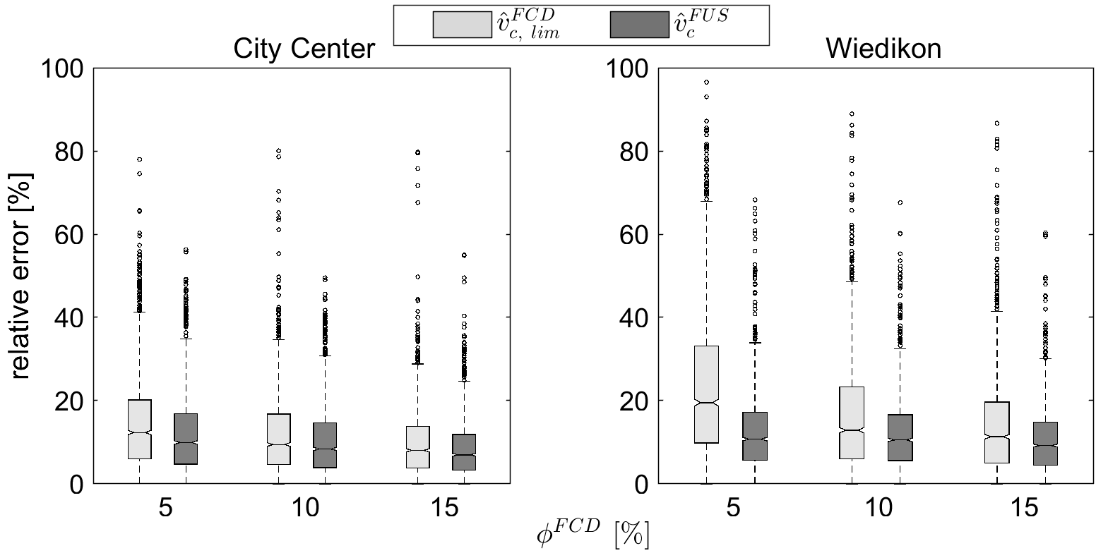
Fusion – Empirical Analysis
32

Slide 35
Conclusions
33

Slide 36
Two pragmatic methods presented:
  Based on AVL data
  Based on fused FCD and AVL data
AVL-based method provides good approximation of the average car speed
Fusing FCD and AVL it is possible to acquire further improvements in the estimation accuracy
Using the proposed methodology it is possible to estimate MFDs even where no FCD nor LDD exist
34

Slide 37
THANKS!
Reference:
Dakic, I. and M. Menendez (2018) On the use of Lagrangian observations from public transport and probe vehicles to estimate car space-mean speeds in bi-modal urban networks, Transportation Research Part C: Emerging Technologies (accepted).
idakic@ethz.ch

