Slide 1





Introduction to
Part I
Jiwoo Oh / Sarah Duclos
ETH Zurich, Institut für Chemie- und Bioingenieurwissenschaften
ETH Hönggerberg / HCI F143– Zürich
E-Mail: jiwoo.oh@chem.ethz.ch
sarah.duclos@chem.ethz.ch
https://shihlab.ethz.ch/education/Snm/matlab-introduction

Slide 2









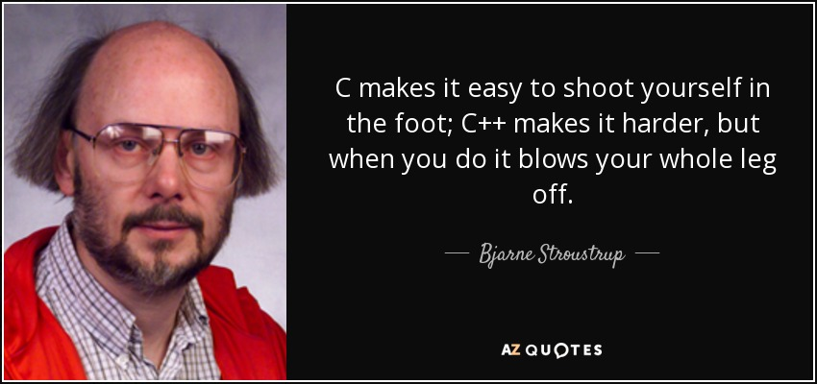
Scientific programming
GSL
High-level
Low-level
General-purpose
Fast and Powerful
General-purpose
Popular and open source
Dynamically typed
Extremely readable
Statically typed
Very steep
learning curve
Multi-paradigm
(Structured and Object-Oriented)
Gentle learning curve
Multi-paradigm
(Structured and Object-Oriented)
High-level
Proprietary
Specific-purpose
Integrated Environment
Dynamically typed
Minimal learning curve for scientific programming
Multi-paradigm
(Structured and Object-Oriented)
Source: TIOBE Index Sep. 22

Slide 3
Introduction
What is Matlab?
  Matlab is an interactive system for numerical computation
What are the advantages of Matlab?
  Quick and easy coding (high level language)
  Procedural coding and Object oriented programming are supported
  Minimal effort required for variable declaration / initialization
  Simple handling of vectors and matrices (MATrix LABoratory)
  High quality built-in plotting functions
  Full source-code portability
  Strong built-in editing and debugging tools
  Extremely diverse and high quality tool boxes available
  Large community that contributes files and programs (mathworks file exchange website)
  Extensive documentation / help files

Slide 4
Introduction (Continued)
What are the weaknesses of Matlab?
  Not optimal for symbolic calculations (especially on the output side), use Maple or Mathematica instead
  Not as fast as C++ or Fortran, especially for computationally demanding problems
  Very expensive (except for students)
Where to get Matlab?
  ETH students have free access to Matlab through the ETH IT shop
  Go to https://itshop.ethz.ch/ and search for Matlab in the catalogue
  Create a new Request for the Matlab software
  Follow the installation procedure provided in the IT shop

Slide 5
Compiled vs Interpreted
  It doesn’t refer to the language but to its implementation
  Compiled
  Interpreted
  A compiler translates your script into lower-level code (e.g. machine/byte code) ahead of execution
  An interpreter analyze and translates your code at run time.
  No need to wait for the full compilation and linking when a change in the source code occurs
  Super fast run time
  Compilation is slow but you can do it once and «ship» the «built» executable directly
  Interpreter only cares about the part of the code being executed

Slide 6
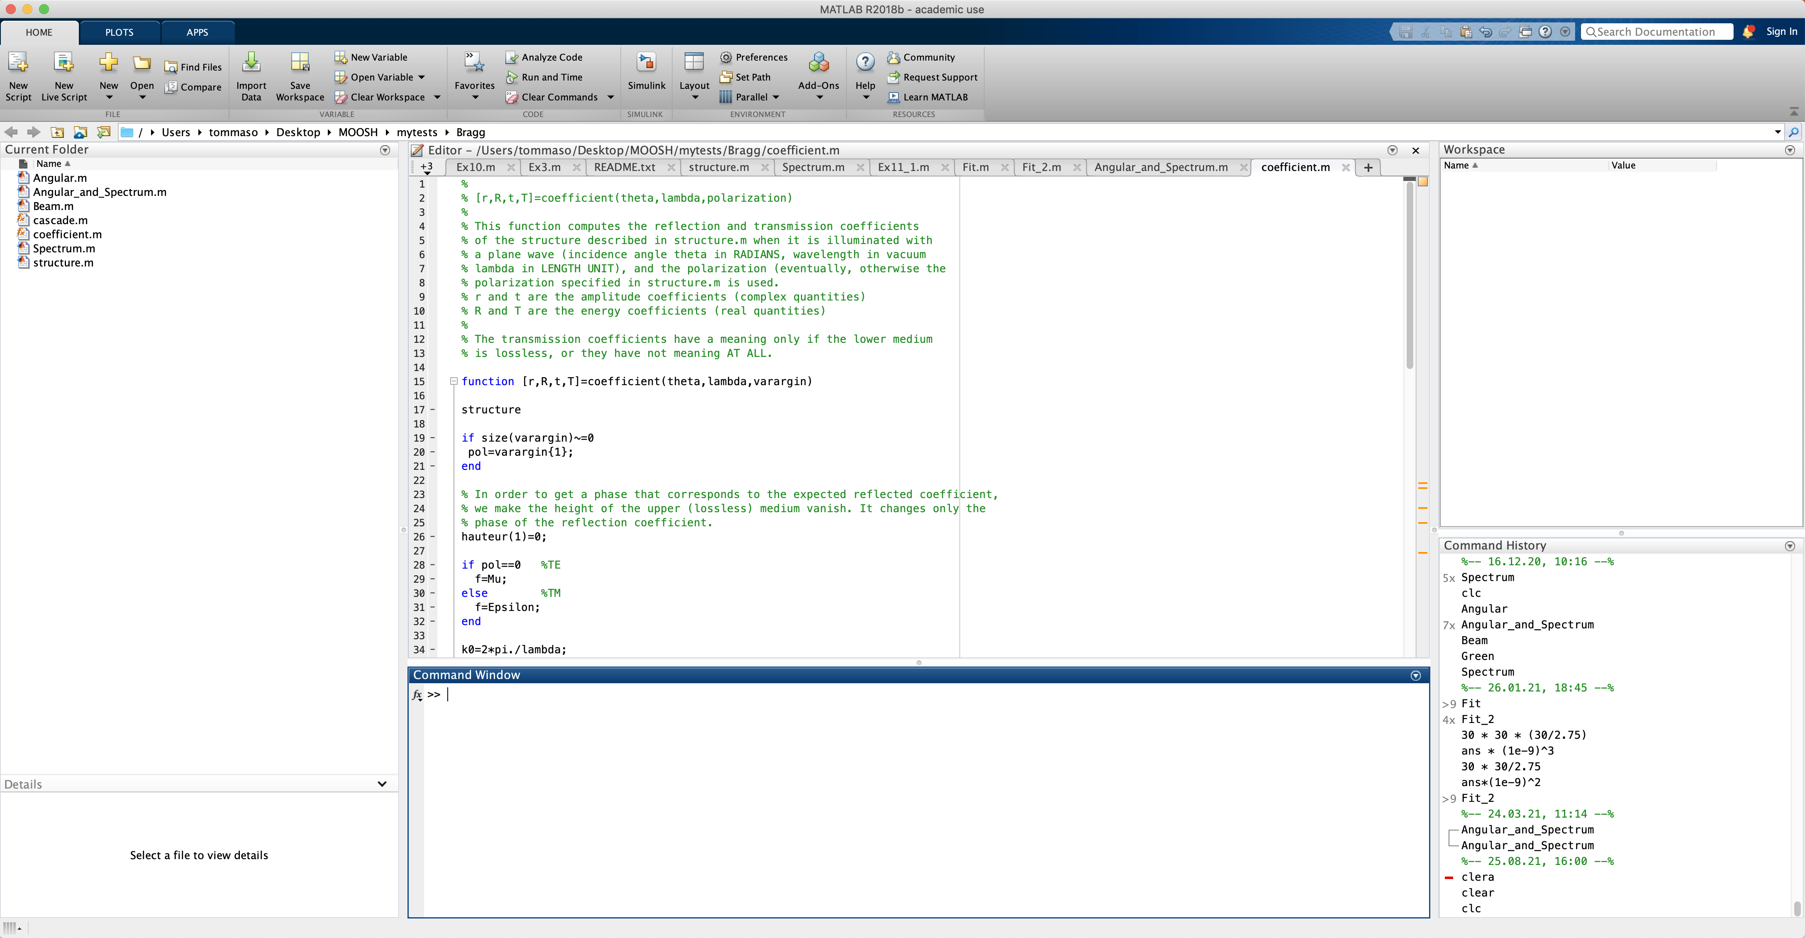
Matlab default environment (Try it out!)
Variable Inspector / Editor
Workspace (Variable List)
File Structure
Command Prompt
Command History
File Details

Slide 7
Where to get help and docs
If you know which command to use, but not how:
  Type help command in the command window for quick help
  Type doc command in the command window to open the help page of the command
  Right click on a word and select «help on selection», or click the word and press F1
If you do not know which command to use:
  There are extensive forums and other sources available on the internet, google helps a lot (Mathworks forum)!
  Type doc or use the menu bar to open the user help and search for what you need
  Send us an email ☺

Slide 8
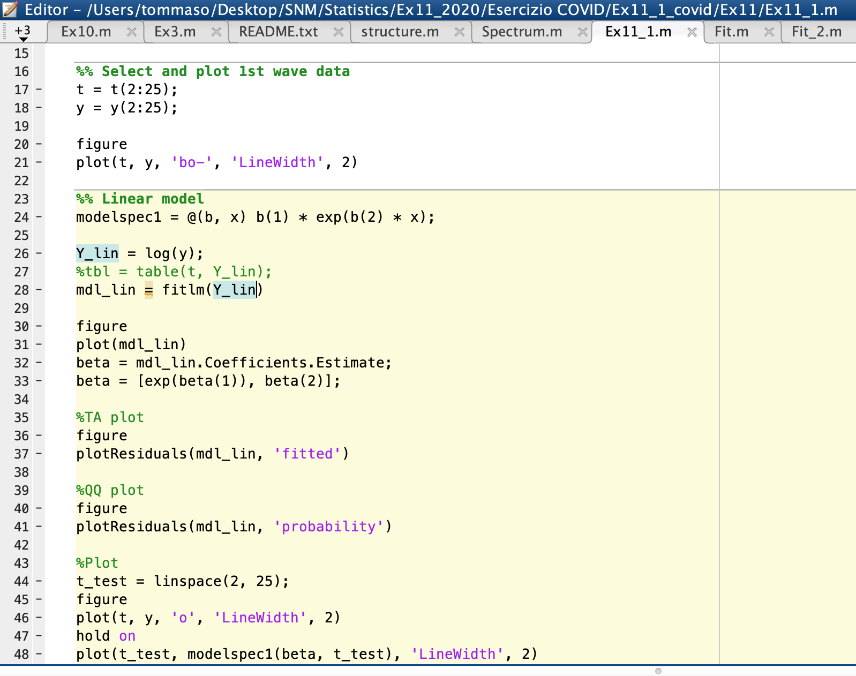
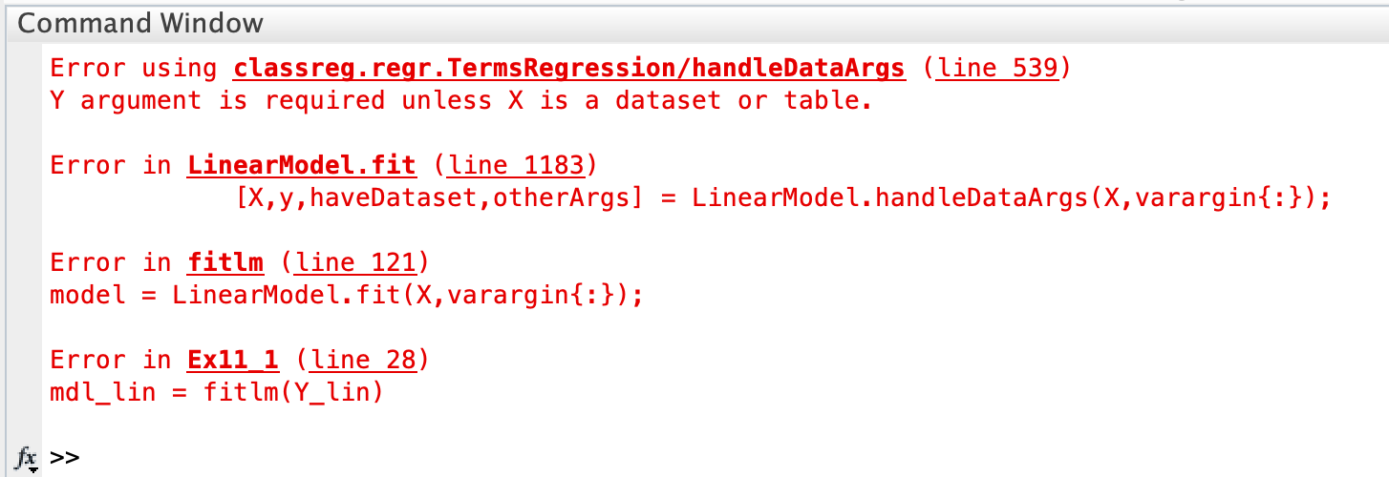
What if something goes wrong?
The topmost error message is usually the one containing the most useful information
The underlined parts of the message are actually links that you can click to get to the place where the error happened!
If a program gets stuck, use ctrl+c to terminate it

Slide 9
Variables in Matlab
Rules
  Variable names are case sensitive («NameString» ≠ «Namestring»)
  Maximum 63 characters
  First character must be a letter
  Letters, numbers and underscores «_» are valid characters
  Spaces are not allowed
Try:
Valid examples:
  a = 1
  speed = 1500
  Cost_Function = a + 2
  String = 'Hello World'
Invalid examples:
  2ndvariable = 'yes'
  First Element = 1

Slide 10
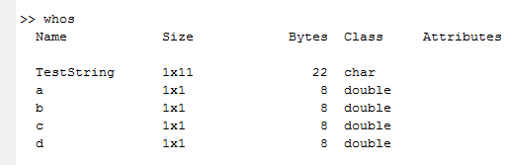

Variables in Matlab (Continued)
Try out these commands:
  a = 2
  b = 3;
  c = a + b;
  d = c / 2;
  d
  who
  whos
  clear
  who
  TestString = 'Hello World'
Note that every variable has a size (all variables are arrays!)
No need to declare variables
or specify variable types!

Slide 11
Variables in Matlab (Continued)
Variable assignments
  a = 2;
  b = 3;
  c = a + b; The result is stored in «c»
  a + b The result is stored in «ans»
  a = b = 2; This produces an error
By pressing the up and down arrows, you can scroll through the previous commands
A semicolon «;» at the end of a line supresses command line output
By pressing the TAB key, you can auto-complete variable and function names

Slide 12
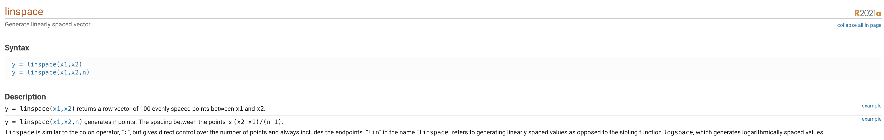
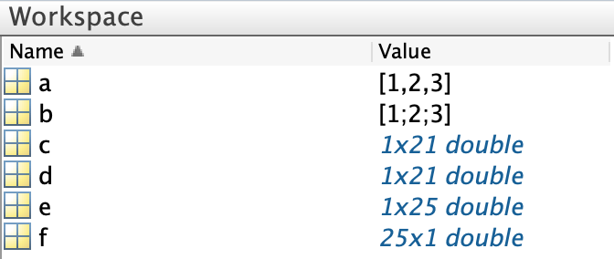
Vectors in Matlab
Vector handling is very intuitive in Matlab (try these!):
  Row vector: a = [1 2 3]
  a = [1, 2, 3]
  Column vector: b = [1; 2; 3]
  Vector with defined spacing: c = 0:5:100 (unit: 0:100)
  Vector with even spacing: d = linspace(0, 100, 21)
  e = logspace(0, 3, 25)
  Transpose: f = e’
You should see

Slide 13

Vector arithmetics
Try these out:
  a = [1, 2, 3]
  b = [1; 2; 3]
  Operations with constants
  c = 2 * a
  d = 2 + a
  Vector addition
  f = a + c
  Vector product
  A = b * a A is a (3,3) matrix!
  a * a Error! (1,3)*(1,3)
  a ^ 2
  Element-by-Element operations
  a .^ 2
  d = d ./ a
  Functions using element-by-element operations (examples)
  b = sqrt(b)
  c = exp(c)
  d = factorial(d)
Operations with scalar constants (except power) are always element-by-element.

Slide 14
Vector arithmetics (Continued)
Notes on vector multiplication
  a = [1, 2, 3]
  b = [1; 2; 3]
  c = a * b (1,3)*(3,1) = (1,1) Scalar (dot product)
  d = b * a (3,1)*(1,3) = (3,3) Matrix
  e = a .* a (1,3).*(1,3) = (1,3) Vector (element-by-element)
  f = a .* b Error! Vectors must be the same size for element-by-element operations
Remember the rules for vector / matrix addition, subraction and multiplication!

Slide 15
Matrices in Matlab
Creating matrices (try these out!)
  Direct: A = [1 2 3; 4 5 6; 7 8 9]
  Matrix of zeros: B = zeros(3); B = zeros(3,2);
  Matrix of ones: C = ones(3); C = ones(3,2);
  Random matrix: R = rand(3); R = rand(3,2);
  Normally distributed: RD = randn(3)
Matrix characteristics
  Size [nRows, nColumns] = size(A)
  nColumns = size(A,2)
  Largest dimension maxDim = length(A)
  Number of elements nElements = numel(A)
Creating vectors
  Single argument calls create a square matrix, therefore use commands like v = ones(3,1); to create vectors

Slide 16



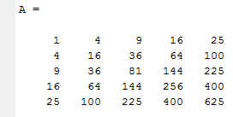
Accessing elements of vectors / matrices
Try:
Vectors a = (1:5).^2
  Single element:
  Multiple elements:
  Range of elements:
  Last element:
  All elements:
Matrices A = a'*a;
  Single element:
  Submatrix:
  Entire row / column:
  Multiple rows / columns:
  Last element of row / column:
  All elements as column vector:
a(:) always returns a column vector.

Slide 17
Arithmetics with matrices
Try these out:
  A = rand(3)
  Operations with constants
  B = 2 * A
  C = 2 + A
  Matrix addition; Transpose
  D = A + C
  D = D'
  Deleting rows / columns
  C(3,:) = []
  D(:,2) = []
  Matrix multiplication
  C * D
  D * C Not commutative!
  A ^ 2
  Element-by-element operations
  A .^ 2
  E = 2 .^ A E_{i,j} = 2^A_{i,j}
  sqrt(A)
  Functions using matrices
  sqrtm(A)
  sqrtm(A)^2
  inv(A)

Slide 18
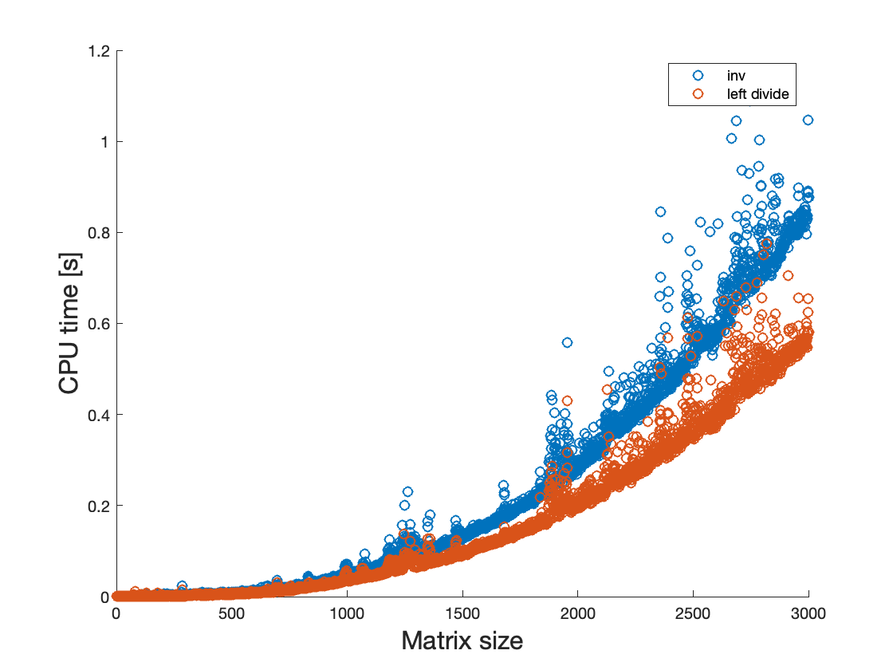
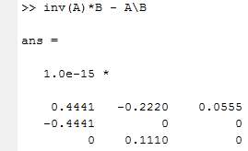
Matrix division
Consider the following
  A = rand(3); B = rand(3);
  A*C = B
  ➔ C = A⁻¹*B = inv(A)*B
  Matrix inversion is one of the most computationally expensive operations overall, so what should we do instead?
  Matlab has more sophisticated built-in algorithms to do matrix divisions which are called left- and right divide; They are symbolized by the operators \ and /, respectively.
  inv(A)*B = A⁻¹*B ➔ A\B;
  A*inv(B) = A*B⁻¹ ➔ A/B;

Slide 19
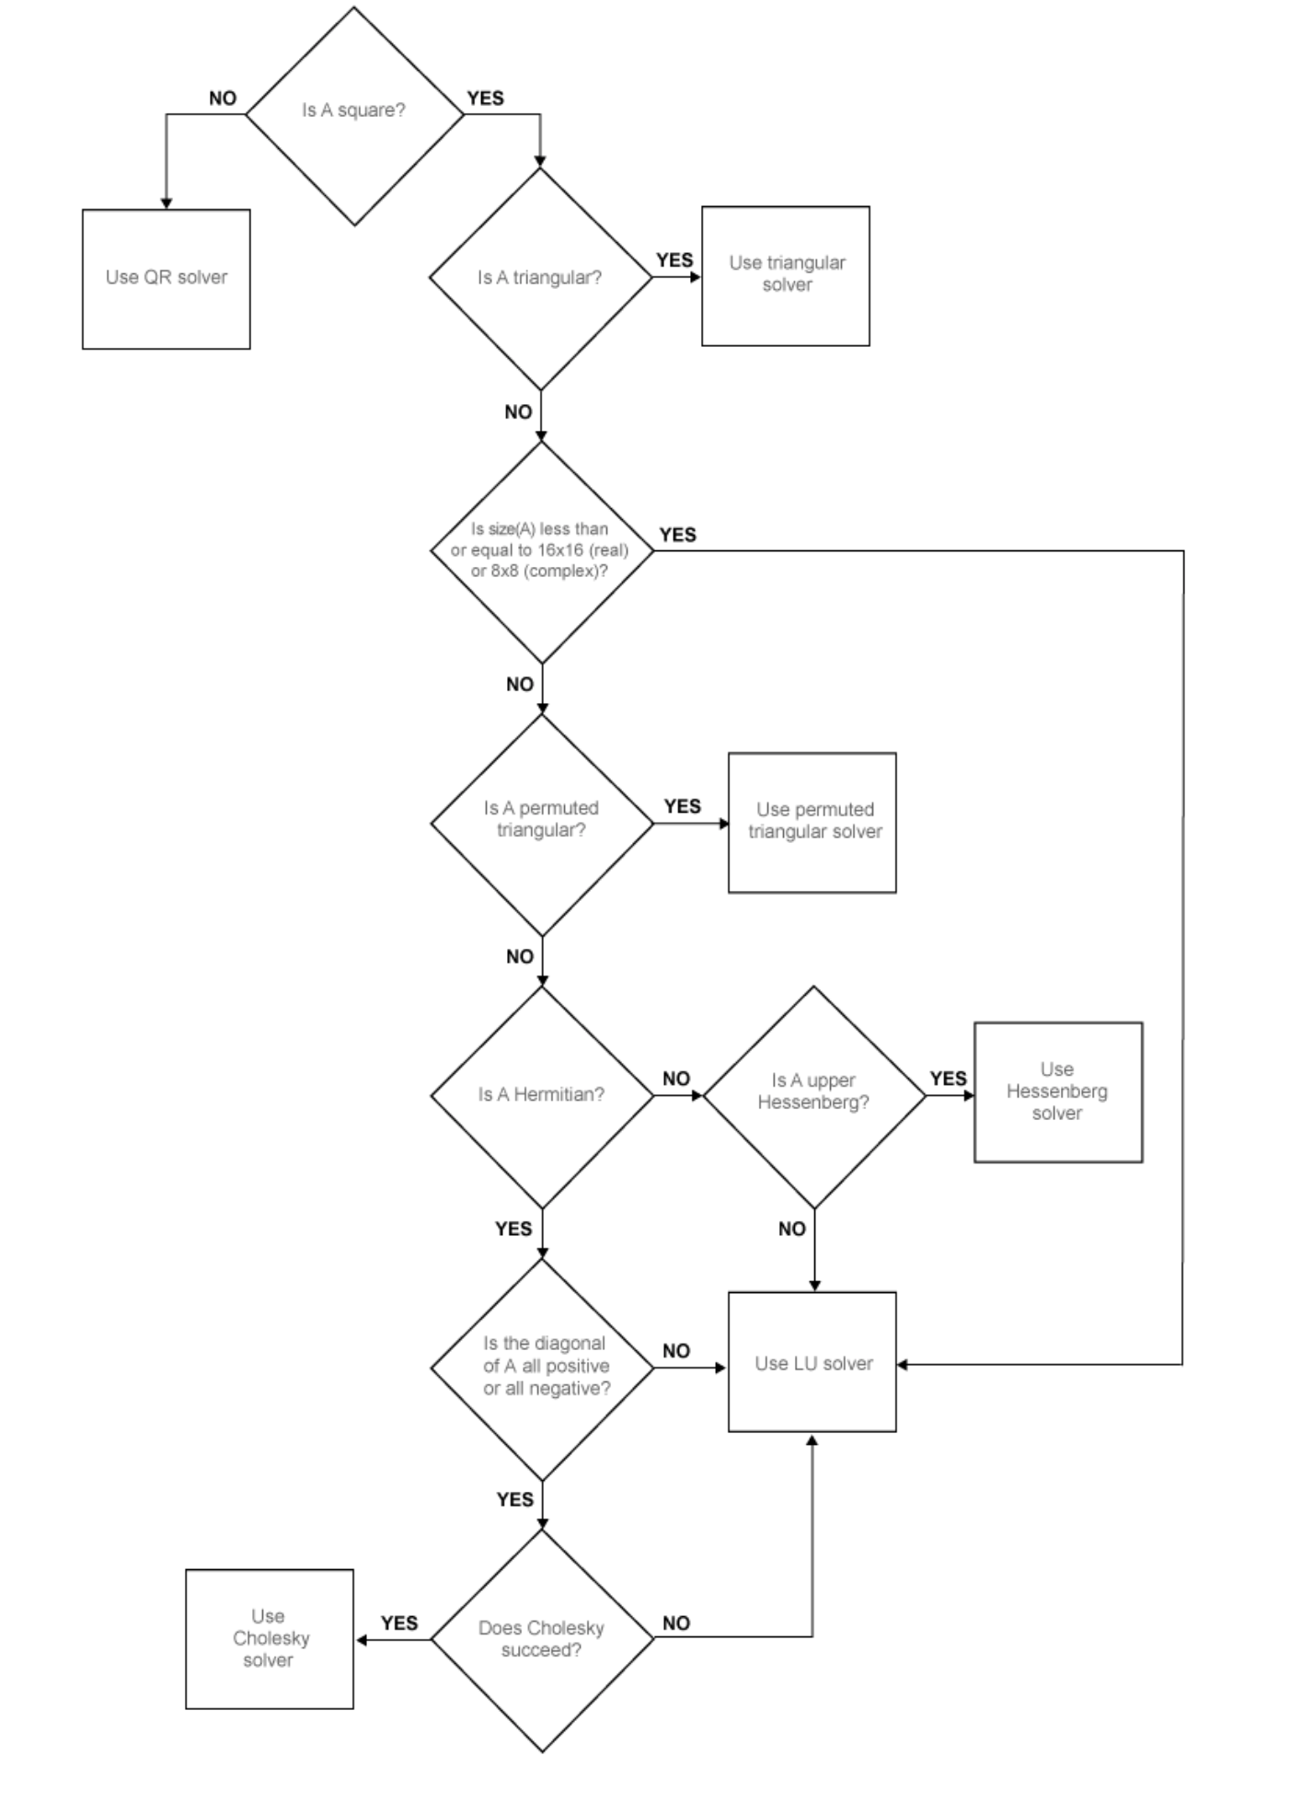
Matrix division: Matlab is smart!

Slide 20
More matrix manipulations
Try:
Matrices in block form
  B = [ones(3); zeros(3); eye(3)]
From matrices to vectors
  b = B(:)
From vectors to matrices
  b = 1:12; B = zeros(3,4); B(:) = b
  B = reshape(b, 3, 4)
  C = repmat(b, 5, 1)
Diagonal matrices
  b = 1:12; D = diag(b)
Meshes
  [X, Y] = meshgrid(0:2:10, 0:5:40)

Slide 21
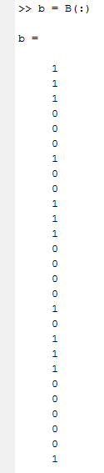
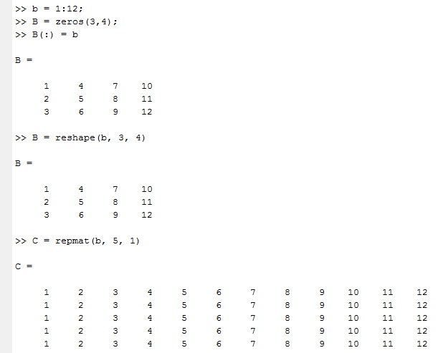
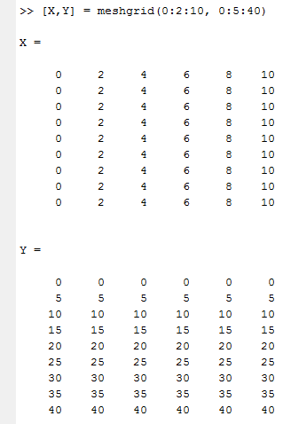
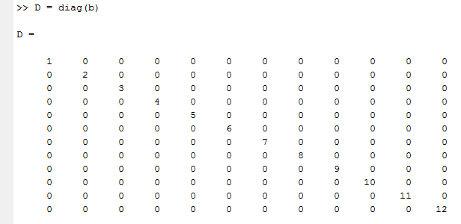
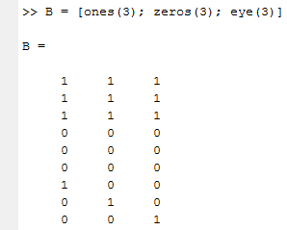
More Matrix Manipulations (Continued)

Slide 22

Operators for matrices
Consider the operators:
  [nRows, nColumns] = size(A);
  [maxValue, Position] = max(A,[],dim);
  sum(A,dim);
  sum(A(:));
  det(A);
  inv(A);
  eig(A);
  cond(A);
  norm(A,p);
Also: min(A)
Also: mean(A), var(A), std(A), ...

Slide 23
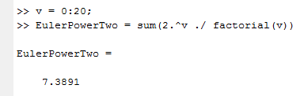
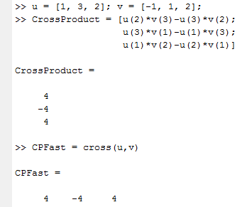
Exercise
Compute the approximate value of exp(1)
  Hints: Define a vector of length 20 for the first 20 elements of the summation, then sum it up; The ! operator is factorial()
Compute the approximate value of exp(2)
Compute the cross product of u = [1, 3, 2] and v = [-1, 1, 2]

Slide 24
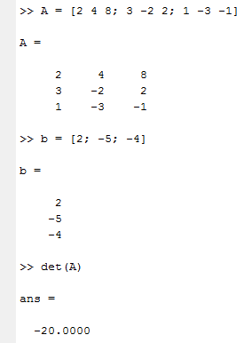
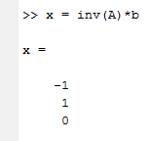
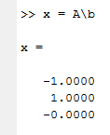
Solution of Linear Algebraic Systems (Exercise)
Write the following system of equations in Matrix form:
Is this system singular?
How would you solve this system?
  Computing the inverse of a matrix is very expensive. Use left division instead!

Slide 25
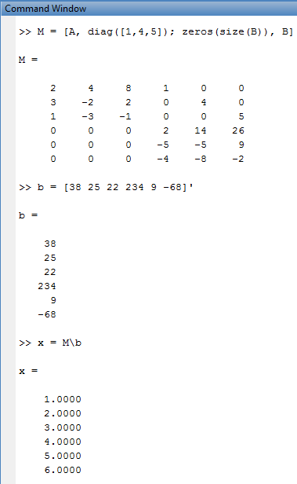
Exercise (Continued)
Solve the system
Now solve this system:

