Slide 1
Introduction to
Part II
Jiwoo Oh / Sarah Duclos ETH Zurich, Institut für Chemie- und Bioingenieurwissenschaften ETH Hönggerberg / HCI F143 / F106 – Zürich E-Mail: jiwoo.oh@chem.ethz.ch sarah.duclos@chem.ethz.ch https://shihlab.ethz.ch/education/Snm/matlab-introduction

Slide 2
M-Files
What is an m-file?
An m-file is a collection of commands. It is equivalent to programs, functions, subroutines, modules, etc. in other programming languages. It can even contain entire class definitions.
What can I use it for?
Creating a permanent record of what you are doing
Experimenting on an algorithm
Writing utilities and whole programs
What types of m-files are there?
Script m-file: No input and output. Operates on workspace variables.
Function m-file: Starts with the function key-word, accepts inputs and gives outputs. All variables are local.
Class m-file: Contains the classdef key-word, used in object oriented programming.

Slide 3
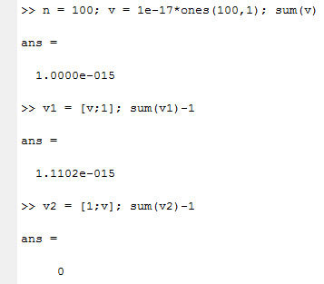
Example of a Script
Problem definition
v = 1e-17 * ones(100,1); sum(v)
v1 = [v ; 1]; sum(v1) - 1
v2 = [1 ; v]; sum(v2) - 1
Create the «mysum» script
(In Matlab:) File → New → M-File
clear all; close all;
v = 1e-17 * ones(100, 1);
v1 = [v ; 1];
s = sum(v1);
s - 1
(In Editor:) File → Save As... → mysum.m
Check the directory path!
Avoid reserved words and built-in function names

Slide 4
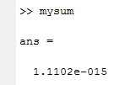
Example of a Script (Continued)
You should see
How to run the script?
From the command window (check the path!)
From the editor (press Run button or use Debug → Run or press F5)
The editor has found unusual syntax or even a syntax error here!
Mouse-over to see what is the issue.

Slide 5
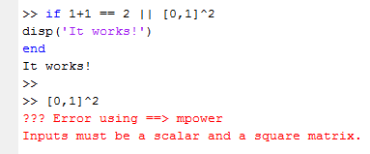
Relational and logical operators
Relational operators are straight forward in Matlab:
<, >, <=, >=, ==, ~=
The NOT operator is the tilde symbol «~»
For the logical operators AND and OR, two kinds exist:
&&, || Operators with short-circuiting (scalars only)
&, | Operators for element-by-element comparisons
Logical operators return logical types
Example of how short-circuitung operators work:
In the context of if and while, both kinds of operators short-circuit.

Slide 6
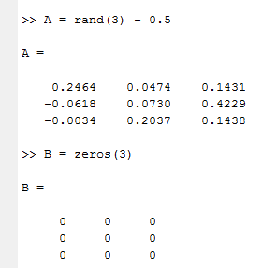
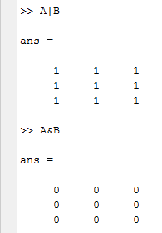
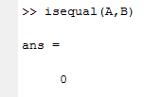
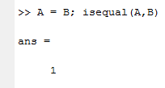
Relational and logical operators (continued)
Example of element-by-element comparison:
Compare entire matrices with isequal(A,B)
All numbers other than 0 evaluate to TRUE

Slide 7
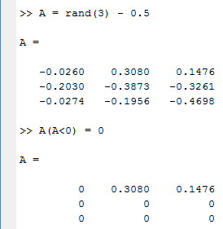
Relational and logical Operators (continued)
There are a some more operators that you can use:
any(A,dim); True if at least one element is ≠ 0
all(A,dim); True if all elements are ≠ 0
xor(A,B); True if one is = 0 and the other is ≠ 0
isnumeric(A); True if A is a numerical type
isfinite(A); True for each element if it is neither NaN nor inf
Indexing is possible through logical variable types (try it!)
A(A<0); All elements < 0
A(isfinite(A)); All elements except NaN and inf
A(A == B); All elements that are equal to their counterpart
You can even edit elements directly this way

Slide 8
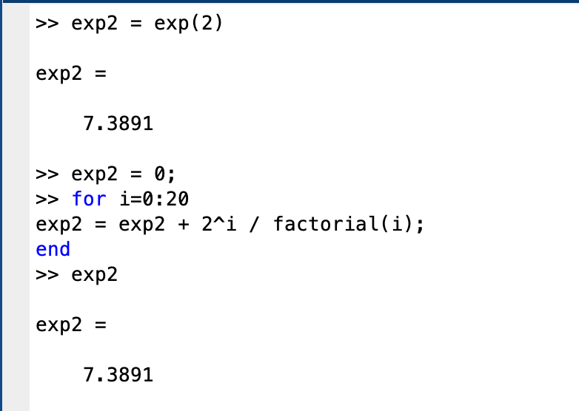
For-loops in Matlab
General form of for-loops:
Example:
If Matlab gets stuck in a loop (or any other calculation), use ctrl+c to terminate the program.

Slide 9
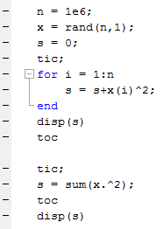
Examples with for-loops
Try these:
Loops are almost always slower than matrix / vector calculations!

Slide 10
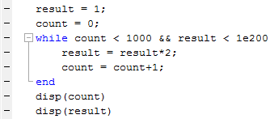
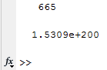
While-loops in Matlab
General form of while-loops:
while expression statements; end
The statements are executed as long as the expression is true (or ≠ 0)
The statements are executed an indefinite number of times
It is good practice to limit the number of iterations (eg. while n < nmax)

Slide 11
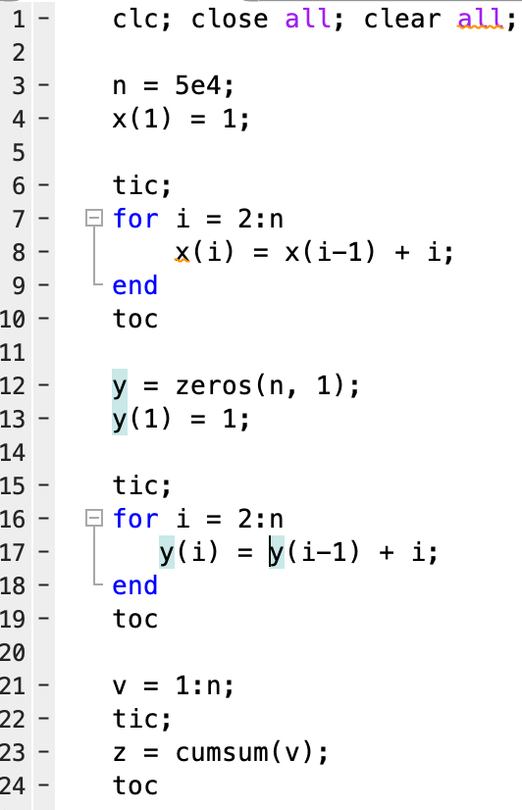
Examples of loops
Try the following:
Vectorize your operations and use built-in functions.
If you must use a loop, preallocate your variables.

Slide 12
Exercise
Create the matrix A(5,5) with random elements between -2 and 2 (type help rand to figure out how the function works)
Set all negative elements of A to 1.5 (use logical indexing!)
Create a matrix B consisting of the 2nd and 3rd column of A
Create a matrix C consisting of the 1st and 4th row of A
Calculate D = A∙B∙C. What is the size of D?
Add D+A = E. Multiply the transpose of E with B to create F.
Create the matrix G so that G_{i,j} = 2+2*C_{i,j}² / F_{j,i}
Create an equally spaced row vector b with 5 elements from 3 to 38
Find the solution of the linear system A∙x = b’
Find the solution of y∙A = b
Compute the 2-norm of x
Find the vector v representing the 2-norm of each column of A
Find the values of the series

Slide 13
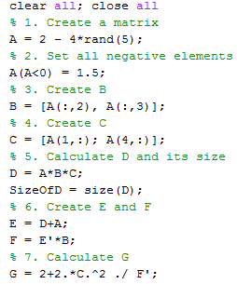
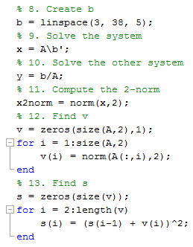
Solutions (one Possibility)

Slide 14
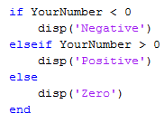
Controlling program flow
The if block has the following structure
if expression statements; elseif expression statements; else statements; end
Example
The elseif and else clauses are optional.

Slide 15
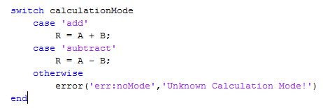
Controlling program flow (Continued)
The switch block does multiple comparisons at once
switch variable case expression statements; case expression statements; ... otherwise statements; end
Example
Message identifier
Error message

Slide 16
Controlling program flow (Continued)
Other commands for controlling program flow are:
break; Exits the current loop
continue; Immediately goes to the next iteration
return; Terminates the entire program / function

Slide 17
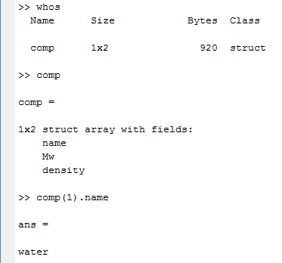
Data type «struct»
What is a struct?
Structs are arrays with a property called «fields». Fields hold different kinds of data and are accessed by dots. Structs are very useful for bundling different kinds of information.
Example (try it out!)
comp(1).name = 'water'; comp(1).Mw = 18.02; comp(1).density = 1; comp(2).name = 'ethanol'; comp(2).Mw = 46.06; comp(2).density = 0.789;

Slide 18
Data type «struct»
comp(1)
comp(2)
comp(3)
.name = 'water'
.name = 'ethanol'
.name = ...
.MW = 18.02
.MW = 46.06
.MW = ...
.density = 1
.density = 0.789
.density = ...
.Antoine = [ 8.07; 1730; 233];
.Antoine = [ 8.20; 1643; 230];
.Antoine = ...
comp (1,n) struct

Slide 19
Exercise
Create a new m-file called quadratic_roots.m
Implement the following algorithm
If b > 0
Elseif b < 0
Else

Slide 20
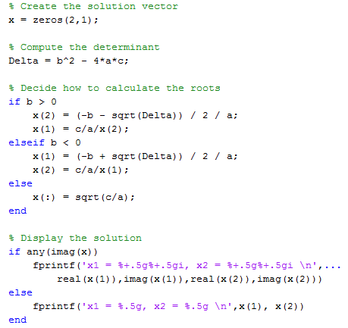
Possible Solution

