Slide 1
Introduction to
Part III
Jiwoo Oh / Sarah Duclos ETH Zurich, Institut für Chemie- und Bioingenieurwissenschaften ETH Hönggerberg / HCI F143 / F106 – Zürich E-Mail: jiwoo.oh@chem.ethz.ch sarah.duclos@chem.ethz.ch https://shihlab.ethz.ch/education/Snm/matlab-introduction

Slide 2
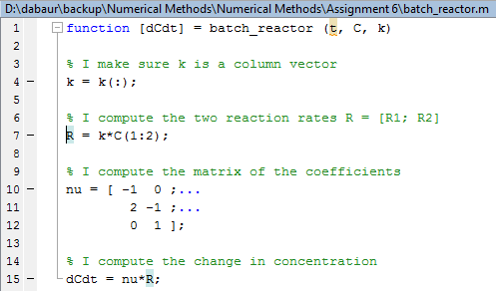
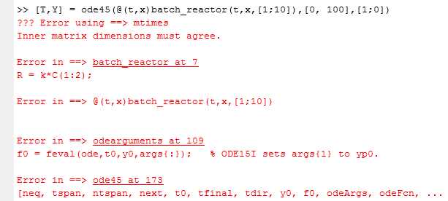
How to deal with error messages in matlab
The topmost error message is usually the one containing the most useful information
The underlined parts of the message are actually links that you can click to get to the line where the error happened!

Slide 3
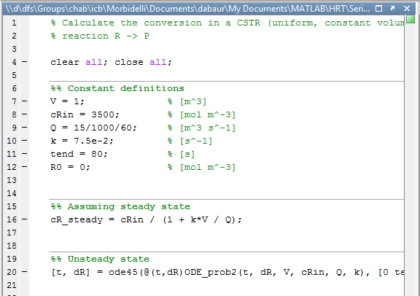
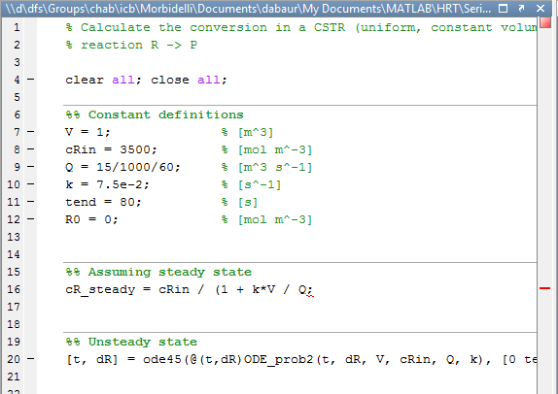
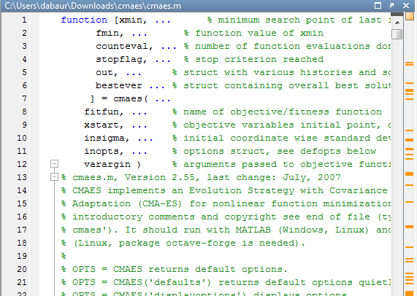
Preventing errors before they happen
The MATLAB editor does (some) on-the-fly proof reading
Green = OK
No syntax errors or unusual syntax found
Be aware that of course there can still be semantical errors!
Orange = Unusual Syntax
The script / function will run, but there are some unusual or subobtimal commands
This can be caused by (for example): Not preallocating variables, using variables in an unusual way, overriding variables before they are used even once, etc.
Clicking the square and mouse-over works too
Red = Syntax Error
The script / function will produce and error when run.
Click the red square to jump to the error, mouse over the red bar or the underlined part to get some info

Slide 4
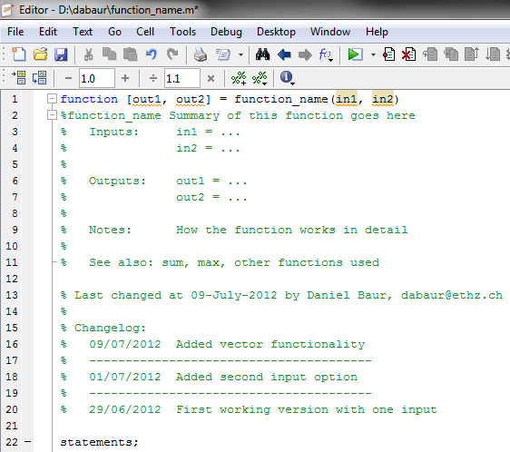
Functions in Matlab
Function name (= file name)
function keyword
Inputs
Outputs
Function description (spend a minute or two here to save yourself hours later on)
Function body (where the magic happens)

Slide 5
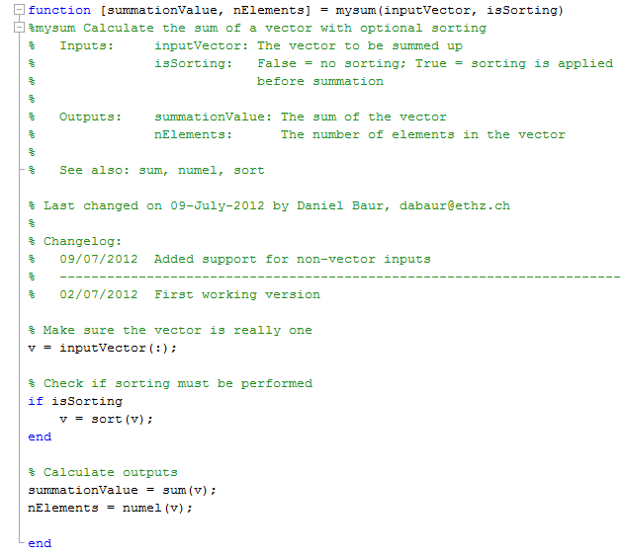
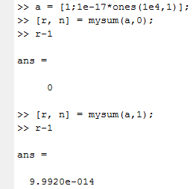
Example of a Function
Calling the function

Slide 6
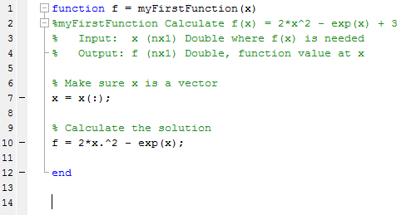
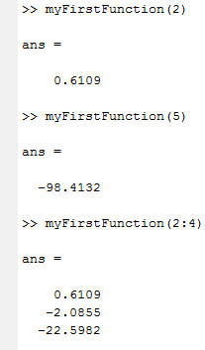
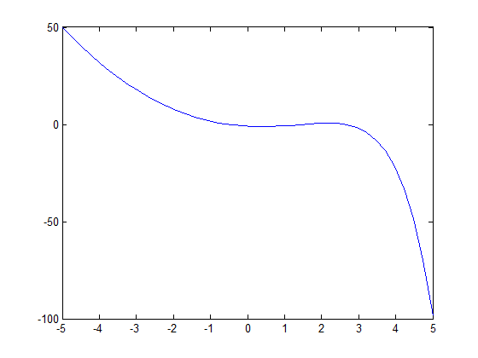
Exercise
Create a function called «myFirstFunction.m»
Scope: Compute f(x) = 2*x^2 – exp(x) + 3
Inputs: Value of x where f(x) is computed Outputs: f(x) at x
Run the function for different values of x
Evaluate the function at 40 points evenly spaced from -5 to +5 and save the values in y
Plot y vs. x, use plot(x,y)

Slide 7
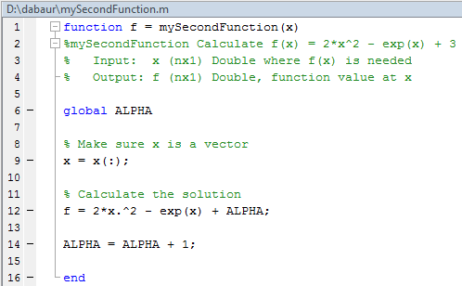
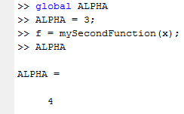
Local vs. global variables
All variables in functions are local variables
This means they exist only inside the function and are cleared from the workspace after the function ends
You can create variables that are seen everywhere by using the global key-word
ALPHA has changed everywhere!

Slide 8
Local vs. global variables (Continued)
It is common practice to name global variables in CAPS
Try to avoid global variables, since they tend to make your code confusing and hard to understand
If you want to pass a lot of variables to a lot of functions, use structs and parametrizing functions

Slide 9
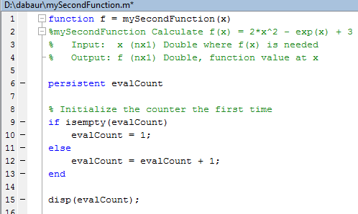
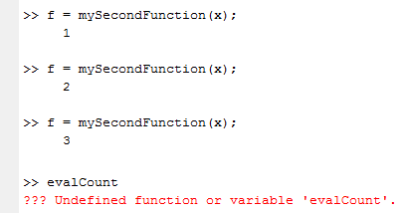
Local vs. global variables (Continued)
If you want to create a variable that keeps its value from one function call to the next (for example an evaluation counter), use the persistent key-word
Persistent variables are local variables spanning all calls of a specific function.

Slide 10
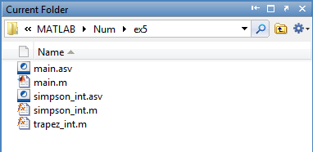
Solving problems / exercises in Matlab
Usually when you solve problems in Matlab, your program folder will look something like this:
Main executable (script m-file)
Functions used by main.m

Slide 11
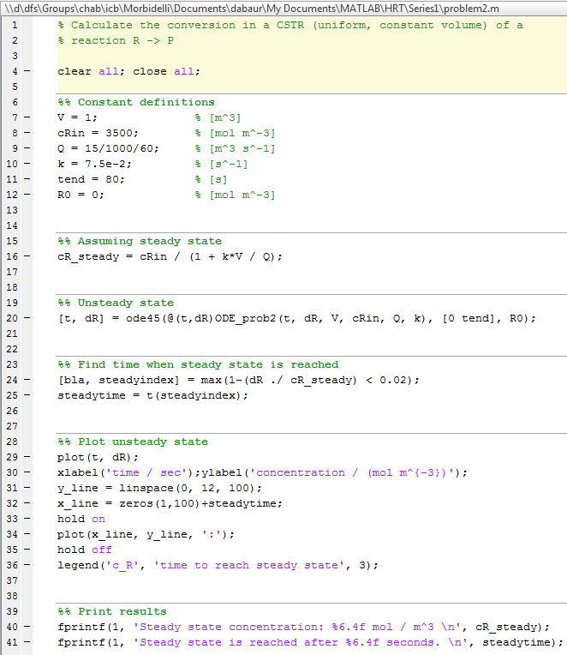
The main File
There is usually one main file that is executed, or one per task
It defines or loads variables, operates on them (calculations, solver calls, restructuring, etc.) and displays or saves the results

Slide 12
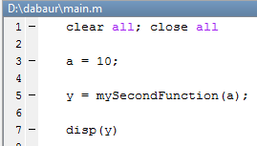
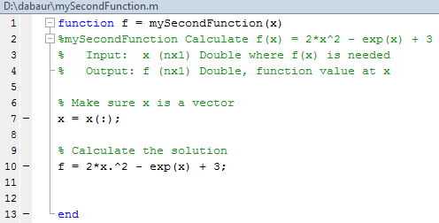
Calling functions from scripts
Scripted program execution is like riding a train down the main file:

Slide 13
Debugging functions in Matlab
The command keyboard interrupts program execution and brings up the command prompt
You can use this prompt normally, for things like looking at variables or even changing them
The command return continues program execution (with the changed variables!)
Use the command dbquit (DeBugQuit) or the toolbar to terminate program execution immediately
Note that when keyboard is in a loop, it will stop at every iteration; dbquit is the quickest way to escape here
A very powerful debugging option is to use keyboard in a catch block (interrupt if an error occurs!)

Slide 14
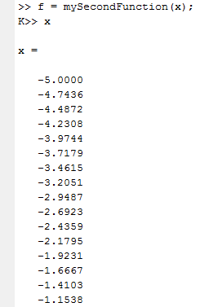
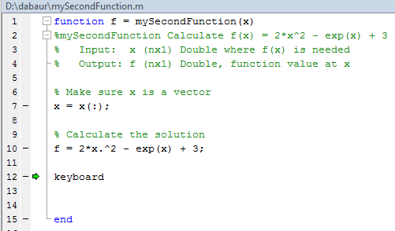
Debugging example
«Keyboard» command prompt
Program execution has been halted here

Slide 15
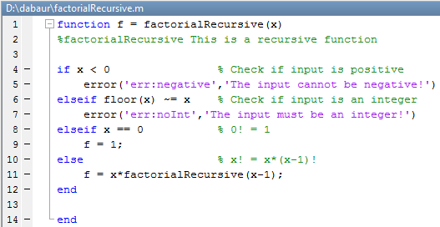
Recursive functions
Functions in Matlab can be called recursively
Example: Compute the factorial of an integer number
There is an adjustable limit of 500 recursive calls, after which an error is thrown to prevent stack overflow

Slide 16
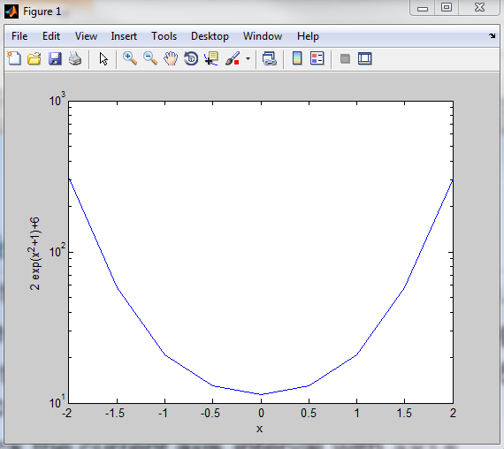
Exercise
Plot the result of «myFirstFunction» vs. [-5:0.5:5]
Type hold on; This prevents plot overwriting
Plot the result of «myFirstFunction» vs. [-5:0.5:5] using the command plot(x, f, 'ro')
Check the current axis interval with axis
Define a new interval with axis([-3 3 -10 20])
Set axis labels by xlabel('x'), ylabel('f(x)')
Superimpose plot(x, 3*sin(x))
Create a new figure with figure
Plot the function 2*exp(x²+1)+6 using semilogy
Place axis labels and rescale the plot to x=-2...2 and y = 10...1000

Slide 17
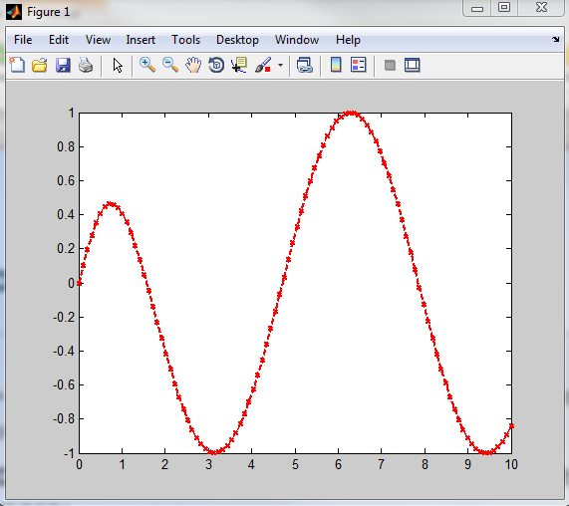
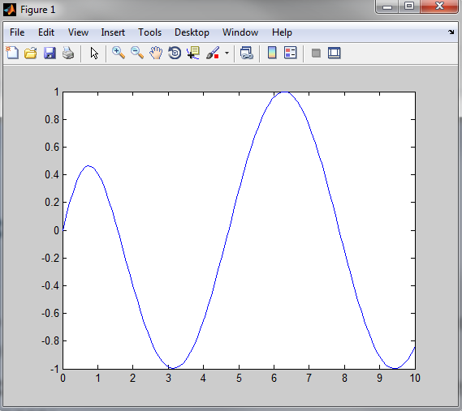
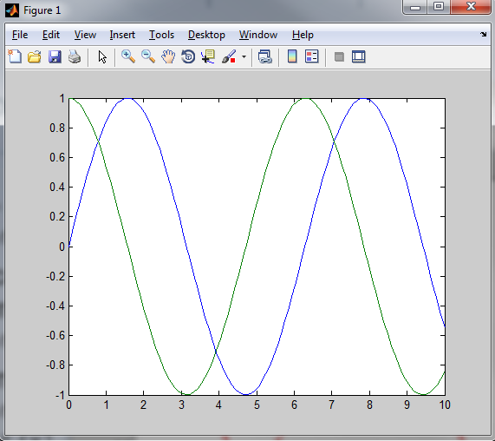
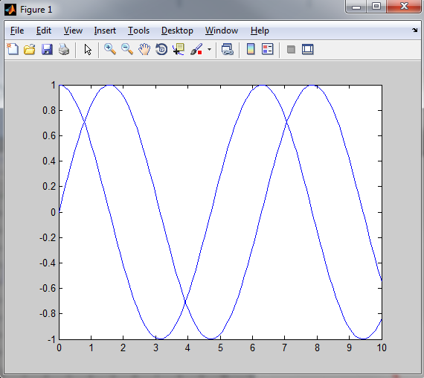
More on 2D Plots
Try:
x = linspace(0,10,100); y = tanh(x).*cos(x);
plot(x,y)
You can change color, line style, marker style, line width and more:
plot(x, y, 'rx--', 'LineWidth', 2)
Plotting multiple data sets:
plot(x1, y1, x2, y2)
plot(x1, y1); hold on plot(x2, y2); hold off
Color
Line Style
Marker
Line Width (default: 0.5)

Slide 18
Line color and style specifiers
Line Style | Specifier
Continuous (default) | 'r'
Dotted Line | ':'
Dashed Line | '--'
Dash-dotted Line | '-.'
Line Color | Specifier
Red | 'r'
Green | 'g'
Blue | 'b'
Cyan | 'c'
Magenta | 'm'
Yellow | 'y'
White | 'w'
Black | 'k'

Slide 19
Marker style specifiers
Marker Style | Specifier
Triangle (up) | '^'
Triangle (down) | 'v'
Triangle (left) | '<'
Triangle (right) | '>'
Marker Style | Specifier
Plus Sign | '+'
Circle | 'o'
Asterisk | '*'
Point | '.'
Cross | 'x'
Square | 's'
Diamond | 'd'
Five-pointed Star | 'p'
Six-pointed Star | 'h'
Much more on line properties: doc lineseriesproperties

Slide 20
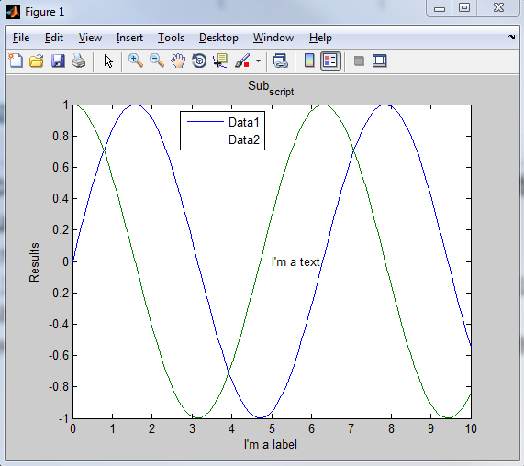
Annotating graphs
You can use these commands to add descriptive elements to your graphs
text(x, y, 'I''m a text');
title('Sub_{script}'); xlabel('I''m a label'); ylabel('Results');
legend('Data1', 'Data2', 'Location', 'Best')
Most Matlab annotators can interpret LaTeX-Commands!

Slide 21
Text properties
Property Name | Description | Property Value
Rotation | Text orientation | Scalar (deg.), default: 0
FontAngle | Normal, Italic | Default: Normal
FontName | Specifies font | Arial, Times, Courier, etc.
FontSize | Size of the font | Scalar, default: 10
FontWeight | Thickness of the font | Light, normal, bold
Color | Text Color | Same as for line
BackgroundColor | Color of background | Same as for line
EdgeColor | Color of box around text | Same as for line
LineWidth | Line width of the box line | Scalar, default: 0.5

Slide 22
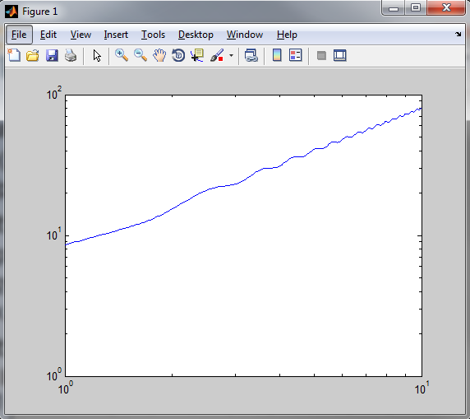
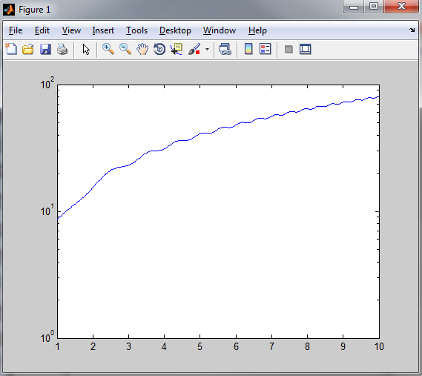
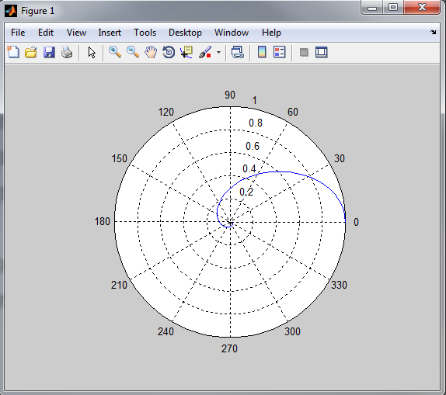
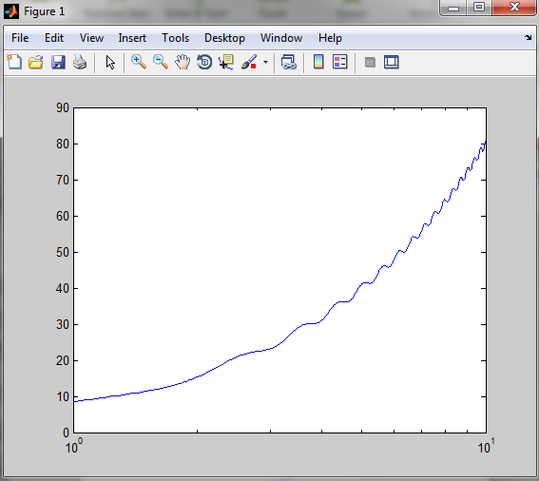
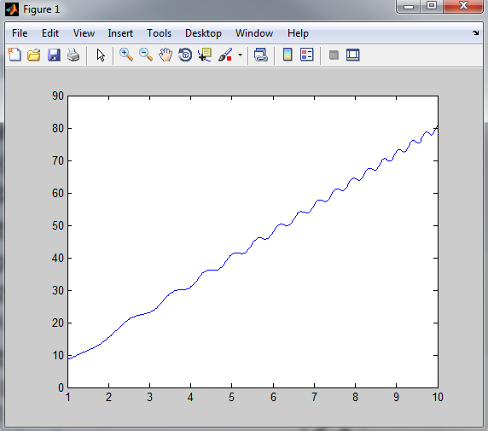
Other types of plots
Plot a function in an interval
fplot(@(x)8*x + cos(x.^2), [1,10]);
[x,y] = fplot(@(x)8*x + cos(x.^2), [1,10]; No plot!
Different scales on the axes
semilogx(x,y)
semilogy(x,y)
loglog(x,y)
Different coordinate systems
theta = linspace(0, 2*pi); r = 1./(1+theta.^2); polar(theta, r);
r
θ

Slide 23
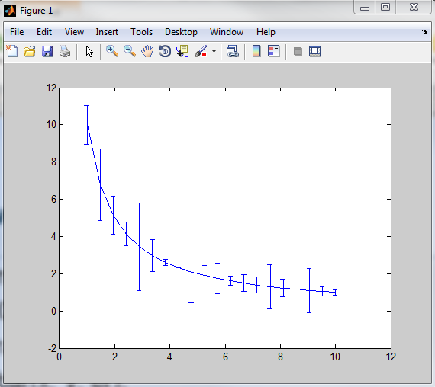
Plots with error bars
x = linspace(1,10);
y = 10./x;
er = randn(size(y));
errorbar(x, y, er);
The errorbars go from y-er to y+er

Slide 24
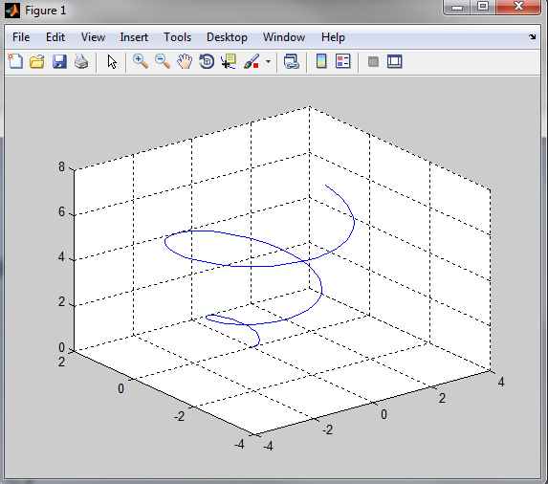
3D plots I: Lines in space
t = linspace(0, 2*pi);
x = sqrt(t).*cos(2*t);
y = sqrt(t).*sin(2*t);
z = t;
plot3(x,y,z)
grid on
The same line style options apply here. grid on also works for other plots.

Slide 25
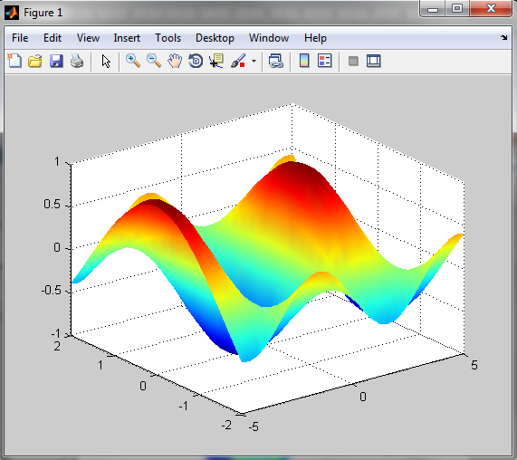
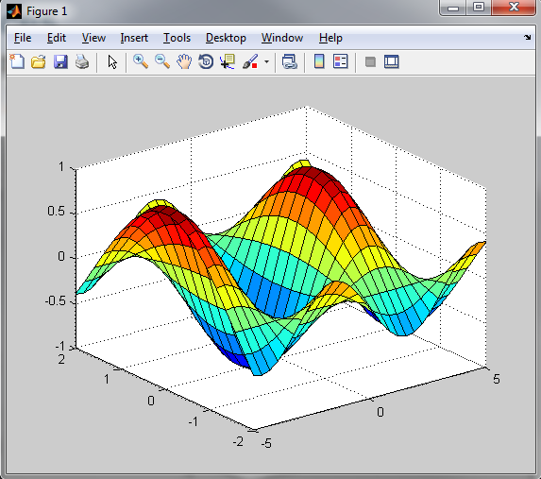
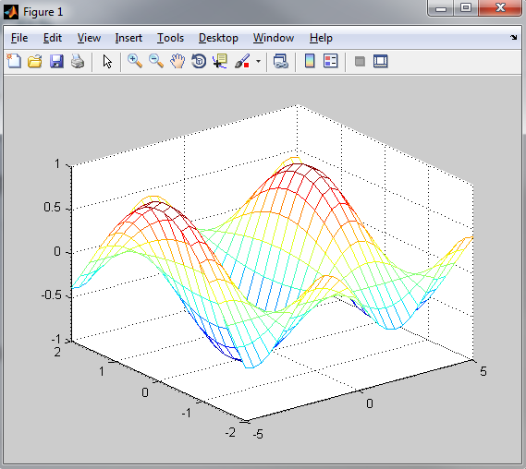
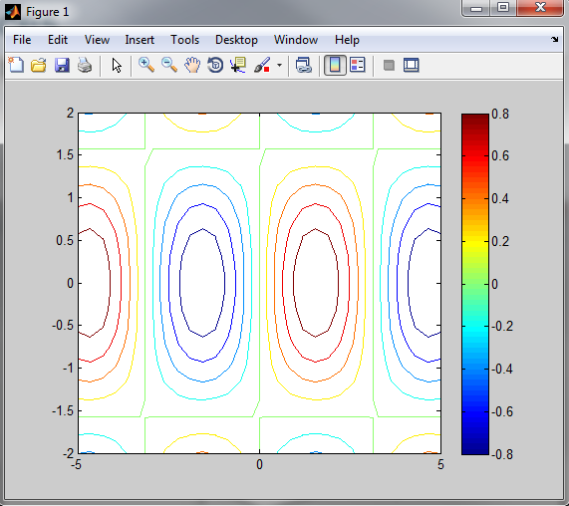
3D plots II: Surfaces
x = linspace(-5, 5, 30);
y = linspace(-2, 2, 20);
[X, Y] = meshgrid(x,y);
Z = sin(X) .* cos(Y);
mesh(X,Y,Z);
surf(X,Y,Z);
shading interp;
contour(X,Y,Z);
colorbar;

