Slide 1





Introduction to
Part IV
Jiwoo Oh / Sarah Duclos
ETH Zurich, Institut für Chemie- und Bioingenieurwissenschaften
ETH Hönggerberg / HCI F143 / F106 – Zürich
E-Mail: jiwoo.oh@chem.ethz.ch
sarah.duclos@chem.ethz.ch
https://shihlab.ethz.ch/education/Snm/matlab-introduction

Slide 2
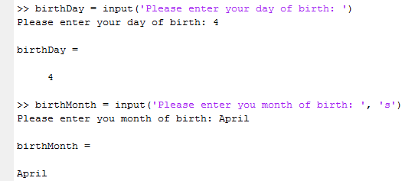
Getting inputs at runtime
Command line input from user

Slide 3
Getting inputs at runtime (continued)
Loading data from a file
  data = load('file_name');
  The file must be an ASCII file that is formatted in matrix form (same number of rows and columns everywhere)
  If the file is a Matlab workspace file (*.mat) created by save, load('file_name'); will load the saved variables into the workspace, including their names (this will overwrite existing variables!)
There is a more general (but usually slower) command
  M = importdata('file_name', delim, nheaderlines);
  Matlab will try to recognize the file extension and act accordingly
  delim is a delimiter (e.g. '\t' for tab stop)
  If delim and nheaderlines are used, M will be a struct where the data is contained in M.data

Slide 4
File handling in Matlab
Opening a file and creating a file identifier
  [fid, message] = fopen('file_name', 'w');
  message will contain an error message if the file could not be opened
The permission flags are
  'w' Write (completely overwrites an existing file!)
  'r' Read
  'a' Append
  'w+' Update mode (read and write the same file)
Closing a file
  status = fclose(fid); status = fclose('all');
  status will be 0 if successful or -1 if not

Slide 5

File handling in Matlab (continued)
Reading data from a file
  A = fscanf(fid, format);
Writing data to a file
  fprintf(fid, format, A, ...);
Displaying formatted data in the command prompt
  fprintf(format, A, ...);
Format specifiers have the form
  %5.4g
Use doc fprintf for more info about format specifiers
Conversion character (here: float or exponential form)
Decimal digits (optional)
Reserved digits (optional)

Slide 6
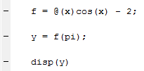



Data type «function_handle»
What is a function handle?
  Function handles put a function into a variable
  @() is used to define function handles
  Putting a variable name into the parentheses after the @ tells MATLAB: «All that comes now is a function of this variable!»
Example (try it!):
  Consider the function f(x) = cos(x) – 2
  Functions of multiple variables are also possible:

Slide 7
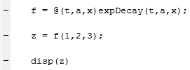


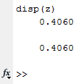
Function handles and m-files
We can use function m-files in function handles:
If we want the function handle to be a function of all input variables, we can ommit the parentheses:

Slide 8

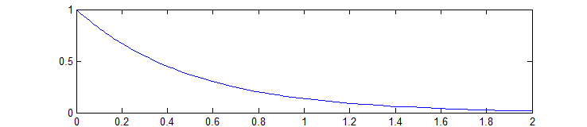


Parametrizing functions
Some (built-in) function require a function handle as input
Example:
fplot requires a function handle with one input, but our function requires three inputs! But we only want time dependence anyway, so we fix the other two:

Slide 9
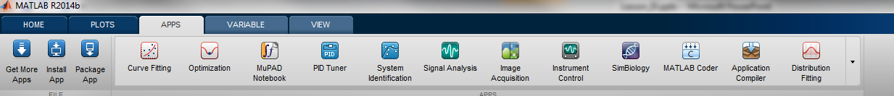
Solving different problems in Matlab
If you don’t know where to start, check the APPS rider
Many common problems can be solved with an app, and they even come with GUIs
Also watch out for the function to generate scripts from the apps

Slide 10
Solving linear systems in matlab
As we have already seen, solving linear systems in Matlab is very simple
  Ax = b → x = A\b;
  yA = b → y = b/A;
  AX = B → X = A\B;
This is possible even for underdefined systems (Ax = b where A has fewer rows than columns); Matlab then finds a «least squares» solution to the problem, i.e. a vector x that minimizes the length of the vector Ax – b

Slide 11
Solving non-linear equations in Matlab
For scalar valued functions and inputs, use fzero
  x = fzero(@fun, x0);
fun is a function taking a scalar x as an input and returning the scalar valued f(x)
To pass additional arguments, use a parametrizing function
  fun = @(x)non_lin_fun(x, a, b, c);
This can be done directly in the call
  x = fzero(@(x)non_lin_fun(x, a, b, c), x0);
If x0 is scalar, it is treated as an initial guess; if it is a vector of length 2, the function values must have a different sign
To find all the roots of a polynomial, use roots

Slide 12
Solving non-linear systems in Matlab
For vector / matrix valued functions or inputs, use fsolve
  x = fsolve(@fun, x0);
Again, fun is a function taking x as an input and returning f(x) (both can be scalars, vectors or matrices)
x0 is an initial guess
To pass additional variables to fun, use a parametrizing function
  x = fsolve(@(x)nl_fun(x, a, b), x0);

Slide 13

Solving optimization problems in Matlab
For linear programming problems
use linprog
For unconstrained optimization use fminsearch
For constrained optimization use fmincon
Refer to the help files on how to use these functions; Replace inputs you do not need with the empty matrix []
Also keep in mind the trick

Slide 14
Statistics in Matlab
The two most important functions for regression are
  [p, S, mu] = polyfit(x, y, n);
  which fits the data to a polynomial of degree n (note that n = 1 is linear regression). S and mu can be used to estimate the error, refer to the documentation for details.
  par = lsqcurvefit(@fit_fun, par0, xdata, ydata, lb, ub);
  which fits the data to an arbitrary function given in fit_fun, depending on a number of parameters par (that can be constrained by lb and ub). fit_fun must take as inputs par and xdata, and return as output a vector of y values predicted by the fit-function. Note that the algorithm builds the square error (y – ydata)² by itself.
Other useful statistical functions include
  min(A); max(A); mean(A); var(A); std(A);

Slide 15
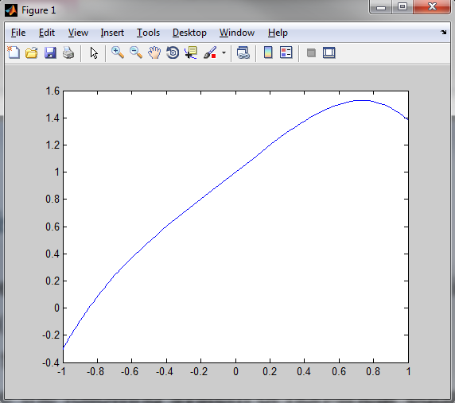
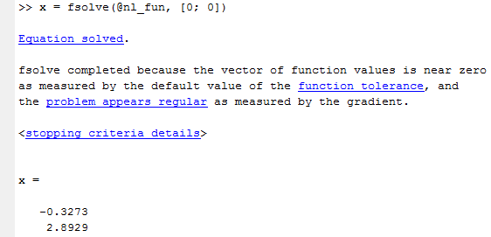
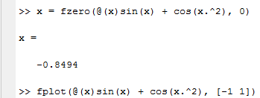

Exercise
Solve this non-linear equation using 0 as an initial guess
Plot the function from -1 to 1
Solve the following system of non-linear equations
(use [0; 0] as starting point)

Slide 16
Computing definite integrals in Matlab
Several integrators exist
  quad: Low accuracy, non-smooth integrands
  quadl: High accuracy, smooth integrands
  quadgk: High accuracy, oscillatory integrands, can handle infinite intervals and singularities at the end points
They all use the following syntax
  Q = quadl(@fun, a, b)
fun is a function that takes x as an input returns and f(x)
fun must be vectorized (use the element-by-element operators .*, ./ and .^)

Slide 17
Solving ODEs in Matlab
If an ODE cannot be cast in the above form (explicit form), it is called an implicit ODE; This is not discussed here
In order to bring a higher degree ODE into the explicit first order form, use the following «trick»

Slide 18
Solving ODEs in Matlab (Continued)
There are several ODE-Solvers in Matlab for different purposes, but they all use the same syntax:
  [t, x] = ode45(@ode_fun, tspan, x0)
ode_fun is a function taking as inputs a scalar t and a vector x, and returning a vector of values for dx / dt
tspan denotes the range of the solution
  tspan = [tstart, tend] Solves from tstart to tend
  tspan = [t0, t1, ..., tn] Provides the solution at these specific time-points
x0 is a vector of initial conditions

Slide 19
Exercise
Consider a batch reactor where these reactions take place
Compute the concentrations of A and B using ode45
  Use k₁ = 1, k₂ = 0.5; A₀ = 1, B₀ = 0
  Use a time range of [0, 10]
  Assume T = const. and V = const.
  Hint: Use a parametrizing function of the form
  @(t, x)ode_fun(t, x, k1, k2)
Plot the concentration profiles of A and B vs time

Slide 20


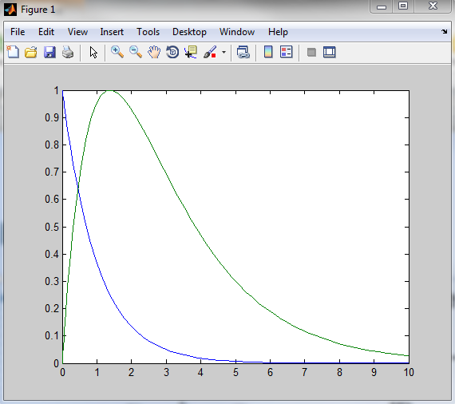
Solution

Slide 21
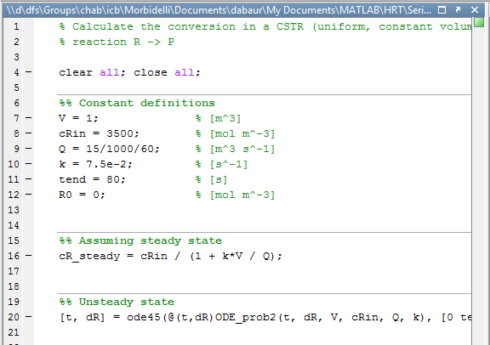
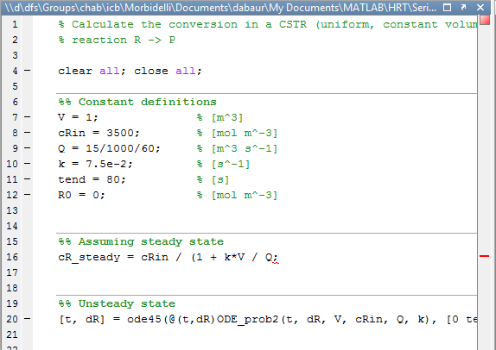
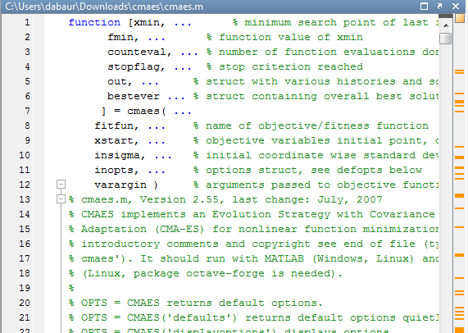
Preventing errors before they happen
The MATLAB editor does (some) on-the-fly proof reading
Green = OK
No syntax errors
or unusual syntax found
Be aware that of course there
can still be semantical errors!
Orange = Unusual Syntax
The script / function will run, but there are some unusual or subobtimal commands
This can be caused by (for example): Not preallocating variables, using variables in an unusual way, overriding variables before they are used even once, etc.
Clicking the square and mouse-over works too
Red = Syntax Error
The script / function will produce and error when run.
Click the red square to jump to the error, mouse over the red bar or the underlined part to get some info

Slide 22
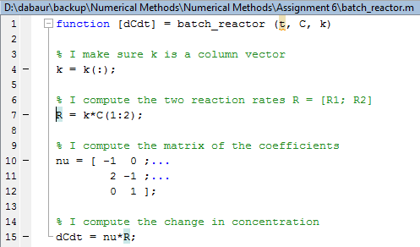
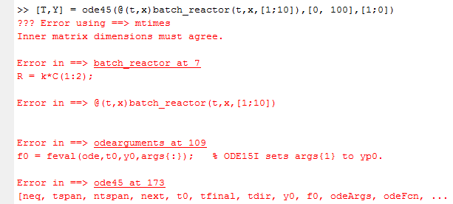
How to deal with Error Messages in Matlab
The topmost error message is usually the one containing the most useful information
The underlined parts of the message are actually links that you can click to get to the line where the error happened!

Slide 23
Programming Tips for Matlab
The main executable should be a script, not a function
  If you use a function, the workspace will be empty after execution. This means that you cannot check any variables or work with them.
Use clear all; close all; (and optionally clc) at the beginning of your scripts
  This prevents left-over variables and plots from producing unexpected results
Use variable loop bounds when looping over a vector
  If there is a vector z = linspace(0, 100); and you want to loop over it, use a for loop of the form for i = 1:length(z). That way, you won’t have to change the loop bounds if want to change the length of z.

Slide 24
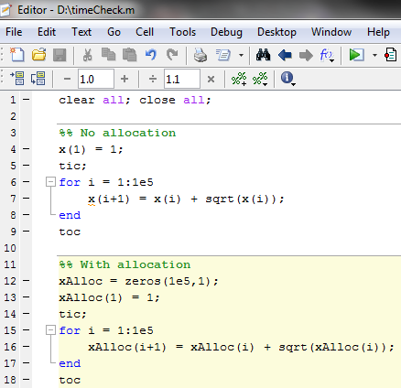

Programming Tips for Matlab
Preallocate variables before loops, i.e. fill them with zeros
  This will vastly speed up your code, especially with larger operations

Slide 25
Some General Advice
When writing programs, try to follow these guidelines
  Think before you code!
  K.I.S.S. (Keep It Simple, Stupid)
  Write comments in your code, especially where you feel that it is complicated (it will also help you remember what you did)
  Use meaningful variable and function names (but avoid built-in function names and reserved words)
  Use indentation; you can quickly indent everything by pressing ctrl+a (select all), then ctrl+i (auto indent)
  (Optional) Once you have code that is working, try to improve it

