Slide 1
Quadrature rules
Sarah Duclos Ivetich
ETH Zurich, Institut für Chemie- und Bioingenieurwissenschaften
ETH Hönggerberg / HCI F106 – Zürich
E-Mail: sarah.duclos@chem.ethz.ch
https://shihlab.ethz.ch/education/Snm/numerics

Slide 2
Numerical Quadrature (Integration)
Problem:
Generally, it is not possible to find the primitive of a function f(x) in order to solve a definite integral in the interval [a,b]
Solution:
Approximate the area under the curve numerically

Slide 3
Composite Midpoint Rule
Constant function
for each step
a
x₁
x₂
x_{n-1}
b

Slide 4

Trapezoidal rule

Slide 5
Composite Trapezoidal rule
Linear function
for each step
a
x₁
x₂
x_{n-1}
b

Slide 6
Simpson rule

Slide 7
Composite Simpson rule
The interval is split up and the areas are integrals of quadratic functions
Parabola through f(a), f(x1), f(x2)
a
x₁
x₂
x_{n-1}
b

Slide 8
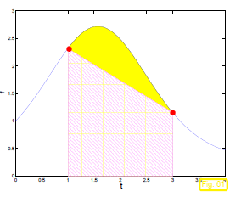
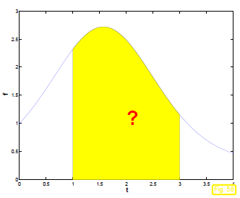
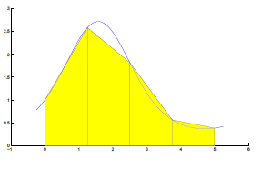
Quadrature methods
Single Step Trapezoidal Rule
Composite Trapezoidal Rule

Slide 9
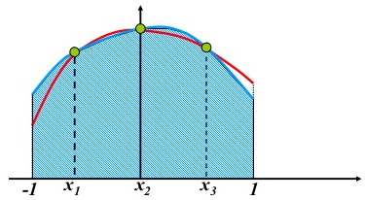
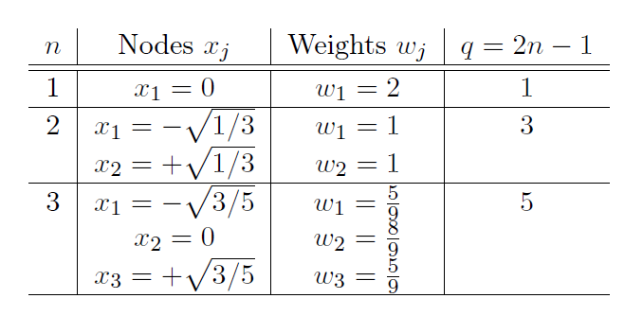
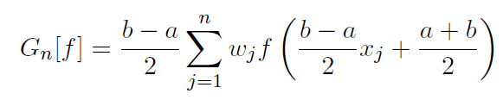
Gauss Quadrature
Depending on the polynomial order n nodes x_{j} and weights w_{j} are used
To approximate the area under a function.
n = 3

Slide 10
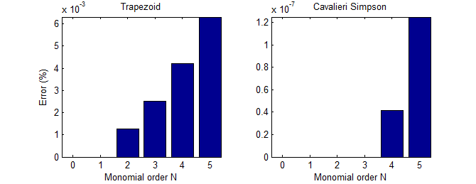
Degree of exactness
Trapezoids are areas under linear functions
  → Linear functions are approximated exactly; q = 1
Simpson uses the area under quadratic functions
  → Polynomials up to order three are approximated exactly! q = 3
  Even degree interpolation polynomials get one degree of exactness for free
Example

Slide 11
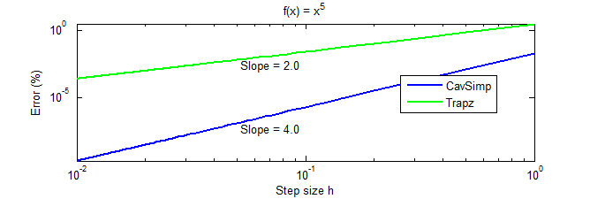
Degree of exactness vs. order of accuracy
When a non-exact result is obtained, the error is proportional to the step size to a certain power s, the order of accuracy
It can be shown that s = q + 1 for sufficiently smooth f

Slide 12
Assignment 1
Write a Matlab program to calculate and plot the concentration profile in the slab
  Use the following values:
  c∞ = 0; c₀ = 1
  Create a vector zeta = linspace(1e-6, 3), calculate the value of c for each zeta, then plot c vs. zeta
  Use integral or quadl for the integration
Create a function which calculates an integral with the trapezoidal rule
  Use the form: function F = trapInt(f, n, a, b)
  Where f is a function handle to the function that is to be integrated,
  n is the number of points and a and b denote the interval
  Use for the step size h = (b-a)/(n-1)
  Provide the mean error of the two methods (1. and 2.) using fprintf

Slide 13
Assignment 2: Quadrature degree of exactness
Determine the degree of exactness of the midpoint, trapezoidal and Simpson rules.

Slide 14
Assignment 3: Quadrature method comparison

Slide 15
Assignment 3: Quadrature method comparison

