Slide 1
Solution of Nonlinear Functions
Jiwoo Oh
ETH Zurich, Institut für Chemie- und Bioingenieurwissenschaften
ETH Hönggerberg / HCI F 143
E-Mail: jiwoo.oh@chem.ethz.ch
https://shihlab.ethz.ch/education/Snm/numerics.html

Slide 2
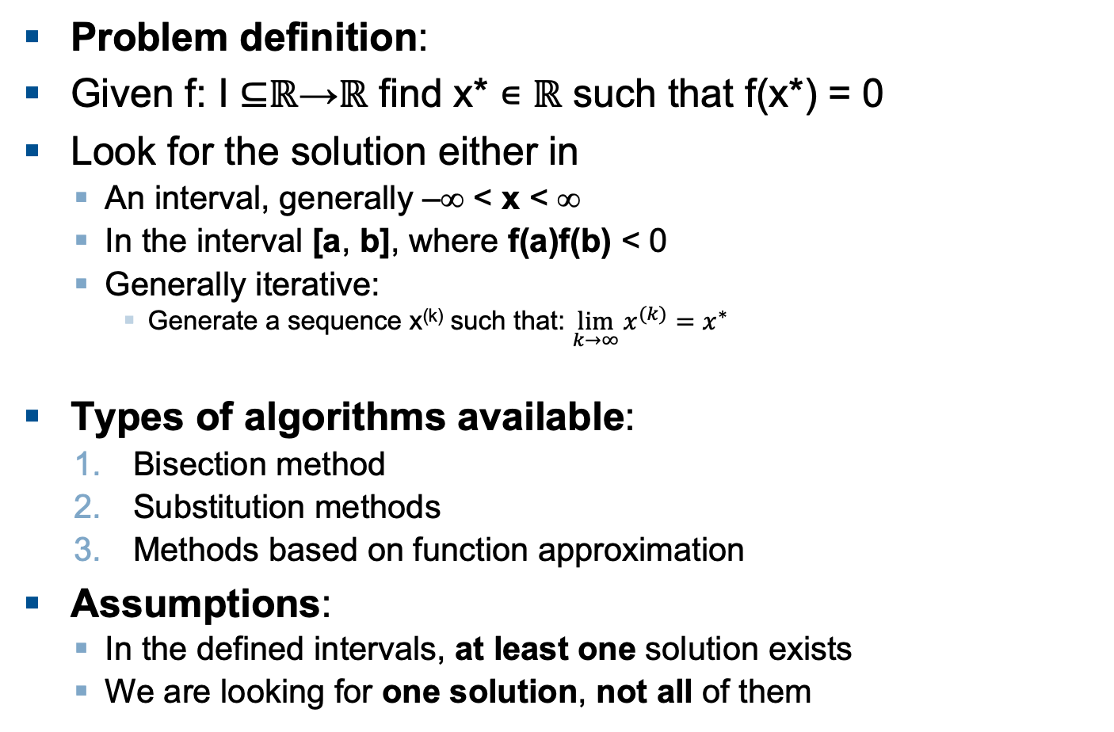
Zero of a Nonlinear Function
Problem definition:
Given f: I ⊆ℝ→ℝ find x* ∊ ℝ such that f(x*) = 0
Look for the solution either in
  An interval, generally –∞ < x < ∞
  In the interval [a, b], where f(a)f(b) < 0
  Generally iterative:
    Generate a sequence x^{(k)} such that: $\lim_{k→∞}{x^{(k)}=x^{∗}}$
Types of algorithms available:
  Bisection method
  Substitution methods
  Methods based on function approximation
Assumptions:
  In the defined intervals, at least one solution exists
  We are looking for one solution, not all of them

Slide 3
Fixed point iterations
Fixed point iterations generally have the form
A fixed point of F is a point x*, where
A fixed point iteration is called consistent with a non-linear equation f(x), if

Slide 4
Convergence order of fixed point iterations
For any (converging) fixed point iteration, we can write
where c is the rate of convergence and q is the convergence order
If we take the logarithm on both sides, we get
Which we can use to fit an average q and c

Slide 5
Bisection Method
Define starting interval [a,b] (check that f(a)*f(b) < 0)
Compute x = mean([a, b])
Redefine the interval
  Set either a = x or b = x so that f(a)*f(b) < 0 is still fulfilled
Iterate 2 and 3 until the requested
precision is reached
Advantages
  After n iterations, the interval is reduced
  by 2^{n}
  Final precision can be predicted a priori
Disadvantages
  Function characteristics are not used
  to speed up the algorithm
b
a
x
a

Slide 6
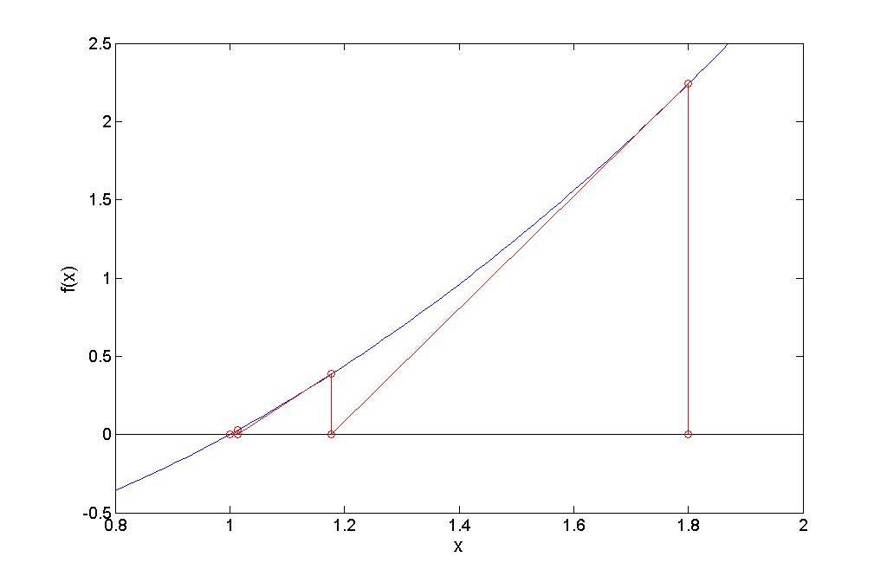
Newton Method
The Newton method is based on Taylor expansion
Advantages
  It has 2nd order convergence
Disadvantages
  Convergence is not guaranteed
  even if the uncertainty interval
  is known
  If the derivative must be
  calculated numerically,
  the secant method is more convenient
x₁
x₀

Slide 7
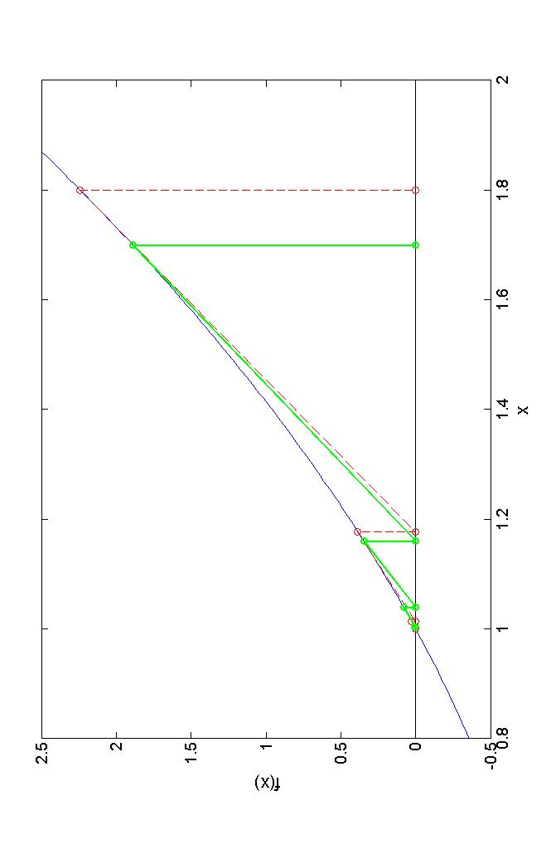
Secant Method
The Secant is based on the same principles as the Newton method, but it approximates the derivative numerically
Advantages
  Does not require the analytical
  first order derivative
Disadvantages
  Convergence is not assured
  even if the uncertainty interval
  is known
  Convergence order is only 1.618
x₀ = 1.8
x₁ = 1.7
Secant
Newton

Slide 8
How does Matlab do it? Nonlinear Functions
fzero finds the zero of a scalar valued function; It uses a combination of bisection, secant, and inverse quadratic interpolation methods
roots finds all the roots of a polynomial function;
It computes the eigenvalues of the companion matrix, which correspond to the roots of the polynomial
  A = diag(ones(n-1,1),-1);
  A(1,:) = -c(2:n+1)./c(1);
  eig(A);
  Where c is the vector of the polynomial coefficients

Slide 9
Matlab Syntax Hints
x = fzero(fun, x0);
  fun is a function taking as input a scalar x, returning as output the scalar function value f(x)
  x0 is either an initial guess (if it has length 1) or an uncertainty interval (if it has length 2, then f(x0(1))*f(x0(2)) < 0 must be fulfilled)
x = roots(c);
  c is a vector containing the polynomial coefficients in the order

Slide 10
Assignment 1: Fixed point iterations
1. Show analytically that the three fixed point equations are consistent with (1)

Slide 11
Assignment 1: Fixed point iteration
2. For each of the iterative formulas (2)-(4) try to find a fixed point using an iteration of the form with and denoting –th iteration
Use a starting guess x0 between 0 and 1
while abs(x_{k}-x_{k-1}) > 1e-8 calculate the next x value
Store all values that you calculate in a vector xvec
Also terminate the while-loop if 1e5 iterations are exceeded
3. For each Formula, say if the fixed point iteration converges or not? Provide the answers using an if block in your code.
4. Compare your results with those, which can be obtained by using fsolve for each of the cases (1) to (4).
Could you improve your results by using a different maximal error (tolerance level)?

Slide 12
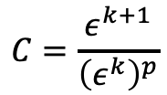
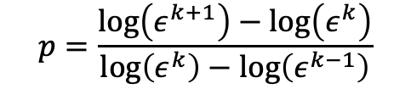
Assignment 1: Fixed point iteration
5. Estimate the convergence orders p and the rates of convergence C for the formulas which have a fixed point (keep in mind that the following formulas cannot be applied to the first and last elements of your x^{k} vectors).
Define xstar based on the last iteration value or the solution from fsolve
Calculate the vector eps = abs(xvec - xstar)
Use the results to determine p and C according to (5) and (6), plot the results (p and C vs k) using subplot and interpret them.
$$p=\frac{\log\left(ε^{k+1}\right)−\log\left(ε^{k}\right)}{\log\left(ε^{k}\right)−\log\left(ε^{k−1}\right)}$$
(5)
$$C=\frac{ε^{k+1}}{{\left(ε^{k}\right)}^{p}}$$
(6)

Slide 13
Assignment 2: CSTR Multiple Steady States
Consider a CSTR where a reaction takes place
We assume the following
  V = const., i.e. Q^{in} = Q^{out} = const.
  Perfect coolant behavior, i.e. T^{C,in} = T^{C,out} = const.
  Constant density and heat capacity of the reaction mixture
  Constant reaction enthalpy
  Constant feed, i.e. c^{A,in} = const., T^{in} = const.

Slide 14
CSTR Mass and Energy Balances
The mass and energy balances read
With the T-dependent reaction rate constant

Slide 15
Dimensionless Mass and Energy Balances
If we define
We get a dimensionless form

Slide 16
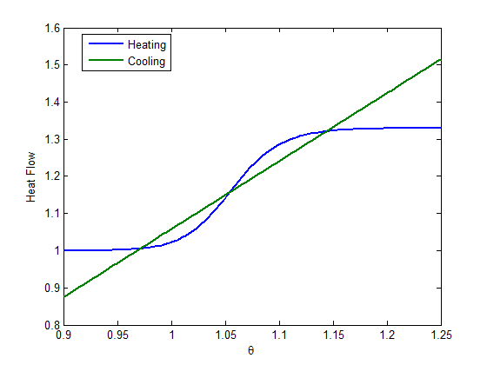
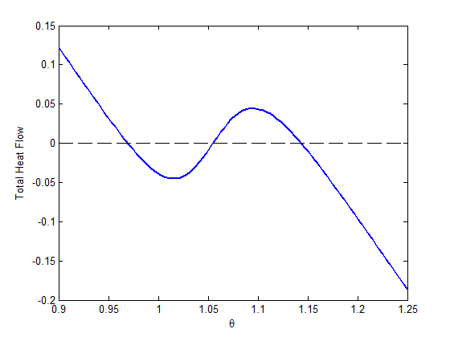
CSTR Temperature Equilibrium
The steady state concentration of A reads
The temperature in steady state is therefore given by

Slide 17
Assignment 2
Plot the total heat flow Q from and to the reactor vs. the dimensionless reactor temperature θ, for θ between 0.9 and 1.25
  Use α = 49.46; κ₀ = 2.17e20; K^{C} = 0.83; η = 0.33 and θ^{C} = 0.9.
Implement and use the secant method to find the three steady-state temperatures of the CSTR.
  Use a function of the form
  function [x,xvec] = secantRoot(f,x0)
  Also return the x-values calculated as a vector xvec.
  The calculation steps of the secant method can be found on slide 7
  The secant method uses two starting guesses;
  from x0, calculate x1 = (1+ε)*x0. Suggest a value for ε (not too small).
  Loop while abs(x_{k} – x_{k-1}) > 1e-8 and f(x_{k}) > 1e-6 and n < 1e5
  You will have to store two x-values at any given iteration, that is x_{k} and x_{k-1} to calculate x_{k+1.}
  In what range of x0 can you converge to the intermediate solution? What feature of the function determines which solution is found?

Slide 18
Assignment 2 (continued)
Repeat the task of 2.by using the Newton method, i.e. by using the analytical solution instead of the approximation.
Repeat the task of 2. by using the finite difference approximation of the derivative such that f ′(x_{k}) = (f (x_{k} + h) − f (x_{k}))/h, where two values for h, 1e-6 and 1e-16, are used.
Use the resulting xvec to estimate the convergence order and rate of convergence of the three methods. What do you observe regarding the algorithmic performance of each method? (Hint: you can use the built-in keywords tic and toc)

Slide 19
Solution of Nonlinear Equation Systems
Jiwoo Oh
ETH Zurich, Institut für Chemie- und Bioingenieurwissenschaften
ETH Hönggerberg / HCI F 143
E-Mail: jiwoo.oh@chem.ethz.ch
https://shihlab.ethz.ch/education/Snm/numerics.html

Slide 20
Zero of Nonlinear Equation Systems
Problem definition:
Find the solution of F(x) = 0, where both F and x are vector (or matrix) valued; Look for the solution either
  In an interval x_{lb} < x < x_{ub}
Types of algorithm available:
  Substitution algorithms
  Methods based on function approximation
Assumptions:
  At least one zero exists in the defined interval
  We are looking for one zero, not all of them

Slide 21


Function linearization
Let us again consider Taylor expansion
In matrix form, this reads
Which is equivalent to
$$J\left(x^{\left(k\right)}\right)Δx^{\left(k\right)}=−f(x^{(k)})$$
Newton method
$$x^{(k+1)}=x^{(k)}+Δx^{(k)}$$

Slide 22

The Jacobian matrix
Consider a continuous, differentiable function
$$f: ℝ^{n}→ℝ^{n}$$

Slide 23


The Multidimensional Newton-Algorithm
Define a starting point x
Compute –f(x)
Compute J(x)
  Either analytically or numerically
Solve the linear system of equations J(x)*Δx = -f(x)
for Δx, then set x = x + Δx
Iterate 2 through 4 until some stopping criteria are fulfilled
$$J\left(x^{\left(k\right)}\right)Δx^{\left(k\right)}=−f(x^{(k)})$$
$$x^{(k+1)}=x^{(k)}+Δx^{(k)}$$

Slide 24
Improvements on the Algorithm
It might not be necessary to compute the Jacobian at every iteration, the algorithm can also work nicely if the Jacobian is only computed every few iterations
When doing this, instead of solving the linear system of equations, it might be more efficient to compute inv(J) when recomputing J, or factorize it in a convenient manner
A numerical Jacobian can sometimes lead to better (numerical) results than an analytical one
Another option is to adapt the step size, so before accepting a Δx, one checks if norm(f(x+Δx)) is in fact smaller than norm(f(x)), and if not, a step of size λ*Δx with λ < 1 is tried instead

Slide 25
How does Matlab do it? Nonlinear Systems
fsolve is the general solver for non-linear equation systems; It can use different algorithms, namely
  Trust-region algorithms: Instead of just going in the direction that the Newton step suggests, a check is performed if x_{k+1} is really better than x_{k}. This is done by approximating the behavior of the (maximally quadratic) function around x_{k} (the trust-region). An optimization is then performed to find an optimal step.
  Trust-region-dogleg: The so-called dogleg method is used to solve the optimization problem, which constructs the step as a convex combination of the Cauchy step (steepest descent) and a Gauss-Newton step.
  Trust-region-reflective: The optimization problem is solved via a conjugate gradient method in a 2-D subspace.
  The Levenberg-Marquardt method, which finds the step by solving

Slide 26
Matlab Syntax Hints
fsolve uses the syntax
  x = fsolve(nl_fun, x0, options);
  where nl_fun is a function taking as input x, returning as output the function values f at x, both can be vectors or matrices
  x0 is an initial guess
  options can be set by options = optimset(...) to choose algorithms, give analytical Jacobians, etc.; see doc fsolve for details

Slide 27
Assignment 3: CSTR with multiple reactions
Consider a CSTR where two reactions take place
We assume the following
  V = const., i.e. Q^{in} = Q^{out} = const.
  Constant temperature and density of the reaction mixture
  Constant feed, i.e. c^{A,in} = const., c^{B,in} = const.

Slide 28
CSTR mass balance
(Accumulation) = Flow*(In – Out) + Reaction

Slide 29
CSTR steady state
where is the residence time

Slide 30
Assignment 3
Write down the analytical Jacobian matrix for the steady state CSTR shown on slide 29.
Implement the basic Newton method as shown on slide 6.
  Use a function of the form
  function [x, info] = newtonMethod(f, J, x0, tol);
  where f is a function handle to the function you want to solve, J is a function handle that returns the Jacobian matrix, x0 is an initial guess and tol is a vector of tolerances.
  As in with the secand method, use a while loop to find the solution.
  Suggest stopping criteria and failure checks. When can the Newton method fail in general?
  Use left division «\» to solve the linear system at every iteration (do not use inv(J)!)
  Let info be a struct you can use to return additional information, like reason of termination and number of steps needed.

Slide 31
Assignment 3 (continued)
Use your Newton algorithm to solve the steady state CSTR numerically.
  Create two function files; one that calculates the CSTR equations (1) as functions of x, and one that calculates the analytical Jacobian as a function of x.
  Use x^{In}₁ = 1; x^{In}₂ = 1.5; k₁ = 0.5; k₂ = 10; and τ = 5
  What is the total conversion of A to D?
  Compare your result to what fsolve() finds. Try different starting guesses. Can you find more than one solution?
Find online the function jacobianest.
  Modify your Newton algorithm so that it uses jacobianest to approximate the Jacobian if the input J is empty (use isempty(J) to check). To provide an empty input, use [] in the call.
  How many steps are required with the analytical Jacobian compared to the numerical Jacobian? Which algorithm takes longer?

