Slide 1
Ordinary Differential Equations (ODEs)
Sarah Duclos Ivetich ETH Zurich, Institut für Chemie- und Bioingenieurwissenschaften ETH Hönggerberg / HCI F106 – Zürich E-Mail: sarah.duclos@chem.ethz.ch https://shihlab.ethz.ch/education/Snm/numerics.html

Slide 2
Problem Definition
We are going to look at initial value problems of explicit ODE systems, which means that they can be cast in the following form

Slide 3
Higher Order ODEs
Higher order explicit ODEs can be cast into the first order form by using the following «trick»
Therefore, a system of ODEs of order n can be reduced to first order by adding n-1 variables and equations
Example:
1 Equation
System!

Slide 4
Some Nomenclature
On the next slides, the following notation will be used

Slide 5
Error calculation
Local truncation error (the error caused by one iteration)
Global truncation error (cumulative error caused by many iterations)
$τ_{j}=y\left(t_{j}\right)−y\left(t_{j−1}\right)−h∙f(t_{j−1},y_{j−1},h)$
Order of accuracy: $τ_{j}=C∙h^{p+1}$
$e_{n}=y\left(t_{n}\right)−y_{n}$
Order of accuracy: $e_{n}=C∙h^{p}$

Slide 6
Determination of global error
We are now interested in the value at exactly the end point t_{end}, not just the general behavior of the solution, because for the global error E at time t_{end} is where ŷ is the analytical solution.
Problem: If (t_{end} – t₀) does not evenly divide by h and the step size is fixed, we will miss the end point!
t₀
t₁
t₂
t₃
…
t_{n-3}
t_{n-2}
t_{n-1}
t_{n}
t_{end}

Slide 7
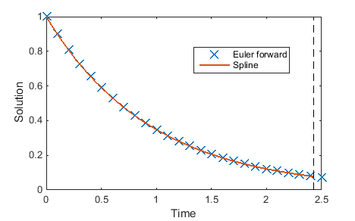
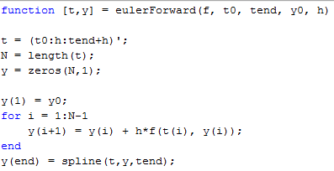
Determination of global error
Solution: Overshoot and interpolate!
Instead of t = t0:h:tend, we continue up to t_{end}+h! That is t = t0:h:tend+h;
We then replace the last point in the solution vector by interpolation (between all points or the last few points), e.g. with spline interpolation:

Slide 8
Numerical Solution of a 1-D First Order ODE
Since we know the first derivative, Taylor expansion suggests itself as a first approach
This is known as the forward / explicite Euler method, named after Leonhard Euler (Basel, 18th century)

Slide 9
Definition of an implicit algorithm
In an implicit algorithm, the function value at the next step appears on the right hand side of the step equation:
A simple example is the backward / implicit Euler method:
A system of equations has to be solved at every iteration step; Why even use implicit algorithms?

Slide 10
Matlab Syntax Hints
All ODE-solvers use the syntax [T, Y] = ode45(ode_fun, tspan, y0, …);
ode_fun is a function handle taking two inputs, a scalar t (current time point) and a vector y (current function values), and returning as output a vector of the derivatives dy/dt in these points
tspan is either a two component vector [tstart, tend] or a vector of time points where the solution is needed [tstart, t1, t2, ...]
y0 are the values of y at tstart
Use parametrizing functions to pass more arguments to ode_fun if needed f_new = @(t,y)ode_fun(t, y, k, p);
This can be done directly in the solver call
[T, Y] = ode45(@(t,y)ode_fun(t, y, k, p), tspan, y0);

Slide 11
Assignment 1: LTE of implicit Euler

Slide 12
Assignment 2: Harmonic oscillator
A mass on a spring is subject to a force when out of equilibrium
According to Newton’s second law (neglecting friction), the resulting movement follows the solution to an ODE:
F
m
y
Spring force

Slide 13
Assignment 2: Damped harmonic oscillator

Slide 14
Assignment 3: Ideal harmonic oscillator

