Slide 1
Ordinary Differential Equations (ODEs)
Jiwoo Oh
ETH Zurich, Institut für Chemie- und Bioingenieurwissenschaften
ETH Hönggerberg / HCI F 143 – Zürich
E-Mail: jiwoo.oh@chem.ethz.ch
https://shihlab.ethz.ch/education/Snm/numerics.html

Slide 2
Runge-Kutta methods
If we approximate the slope field more accurately between two iteration steps, we can generate methods higher local and global accuracy orders
Approximating the slope field in m stages:

Slide 3
Butcher tableau
A convenient way of of writing down explicit RK methods is the Butcher tableau
Example: Heun, order 2

Slide 4
Visualization of RK methods

Slide 5
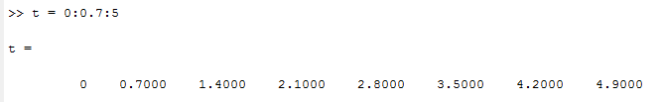
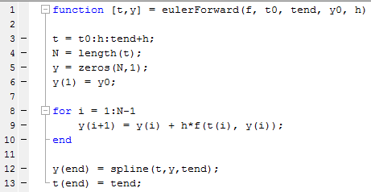
Interpolation of end value
t₀
t₁
t₂
t₃
…
t_{n-3}
t_{n-2}
t_{n-1}
t_{n}
t_{end}
t_{n+1}

Slide 6
Assigment 1: Radioactive decay
A decaying radioactive element changes its concentration according to the ODE
where λ is the decay constant
The analytical solution to this problem reads

Slide 7
Assignment 1: Radioactive decay
You have implemented the forward Euler method
  The forxward Euler method reads
  The backward Euler algorithm uses the following step formula
  Note that you cannot just put this formula into Matlab like this! Use fsolve to solve for with the same conditions as above.
  You might want to use these to avoid spamming you command line:
  options = optimset('display','off');
  y(i+1) = fsolve( ........, options);

Slide 8
Assigment 1: Radioactive decay
Butcher tableaus can be read as:
  Solve the radioactive decay problem using the 2nd order Heun method and «the» 4th order RK method using the conditions y0 = 1, lambda = 1 and h = 0.1 from t0 = 0 to tEnd = 10
Define 4 new functions such
function [t,y] = eulerForward(f,t0,tend,y0,h)
function [t,y] = eulerBackward(f,t0,tend,y0,h)
function [t,y] = Heun2(f,t0,tend,y0,h)
function [t,y] = RK4(f,t0,tend,y0,h)
to be called in your main code

Slide 9
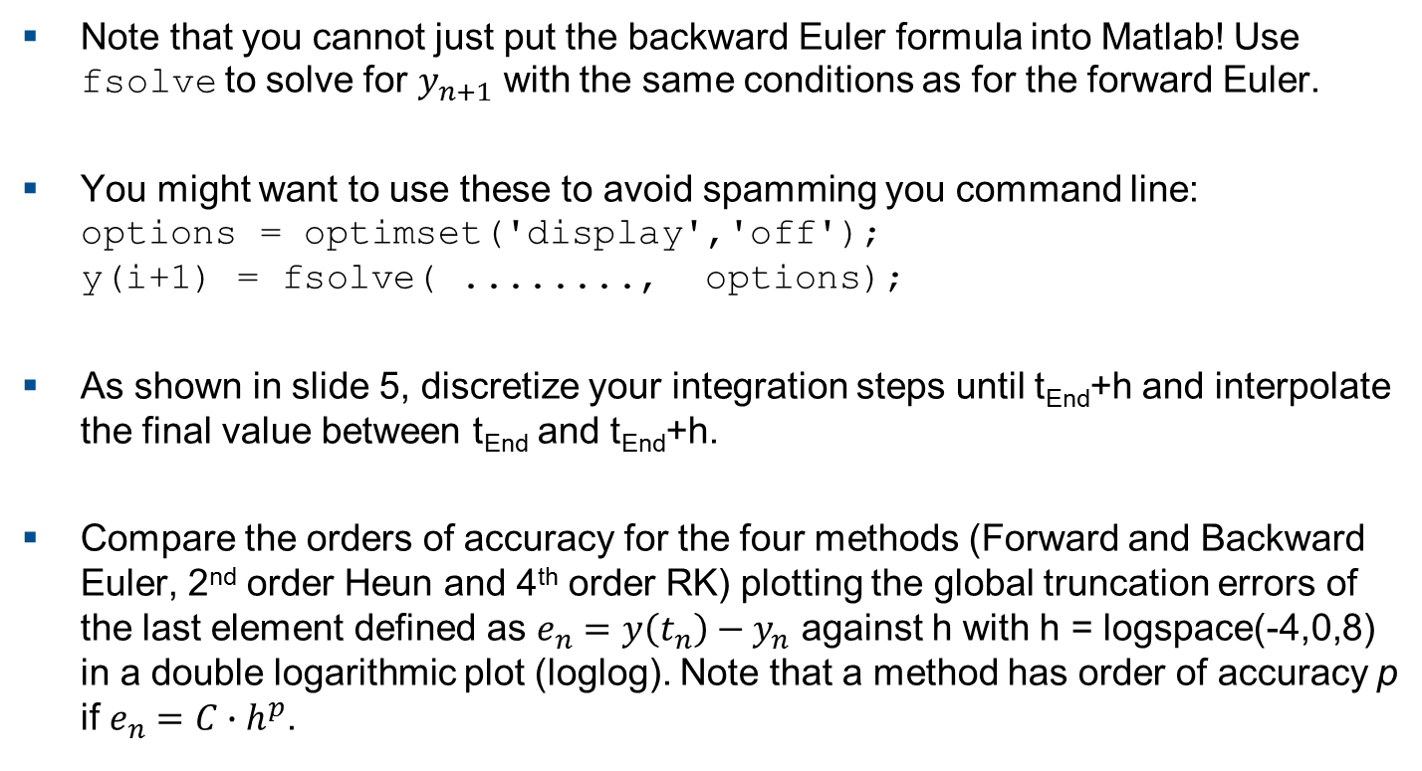
Assigment 1: Radioactive decay
Note that you cannot just put the backward Euler formula into Matlab! Use fsolve to solve for $y_{n+1}$ with the same conditions as for the forward Euler.
You might want to use these to avoid spamming you command line:
options = optimset('display','off');
y(i+1) = fsolve( ........, options);
As shown in slide 5, discretize your integration steps until t_{End}+h and interpolate the final value between t_{End} and t_{End}+h.
Compare the orders of accuracy for the four methods (Forward and Backward Euler, 2nd order Heun and 4th order RK) plotting the global truncation errors of the last element defined as $e_{n}=y\left(t_{n}\right)−y_{n}$ against h with h = logspace(-4,0,8) in a double logarithmic plot (loglog). Note that a method has order of accuracy p if $e_{n}=C∙h^{p}$.

Slide 10
Assignment 2
The van der Waals equation for some non-ideal gas reads
Taking the derivative, we get

Slide 11
Assignment 2 (continued)
Plot the van der Waals equation for 1000 points between V = 0.34 and V = 4
Try to approximate the equation by solving the ODE
  Use ode45, tSpan = [0.34, 4]; and y0 = P(0.34);
  Note that the ODE does not depend on the solution, but only the independent variable (i.e. the first input into your odefun!)
  Plot the solution of the ODE together with the analytical solution and zoom in to ylim([0, 2]). What do you observe?
  Try the same with ode15. What do you observe when you zoom in?
Plot dP/dV against V in the range we considered.
  What might be the problem with the solvers, considering what they have to do in the slope field?
Tighten the tolerances.
  Plot the solutions again and zoom in to ylim([0,2]).

Slide 12
Assignment 3
Compute the stability function of the Runge method (also known as the explicit midpoint method (EM)).

