Slide 1
Ordinary Differential Equations (ODEs)
Sarah Duclos Ivetih
ETH Zurich, Institut für Chemie- und Bioingenieurwissenschaften
ETH Hönggerberg / HCI F106 – Zürich
E-Mail: sarah.duclos@chem.ethz.ch
https://shihlab.ethz.ch/education/Snm/numerics.html

Slide 2
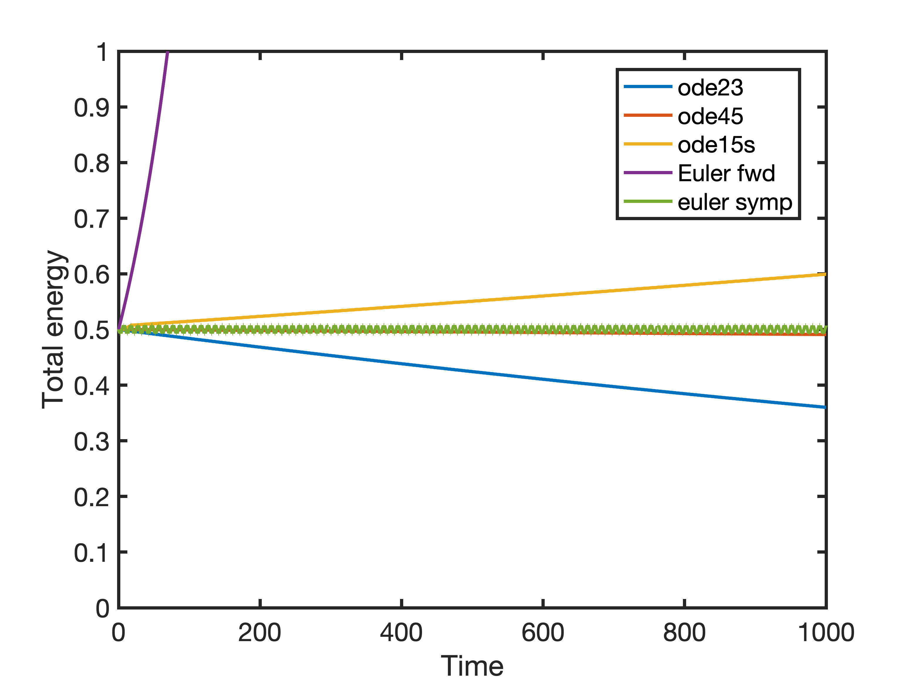
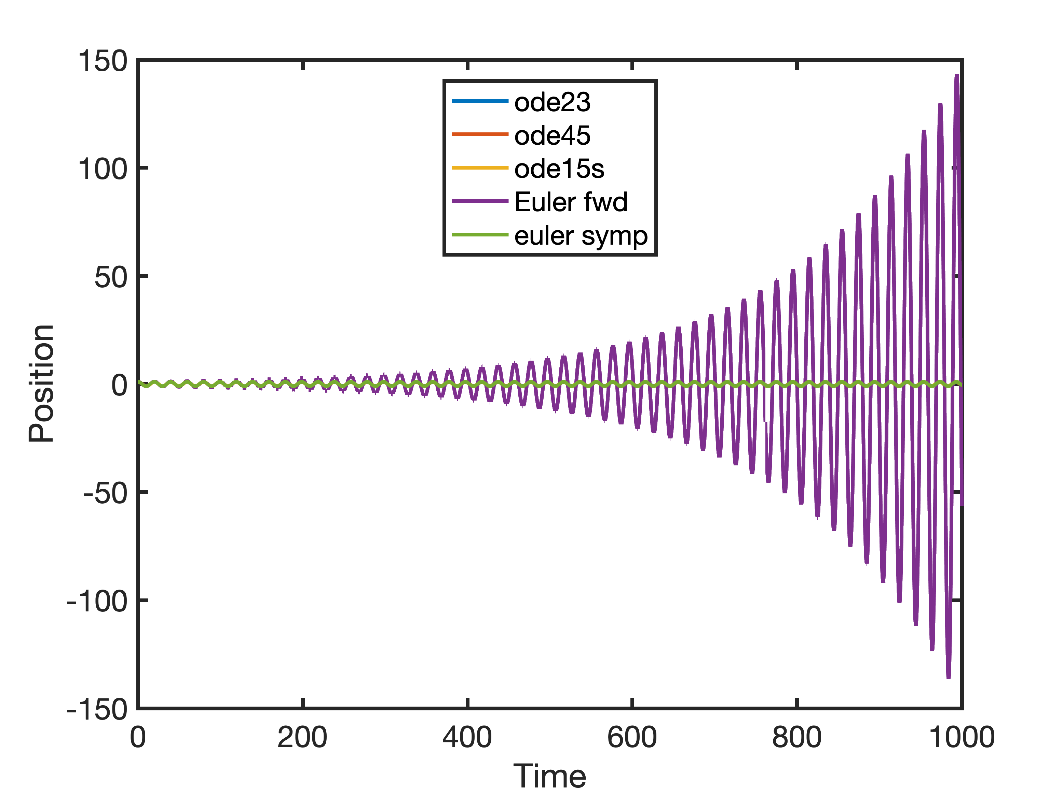
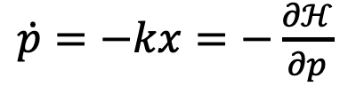
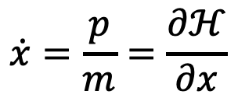
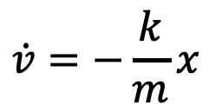

Choosing the right integration scheme
$$\dot{x}=v$$
$$\dot{x}=\frac{p}{m}=\frac{∂ℋ}{∂x}$$
$$\dot{v}=−\frac{k}{m}x$$
$\dot{p}=−kx=−\frac{∂ℋ}{∂p}$

Slide 3
Definition of an implicit algorithm
In an implicit algorithm, the function value at the next step appears on the right hand side of the step equation:
A simple example is the Backward Euler method:
A system of equations has to be solved at every iteration step; Why even use implicit algorithms?

Slide 4
Stability of numerical ODE solvers
Linear constant coefficient ODE systems such as this are used as «test-equations» for solvers
Example: Forward Euler
This iteration will only converge to a value if the spectral radius of the iteration matrix is smaller than 1:

Slide 5
Stability region of the forward Euler algorithm
The forward Euler algorithm is stable if
Since eigenvalues are complex in general, we need to use the definition of the complex absolute value
Therefore the algorithm is stable if

Slide 6
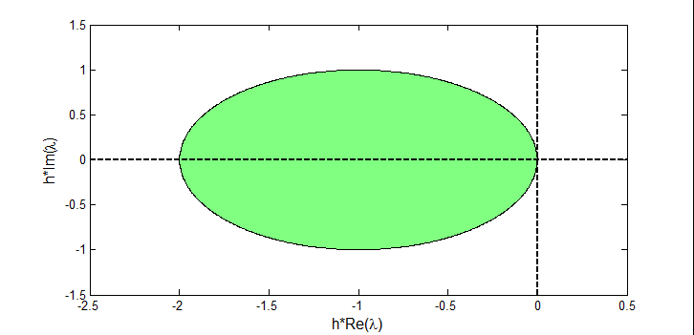
Visualizing the stability region
We can plot the value of our stability equation as a function of ha and hb

Slide 7
Backward Euler Method
As mentioned before, the simplest implicit method is the Backward Euler method
If we substitute our problem
We obtain
In case of linear ODEs, this is a linear system of the form Mx = b that has to be solved at every iteration step
Note that in general this can be a non-linear system

Slide 8
Stability of the Backward Euler Method
If we solve for the next step, we get
Again the spectral radius of the iteration matrix determines convergence:
Therefore, the algorithm is stable if

Slide 9
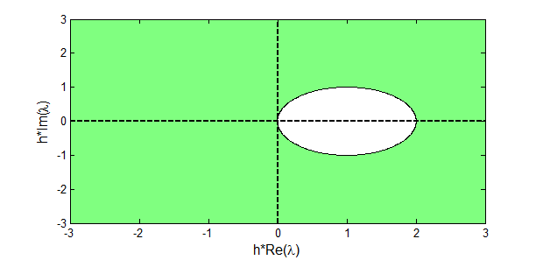
Visualizing the stability region
We see that if a = Re(λ)_{max} < 0, the stability is independent on the step size
This property is called A-stability

Slide 10
A-Stability of other algorithms
Explicit Runge-Kutta methods, as well as explicit multi-step methods can never be A-stable
  Note that the Forward Euler method can be seen as both an explicit multi-step method or RK method of order 1
Implicit multi-step methods can only be A-stable if they are of order 2 or lower (second Dahlquist barrier)
However, implicit RK methods of higher order can be A-stable

Slide 11
Stiff problems
A problem is considered stiff if e.g. the following apply:
  A linear constant coefficient system is stiff if all of its eigenvalues have a negative real part and the stiffness ratio is large
  Stability requirements, rather than accuracy considerations, constrain the step length
  Some components of the solution show much faster dynamics than others
Explicit solvers require an impracticably small h to insure stability, therefore implicit solvers are preferred

Slide 12
Implicit algorithms and stiff problems
Since implicit algorithms are generally more stable than explicit algorithms (some are even A-stable!), they fare much better with stiff problems, where the step size is often restricted by stability issues
  For non-A-stable implicit algorithms, the main goal is usually to get the largest possible stability region, since this is the main advantage of implicit algorithms
However, this stability comes at the price of larger computational demand per step, which is needed to solve the arising algebraic equation systems
  There are however highly specialized algorithms to solve systems arising from implicit solvers, which can take into account special features of the problem like sparseness or bandedness

Slide 13
Assignment 1
Find the stability region for the second order Heun method (by hand)
  The second order Heun method reads
  Use a linear, constant coefficient ODE as test system, i.e.
  Find an expression of the form abs(...) < 1 that guarantees stability if it is fulfilled (compression factor)

Slide 14
Assignment 1 (continued)
Try to use the definition of the complex absolute value to find an expression that does not contain the absolute value operators and use the function draw_stabfunc (given online) to plot the stability region.
  The easiest approach is to substitute a complex number w for h* λ_{max}, defined as w = a + b*i, and then applying the definition of the complex absolute value:
  Note that for this, you will have to multiply out the square of w (remember that i² = -1). Before you resolve the absolute value, bring the complex number into standard form c + d*i

Slide 15
Exercise 2
Consider the following chemical reactions in a batch reactor:

Slide 16
Assignment 2
Solve the batch reactor and plot the solutions
  Use k1 = 1000; k2 = 0.1; y0 = [1, 0.1] and tSpan = [0,1];
  Do you expect the system to be stiff? Use the linearization method to check the stiffness ratio at y = y0 (by hand), by calculating the eigenvalues of the Jacobian of the system
  Remember that the eigenvalues of a matrix can be calculated by solving det(J – λI) = 0 for λ
  The determinant of a 2x2 matrix is
  Use ode45 to solve the system and plot the solutions. Is it stiff? Looking at the Jacobian, can you say why? Note how y changes and how it changes the Jacobian and its eigenvalues!

Slide 17
Assignment 3
We consider the Van der Pol ODE
with u = 1000 and t € [0,3000], with the following initial values: y(0) = 2, y’(0) = 0
Run StiffVanDerPol.m which solves the IVP numerically using Matlab’s ode45 and ode23s.
Note: The computation with ode45 can take a few minutes.
Based on the resulting plots, can you explain the large difference in run time?

