Slide 1
Linear Regression
Sarah Duclos Ivetich
ETH Zurich, Institut für Chemie- und Bioingenieurwissenschaften
ETH Hönggerberg / HCI F 143
E-Mail: sarah.duclos@chem.ethz.ch
https://gitlab.ethz.ch/tmarcato/snm22

Slide 2
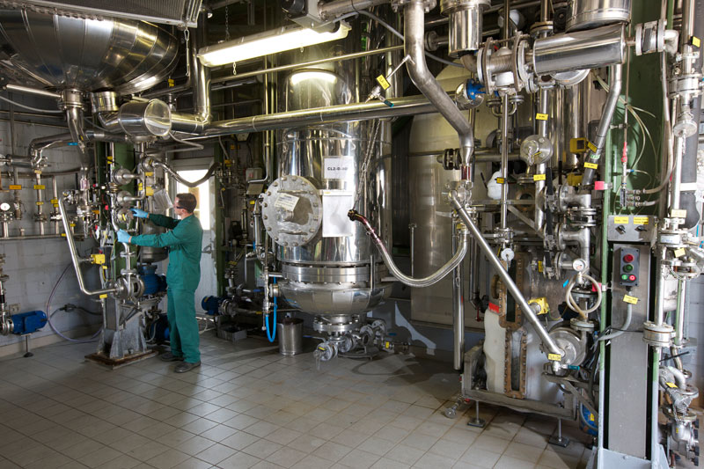
Design of Experiments – An Example
The Problem
Measure the time (response) for pressure discharge of a tank filled with water through a pipe
Objectives
Obtain a prediction error smaller than 10%
Minimize the experimental effort
Regression factors (4)
Length of the pipe (10 – 50 m)
Diameter of the pipe (1 – 5 cm)
Head pressure (0.1 – 0.4 bar)
Temperature of water (10 – 50 ˚C)
Sarah duclos Ivetich / Numerical Methods for Chemical Engineers / Linear Regression

Slide 3
Multiple Linear Regression
  Use the log₁₀ of the discharge time
  18 experiments (based on experimental design)
  Final model (max polynomial order = 2):
Parameter | Estimate | SE | tStat | pValue
θ₀ | 2.9898 | 0.009 | 336.43 | 0.000
θ₁ | -0.2961 | 0.003 | -94.23 | 0.000
θ₂ | 0.1910 | 0.003 | 60.80 | 0.000
θ₃ | -0.9432 | 0.003 | -300.20 | 0.000
θ₄ | -0.0163 | 0.003 | -5.19 | 0.001
θ₅ | -0.0058 | 0.003 | -1.85 | 0.098
θ₆ | -0.0064 | 0.003 | -2.03 | 0.073
θ₇ | 0.0079 | 0.003 | 2.51 | 0.033
θ₈ | 0.4350 | 0.009 | 46.15 | 0.000
Root mean squared error (RMSE): |  |  | 0.0126
R-squared: | 1.000 |  | Adjusted R²: | 1.000
F-statistic vs. constant model: |  | 13100 | p-value: | 2.24E-17
Sarah duclos Ivetich / Numerical Methods for Chemical Engineers / Linear Regression

Slide 4

Model Validation
1000 experimental points randomly generated
Objective = 10%
⇒ model under-fitting
Sarah duclos Ivetich / Numerical Methods for Chemical Engineers / Linear Regression

Slide 5
D-Optimal Model Augmentation
Use the log10 of the discharge time
D-Optimal Design with 98 experiments
Final model (max polynomial order = 4):
Old model (98 exp)
Root mean squared error (RMSE): |  |  | 0.00140
R-squared: | 0.9998 |  | Adjusted R²: | 0.9997
F-statistic vs. constant model: |  | 12200 | p-value: | 1.31E-115
Sarah duclos Ivetich / Numerical Methods for Chemical Engineers / Linear Regression

Slide 6
Mechanistic model
Darcy–Weisbach equation
$$t\sim \frac{πD^{2}}{2}{\left(\frac{∆p}{2ρf_{D}L}\right)}^{1/2}$$
Sarah duclos Ivetich / Numerical Methods for Chemical Engineers / Linear Regression

Slide 7

DoE Tank Discharge – What if no mechanistic model?
Model | Pros | Cons
Multiple Linear Regression | Very simple to start No required knowledge | Large overfitting Very large number of exps. (ca. 100)
Knowledge
No. of Experiments
MLR + Non-dimensional quantities (e.g. Re)
Simple to use
Little knowledge required
Not physical
Medium level of exp. effort
Limited number of experiments (15)
Deterministic Model
Very little number of experiments (8)
Detailed knowledge required
Sarah duclos Ivetich / Numerical Methods for Chemical Engineers / Linear Regression

Slide 8
Why stepwise?
Sarah duclos Ivetich / Numerical Methods for Chemical Engineers / Linear Regression

Slide 9
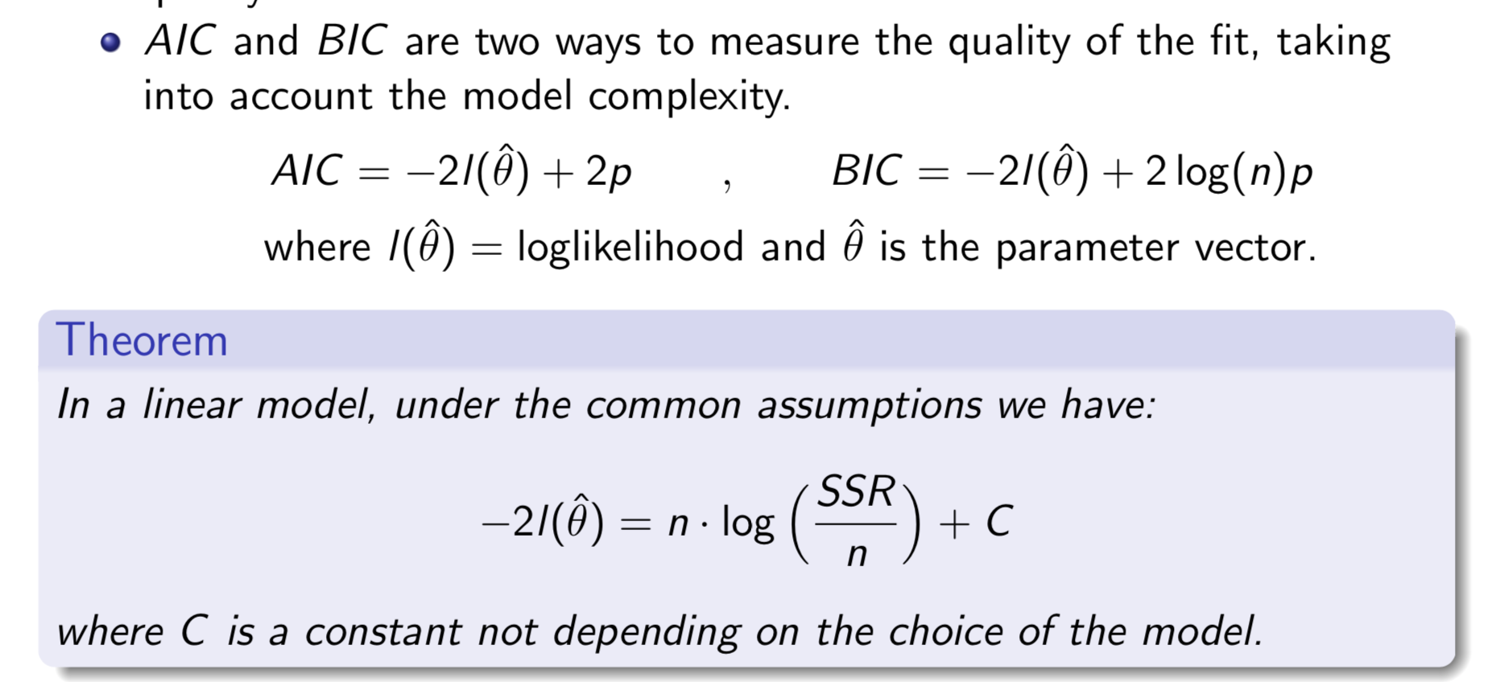
Are all model terms relevant for improving model performance?
Sarah duclos Ivetich / Numerical Methods for Chemical Engineers / Linear Regression

Slide 10
Why validation?
Sarah duclos Ivetich / Numerical Methods for Chemical Engineers / Linear Regression

Slide 11
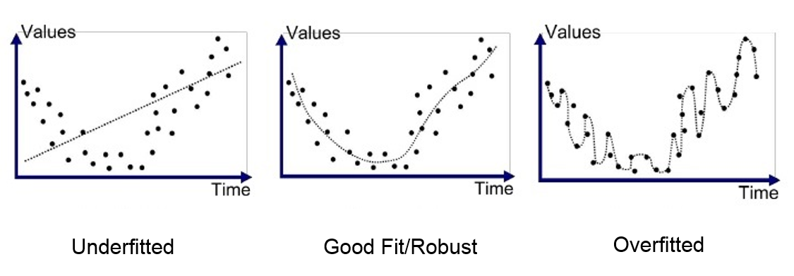
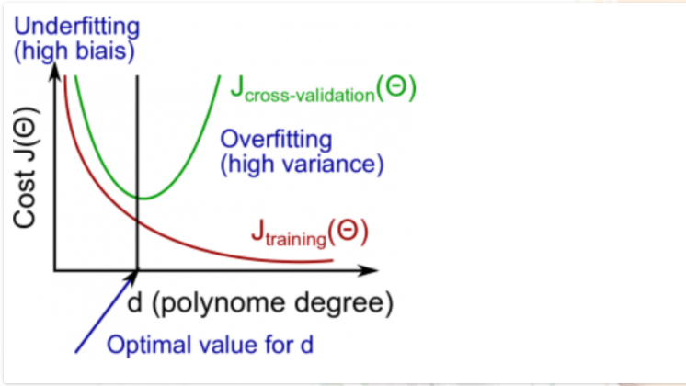
Is developed model generally valid?
Does it perform well when I test it on an external data set?
Sarah duclos Ivetich / Numerical Methods for Chemical Engineers / Linear Regression

