Slide 1
UHV Techniques
As part of the course ‘Molecular Aspects of Catalysts and Surfaces’
529-0611-00L
Dr. Luca Artiglia
Paul Scherrer Institut
luca.artiglia@psi.ch

Slide 2


What is Vacuum?
The term VACUUM can be used to describe these conditions:
1) Complete absence of matter (definite volume in which gases are almost absent – e.g. interstellar space)
2) Physical state in which the pressure in a definite volume is smaller than in the surroundings (e.g. smaller than the atmospheric pressure)
An example: ρ_{gas} = 2·10¹⁹ mol/cm³ (atmospheric pressure)
ρ_{gas} = 10⁹ mol/cm³ (orbiting satellite)
Notes:
Scientists define the beginning of interstellar space as the place where the sun’s constant flow of material and magnetic field stop affecting its surroundings. This place is called the heliopause. It marks the end of a region created by our sun that is called the heliosphere.
The sun creates this heliosphere by sending a constant flow of particles and a magnetic field out into space at over 670,000 miles per hour. This stream is called the ‘solar wind.’
Like Earth wind, this wind pushes against the stuff around it. What it pushes against are particles from other stars. —pretty much anything that doesn’t come from our own solar system.

Slide 3

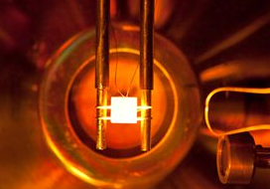
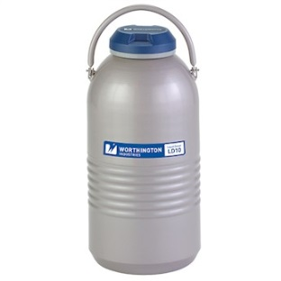
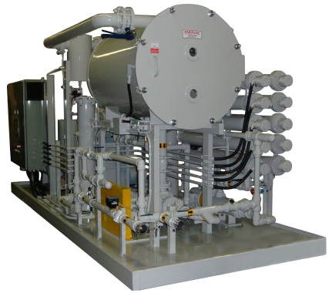
Some applications of Vacuum
Reduce the concentration of a gas below a critical level (e.g. O₂ in bulbs)
Avoid gas-driven physico-chemical processes (e.g. experiments studying the gas-surface interaction) and increase the mean free path of particles (e.g. ion and electron spectroscopies)
Thermal insulation
Degasification of liquids
Notes:
The solubility of gas obeys Henry's law (H=c/p), that is, the amount of a dissolved gas in a liquid is proportional to its partial pressure. Therefore, placing a solution under reduced pressure makes the dissolved gas less soluble. Sonication and stirring under reduced pressure can usually enhance the efficiency. This technique is often referred to as Vacuum degasification. Specialized vacuum chambers, called vacuum degassers, are used to degas materials through pressure reduction.

Slide 4
Vacuum classification
Vacuum | Pressure (torr) | Number Density (m⁻³) | M.F.P. (m) | Surface Collision Freq. (m⁻²·s⁻¹) | Monolayer Formation Time (s)
Atmosphere | 760 | 2.7×10²⁵ | 7×10⁻⁸ | 3×10²⁷ | 3.3×10⁻⁹
Rough | 10⁻¹-10⁻³ | 3.5×10¹⁹ | 0.05 | 4×10²¹ | 2.5×10⁻³
High | 10⁻³-10⁻⁶ | 3.5×10¹⁶ | 50 | 4×10¹⁸ | 2.5
Very high | 10⁻⁶-10⁻⁹ | 3.5×10¹³ | 50×10³ | 4×10¹⁵ | 2.5×10³
Ultrahigh | 10⁻⁹-10⁻¹² | 3.5×10¹⁰ | 50×10⁶ | 4×10¹² | 2.5×10⁶ (29 days!)

Slide 5
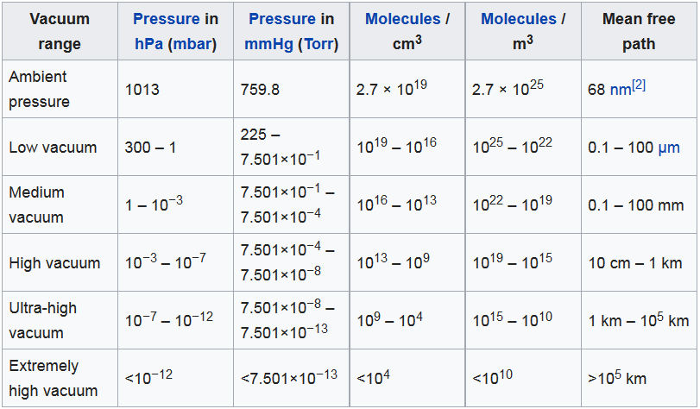
Gas flow regimes
The mean free path is the average distance that a gas molecule can travel before colliding with another molecule and is determined by:
- Size of molecule (2r)
- Pressure (p)
- Temperature (T)
k
.
T
λ_{a} =
(2r)² p
π 2
Notes:
The Boltzmann constant (k_{B} or k), which is named after Ludwig Boltzmann, is a physical constant relating the average kinetic energy of particles in a gas with the temperature of the gas.^{[2]} It is the gas constant R divided by the Avogadro constant N_{A}

Slide 6
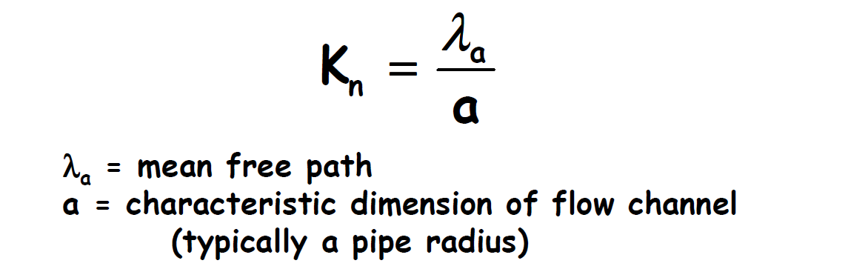
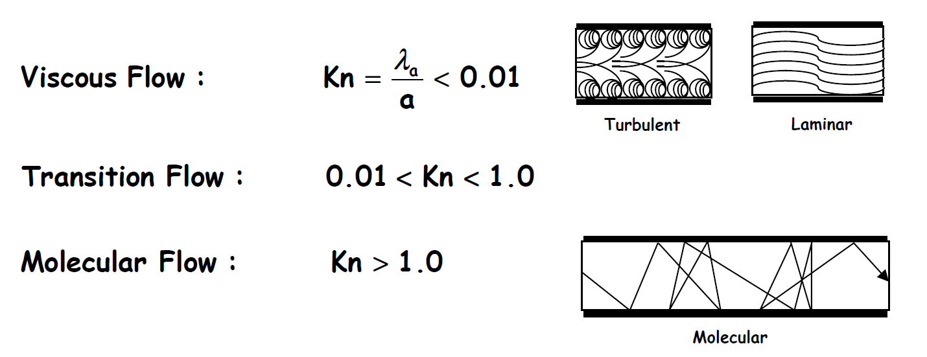
The gas in a vacuum system can be in a viscous state, in a molecular state (or in a transition state) depending on the dimensionless parameter know as the Knudsen number (K_{n}) that is the ratio between the mean free path and the characteristic dimension of the flow channel.
Viscous Flow
(momentum transfer
between molecules)
Molecular Flow
(molecules move
independently)
P> 1 mbar
P<10⁻³ mbar

Slide 7
Creation of Vacuum: pumping technology
1) Primary pumping systems: mechanical pumps that decrease the pressure from atmospheric pressure pressures close to the ultra-high vacuum (10⁻⁶-10⁻⁸ mbar)
- Rough pumps (atmospheric pressure down to 10⁻³ mbar): membrane pumps, rotary pumps, scroll pumps, roots pumps
- Turbomolecular Pumps (from the mbar to about 10⁻⁹ mbar )
2) UHV pumping systems: pumps that work at low pressure and, thanks to their efficiency, allow reaching/improving the ultra-high vacuum (10⁻⁶-10⁻¹¹ mbar).
- Ion Pumps (from 10⁻⁶ mbar to 10⁻¹¹ mbar)
- Getter Pump
- Titanium Sublimation Pump

Slide 8
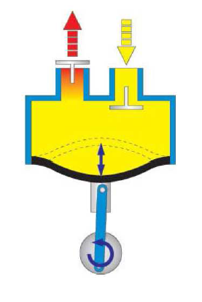
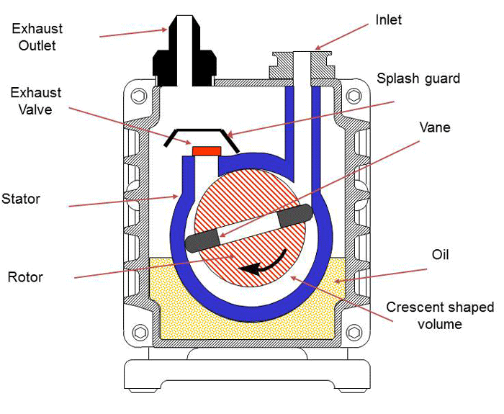
Rough pumps: membrane and rotary pumps
Membrane
Rotary
Combined movement of a diaphragm (plastic-rubber) and suitable valves (check, butterfly, flap valves)
Consists of vanes mounted to an eccentric rotor. The vanes rotate inside a cavity
Volume increased = fluid drawn into the chamber
Volume decreased = fluid forced out
Dry pumps
Can handle gas and liquids
The flow rate depends on the diaphragm diameter and its stroke length
Ultimate vacuum is in the mbar (larger pumps can reach 10⁻¹ mbar)
Vanes are sealed on all edges. The rotation generates a volume expansion (gas pumping)-reduction (exhaust release)
Oil pumps: oil and gas are mixed inside the pump and separated externally
Multiple stage pump can generate a good vacuum (down to 10⁻³ mbar)
Low efficiency but possibility to pump gas, gas + dust and water
Notes:
Of the various vacuum pump technologies, rotary vane pumps are considered wet, positive displacement pumps. They are often called “wet” pumps because the gas being pumped is exposed to oil used as a lubricant to help provide the seal.
For this reason, the oil is carefully selected and specially designed for the application. Positive displacement indicates that the pump works by mechanically trapping a volume of gas and moving it through the pump, creating a low pressure on the inlet side.
The entire assembly (Fig. 2) is machined and assembled with tight tolerances so that the gap between the top of the rotor and the stator wall (often referred to as the “Dou seal”) is approximately .025 mm (1.0 mils). This seal is filled with oil, providing a seal between the inlet and outlet sides. The oil is circulated from the oil reservoir into the pump interior and is exhausted through the exhaust valve with the pumped gas.

Slide 9
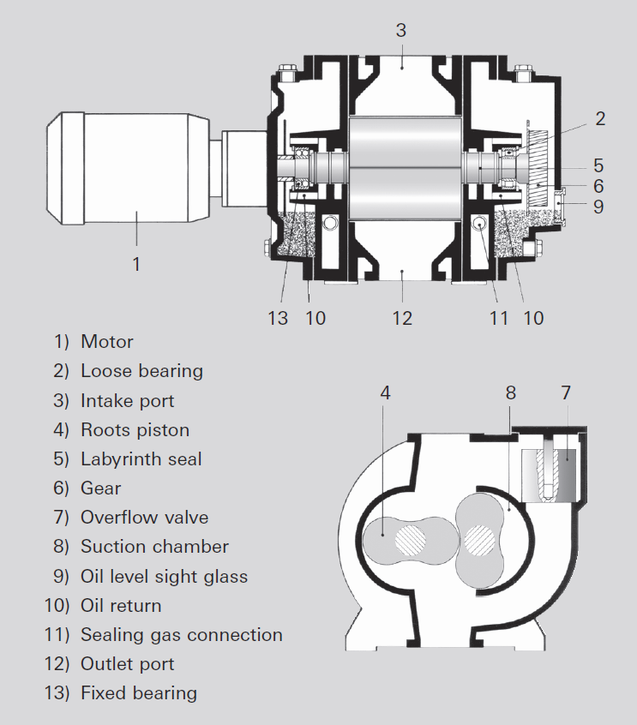
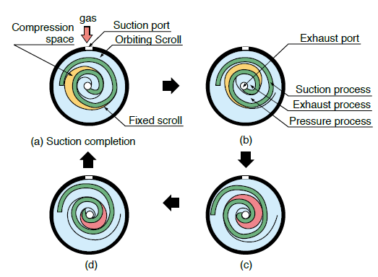
Rough pumps: scroll and roots pumps
Scroll
Roots
One of the scrolls is fixed, while the other orbits eccentrically without rotating. Compressing pockets of fluid form between the scrolls and are driven to the exhaust port
Dry pumps
High efficiency
Small gas pulsation, less vibrations
Difficult maintenance
Ultimate vacuum is in the 10⁻² mbar range
Two 8-shaped synchronously counter-rotating rotors rotate contactlessly ( small gap) in a housing
Dry pumps
Can generate a good vacuum (low 10⁻² mbar)
No friction in the suction chamber, operation at high speed, large flow rate

Slide 10
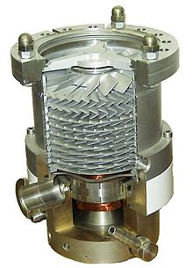
Turbomolecular pumps
A turbomolecular pump is used to obtain and maintain high vacuum.
These pumps work on the principle that gas molecules can be given momentum in a desired direction by repeated collision with a moving solid surface.
A rapidly spinning fan rotor (50000-100000 rpm) 'hits' gas molecules from the inlet of the pump towards the exhaust in order to create or maintain vacuum.

Slide 11
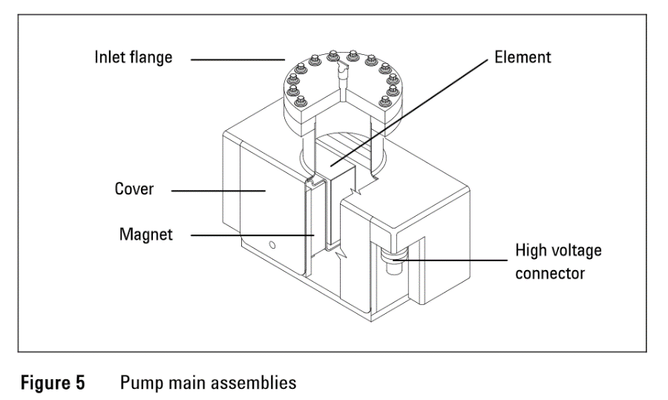
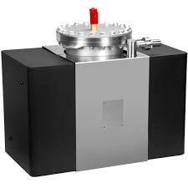
Ion pumps
An ion pump is a static pump capable of reaching pressures as low as 10⁻¹¹ mbar
Can be turned on only at pressures around (or less than) 10⁻⁴ mbar
A strong electrical voltage (typically 3–7 kV) is applied to the anode, producing free electrons. Electrons get caught by the magnetic field and rotate around it
Electrons hit gas molecules ionizing them
Positively charged molecules accelerates toward the cathode (grounded) at high velocity
The cathode is sputtered and titanium compounds deposit on the anode
The cathode acts as a getter (e.g. adsorbs inert gases)

Slide 12
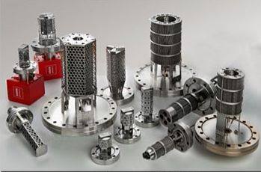
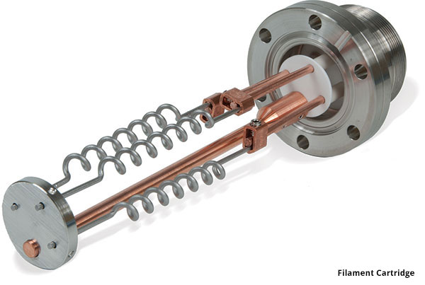
Getter and TSP
Non-evaporable getter
Titanium sublimation
Static pumps helping to establish and maintain ultra-high vacuum
Porous alloys or powder mixtures of Al, Zr, Ti, V and Fe, forming stable compounds with active gases
Can be placed in narrow/difficult to reach spaces (particle accelerators)
Activated by annealing to >550 K
Static pump helping to refine the vacuum
Titanium filament through which a high current (typically around 40 A) is passed periodically
Titanium sublimates and coats the surrounding chamber walls
Components of the residual gas in the chamber which collide with the chamber wall react with titanium to form stable, solid products

Slide 13
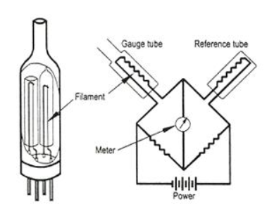
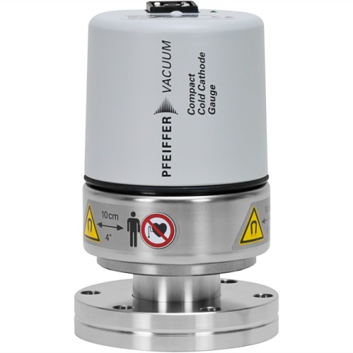
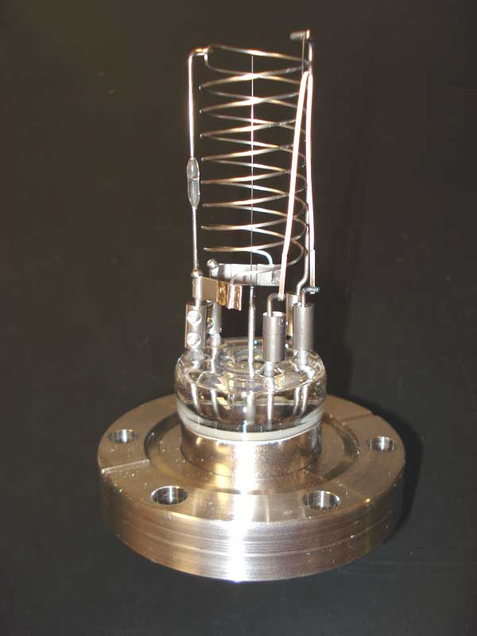
Vacuum measurement
Low vacuum: Pirani (atm. pressure – 10⁻⁴ mbar)
Two Pt filaments are the arms of a Wheatstone bridge and heated to a constant temperature
Residual gases conduct away part of the thermal energy of the measurement filament. The amount of electrical current needed to restore its temperature is converted to a pressure readout
High vacuum: cold cathode (10⁻⁴-10⁻⁹ mbar)
2 electrodes: anode, cathode + permanent magnetic field (works like a ion pump!)
High-Ultrahigh vacuum: hot cathode (10⁻⁴-10⁻¹¹ mbar)
3 electrodes: filament, collector, grid
The pressure is measured through a gas discharge in the gauge head. The gas discharge is obtained by applying a high voltage
The filament emits electrons, which are attracted to a polarized grid
Residual gas molecules are ionized by the electrons and attracted by the collector. Pressure reading is determined by the electronics from the collector current.

Slide 14
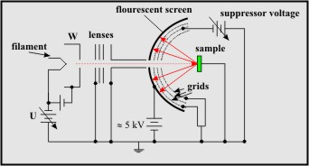
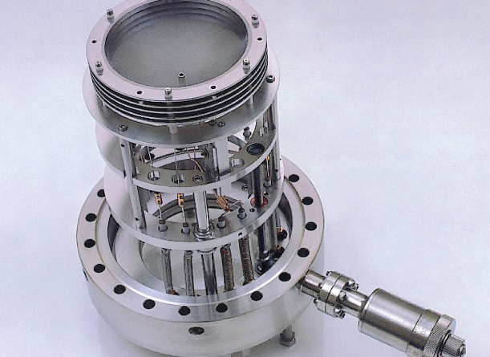
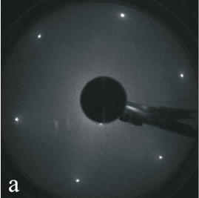
Some vacuum techniques (surface science studies) – General description
Electron-based techniques
X-ray and UV photoelectron spectroscopy (XPS and UPS), Auger electron spectroscopy → 23.10.2019, h 8:45, HCI D8
Low energy electron diffraction (LEED)
LEED instrument
1x1 reconstruction
Pt(111)
Electron beam (20-2000 eV) hits a single-crystalline material
Diffracted electrons are generated and hit a fluorescent screen: electrons impinging on an ordered surface are elastically scattered by it
Information on the symmetry of the surface structure – surface sensitive

Slide 15
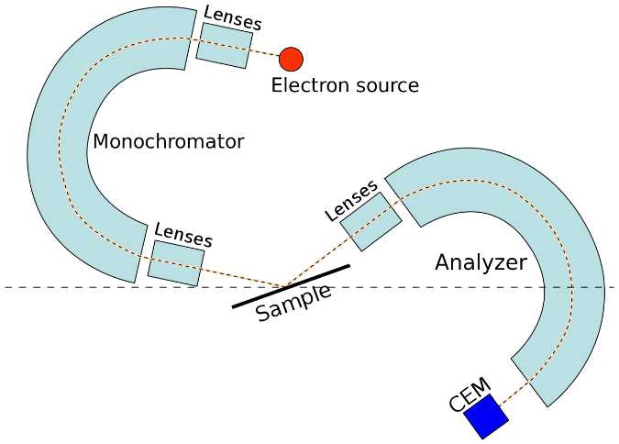
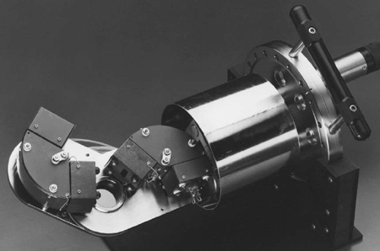
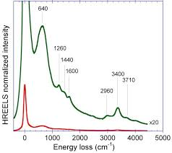
Typical vacuum techniques (surface science studies)
Electron-based techniques
High resolution electron energy loss spectroscopy (HREELS)
Elastic peak
HREELS instrument
Example of EEL spectrum
Electron beam (10⁻³-10 eV) with known energy hits the surface of a material
Electrons can excite the electronic structure of the sample or vibrational modes of adsorbates → energy loss of the electrons (inelastic scattering)
The analyzer measures the energy of the scattered electrons and the energy losses are evaluated
Surface properties of a sample learned from energy losses
Selection rule: change of the dipole moment perpendicular to the surface
Surface sensitive technique (a few nm)

Slide 16
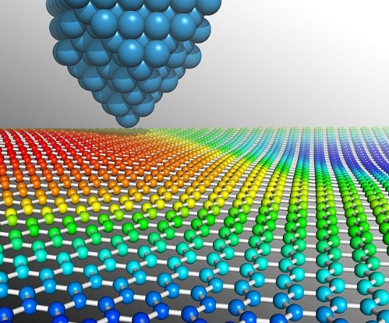
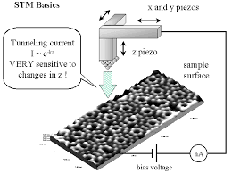
Typical vacuum techniques (surface science studies)
Temperature Programmed techniques
Temperature programmed desorption and reaction (TPD-TPD) → next topic
Scanning probe microscopy techniques
Scanning tunneling microscopy (STM)
A conductive tip is brought close to a surface and a bias is applied between the two
Electrons can tunnel in the vacuum
The measured tunneling current is a function of the tip position, applied bias and local density of states (LDOS)
The tip is scanned across the surface while monitoring the current and plotted as an image

Slide 17
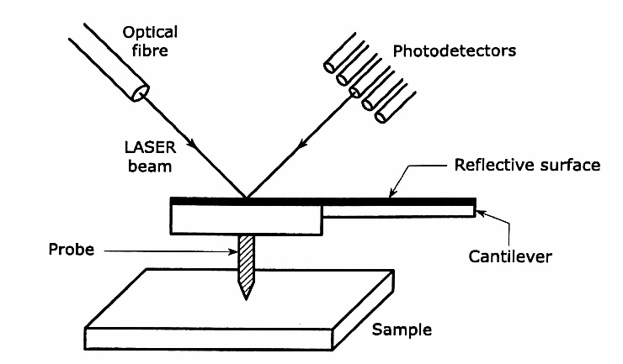
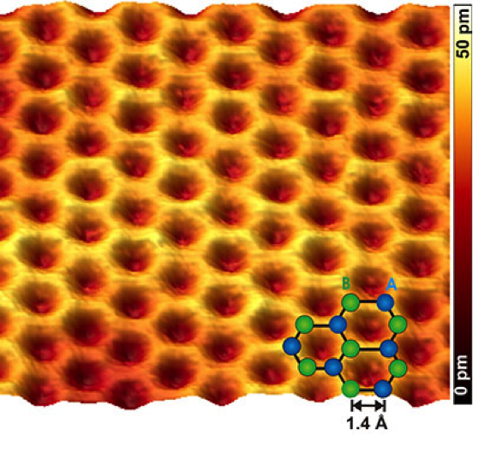
Typical vacuum techniques (surface science studies)
Scanning probe microscopy techniques
Atomic force microscopy (AFM)
A cantilever with a sharp tip is used to scan the sample surface
When the cantilever is brought close to the surface, forces (mechanical contact, van der Waals, capillary..) between the tip and the sample lead to a deflection of the cantilever
The deflection is measured by means of a laser projected on the cantilever and deflected by it to a photodetector
Can operate in contact mode (the tip drags the surface) or in non-contact mode (the cantilever oscillates at/near its resonant frequency and short contact forces experienced from the sample modify this vibration)

Slide 18
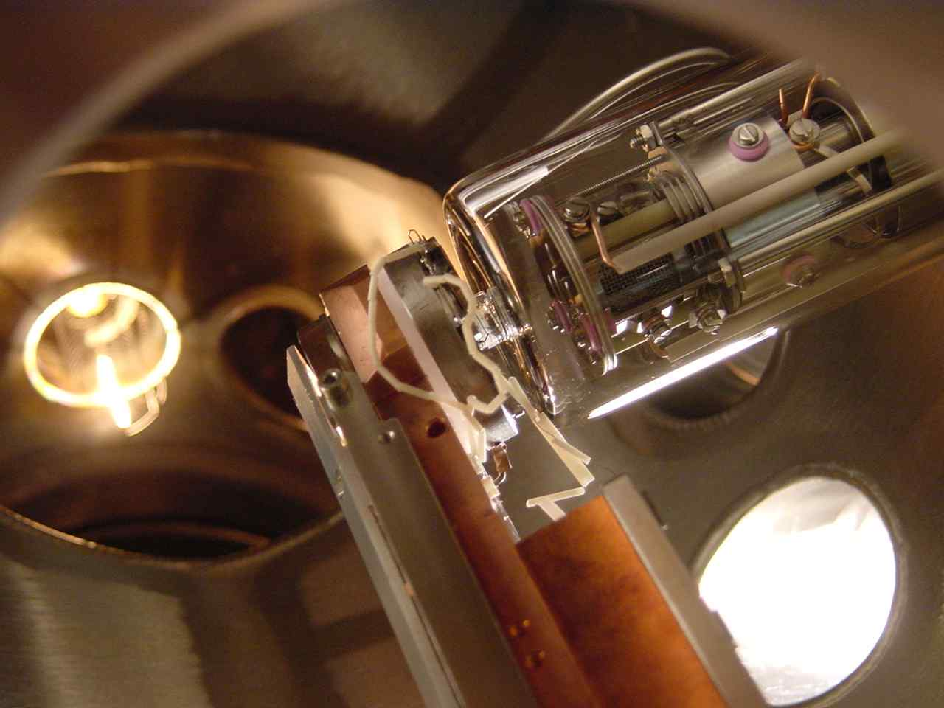
TPD
Temperature Programmed Desorption
Notes:
The Arrhenius equation is a formula for the temperature dependence of reaction rates. This equation has a vast and important application in determining rate of chemical reactions and for calculation of energy of activation. Arrhenius' equation gives the dependence of the rate constant of a chemical reaction on the absolute temperature, a pre-exponential factor and other constants of the reaction.
A is the pre-exponential factor, a constant for each chemical reaction. According to collision theory, A is the frequency of collisions in the correct orientation.
Surface coverage Θ = N_{ads}/N_{surf} (number of adsorbed particles/number of surface active sites available)

Slide 19
Temperature programmed desorption*
Ultra high vacuum can be used to study the adsorption/reaction of molecules on a surface (monolayer formation time in UHV 10³-10⁶ s). Discussion based on Langmuir ad-(de-)sorption isotherm
Langmuir Adsorption-Desorption
Adsorption is localized (adsorbed particles are immobile)
Substrate surface is saturated at Θ = 1 ML (all adsorption sites occupied)
No interactions between the adsorbed particles
Kinetics
If k (rate constant) is described by an Arrhenius eq.:
The rate law is then referred to as the Polanyi-Wigner equation:
ν_{n}: Pre-exponential factor
n: Desorption order
Θ: Surface coverage
E_{des}: Activation energy for desorption
*Resource for further reading: Temperature-Programmed Desorption (TPD). Thermal Desorption Spectroscopy (TDS), Sven L.M. Schroeder and Michael Gottfried, June 2002, available online.
Notes:
The Arrhenius equation is a formula for the temperature dependence of reaction rates. This equation has a vast and important application in determining rate of chemical reactions and for calculation of energy of activation. Arrhenius' equation gives the dependence of the rate constant of a chemical reaction on the absolute temperature, a pre-exponential factor and other constants of the reaction.
A is the pre-exponential factor, a constant for each chemical reaction. According to collision theory, A is the frequency of collisions in the correct orientation.
Surface coverage Θ = N_{ads}/N_{surf} (number of adsorbed particles/number of surface active sites available)

Slide 20
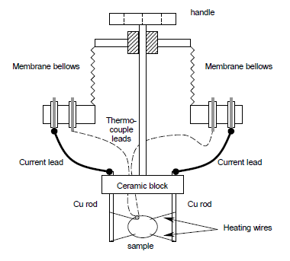
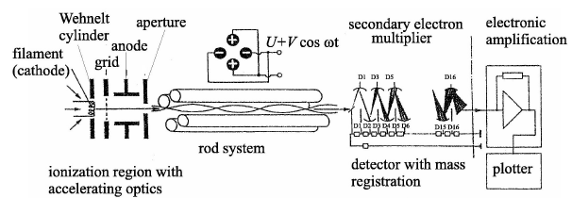
Temperature programmed desorption
A typical TPD experiment (UHV):
Clean sample surface exposed to a precise amount of gas (usually measured in Langmuirs – 1 L = 10⁻⁶ Torr · s)
Sample placed in front of a quadrupole mass spectrometer (QMS) and heated with a precise rate (β)
The quadrupole acts as a filter, separating ions with different m/z, which are then collected
A typical spectrum shows the intensity of a specific m/z vs. temperature
Notes:
The QMS consists of three components, (i) the ion source with electron impact ioniser and ion extraction optics, (ii) the actual quadrupole analyser consisting of four cylindrically rods, and (iii) the ion detector (electron multiplier). In the present experiment, the ions are generated by electron impact ionisation (as in most conventional mass spectrometers). Free electrons are formed by thermal emission from an electrically heated tungsten filament.
J = c exp(-Φ/kT)
J is the current density of emitted electrons, C a constant (independent of the filament material), T the temperature and Φ the work function of the filament material. It is intuitive to see that the emission current increases with the temperature. The emitted electrons are accelerated by a potential difference (typically 70 V) between the filament and the grid. Ionisation takes place in the area between grid and aperture, which are at approximately equal potentials. The temperature of the filament is in the range around 2500 K. The emitted electrons have a certain kinetic energy distribution due to the temperature of the filament, but also (more important) due to the electrical potential drop across the heated filament. The energy distribution is typically in the range 2 eV.
The quadrupole analyser consists of four cylindrical rods, arranged symmetrically at a distance r0(x,y) around the optical axis z of the system. Opposite rods are electrically connected. The voltage applied to the two pairs of opposite rods can be expressed as
V =U +V ⋅cos(ω ⋅t) 1
V = −(U +V ⋅cos(ω ⋅t)) 2
with a constant component U and a radiofrequency component V ⋅cos(ω ⋅t). The differential equations of motion for an ion in such a potential are known as Mathieu equations. Their analysis reveals that for a given ion (m/Ze) only certain values of U and V result in stable oscillatory trajectories, while for other values for U and V the amplitude of the oscillations increases exponentially, so that the ion will strike a rod and lose its charge. Note that particles are separated according to their mass/charge ratio m/Ze; doubly ionised paticles thus appear in the spectrum at half their molecular mass, triply charged ions at one third, etc. By this method, molecules with molecular masses of over 1000 can be detected even if the mass spectrometer has a maximum range of, e.g., 300 amu. Apart from the isotope pattern of the molecular ion one can also observe products of ion fragmentation processes. The simplest way of detecting ions or electrons is via the detection of their charges. In simple quadrupole mass spectrometers the ions hit a metallic collector cone (Faraday cup) and the
charge transferred is recorded using an electrometer preamplifier, which can detect currents down to a the pA-range. For even lower ion currents (i.e., for less than 107 ions per second), one uses secondary electron multipliers or channeltron multipliers.

Slide 21
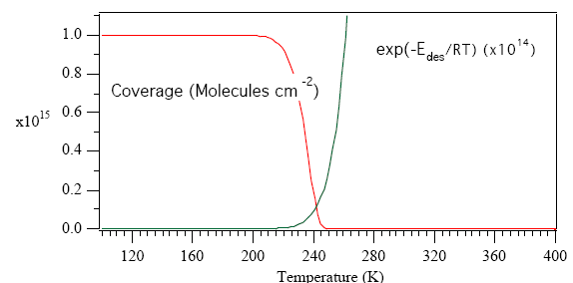
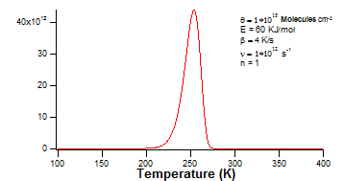

Temperature programmed desorption
If the pumping rate is faster than the desorption rate (no readsorption) a series of separated peaks can be recorded (each of them corresponding to a surface desorption process)
T_{m}
~$e^{(\frac{−E_{des}}{RT})}$
~Θ^{n}
Pressure drop gives information about the order of the desorption process
Initial increase is mainly determined by E_{des}
A TPD experiment can give important information:
Heat of desorption
Surface coverage (quantification of the monolayer)
Surface reactivity (gas-substrate interaction, adsorption sites)
Kinetics of desorption

Slide 22
Temperature programmed desorption
Spectral interpretation is most commonly performed using the Polanyi-Wigner equation
In a TPD experiment β is the heating rate, defined as β = dT/dt = const. Thus dt = dT/β can be substituted in the equation to give
When T = T_{max}
This equation can be used to obtain ΔE_{des} from TPD spectra (see the next slides)

Slide 23
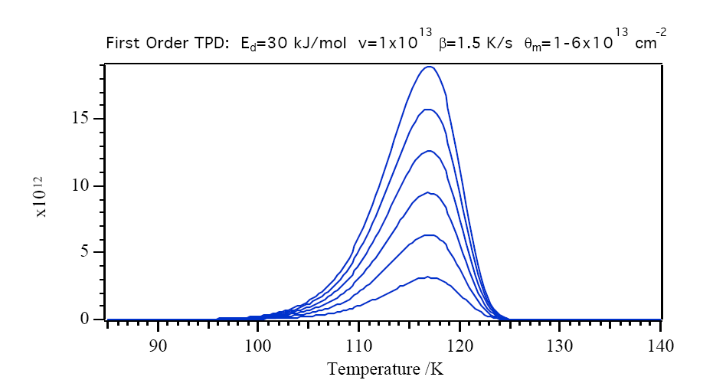
First order kinetics (molecular)
Spectra obtained at different Θ
The desorption peak areas depend on Θ
The desorption peaks are asymmetric
T_{m} constant with increasing Θ
T_{m} increases with ΔE_{des}

Slide 24
First order kinetics: approximate evaluation of ΔE_{des}
In 1962 Redhead, assuming that activation parameters are independent of surface coverage and that desorption followed 1st order kinetics, derived a simple equation.*
Solving this equation for ΔE_{des} gives:
The second part in the brackets is small relative to the first, and can be approximated to 3.64 (error is less than 1.5% for 10⁸ < ν/β < 10¹³ K⁻¹)
T_{m} and β are determined experimentally
The activation energy from a single desorption spectrum can be estimated using an approximate value for ν. ν = 10¹³ s⁻¹ is a commonly chosen value.
.
As an example: in this case T_{m}= 117 K.
Assuming ν=1.0·10¹³ s⁻¹ and β=2 K/s
ΔE_{des}= 29.5 kJ/mol
T_{m}
*P. A. Redhead, Vacuum 12, 203-211 (1962).

Slide 25
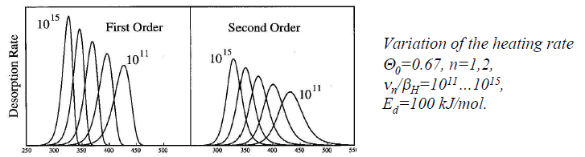
First order kinetics: approximate evaluation of ΔE_{des} from curves having different β
A series of spectra for the same Θ is acquired employing different β = dT/dt = const. From each spectrum, the temperature of the desorption rate maximum T_{m} is determined
Taking the ln and rearranging..
Plotting of ln(T²_{m}/β) vs. 1/T_{m} for a series of β values provides ΔE_{des} from the slope and ν from the intercept with the ordinate
.

Slide 26
Second order kinetics (recombinative desoprtion)
Spectra obtained at different Θ
T_{m} shifts with increasing Θ
Characteristic nearly symmetric peak shape with respect to T_{m}
Θ(T_{m}) is a half of the value before desorption
.
dividing by the units and rearranging we obtain:
Plotting the ln(T²_{m}/β) vs. 1/T_{m} for a series of β values provides ΔE_{des} from the slope and (if Θ is known) ν from the intercept with the ordinate

Slide 27
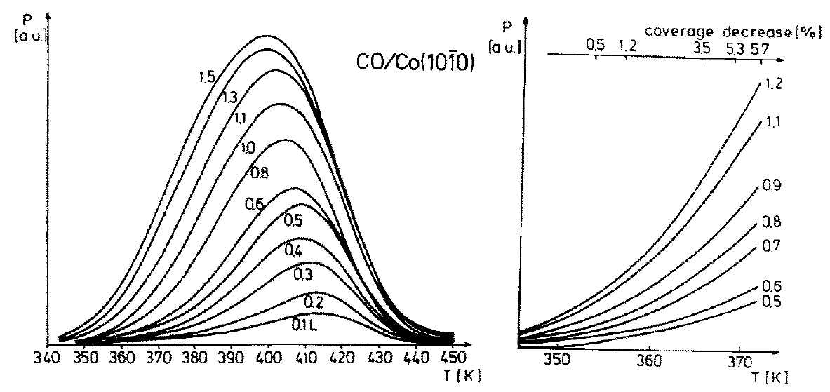
Leading edge analysis
But the activation parameters often depend on the coverage and temperature!
Increasing Θ, T_{m} shifts negatively due adsorbate-adsorbate interactions
Leading edge
.
Habenschaden and Küppers leading edge method*
Leading edge: Θ almost unchanged
The rate of desorption is evaluated from each single leading edge
ln(r_{des}) plotted vs. 1/T. The slope gives ΔE_{des} and the intercept with y gives ν
*E. Habenschaden, J. Küppers, Surf. Sci. 138, L147 (1984).

Slide 28
An example of TPD applied to the study of a catalytic reaction

Slide 29
Carbon monoxide oxidation on a Pt foil

Slide 30
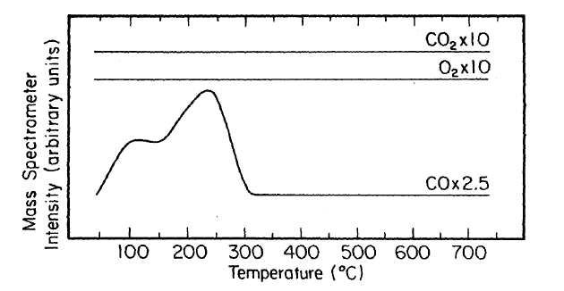
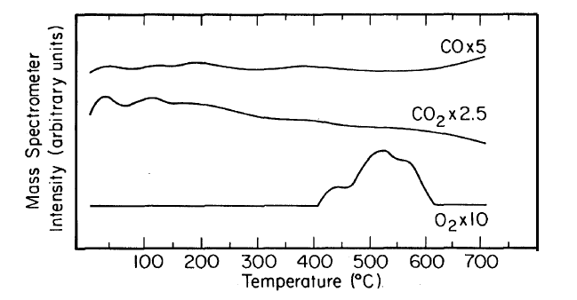
CO and O₂ desorption
Procedure: 50 L of gas dosed on the clean foil at RT. Sample heated from RT to 700°C with β=10 K/s
Molecular adsorption (first order)
Two main desorption peaks (a foil is polycristalline) at ca. 110 and 225°C
Dissociative adsorption (recombinative desorption process)
Multiple desorption peaks at higher temperature than for CO (larger ΔE_{des})

Slide 31
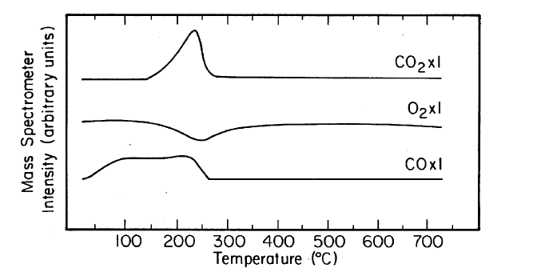
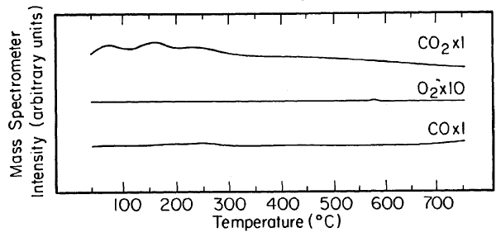
Temperature programmed reaction (TPR)
Procedure: 50 L of CO dosed on the clean foil at RT. Sample heated from RT to 700°C with β=10 K/s while flowing 3·10⁻⁷ Torr of O₂.
Sample surface saturated with CO
CO desorption peaks intensity decreases
As the CO starts to desorb, the partial pressure of O₂ decreases and the signal of CO₂ increases
Procedure: 50 L of O₂ dosed on the clean foil at RT. Sample heated from RT to 700°C with β=10 K/s while flowing 3·10⁻⁸ Torr of CO.
Sample surface saturated with O₂
CO₂ is produced immediately, but its signal goes down above 300°C
CO₂ production correlated with CO desorption

Slide 32
In case of E-R mechanism the reaction should start immediately after introducing one of the reagents (in the presence of the other adsorbed)
In both TPR experiment CO₂ production correlates with the presence of both reagents on the sample surface
TPR performed after CO pre-adsorption clearly demonstrates competition between the reagents for the adsorption sites (especially reaction at high temperature). CO is blocking the adsorption sites (poisoning effect), and some energy (temperature) is required to remove part of it and allow oxygen to adsorb and split
TPR performed after O₂ pre-adsorption clearly demonstrates that adsorbed CO is necessary for CO₂ formation (no more CO₂ formed above 300°C
These model experiments support the hypothesis that a L-H mechanism operates, in good agreement with the literature

Slide 33
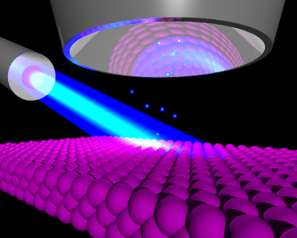
XPS
X-ray Photoelectron Spectroscopy
Resource for further reading: Surface Analysis by Auger and X-ray Photoelectron Spectroscopy, D. Briggs, J.T. Grant, eds., IM Publications and SurfaceSpectra Ltd., 2003
Photoelectron Spectroscopy, Principles and Applications, S. Hüfner, eds. Springer-Verlag Berlin Heidelberg 1995,1996,2003.

Slide 34

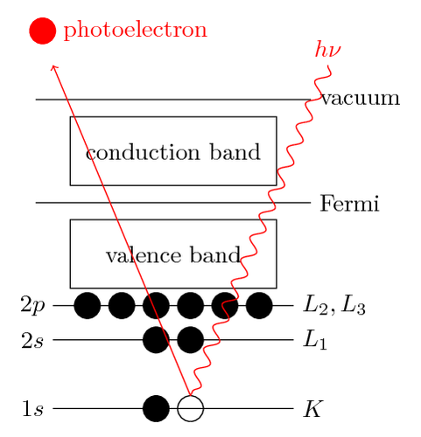

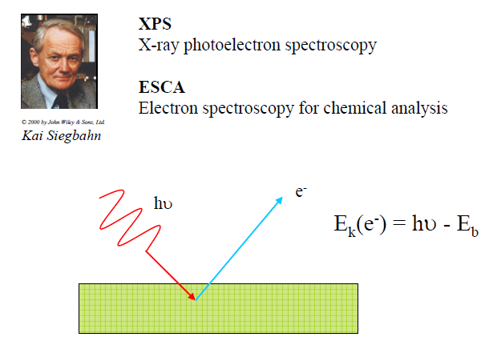

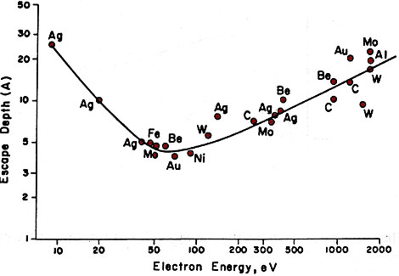
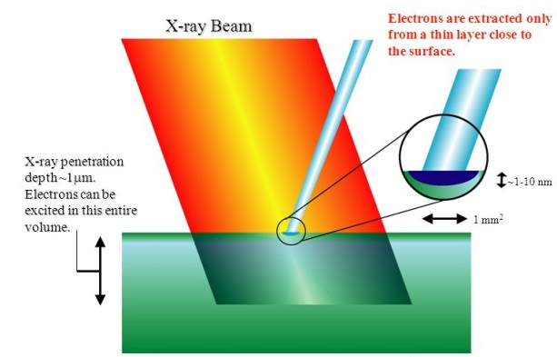
What is XPS?
Nobel prize (physics) 1981
Nobel prize (physics) 1921
Photoelectric Effect
Albert Einstein
Binding energy!
The binding energies are characteristic of specific electron orbitals in specific atoms
XPS lines are identified by the shell from which the electron is emitted
Photoelectrons can escape only a few nm (this depends on their KE)
Surface sensitive!
Notes:
Electrons are dislodged only by the impingement of photons when those photons reach or exceed a threshold frequency (energy). Below that threshold, no electrons are emitted from the material regardless of the light intensity or the length of time of exposure to the light (rarely, an electron will escape by absorbing two or more quanta. However, this is extremely rare because by the time it absorbs enough quanta to escape, the electron will probably have emitted the rest of the quanta.). To make sense of the fact that light can eject electrons even if its intensity is low, Albert Einstein proposed that a beam of light is not a wave propagating through space, but rather a collection of discrete wave packets (photons), each with energy hν. This shed light on Max Planck's previous discovery of the Planck relation (E = hν) linking energy (E) and frequency (ν) as arising from quantization of energy. The factor h is known as the Planck constant.
In 1887, Heinrich Hertz discovered that electrodes illuminated with ultraviolet light create electric sparks more easily. In 1900, while studying black-body radiation, the German physicist Max Planck suggested that the energy carried by electromagnetic waves could only be released in "packets" of energy. In 1905, Albert Einstein published a paper advancing the hypothesis that light energy is carried in discrete quantized packets to explain experimental data from the photoelectric effect. This model contributed to the development of quantum mechanics. In 1914, Robert Millikan's experiment supported Einstein's model of the photoelectric effect. Einstein was awarded the Nobel Prize in 1921 for "his discovery of the law of the photoelectric effect", and Millikan was awarded the Nobel Prize in 1923 for "his work on the elementary charge of electricity and on the photoelectric effect".

Slide 35
XPS in a nut-shell
X-ray photoelectron spectroscopy (XPS) is a classical method for the semiquantitative analysis of surface composition
It is also referred to as Electron Spectroscopy for Chemical Analysis (ESCA)
It is based on the photoelectric effect, i.e., emission of electron following excitation of core level electrons by photons
It is surface sensitive because of the low inelastic mean free path of electrons
An XPS setup consists of a X-ray source, a sample chamber and an electron analyzer
XPS requires a source of X-rays, i.e., either from a lab-based anode or from a synchrotron
Traditionally, XPS works only in ultrahigh vacuum because of scattering of electrons in gases
XPS can also be performed in the mbar pressure range

Slide 36
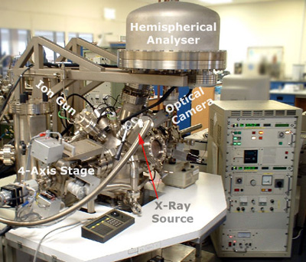
This is a lab based XPS instrument

Slide 37
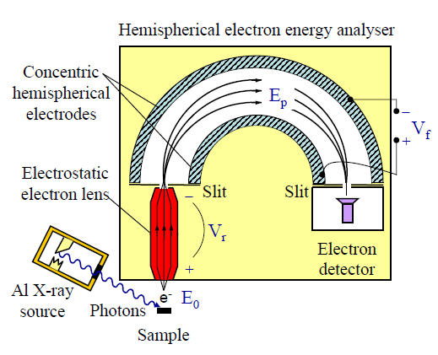
Electron energy analyzer
The most often used type of electron kinetic energy analyzers is composed of an electrostatic lens and a hemispherical analyzer
Electrostatic lens decelerates electrons to a fixed (pass) energy in the range of a few to 100 eV and at the same time focusses them on an entrance slit of the hemispheric analyzer
Electrons travel between two concentric hemispheres with a constant potential difference and reach a detector with one dimension aligning a small kinetic energy range
A spectrum is obtained by sweeping the lens electric field to cover specific kinetic energy ranges of the photoelectrons
Operation of an electron analyzer requires high vacuum to avoid scattering losses of electrons and to protect the detector
Notes:
Potential of mean path through analyzer is
V0 =V1R1 + V2R22R0
An electron of kinetic energy eV = V0 will travel a circular orbit through hemispheres at radius R0. Since R0, R1 and R2 are fixed, in principle changing V1 and V2 will allow
scanning of electron KE following mean path through hemispheres.
Total resolution of instrument is convolution of x-ray source width, natural linewidth of peak, analyzer resolution. Analyzer FWHM is really only one we can control
Resolution (R= DeltaE/E) defines ability to separate closely spaced photoemission peaks (important for determining chemical shift):
To achieve constant resolution over full kinetic energy range: retardation of electrons to fixed kinetic energy before entry into hemisphere: pass energy:
Easiest way is to retard electrons entering energy analyzer to fixed KE, called
the pass energy E0, so that fixed resolution applies across entire spectrum
DeltaE/E0=s/2R0, s= slit width
Using electrostatic lens system to retard electrons to pass energy and focus them on entrance slit of hemisphere.
To record a spectrum over a range of initial excitation energies it is necessary to scan the voltages applied to these transfer lenses and the prescription for these lens voltages is known as the set of lens functions. These lens functions are typically stored in some configuration file used by the acquisition system.

Slide 38
The photoemission process
Photoelectron
Kinetic energy
E_{V}
Φ
E_{F}
Valence band
Binding energy
Core hole
Photon
Core levels
KE = hν – BE – Φ for a solid
KE = hν – IP for a gas
Φ : photoelectric workfunction
Notes:
Clearly from picture above,
- no photoemission for hν < Φ
- no photoemission from levels with BE + Φ> hν
- KE of photoelectron increases as BE decreases
- intensity of photoemission increases with intensity of photons
- need monochromatic (x-ray) incident beam
- a range of KE's can be produced if valence band is broad
- since each element has unique set of core levels, KE's can be used to fingerprint element

Slide 39
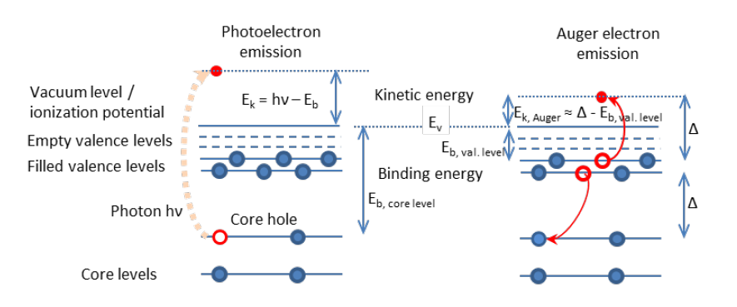
Fate of core hole
Auger electron emission
or
X-ray fluorescence
Photoemission
Relaxation
Notes:
Auger electrons
Result from excess energy of atom during relaxation (after core hole) creation
always accompany XPS
broader and more complex structure than photoemission peaks, because of different valence levels involved and secondary effects
Nomenclature: ABC, with A: level of initial core hole, B: level from which A is filled, C: level from which Auger electron is emitted.
Example: KLL
KE of Auger electrons are independent of incident photon energy: KE_{ABC} = BE_{A} – BE_{B} – BE_{C}*.
BE_{C}* is slightly different from BE_{C} because of the hole in level B
Auger spectra are sensitive to chemistry, because of the involvement of outer shells.

Slide 40
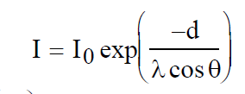
Why is XPS surface sensitive? XPS probe depth
E_{kin} = hν-BE-φ
X-ray photons can penetrate μm but…
Only photoelectrons from the first layers can escape without energy loss
Inelastic mean free path (λ) and probing depth strongly depends on the kinetic (and thus photon) energy
Depth profiles can be obtained either by varying the incident photon energy (tunable x-ray source) or by varying the detection angle (θ)
Contribution to the photoelectron signal from atoms below the surface decreases exponentially
In normal emission 95% of the signal comes from a 3λ depth
X-ray
E_{kin} = hν-BE-φ-Δ
Θ
e–
d
Contribution of atom in depth d to PE peak:
Notes:
XPS spectra show characteristic "stepped" background (intensity of
background to high BE of photoemission peak is always greater than low BE)
Due to inelastic processes (extrinsic losses) from deep in bulk
Only electrons close to surface can, on average, escape without energy
loss
Electrons deeper in surface loose energy and emerge with reduced KE,
increased BE
Electrons very deep in surface loose all energy and cannot escape

Slide 41
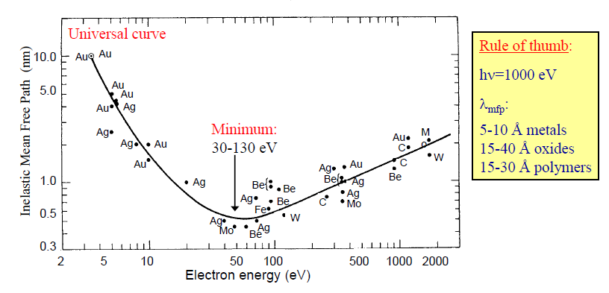
Electron inelastic mean free path

Slide 42
Inelastic background
E_{kin} = hν-BE-φ
Photoelectrons from deeper layers lose part of their energy (inelastic collisions) and are emitted with reduced KE (> BE)
XPS spectra show characteristic "stepped" background (intensity of background towards higher BE of photoemission peak is always larger than towards lower BE)
X-ray
E_{kin} = hν-BE-φ-Δ
Θ
e–
d
2s
2p
3s
3d
1000 Binding energy (eV) 0
0 Kinetic energy (eV) 1000
Notes:
XPS spectra show characteristic "stepped" background (intensity of
background to high BE of photoemission peak is always greater than low BE)
Due to inelastic processes (extrinsic losses) from deep in bulk
Only electrons close to surface can, on average, escape without energy
loss
Electrons deeper in surface loose energy and emerge with reduced KE,
increased BE
Electrons very deep in surface loose all energy and cannot escape

Slide 43
A photoelectron spectrum in more detail
O 1s
Ti 2p_{3/2}
TiO₂ Survey
hv=730 eV
Peak shape
Spin-orbit splitting
Ti 2p_{1/2}
Auger peaks
Ti 2s
Ti LMM
Ti L_{2,3}M_{2,3}V
Auger peaks
Shake-up
C 1s
O KLL
Ti 3p
Background shape
Ti 3s
O 2s
VB
Binding energy scale (eV)
Notes:
Photemission process often envisaged as three steps
(i) Absorption and ionization (initial state effects)
(ii) Response of atom and creation of photoelectron (final state effects)
(iii) Transport of electron to surface and escape (extrinsic losses)

Slide 44
Spin-orbit splitting
n: principal quantum number
l: orbital angular momentum quantum number
s: spin angular momentum quantum number
j =|l ± s|: total angular momentum quantum number
For l = 0, s levels are singlets, no splitting
For l > 0, p,d,f levels give rise to doublets. The spin angular momentum of electrons left in an orbital couple with the angular momentum vector
The degeneracy 2j + 1 determines the possibility for parallel and anti-parallel pairing
The ratio between the degeneracies (R), (2j₊+1)/(2j₋+1), determines the relative peak ratio of the two peak components.
ΔE between two components = spin orbit splitting.
Magnitude of spin-orbit splitting increases with Z and decreases with distance from nucleus (same energy level, ΔE increases with decreasing l)
l = 0 .. s
1 .. p
2 .. d
3 .. f
n
2p_{3/2}
j = l - s
j = l + s
Notes:
Spin orbit splitting increases with atomic number
ΔE increases with Z (n and l constant). ΔE increases with decreasing l (n constant). Same energy level, different orbitals, ΔE p>d>f. Outer orbitals have smaller spin-orbit splitting.

Slide 45



Core level chemical shifts
Position of orbitals in atom is sensitive to its chemical environment
Chemical shift correlated with overall charge on atom (more positive charge = increased BE)
  number of substituents
  substituent electronegativity
  formal oxidation state (depending upon ionicity/covalency of bonding)
Chemical shift analysis is powerful tool for chemical composition, functional group and oxidation state analysis
Citric acid
Notes:
Note: Spin-orbit splitting is approximately constant - confirming SOS is largely an initial state effect
Chemical shift information very powerful tool for functional group, chemical enviroment, oxidation state
Cations → electrons are removed. The electrons left experience a larger attraction for the nucleus. It is more difficult to withdraw an electron from a cation! Photoemitted electrons from a cation will have a lower KE, thus a higher BE.

Slide 46


Secondary structure of a spectrum
Interaction of the photoemitted electron (along its trajectory) and the remaining electrons: final state effects (satellite peaks)
Shake-up. An electron of the VB can be excited. The energy of this excitation will be deducted from the kinetic energy of the photoelectron. Relevant in metals, in which the valence and conduction bands overlap, empty states are available at very low excitation energies
Simultaneous excitation of a specific wave mode in the sample (e.g. surface plasmons). The kinetic energy loss is hω_{s} (ω_{s} is the plasmon frequence), and will repeat at multiples of ω_{s}

Slide 47

Secondary structure of a spectrum
Multiplet splitting. Arises when an atom contains unpaired electrons (e.g. Cr³⁺, 3p⁶3d³). During the photoemission process, there can be coupling between the unpaired electron in the core with the unpaired electrons in the outer shell. This can create a number of final states, which will be seen in the photoelectron spectrum as a multi-peak envelope. This creates different final states, depending on the orientation of the spin of the unpaired electrons
Cr 2p_{3/2}

Slide 48
Estimate of the signal intensity
Contribution of element A at depth d to photoemission signal
Concentration of
element A at depth d
Analyzer transmission
Angular acceptance
Photon flux
Attenuation from depth d at detection angle θ
Subshell ionization
cross section
Cross section - σ(KE) - is the probability to have the photoemission event
10¹⁵ atoms cm⁻² (equivalent to a monolayer) lead to about 10⁻³ photoelectrons per incident photon
Typical photon flux: 10¹² s⁻¹, leads to about 10⁹ photoelectrons s⁻¹
Notes:
Calculations indicate maximum si,j is ~ 10-18 cm2
If 1 ML contains 1015 atoms·cm-2, should get about 10-3 photoelectron per
incident photons (1015 ´ 10-18)
If x-ray source flux is 1012 photons·s-1, should produce about 109
electrons·s-1 from 1 ML
For most elements, sensitivity is 0.1-1 % ML (º subnanomolar)
Observations:
si,j for C in CF4, CH4, graphite… is identical
Each subshell has different si,j - different sensitivity
Low Z elements have low si,j implies lower sensitivity

Slide 49





Ambient pressure x-ray photoelectron spectroscopy
But…XPS is historically bound to high – ultra-high vacuum
Pressure gap
Material gap
APXPS has partially filled the gaps!*
XPS up to 5 mbar (soft x-rays)
and 50 mbar (tender x-rays)
Possibility to investigate “real” samples (powders, semiconductors)
*O. Karslıoğlu, H. Bluhm, in Operando Research in Heterogeneous Catalysis, Vol. 114, Springer Series in Chemical Physics pp 31-57.
Notes:
<MED>_{avg} = 2/π · IMFP

Slide 50

Depth profile
If a tunable X-ray source (from a synchrotron) is available, a given electronic level can be excited with varying photon energies, resulting in varying photoelectron kinetic energies. Since the IMFP monotonously increases with increasing kinetic energy above about 100 eV, XPS can be used to obtain depth profiles of elements or their chemical state.
Au⁰
Oxidation of Au exposing a gold foil (T=373 K) to 0.3 mbar O₃ (1%) in O₂
New component in the Au 4f spectrum, associated with cationic gold
The appearance of a O 1s peak confirms that a Au-O bond forms
Au^{δ+} intensity is maximum at hν=175 eV, and decreases with increasing excitation energy (surface cationic gold)
Au^{δ+}

Slide 51

Depth profile
The Au^{δ+}/Au⁰ ratio can be plotted vs. kinetic energy (→IMFP)
It decreases demonstrating that the oxide stays at the surface
The experimental data can be fitted with a function reproducing the attenuation of the photoemission signal either in a uniform oxide layer (thickness t – straight line) or in patches of oxide overlayer (dashed line) supported on a semi-infinite metallic support
t=0.3 nm suggests that a O-Au-O trilayer forms at the surface

Slide 52


Characterization of the solid-gas interface (SLS-PSI)
Solid-gas interface endstation @X07DB*
Flow tube configuration
Heated sample holder. Sample powder pressed, dispersed in ethanol and drop-casted on a gold foil
Fast heating (e.g. from RT to stable 300°C in a few seconds)
*F. Orlando, et al. Top. Catal. 2016, 59, 591.
Notes:
<MED>_{avg} = 2/π · IMFP

Slide 53

1) Carbon monoxide oxidation on Pt/CeO₂
Metal NPs (Pt, Pd, Au) supported on reducible oxides showed the best performance in the low temperature oxidation of carbon monoxide*
For CeO₂: adsorption and activation of oxygen preferentially occur on the support, whereas carbon monoxide is adsorbed and supplied by the metal#
Under catalytically relevant conditions: rapid reoxidation of ceria.
Ce³⁺ generated in the catalytic cycle is difficult too short lived to be detected under steady state conditions.
Studies employing time-resolved techniques are required to gather more information about the evolution of the active sites and their role in the reaction mechanism
* I. X. Green, et al., Science 2011, 333, 736. M. Cargnello, et al., Science 2013, 341, 771. J. Saavedra, et al., Science 2014, 345, 1599.
# R. Kopelent, et al., Angew. Chem. Int. Ed. 2015, 54, 8728.
Page 53
Notes:
<MED>_{avg} = 2/π · IMFP

Slide 54

Carbon monoxide oxidation on Pt/CeO₂
Time-resolved RXES of Pt(1.5%)/CeO₂ (ca. 1.2 nm diameter Pt NPs on powdered ceria) – oxygen excess (1%CO, 4% O₂)*. Pulsed experiment: from CO+O₂ to CO+inert
The Ce³⁺ concentration increases, thus oxygen from ceria participates in the oxidation of carbon monoxide.
The initial rate of ceria oxidation is >10 times higher than that of reduction. Active Ce³⁺ is short lived
Presence of spectator Ce³⁺ (not involved in the catalytic process) – probably formed during pretreatment of catalyst.
OPEN ISSUES
What is the effect of the activation in hydrogen?
Are the active sites located at the metal/oxide interface? Exploit the surface sensitivity of XPS.
* R. Kopelent, et al., Angew. Chem. Int. Ed. 2015, 54, 8728.
Notes:
<MED>_{avg} = 2/π · IMFP

Slide 55



Carbon monoxide oxidation on Pt/CeO₂: experimental results
Pressure in the flow tube stabilized (root pump) at 1.0 mbar
Switch on/off the oxygen while acquiring (CO:O₂ = 1:4)
Oxygen replaced by nitrogen, same pressure and stable m/z signals in ca. 10-15 seconds
Gas line
Flow tube
To root pump

Slide 56

Carbon monoxide oxidation on Pt/CeO₂: experimental results
Activation of the sample in hydrogen (150°C, 1 hour, p=1.0 mbar)*
Ce 3d acquired from 2.2 to 5.0 keV photon energy range
*L. Artiglia, et al. J. Phys. Chem. Lett. 2017, 8, 102.

Slide 57

Carbon monoxide oxidation on Pt/CeO₂: experimental results
Activation of the sample in hydrogen (150°C, 1 hour, p=1.0 mbar)
Ce 3d acquired from 2.2 to 5.0 keV photon energy range
The peaks can be separated into 5 d doublets#, associated to different final state configurations:
v⁰ and v^{I} are associated to Ce³⁺.
v, v^{II} and v^{III} are associated to Ce⁴⁺.
*L. Artiglia, et al. J. Phys. Chem. Lett. 2017, 8, 102.
#P. Burroughs, et al. J. Chem. Soc., Dalton Trans. 1976, 17, 1686-1698.
Notes:
v⁰ and v^{I} are associated to 3d⁹4f² O 2p⁵ and Ce 3d⁹4f¹ O 2p⁶ (Ce³⁺).
v, v^{II} and v^{III} are associated to Ce 3d⁹4f² O 2p⁴, Ce 3d⁹4f¹ O 2p⁵ (shake-down/energy gain states) and 3d⁹4f⁰ O 2p⁶ (Ce⁴⁺)

Slide 58

Carbon monoxide oxidation on Pt/CeO₂: experimental results
Enhancement of the Ce³⁺/Ce⁴⁺ ratio at low photon energy
Higher concentration of Ce³⁺ sites is found at the surface*
On Pt free ceria (red dot) small amount of Ce³⁺ detected only at 2.2.kev
Simple model (exp. distribution) used to fit the experimental data and quantify the depth of reduction of ceria on Pt/CeO₂:#
t = 1.0 nm: Ce³⁺ sites are located in the outer layers of the ceria support, oxygen does not diffuse from the bulk to the surface.
* S. Kato, Phys.Chem.Chem.Phys., 2015, 17, 5078.
# A. Cimino, et al. J. Electron Spectrosc. Relat. Phenom. 1999, 104, 1.
Notes:
Semi-infinite specimen, our ceria support, with a uniform overlayer of thickness t, representing the reduced ceria layer

Slide 59


Carbon monoxide oxidation on Pt/CeO₂: experimental results
Fast scans (1 scan ̴ 20’’) of the Ce 3d_{5/2} at hν=2200 eV acquired immediately after switching from CO/O₂ to CO/N₂
The 3d_{5/2} peak shape modifies between 80 and 160 seconds

Slide 60
Carbon monoxide oxidation on Pt/CeO₂: experimental results
The Ce³⁺/Ce⁴⁺ ratio increases significantly between 80 and 160 seconds (2200 eV)
Same experiment at 3000 eV shows only weak positive oscillations
Catalytically involved Ce³⁺ is at the surface
A constant background of Ce³⁺ is visible throughout the experiment
Spectator sites: formed after the activation, do not participate in the activation of oxygen

