Slide 1
The role of knowledge interdependence in collaborative (STEM) learning
Latsis Symposium 2021, Session 7:
STEM-​Learning through co-​construction of knowledge with computer support
ETH Zurich, September 7, 2021
Prof. Dr. Anne Deiglmayr
University of Leipzig, Germany

Slide 2
Main Points
Dialogue with peers can boost STEM learning.
Productive peer dialogue typically is transactive dialogue.
Educators can motivate and support productive peer dialogue via collaboration scripts.
One popular type of collaboration script, Jigsaw, works by distributing learning resources,
thus creating knowledge interdependence.
BUT…
  Jigsaw is less effective than one might think given its popularity.
  Knowledge interdependence with regards to core concepts may hinder transactive dialogue.
  Jigsaw should be applied with caution, with core concepts NOT distributed between learners.
Notes:
…none of this is specific to either STEM learning, or to computer-supported collaborative learning, but it applies to both

Slide 3
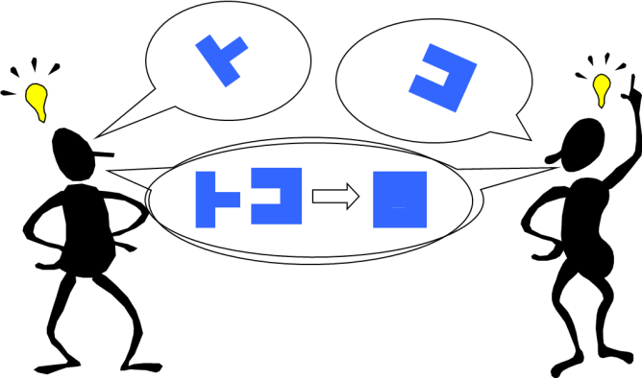
Productive Peer Dialogue is transactive
transactive dialogue
= learners build upon one another’s reasoning in their utterances (Berkowitz & Gibbs, 1983)
Notes:
conceptual change via resolution of socio-cognitive conflicts
deeper conceptual understanding via co-constructed elaboration
internalization of solution strategies via mutual scaffolding in the zone of proximal development

Slide 4
Productive Peer Dialogue is transactive
Transactivity is a central characteristic of dialogue patterns that have been found to be particularly conducive to learning:
discussion of differences in opinion, exchange and synthesis of arguments (Asterhan & Babichenko, 2015; Howe, 2014; Weinberger & Fischer, 2006)
peer-tutoring and peer feedback (Chi & Wylie, 2014; Deiglmayr, 2018)
co-construction and mutual elaboration (Chi, 2009; Jurkowski & Hänze, 2015)
Notes:
conceptual change via resolution of socio-cognitive conflicts
deeper conceptual understanding via co-constructed elaboration
internalization of solution strategies via mutual scaffolding in the zone of proximal development

Slide 5
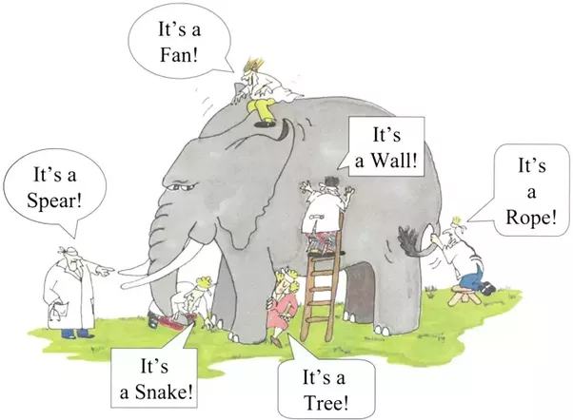
Productive Peer Dialogue
    socio-cognitive perspective
    (e.g. Damon, 1984; Piaget, 1972)
    Students resolve socio-cognitive conflict with peers, deepening their understanding.
    Particularly important for triggering conceptual change in many STEM domains! (e.g. Howe, 2014)

Slide 6
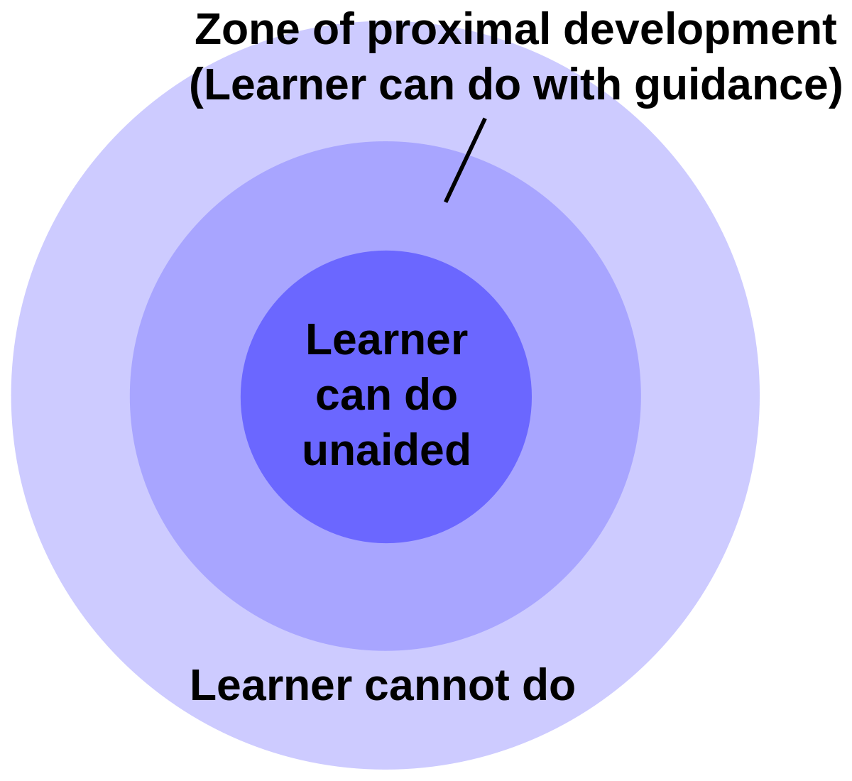
Productive Peer Dialogue
    socio-cultural perspective
    (e.g. Rogoff, 1990; Vygotsky, 1978)
    Peers scaffold each other’s problem-solving in the mutual zone of proximal development.
    Particularly important as a means of acquiring strategies and ways of thinking of a specific subject (e.g. Rogoff, 1990).

Slide 7
Productive Peer Dialogue
ICAP framework of observable modes of engagement (Chi, 2009; Chi & Wylie, 2014)
    interactive > constructive > active > passive
e.g.
co-constructing
argumentative reasoning
tutoring
e.g.
self-explaining
finding solutions
re-organizing
e.g.
summarizing
repeating
highlighting
e.g.
reading
listening
observing

Slide 8






Facilitating collaborative learning
What we are aiming for: individual learning,
facilitated by transactive peer dialogue
What we can design:
resources & tools
roles
instructions
→ routinized as collaboration scripts

Slide 9

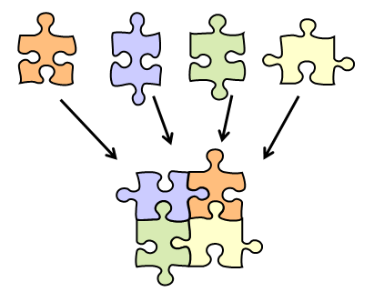
Jigsaw Script
expert groups: learners become experts for one sub-topic
knowledge interdependence
exchange: mutual teaching
Aronson & Patnoe, 2011 (3. Edition)
  design aim: enhancing collaborative motivation by creating positive social interdependence
Bildquellen: www.amazon.com

Slide 10
Jigsaw Script
wide-spread, prototypical collaboration script
(Dillenbourg & Jermann, 2007)
empirically:
  mixed results (Roseth, Lee, & Saltarelli, 2018; Slavin, Hurley, & Chamberlain, 2003)
  knowledge exchange and integration often suboptimal (Berger & Hänze, 2015; Deiglmayr & Spada, 2011)
Could too much knowledge interdependence in fact hinder transactive dialogue (e.g. because of lack in common ground)?

Slide 11
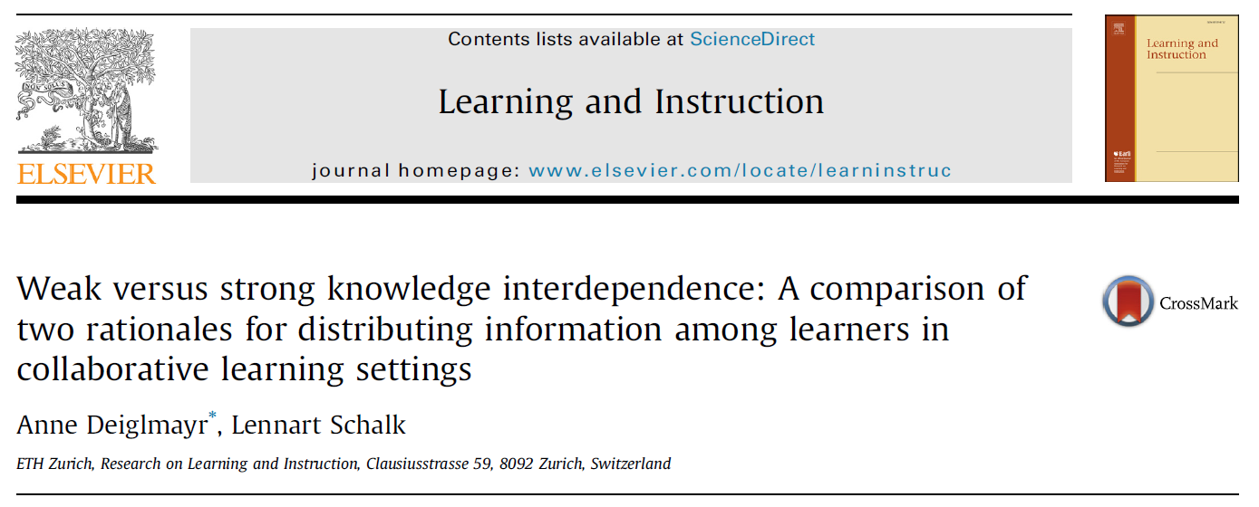

Experimental Study
Lennart Schalk,
PH Schywz
Schweizer Nationalfonds (project no. 139621)
n= 78 University students (42 female), from non-STEM fields, in 26 triads
(Deiglmayr & Schalk, 2015)
Bildquellen: https://www.journals.elsevier.com/learning-and-instruction

Slide 12
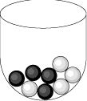
Learning Domain: Urn Models
learning objective: conceptual, principle-based understanding of urn models
(cf. Berthold & Renkl, 2009; Rittle-Johnson, Schneider, & Star, 2015)
Principle 2: Order | Principle 1: Replacement
 | …with replacement | …without replacement
…relevant | Model 1 | Model 2
…irrelevant | Model 3 | Model 4 (→ transfer)
(Deiglmayr & Schalk, 2015)
Notes:
learning materials: word problems as worked examples (adapted from Berthold & Renkl, 2009)
knowledge tests
application: translating word problems into the corresponding equations (M1-3)
transfer: deriving equations for an unfamiliar model (M4)

Slide 13
Learning Materials: Worked Examples
M 1
M 1
M 1
(Deiglmayr & Schalk, 2015)

Slide 14
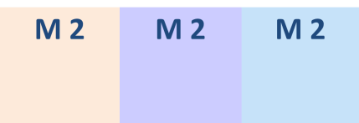
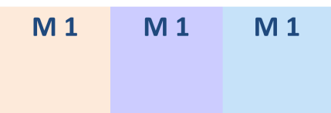

Strong vs. Weak Knowledge Interdependence
traditional JIGSAW
model experts:
→ strong KI
(Deiglmayr & Schalk, 2015)
14
Notes:
starke Wissensinterdependenz: je eine «Experte» pro Urnenmodell
schwache Wissensinterdependenz: je ein «Experte» pro Beispielgeschichte

Slide 15
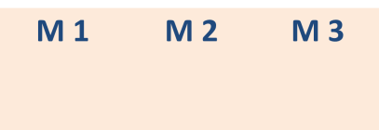
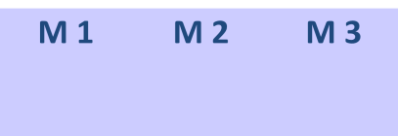
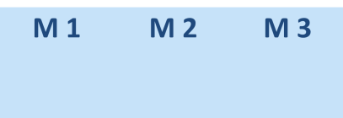
Strong vs. Weak Knowledge Interdependence
traditional JIGSAW
model experts:
→ strong KI
modified JIGSAW
story experts:
→ weak KI
(Deiglmayr & Schalk, 2015)
15
Notes:
starke Wissensinterdependenz: je eine «Experte» pro Urnenmodell
schwache Wissensinterdependenz: je ein «Experte» pro Beispielgeschichte

Slide 16



Procedure (Computer-Based)
Introduction
Pre-Test
Individual Learning Phase
Collaborative Learning Phase
Post-Test
independent variables:
prior knowledge
randomization:
model vs. story set
→ strong vs. weak KI
self-explain
self-explain
self-explain
dependent variables:
content analysis of chat protocols: transactivity
collaborative problem-solving, via chat
application score
transfer score
(Deiglmayr & Schalk, 2015)

Slide 17
Results Post-Test (Application and Transfer)
strong KI
weak KI
strong KI
weak KI
→ main effect of prior knowledge only
(Deiglmayr & Schalk, 2015)

Slide 18
Results Post-Test (Application and Transfer)
strong KI
weak KI
strong KI
weak KI
→ main effect of prior knowledge only
interaction prior_knowledge x type_of_KI
(Deiglmayr & Schalk, 2015)
Notes:
Transfer: Both main effects are also statistically significant

Slide 19
Procedure
Introduction
Pre-Test
Individual Learning Phase
Collaborative Learning Phase
Post-Test
total corpus: n= 1873 utterances, of which
n= 499 explanations, of which n= 310 principle-based, of which:
→ n= 144 constructed individually
→ n= 166 constructed transactively
independent variables:
prior knowledge
randomization:
model vs. story set
→ strong vs. weak KI
self-explain
self-explain
self-explain
dependent variables:
content analysis of chat protocols: transactivity
collaborative problem-solving, via chat
application score
transfer score
(Deiglmayr & Schalk, 2015)

Slide 20
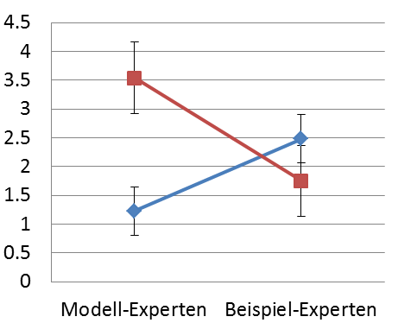
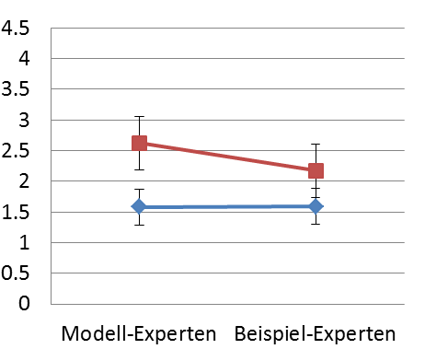
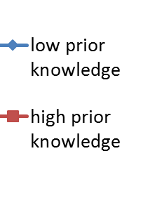
Results Chat Protocols
no. of transactively constructed, principle-based explanations
(M and SE)
no. of individually constructed, principle-based explanations
(M und SE)
strong KI
weak KI
strong KI
weak KI
interaction prior_knowledge x type_of_KI
→ main effect of prior knowledge only
(Deiglmayr & Schalk, 2015)
Notes:
Transactive utterances: both main effects also statistically significant

Slide 21
Summary
mediation: the positive effects of weak KI on conceptual learning are (partially) mediated by transactive co-construction
transactive dialogue
strong vs. weak KI
prior knowledge
conceptual learning and transfer
weak KI→ more participation in transactive co-construction, in particular for learners with low
prior knowledge
weak KI → deeper conceptual learning, in particular for learners with low prior knowledge
(Deiglmayr & Schalk, 2015)

Slide 22

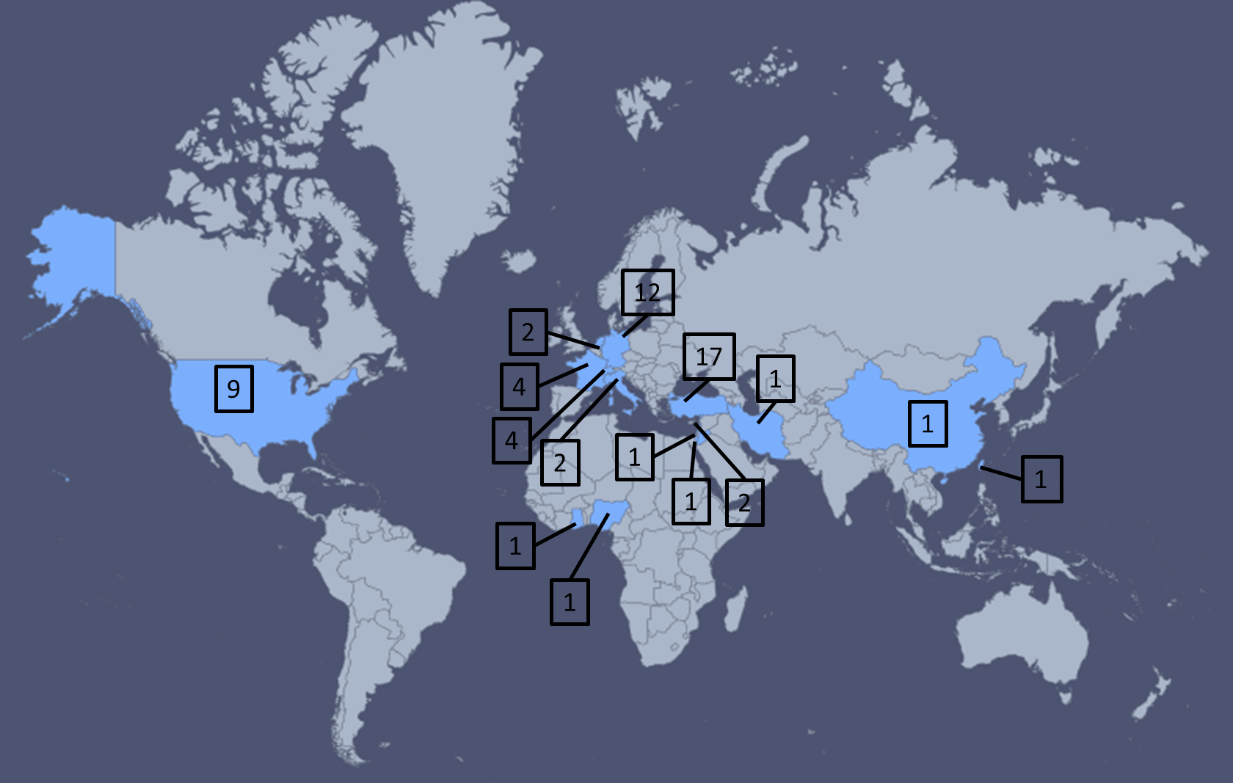
JIGSAW Meta-Analysis
(quasi-)experimental evaluations of the effectiveness of „Jigsaw-type” learning arrangements
currently: 59 studies
(k= 235 effects) coded
Yvonne Oberholzer,
KIT
Lennart Schalk,
PH Schwyz
(Deiglmayr, Oberholzer, & Schalk, in prep)

Slide 23
JIGSAW Meta-Analysis
mean effect (random effects model): g = .19
95%-KI [.11; .28]; z = 4.40; p <.0001
very heterogenous effect pool
(Q_{(df= 234)} = 2012.71; p <.0001; I² = 88.4 % [87.1%; 89.5%])
  moderator analysis
(quasi-)experimental evaluations of the effectiveness of „Jigsaw-type learning arrangements
currently: 59 studies
(k= 235 effects) coded
Yvonne Oberholzer,
KIT
Lennart Schalk,
PH Schwyz
(Deiglmayr, Oberholzer, & Schalk, in prep)

Slide 24
Moderators: Baseline Condition
 | no. of effects | Hedge’s g | 95%-CI
no instruction | 3 | .95 | [.27; 1.63]
individual learning | 33 | .41 | [.15; .67]
traditional instruction | 128 | .29 | [.16; .41]
other collaborative (-) | 35 | -.24 | [-.43; -.05]
other Jigsaw | 36 | .03 | [-.12; .18]
(Deiglmayr, Oberholzer, & Schalk, in prep)
Notes:
Test for subgroup differences (random effects model): Q d.f. p-value Between groups 32.10 4 < 0.0001
Note: Labels of subgroups in which Jigsaw has a statistically significant mean effect are printed in bold. If the effect is negative, “(-)” is added to the label.

Slide 25
Moderators: Age Group
 | no. of effects | Hedge’s g | 95%-CI
Primary (Grades 1-6) | 109 | -.01 | [-.10; .08]
Secondary | 32 | .22 | [-.06; .50]
University / College | 90 | .46 | [.29; .62]
other | 4
(Deiglmayr, Oberholzer, & Schalk, in prep)
Notes:
Test for subgroup differences (random effects model): Q d.f. p-value Between groups 27.70 3 < .001

Slide 26
Moderators: Group Size (during Exchange Phase)
 | no. of effects | Hedge’s g | 95%-CI
2 persons (-) | 17 | -.27 | [-.51; -.02]
3 - 4 persons | 84 | .43 | [.27; .58]
5 persons | 77 | .05 | [-.11; .21]
6 persons | 39 | .17 | [-.01; .34]
not specified | 18
(Deiglmayr, Oberholzer, & Schalk, in prep)
Notes:
Test for subgroup differences (random effects model): Q d.f. p-value Between groups 24.89, 4, <.001

Slide 27
Moderators: Knowledge Interdependence
 | no. of effects | Hedge’s g | 95%-CI
strong (traditional Jigsaw) | 214 | .16 | [.07; .38]
medium (Jigsaw II, or related) | 11 | .42 | [.00; .85]
cannot be coded | 10
(Deiglmayr, Oberholzer, & Schalk, in prep)
Notes:
Test for subgroup differences (random effects model): Q d.f. p-value Between groups 6.71, 2, .04

Slide 28
If you would (still) like to use Jigsaw,…
…it is likely to work best under the following conditions:
with more experienced learners
when the number of experts per Jigsaw group / the number of expert topics is not too large (3-4 expert topics appear to be optimal)
when knowledge interdependence is not too strong
Notes:
Under specific conditions, the Jigsaw Method can be highly effective in supporting individual learning from collaboration.
However, in many situations that constitute common practice (group sizes >4; implementation with primary school students), its effectiveness may be close to zero.
In practice, other forms of collaborative learning might often be more effective. This includes jigsaw-type scripts that realize only medium levels of knowledge interdependence.

Slide 29
Main Points
Dialogue with peers can boost STEM learning.
Productive peer dialogue typically is transactive dialogue.
Educators can motivate and support productive peer dialogue via collaboration scripts.
One popular type of collaboration script, Jigsaw, works by distributing learning resources,
thus creating knowledge interdependence.
BUT…
  Jigsaw is less effective than one might think given its popularity.
  Knowledge interdependence with regards to core concepts may hinder transactive dialogue.
  Jigsaw should be applied with caution, with core concepts NOT distributed between learners.
…efficient division of labour ≠ effective collaborative learning
Notes:
…none of this is specific to either STEM learning, or to computer-supported collaborative learning, but it applies to both

Slide 30

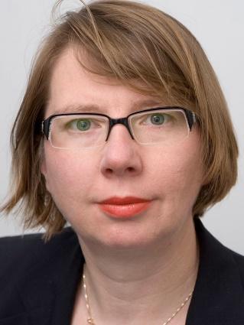




Lennart Schalk
Elsbeth Stern
Yvonne Oberholzer
Thank you!
to my collaborators
to our research assistants
to all students who participated
to the SNF for funding

