Slide 1
Studying math at the university: is dropout predictable?
Stefan Halverscheid, Mathematics Education, Georg-August-Universität Göttingen, Germany

Slide 2
Outline
(1) The dropout problem concerning mathematics in tertiary education
(Heinze, Neumann, Ufer, Rach, Borowski, Buschhüter, Greefrath, H., Kürten, Pustelnik, Sommerhoff 2019)
(2) The impact of school knowledge on studies of physics and mathematics
(H. & Pustelnik, 2013; Pustelnik 2018)
(3) A look at our efforts at the transition from secondary to tertiary education, in particular in preperation courses
(H. & Müller 2013; H. , Pustelnik, Taake & Schneider 2014)
(4) Do preparation courses have an effect on dropout at all?
(Gerdes, H. & Schneider 2021)

Slide 3
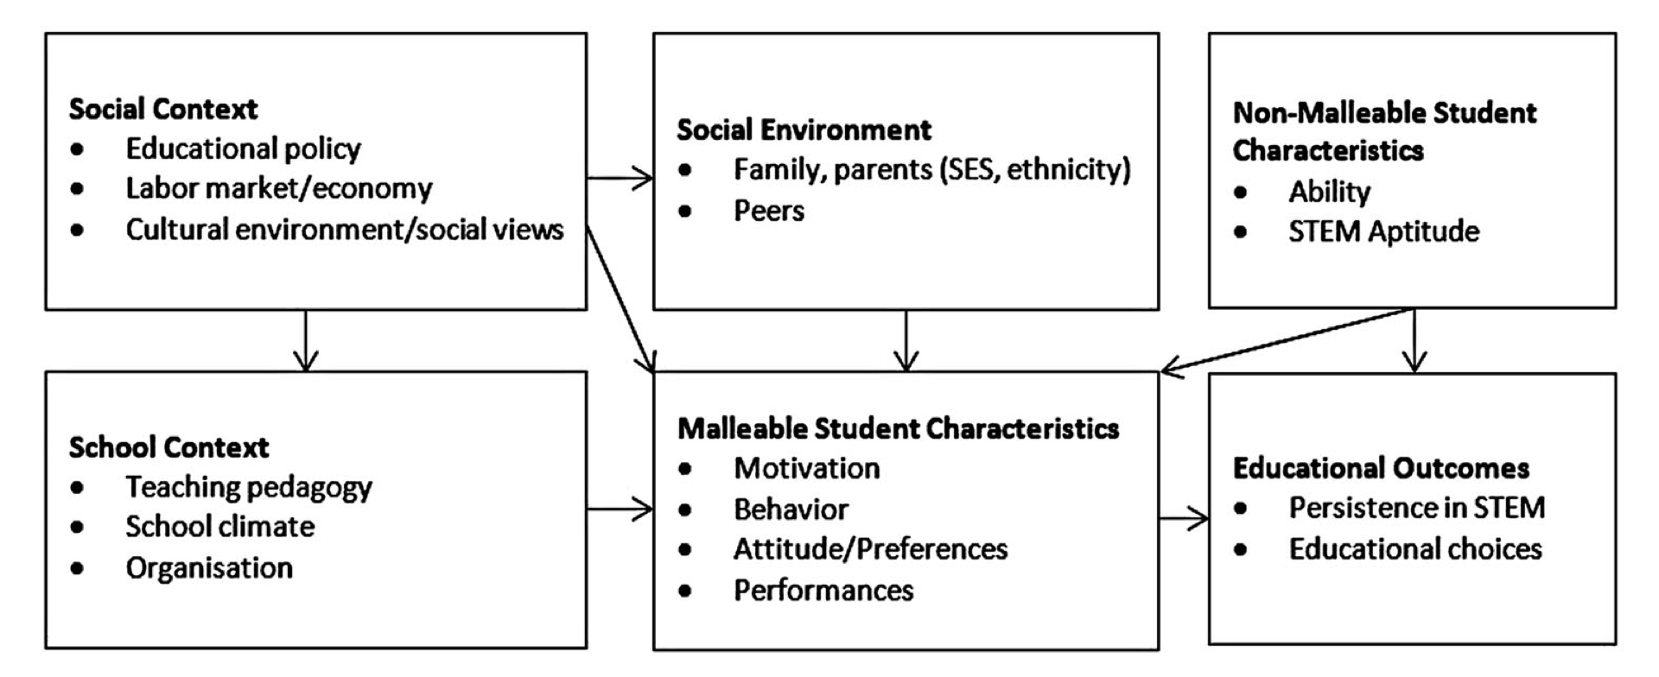
(1) The dropout problem concerning mathematics in tertiary education
In Germany, high dropout rates in STEM studies (Isleib, Woisch & Heublein 2019; Dieter (2012))
Similar problems in other countries, but different admission system and circumstances
The “leaking STEM pipeline“ along the educational career, in particular for girls, is an international phenomenon (Alper, 1993; Berryman, 1983)
Many projects and public money was invested in the transition to STEM tertiary education (Bausch et al., 2014; Hoppenbrock et al., 2016)
A variety of factors affect academic choices
regarding STEM persistance (van den Hurk,
Meelissena & van Langen, 2019)

Slide 4
Tests for abilities in mathematics (at the beginning of the study programme)
Name of the test | Study programmes | First puclication of the test
Einstufungsübung zum Mathematischen Propädeutikum | University: Computer Science, Mathematics, Physics | Halverscheid et al. (2014)
KoM@ING-Eingangstest Mathematik | University & Univ. of Applied Sciences | Neumann et al. (2015)
KUM-A | University: Mathematics and Business Mathematics | Rach & Heinze (2017), Rach & Ufer (2018), Ufer (2015)
Mathematiktest | University: Electrical Engineering, Computer Science | Greefrath et al. (2017)
Mathematiktest Rechenbrücke | Univ. of Applied Sciences: Engineering | Kürten & Greefrath (2016)
SET78 | University: Physics | Krause & Reiners-Logothetidou (1981), Buschhüter et al. (2016)
Test zum Studienbeginn | Univ. of Applied Sciences: Electrical Engineering, Information Technology | Greefrath & Hoever (2016)
Focus on procedural and basic conceptual knowledge, mainly from lower secondary schools.
Several tests give a better prediction for dropout than the final school exam score.
Aus: Heinze, Neumann, Ufer, Rach, Borowski, Buschhüter, Greefrath, H., Kürten, Pustelnik & Sommerhoff (2019), p. 346

Slide 5
(2) The impact of school knowledge: an indicator or a perequesite?
Curricular areas for the
preparation course placement test
(H. & Pustelnik 2013)
Curricular areas compare school curricula and first year contents
Aims: identification of particular problems at the individual level to offer appropriate workshops and tutorials
Algebraic foundations
(systems of) equations
polynomials
Exponential and logarithmic functions
Trigonometric functions
Vectors
Calculus: differentiating
Calculus: integration
Data base since 2012 participants of the preparation courses for BSc in computer science, mathematics, physics, and BA for secondary schools in these subjects
From 2013 through 2016 for N=885 participants a longitudinal study for the first year

Slide 6
Findings of the longitudinal study on first semester
Criterion: Exam pass in calculus and linear algebra
Test result is a better predictor for success than overall school grade and the last mark in mathematics at school
In prediction by logistic regression the last mark in mathematics is added in linear algebra, but not in calculus.
Correct prediction on the basis of these models: 80 % for students‘ successful studies in first semester
Consolidation of knowledge: The areas of lower secondary schools (foundations, equations) have a stronger impact than areas of last school years (vectors, calculus).
Further findings:
Gender effect is small.
Delayed enrolment (enrolment more than 12 months after final school exam) has a significant impact on the test result (F(2; 874) = 43,33; p $≤$0,001; $η^{2}$ = 0,09). Small effect for one year (p = 0,034; d = 0,22), strong effect for longer (p $≤$0,001; d = 0,95)
No effect at transition von 13 years to 12 years, but overall, students with 12 year school do better
Notes:
For the first semester results in calculus and linear algebra (in mathematics and physics) the test result is a better predictor for success than overall school grade and the last mark in mathematics at school

Slide 7
(3) A look at our efforts at the transition from secondary to tertiary education, in particular in preperation courses
Different preperation courses for the following areas:
Mathematics (3 weeks)
Physics (additional 2-week-course after 3-week-course in Mathematics)
Computer Science (3 weeks)
Economics (2 weeks)
Biology and geography (1 week)
Agriculture and forest studies (1 week)
Aim: Enculturation and building up a social network
Problem solving in lectures, tutorials and in small (private) teams
Getting and coping with feed-back
Defending own reasonings in discussions
Building-up lacking knowledge in one area (workshop)

Slide 8
Pre-course maths & physics: mathematical “language“ and problems
15 days:
60-min. lectures & 90 min. ex. classes
( & 90-minutes workshops)
Mathematical "language“ and logic by mathematical problems
Examples in the lecture: problems and school maths from a (slightly) „higher point of view“ (Felix Klein)
Exercise classes: facing problems alone, sharing ideas in a group, defending reasonings
At the end of every exercise class session: 20 minutes paper on a math problem
assertions
sets and numbers
direct proofs
quantifyers
maps
negations of assertions
limits
proofs by contrapositions
indirect proofs
Notes:
So ergaben sich folgende Themen

Slide 9
Qualitative approach to monitor work in tutorials:
Documenting collective activitiy (DAC) and Abstraction in context (AiC)
Abstraction
in Context (AiC)
RBC+C Model
Documenting
Collective Activity
(DCA)
individual
Coursework in a group
individual
individual
Tabach, Hershkowitz, Rasmussen & Dreyfus (2014)

Slide 10
Individual day-by-day feedback in the exercise classes
Return corrected papers,
solution in the class
Feed-back to tutors
correction & scan
Examples in lecture
Deepening contents
given in the lecture by problems
Deepening contents
given in the lecture by problems
Adjusting
level
20-minute individual,
math. writing
20-minute individual,
math. writing
Day n
Day n+1

Slide 11
(4) Do preparation courses have an effect on dropout at all?
(Gerdes, H. & Schneider 2021)
Precourse participants
before Winter 2012/2013
Successful completion of
3-year-Bachelor within 4 years
Students starting in Winter 2012/2013 without precourse
Precourse participants
before Winter 2013/2014
Successful completion of
3-year-Bachelor within 4 years
Students starting in Winter 2013/2014 without precourse
2012
2013
2016
2017

Slide 12
The effect of participating in preparation courses
Bayesian logistic multipli multi-level-regression with random intercept at the level of Bachelor degree programmes and interaction term with successful completion as dependend variable
Variable | $β with$ 95%-CI | OR $β$ with 95%-CI
Intercept | −0.75 [−1.18,−0.37] | 0.47 [0.31, 0.69]*
Participation pre-course | 0.36 [0.19, 0.54] | 1.43 [1.20, 1.71]*
Time till enrollment | 0.08 [−0.04, 0.20] | 1.08 [0.96, 1.22]
Time till enrollment and grade | 0.22 [0.06, 0.39] | 1.25 [1.06, 1.47]*
grade (final school exam) | −0.78 [−0.88,−0.68] | 0.46 [0.41, 0.51]*
gender (male) | −0.22 [−0.39,−0.05] | 0.81 [0.68, 0.95]*
Different federal state | −0.12 [−0.28, 0.05] | 0.89 [0.75, 1.05]
Group level: Bachelor degree programme SD(intercept) | 0.69 [0.45, 1.07]
* Level of significance: 5 %
N = 2953 cases (39% female)
42 % sucessful completion after 4 years

Slide 13
Summary
Mathematical abilities acquainted at school are important (at least for studies in mathematics and physics) and give a prediction of success of about 80 %.
It is hard to catch up.
What can be done? Effects of pre-courses are small, but these are also short.
Higher risks: (very) late enrollment, not participating in (non-compulsary) pre-courses

Slide 14
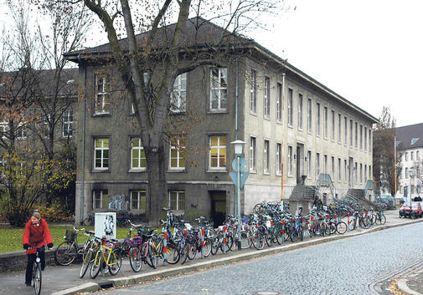
Thank you.
Stefan Halverscheid
Stefan.Halverscheid@mathematik.uni-goettingen.de

Slide 15
Aufgabenabfolge 2017
 | Etappe mathematischen Schreibens | Gegenstand
1 | Eigenschaft nachprüfen | Teilbarkeit, Quersumme
2 | Negation von Aussagen | Gerade und ungerade Zahlen
3 | Schlussfolgerungen aufgrund von Axiomen | Anordnungsaxiome
4 | Mengen durch definierende Eigenschaften | Graphen und Teilmengen des R²
5 | Überprüfung von Eigenschaften, Kontroposition | Injektive und surjektive Abbildungen
6 | Vollständige Induktion | Teilbarkeit
7 | Nachweise mit Existenzquantoren | Beschränkte Folgen
8 | Komplexere Abhängigkeiten vom Existenzquantor | Konvergenz einer reellen Zahlenfolge
9 | Widerlegung durch Angabe eines Gegenbeispiels | Grenzwerte bei Treppenfunktionen
10 | Nachweise zu Allquantoren | Folgenstetigkeit
11 | Indirekte Beweise | Differenzierbarkeit
12 | Nachweise mehrerer Eigenschaften | Bijektivität
13 | Verschiedene Darstellungen vergleichen | Variablendarstellung und Matrizendarstellung
14 | Strukturelle Nachweise | Rechengesetze

Slide 16
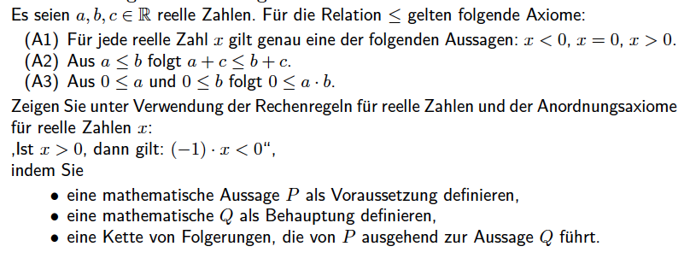
Blick auf eine Aufgabe in der ersten Woche
06.03.18

Slide 17
Ca. 20 %: Grundsätzlich klar strukturierte und begründete Darstellung bei kleinen Verbesserungsmöglichkeiten

Slide 18
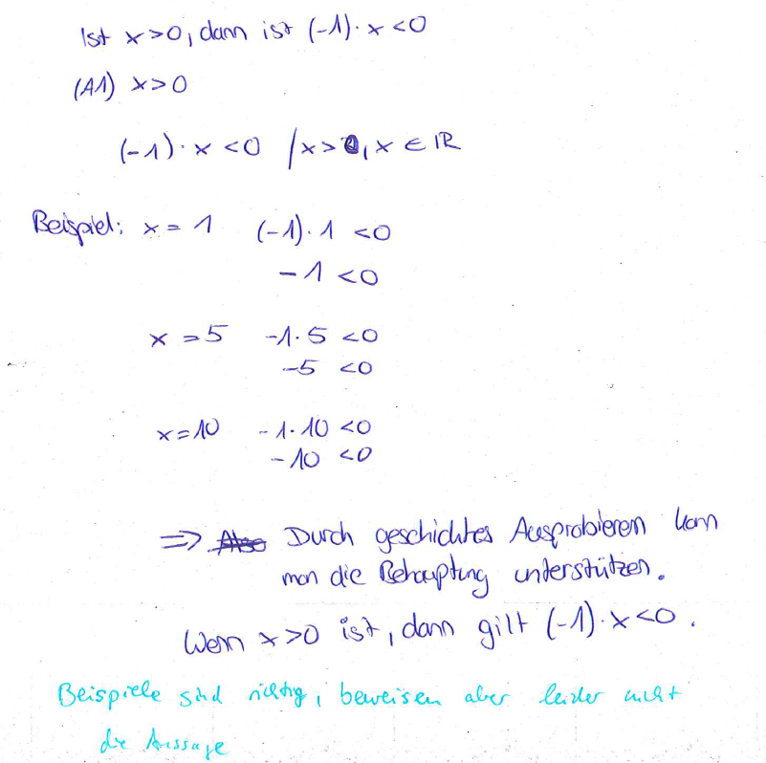
Ca. 20 %: Grundsätzliche Probleme mit dem, was ein Beweis ist

Slide 19
Ca. 25 %: Rolle von Voraussetzung und Schlussfolgerung bei Axiom A3

Slide 20
Blick auf Unterschiedlichkeit von Übungsgruppen: Grundsätzliche Missverständnisse über die Rolle von Axiomen
A | B | C | D | E | F | G | H
9 % | 21 % | 14 % | 47 % | 63 % | 46 % | 26 % | 17 %
Georg-August-Universität Göttingen
06.03.18

Slide 21
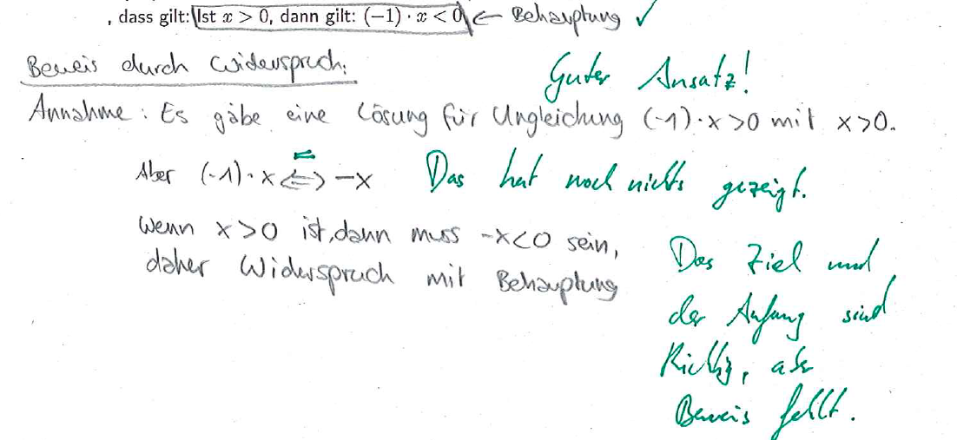
Blick auf Anmerkung von Tutor(inn)en (1)

Slide 22
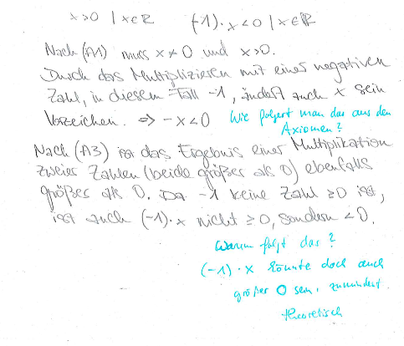
Blick auf Anmerkung auf Tutor(inn)en (2)

