Slide 1
Mathematics for everybody – (how) is this possible? Albrecht Beutelspacher www.mathematikum.de

Slide 2
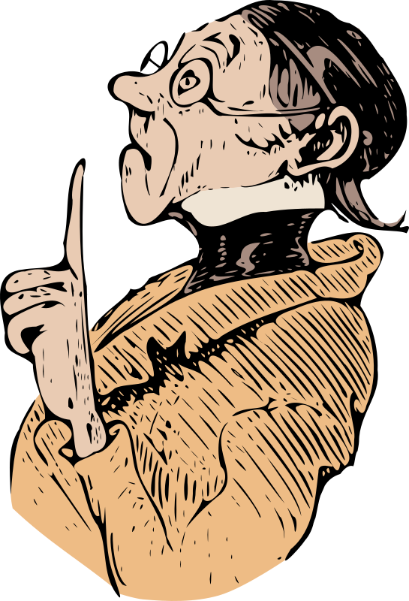
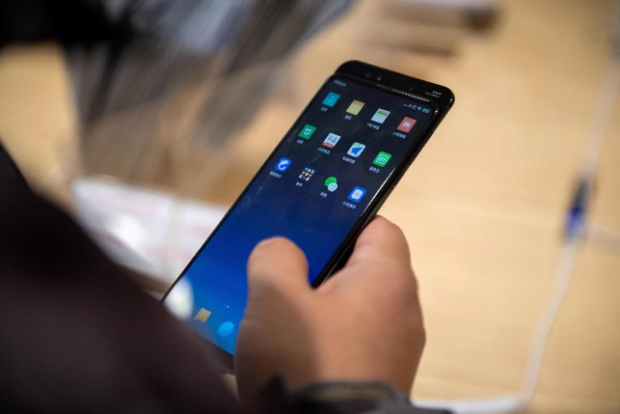
Why should everybody know of mathematics?
General aspect
If mathematics is important, this is relevant for everybody.
Cultural aspects
Mathematics has shaped our way of thinking.
Applied aspects
Modern economy relies heavily on mathematics.

Slide 3
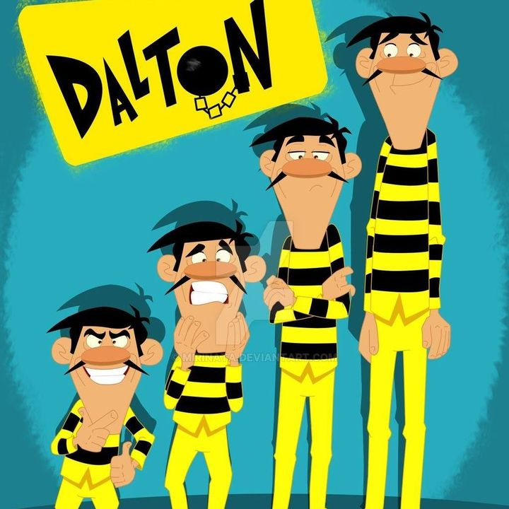
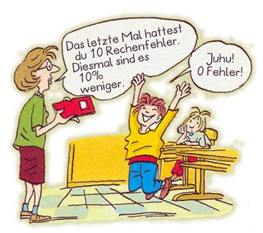
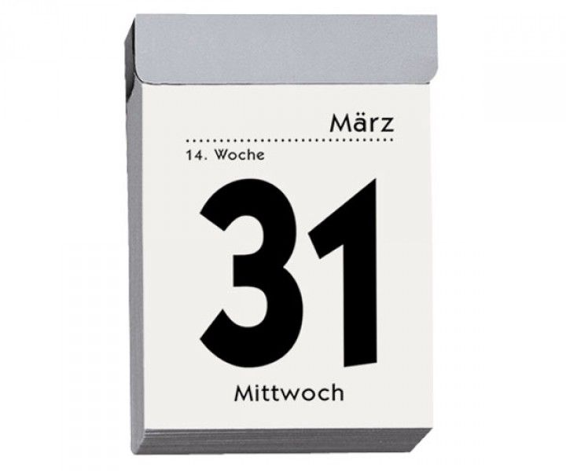
Mathematics for everybody: Why is this impossible?
You don‘t know the people.
What is their interest or motivation?
Mathematical skills are mostly lacking.
They will spend only a limited amount of time.
1 hour?
They come only once.

Slide 4
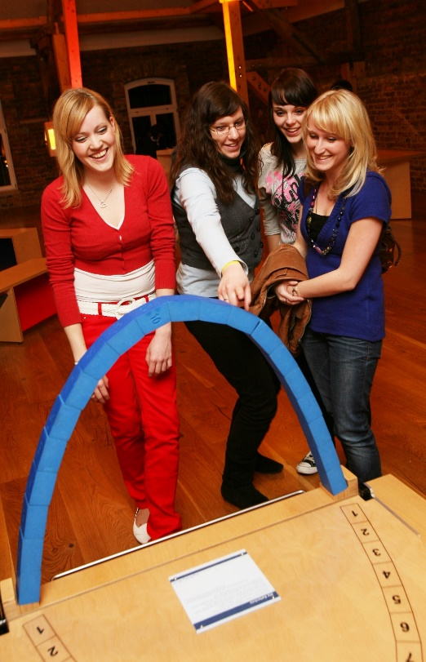
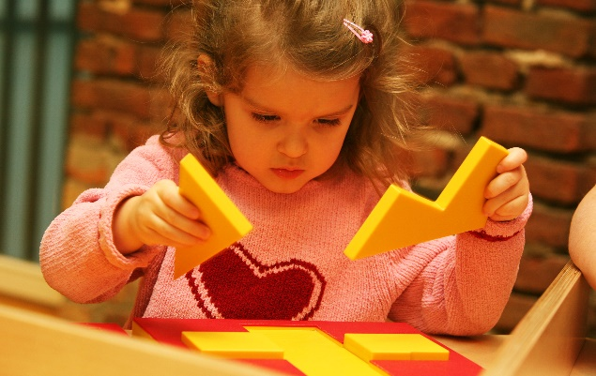
Mathematics can enrich and empower people
They see what‘s behind it.
„Aha“-moment
They know more than they believe.
Empowerment through moments of success.

Slide 5
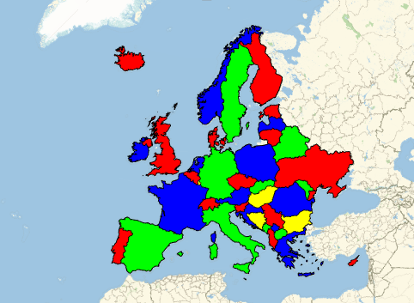
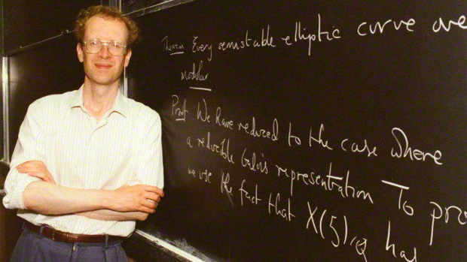
What can you do?
Tell a story
Heroes: Euklid, Galois, Gödel. Wiles, ,,,
Explain a problem
Solving the cubic map coloring Breaking Enigma
Discuss concepts
Infinity prime numbers Möbius strip

Slide 6
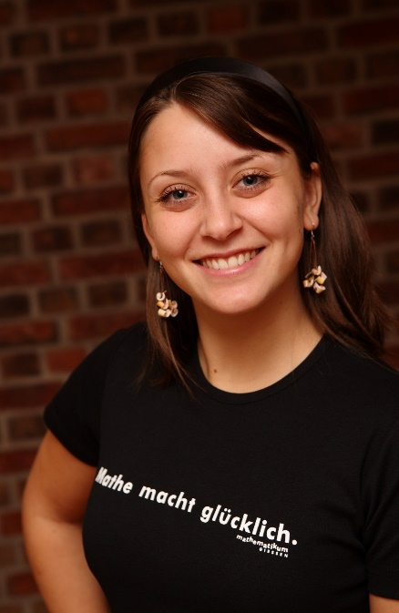
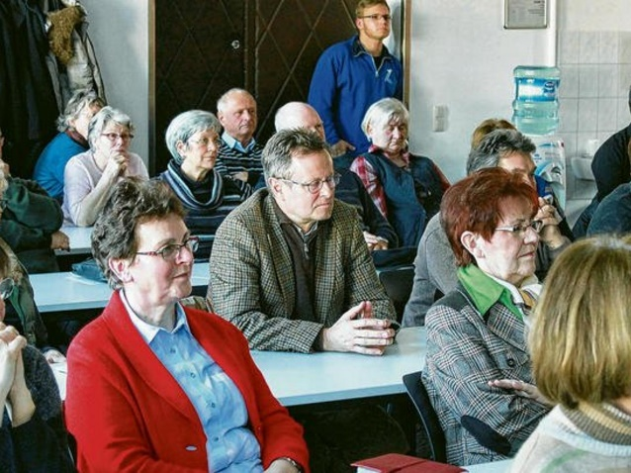
Maths for everybody: Why is this a pleasure for you?
People come on a voluntary basis (in their leisure time).
You are free to choose any topic (and format).
You can make people happy (and yourself as well).

Slide 7
My experience
Articles and books
Cryptography, brain teasers, Children‘s book, …
Talks
Target groups: Teacher, pupils, seniors, …
Golden section, secret codes, How did the Romans calculate?
Radio / TV
Radio: Euklid, Galois, Cantor, Gödel,
TV: based on experiments
Experiments and Mathematikum

Slide 8
Books
Still a math book
Explain everything Few formulas Pictures, applications
Views from outside
A novel
Story

Slide 9
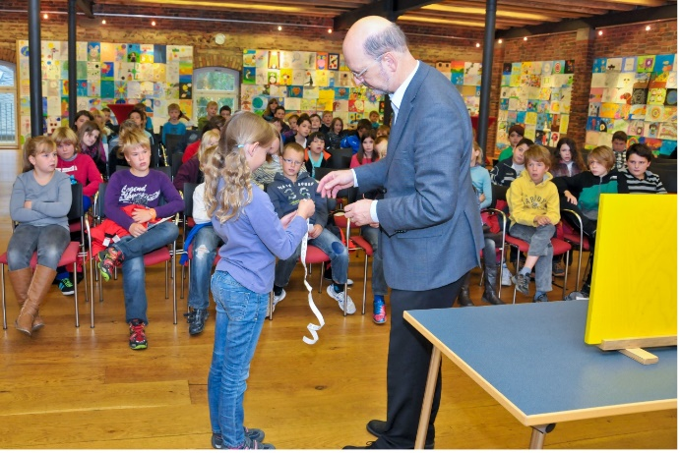
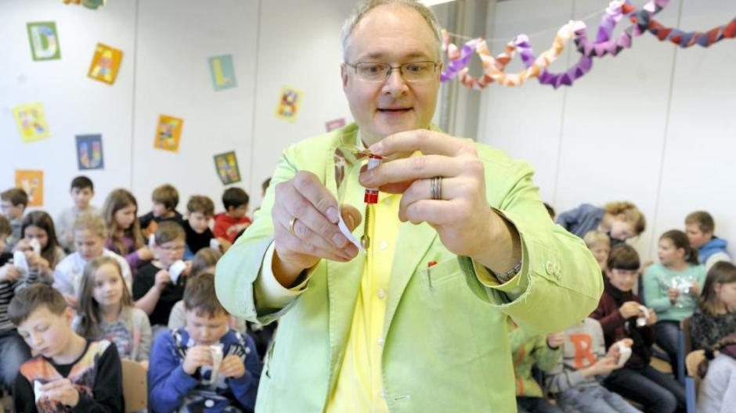
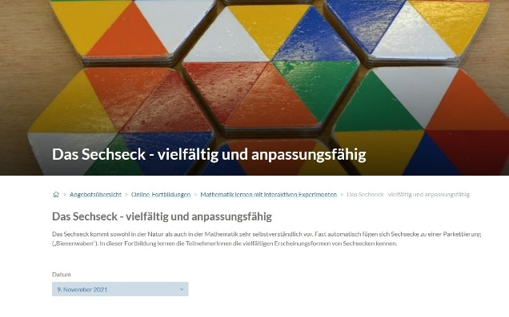
Talks
Mixed auditorium
„Show“ „Edutainment“
Teachers
Experiments and background
Children
„Kinderuni“
Experiments children participate

Slide 10
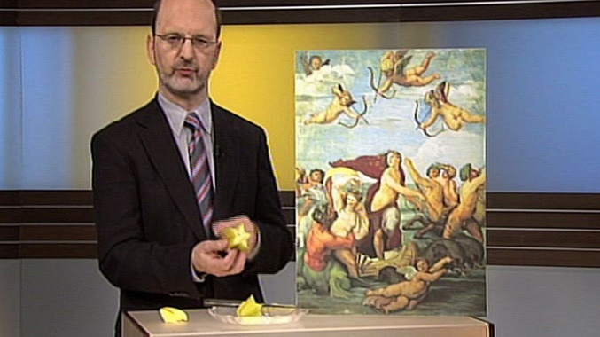
Radio and TV
„Wissenswert“ (hr2),15‘ each
E.g. Euclid, Gödel, infinity, Pi, Ramanujan, sixty, square, zero, …
„Mathematik zum Anfassen“ (ard-alpha), 15‘ each
Each topic with 3 experiments
E.g. Football, Patterns, Pythagoras

Slide 11
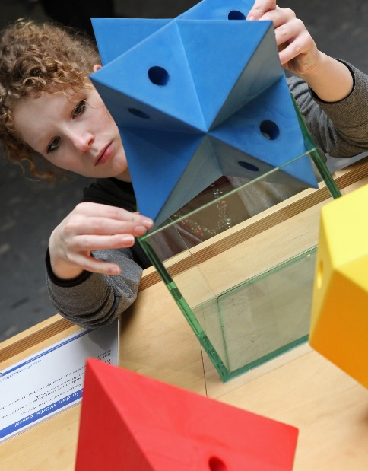
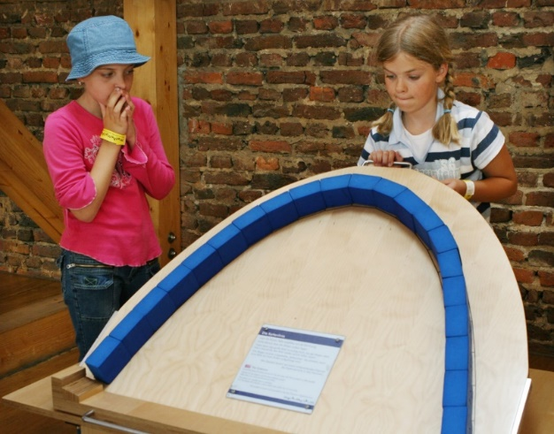
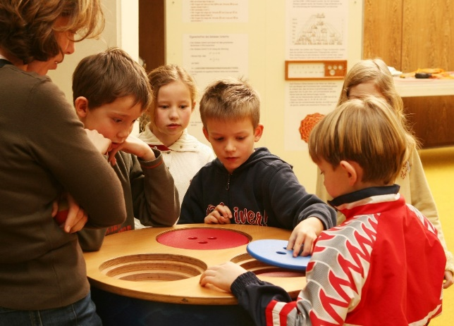
Experiments and Mathematikum
Mathematics through experience (no formulas)
Visitors act autonomously.
An ideal first step into mathematics

Slide 12
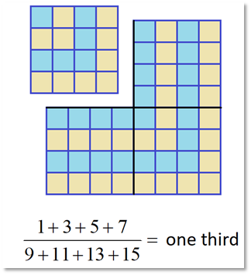
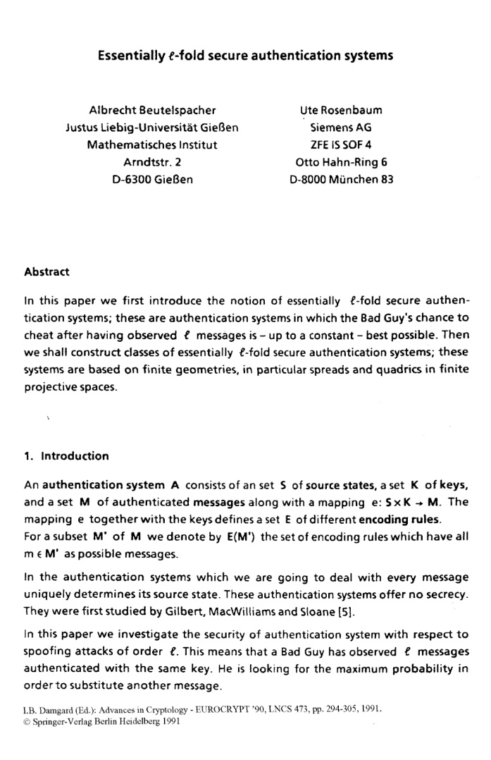
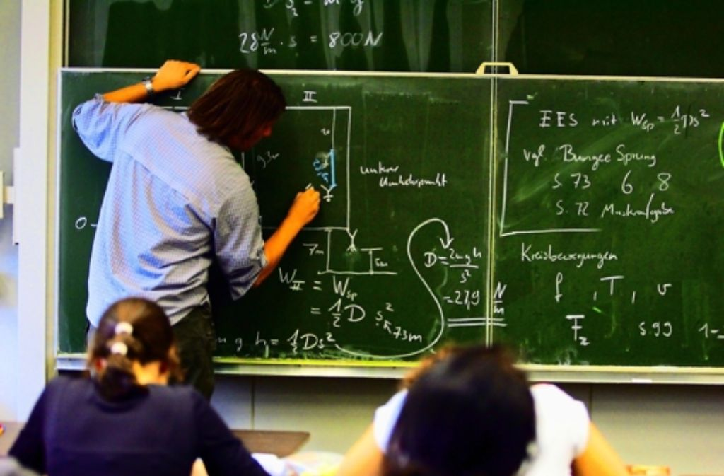
Mathematics for everybody: Don‘ts
Avoid too much stuff.
Less is more.
Avoid formal language.
Use pictures and examples.
Don‘t speak on (your) latest research

Slide 13
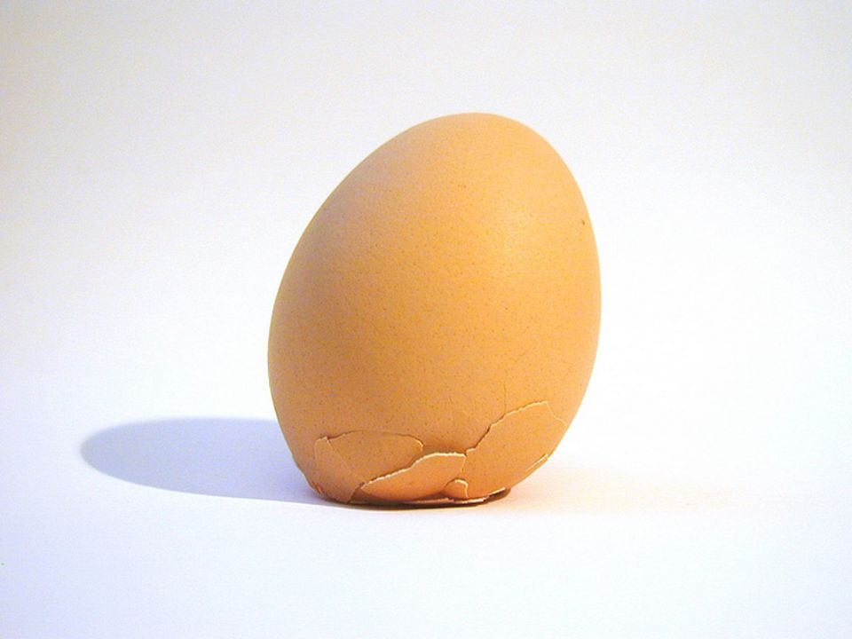
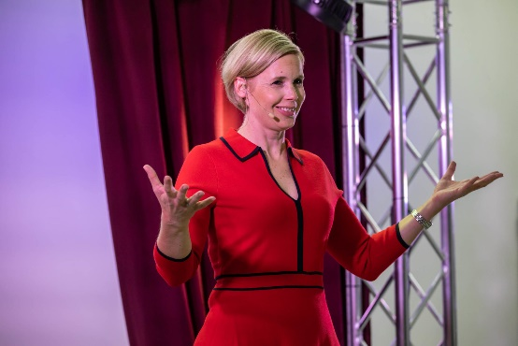
Mathematics for everybody: Dos
Love your auditorium.
Make it simple.
Prepare yourself very carefully
Stop in the right moment.

Slide 14
Inhalt
Allgemeines
Why should everybody …?
Why impossible?
Why a pleasure?
Konkretes
Choose segments and formmats
My way
Articles and Books
Talks (children‘s lectures)
Radio and TV
Experiments
Do‘s
Dont‘s

Slide 15
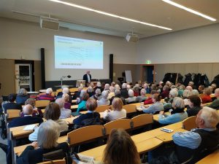
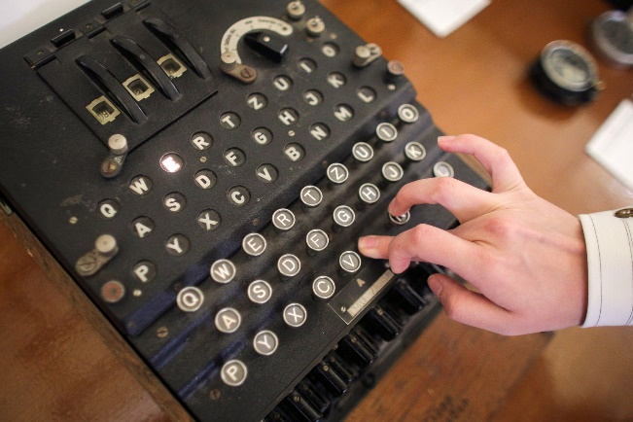
Maths for everybody: Choose segments and formats
Culturally interested people („Bildungsbürger“)
Technically interested people
Children and families.

