Slide 1
Strategic promotion of STEM education for student success
Prof. Dr. Dr. h.c. mult. Sarah M. Springman
Rector
Latsis Symposium, 6 September 2021, Audimax

Slide 2
Global challenges: some background
STEM
Notes:
So how important is STEM? in selection of study focus by students [Animation 1]
Difference between Switzerland & China
Global competition for best graduates (and national ambitions regarding global top universities)
Supply and demand of workforce
Political framework (and pitfalls)
Educational mission of ETH: Educating the workforce for Switzerland
Within a background that mixes 4, 5 & 6
Now moving onto ETH
Sources: https://www.timeshighereducation.com/features/stem-growth-really-stunting-humanities & https://www.bfs.admin.ch/bfs/de/home/statistiken/bildung-wissenschaft/personen-ausbildung/tertiaerstufe-hochschulen/universitaere.html

Slide 3
The big picture: ETH Zürich’s responsibilities
Life Long Learning
Gymnasium
Bachelor
Master
Doctorate
Phase 2
Notes:
So where does ETH have responsibility?
From High School to Continuing Education:
High School –> Elsbeth Stern --> why we are here!
Gymnasium: This ist the most important way into ETH: 3’000+ students per year
(other ways in @ Master & Doctorate, Lifelong Learning
Interationality + permeability)

Slide 4
Challenge to ETH Zürich
Open Access for Swiss High school graduates
Matura as selection mechanism
High drop-out rate of first-year students
Wasted resources of failing students and ETH
Impact of failure
Need for better information / expectation management of high school graduates
Notes:
We are dependent of the Matura as a selection mechanism irrespective of Matura type.
We don’t want to lose so many Maturandinnen and Maturanden as we do now and as we have done in the past. It is a waste of time and resources for all parties involved & not only this; failing is not always constructive / productive.
We need to work on it, and we have already identified fields of action and taken measures
Key focus areas:
ETH: Studyability
Gymnasien: Better matching of high school graduates to ETH-profile, and better expectation management of what should be expected at ETH
Studienwoche
Studieninfotage
Onboarding
Brückenkurs
Support & Coaching
Bild: ETH Zürich / Alessandro Della Bella; Online Prüfungen HG G1

Slide 5
Strategic outlook
STEM subjects and gender issues in education
Campus culture at universities
Curricular and pedagogical issues in university study programmes
Curricular and pedagogical issues in high schools
Notes:
Part of our plan (Educational mission)
Deliberate action (Role and self-conception of ETH)
Walk the walk (taking responsibility; being a reliable partner of the Swiss high schools)
Bild: ETH Zürich / Simon Tanner : Schnupperstudium Informatik

Slide 6
Promoting STEM-education: Commitment of ETH Zürich
Fachdidaktiken
HSGYM
MINT-Lernzentrum
Youth Academy
Notes:
Commitment of ETH Zürich & Outreach for STEM-Education: Visibility (of our engagement) is key
[pre-existing]
Fachdidaktiken; Principles of ETH – committed teachers have a deep understanding of the discipline
MINT-Lernzentrum → National expertise (--> many of our audience today)
Analysis of performance – gender, internationality, …)
HSGYM → Networking in ZH (→ last 7 years)
Bild: ETH Zürich, erster Hochschultag der Mittelschulen 2012

Slide 7
Promoting STEM-education: recent development
ETH Youth Academy
Influencing the choice of Matura
Supporting Olympiad participants
STEM Olympiade (iChO 2023)
Future Learning Initiative
Ashesi-ETH Master in Mechatronic Engineering
Notes:
ETH Youth Academy
Influencing the choice of Matura: How? Developing conceptual understanding / in furst 2 years in «Ing» Gymnasium --> boost effect on 20% annual cohort
Supporting Olympiad participants (Mathematics, Computer Science, Sciences, Tech/Robotics
Math Youth Academy --> ETH Youth Academy
- It is important for us that extracurricular offers should be as closely linked to school as possible, which is why we work so closely with teachers and have our courses given by teachers.
We want to show that expertise in STEM has to be worked hard for, but it can be done. We avoid showpersonship with wonderfully loud experiments, which cannot be placed in an explanatory context and attempt to support conceptual learning.
STEM Olympiade (iChO 2023)
Beyond Switzerland:
FLI – Open ETH Initiative: Manu Kapur will inform you about
Ashesi-ETH Master in Mechatronic Engineering

Slide 8
Holistic view of “future-ready” ETH graduates
ETH Competencies
Critical and Entrepreneurial Thinking
Student centred active learning
Creating space for curiosity, creativity and flexibility
Fostering inter- and transdisciplinary cooperation
Notes:
VUCA (volatility, uncertainty, complexity, and ambiguity) World → Educating our students to identify problems and find solutions in our complex, quickly changing world.
ETH strengths – since 1855 – subject specific grew into method specific
20 ETH Competencies: enabling our students beyond subject-specific competences; transferrable skills, but not only
Critical Thinking: fostering Citizenship & Leadership, responsibility and attitude
Student centered active learning
Creating space for curiosity, creativity and flexibility
Fostering inter- and transdisciplinary cooperation
Creating space and opportunity for extracurricular activities

Slide 9
Our contribution: Two examples
Gender Action Plans of Executive Board and Departments
Continuous development of teaching
Notes:
Serveral underpinning frameworks - rather dry
Spatial ability – D=70% SMS
Mechanical engineering drawing – mathematics. Should never have been Rector

Slide 10
Striving for success
Notes:
We want our students to succeed – what does this mean
Definition of success:
Passing / high marks
Applying the skills learnt
Getting a job / getting the right job
Making a difference
Building electric racing car
Breaking the world record 0-100 kph
Actually MINT/STEM is the basis for these achievements
Strategic goal of ETH: Training our «students to identify problems and find solutions in our complex, quickly changing world»

Slide 11
Providing the necessary tools and infrastructure for success
Student Project House – opening later in 2021
ETH Centre for students and entrepreneurs – to be opened in 2027
Notes:
Maker
Storyteller
Explorer
Inventor
Dreamer

Slide 12
Challenges in the working world
Notes:
Bild: IBM Research Women’s Event

Slide 13
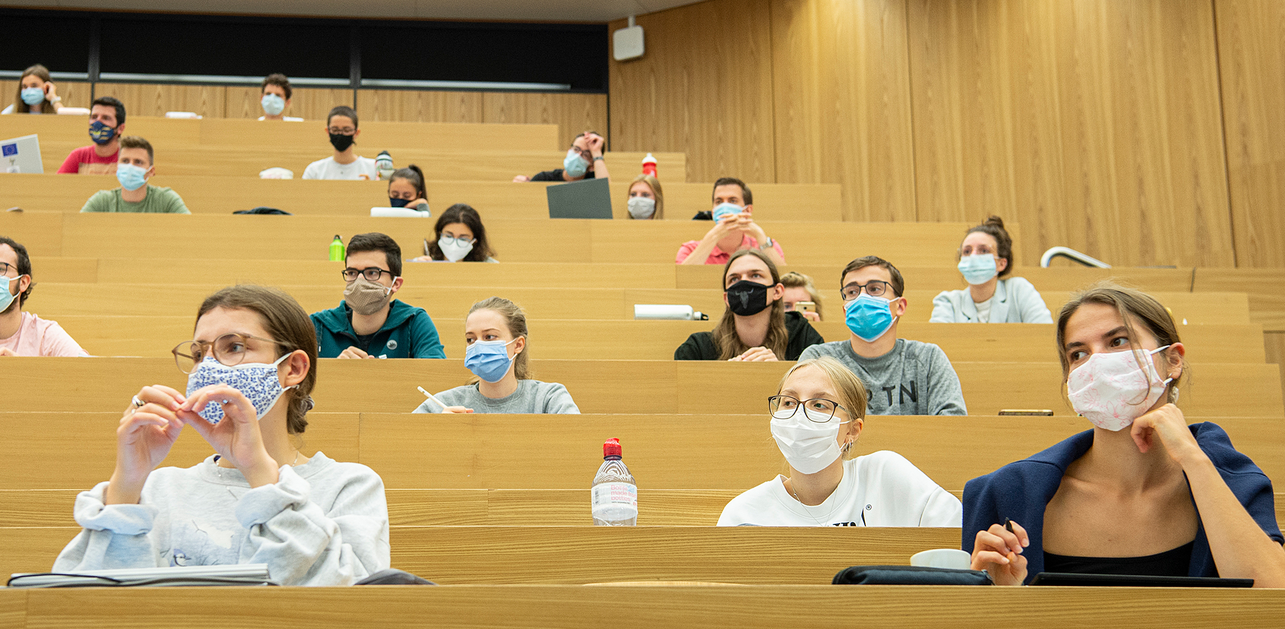
Notes:
Thank you for your attention. I am looking forward to session 4 «ETH’s research on STEM-​learning and Opening of the ETH Youth Academy” of this year’s Latsis Symposium

