Slide 1
Combinational Circuits

Slide 2
What we will learn
Tools to build digital circuits
Transistors
Gates
… and why they matter
Boolean Algebra
Combinational Circuits
Verilog

Slide 3
Abstraction
 | Abstraction Levels | Examples
 | Application Software | Programs
 | Operating Systems | Device drivers
This Course | Architecture | Instructions, Registers
 | Micro architecture | Datapath, Controllers
 | Logic | Adders, Memories
 | Digital Circuits | AND gates, NOT gates
 | Analog Circuits | Amplifiers
 | Devices | Transistors, Diodes
 | Physics | Electrons

Slide 4
Crash course in EE
All the good parts of EE in short
Just the best parts, only highlights
We will have exercises where we need to put this into use
We will use Verilog to program FPGAs…
… and we will learn what these mean in a few hours
What do we need to know to build computers
Understanding how they work will help you
If you want to know more
Plenty of lectures/theses at EE (Prof. Benini, Gürkaynak)

Slide 5
(micro)-Processors

Slide 6
FPGAs

Slide 7
Custom ASICs

Slide 8
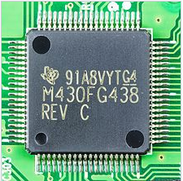
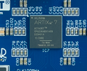
But they all look the same….
 | Microprocessors | FPGAs | ASICs
In short: | Common building block of Computers | Reprogrammable Hardware, flexible | You customize everything
Development Time | minutes | days | months
Performance | o | + | ++
Good for | Simple to use Ubiquitous | Prototyping Small volume | Mass production, Max performance
Programming | Compiler | Bitfile | Design Masks
Languages | C/C++/Java/… | Verilog/VHDL | Verilog/VHDL
Main Companies | Intel, ARM | Xilinx, Altera, Lattice | TSMC, UMC, ST, Globalfoundries

Slide 9
But they all look the same….
 | Microprocessors | FPGAs | ASICs
In short: | Common building block of Computers | Reprogrammable Hardware, flexible | You customize everything
Development Time | minutes | days | months
Performance | o | + | ++
Good for | Simple to use Ubiquitous | Prototyping Small volume | Mass production, Max performance
Programming | Compiler | Bitfile | Design Masks
Languages | C/C++/Java/… | Verilog/VHDL | Verilog/VHDL
Main Companies | Intel, ARM | Xilinx, Altera, Lattice | TSMC, UMC, ST, Globalfoundries

Slide 10
But they all look the same….
 | Microprocessors | FPGAs | ASICs
In short: | Common building block of Computers | Reprogrammable Hardware, flexible | You customize everything
Development Time | minutes | days | months
Performance | o | + | ++
Good for | Simple to use Ubiquitous | Prototyping Small volume | Mass production, Max performance
Programming | Compiler | Bitfile | Design Masks
Languages | C/C++/Java/… | Verilog/VHDL | Verilog/VHDL
Main Companies | Intel, ARM | Xilinx, Altera, Lattice | TSMC, UMC, ST, Globalfoundries

Slide 11
But they all look the same….
 | Microprocessors | FPGAs | ASICs
In short: | Common building block of Computers | Reprogrammable Hardware, flexible | You customize everything
Development Time | minutes | days | months
Performance | o | + | ++
Good for | Simple to use Ubiquitous | Prototyping Small volume | Mass production, Max performance
Programming | Compiler | Bitfile | Design Masks
Languages | C/C++/Java/… | Verilog/VHDL | Verilog/VHDL
Main Companies | Intel, ARM | Xilinx, Altera, Lattice | TSMC, UMC, ST, Globalfoundries

Slide 12
But they all look the same….
 | Microprocessors | FPGAs | ASICs
In short: | Common building block of Computers | Reprogrammable Hardware, flexible | You customize everything
Development Time | minutes | days | months
Performance | o | + | ++
Good for | Simple to use Ubiquitous | Prototyping Small volume | Mass production, Max performance
Programming | Compiler | Bitfile | Design Masks
Languages | C/C++/Java/… | Verilog/VHDL | Verilog/VHDL
Main Companies | Intel, ARM | Xilinx, Altera, Lattice | TSMC, UMC, ST, Globalfoundries

Slide 13
But they all look the same….
Want to learn how these work
By programming these
 | Microprocessors | FPGAs | ASICs
In short: | Common building block of Computers | Reprogrammable Hardware, flexible | You customize everything
Development Time | minutes | days | months
Performance | o | + | ++
Good for | Simple to use Ubiquitous | Prototyping Small volume | Mass production, Max performance
Programming | Compiler | Bitfile | Design Masks
Languages | C/C++/Java/… | Verilog/VHDL | Verilog/VHDL
Main Companies | Intel, ARM | Xilinx, Altera, Lattice | TSMC, UMC, ST, Globalfoundries
Using this language

Slide 14
Building Blocks For Microchips
Conductors
Metals: Aluminum, Copper
Insulators
Glass (SiO₂), Air
Semiconductors
Silicon (Si), Germanium (Ge)

Slide 15
Semiconductor

Slide 16
N-type Doping

Slide 17
P-type Doping

Slide 18
What Is So Great About Semiconductors?
You can “engineer” its properties
Make it P type by injecting type-III elements (B, Ga, In)
Make it N type by injecting elements from type-V (P,As)
Starting with a pure semiconductor, you can combine P and N regions next to each other
Allows you to make interesting electrical devices
Diodes
Transistors
Thrystors

Slide 19
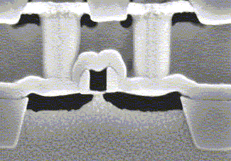
The transistor
By combining
Conductors (Metals)
Insulators (Oxide)
Semiconductors
We get a Transistor (MOS)
Basically it is a switch
Apply (positive) voltage to GATE
Current flows from DRAIN to SOURCE
Why is this cool?
We can combine many of these to realize simple logic gates
Gate
Source
Drain

Slide 20
nMOS + pMOS = CMOS

Slide 21
nMOS + pMOS = CMOS
When One Type MOS works, the other is the load

Slide 22
CMOS Gate Structure
The general form used to construct any inverting logic gate, such as: NOT, NAND, or NOR.
The networks may consist of transistors in series or in parallel.
When transistors are in parallel, the network is ON if either transistor is ON.
When transistors are in series, the network is ON only if all transistors are ON.

Slide 23
CMOS Gates: NOT Gate
A | P1 | N1 | Y
0
1

Slide 24
CMOS Gates: NOT Gate
A | P1 | N1 | Y
0 | ON | OFF | 1
1 | OFF | ON | 0

Slide 25
CMOS Gates: NAND Gate
A | B | P1 | P2 | N1 | N2 | Y
0 | 0
0 | 1
1 | 0
1 | 1

Slide 26
CMOS Gates: NAND Gate
N1 and N2 are connected in series; both must be ON to pull the output to GND.
P1 and P2 are in parallel; only one must be ON to pull the output up to VDD.
A | B | P1 | P2 | N1 | N2 | Y
0 | 0 | ON | ON | OFF | OFF | 1
0 | 1 | ON | OFF | OFF | ON | 1
1 | 0 | OFF | ON | ON | OFF | 1
1 | 1 | OFF | OFF | ON | ON | 0

Slide 27
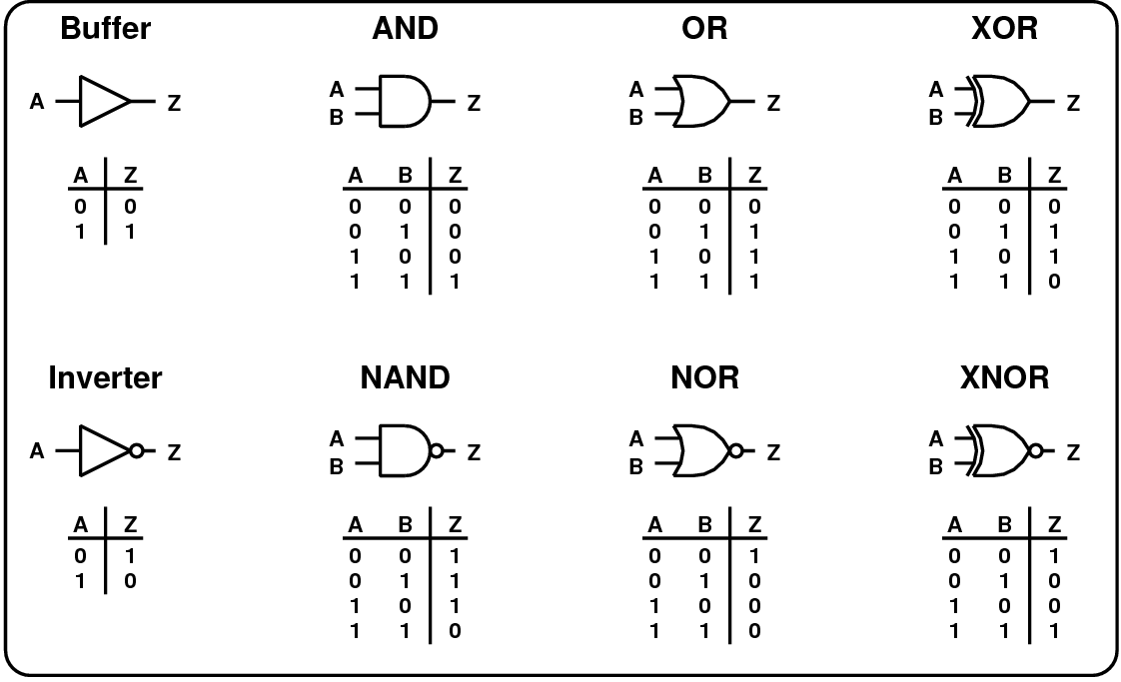
Common Logic Gates

Slide 28
Moore’s Law

Slide 29
Moore’s Law
Coined by Gordon Moore:
In 1965
Co-founder of Intel
Number of transistors that can be manufactured doubles roughly every 18 months.
In other words: it increases 100 fold over 10 years.

Slide 30
How Do We Keep Moore’s Law
Manufacturing smaller structures
Some structures are already a few atoms in size
Developing materials with better properties
Copper instead of Aluminum (better conductor)
Hafnium Oxide, air for Insulators
Making sure all materials are compatible is the challenge
Optimizing the manufacturing steps
How to use 193nm ultraviolet light to pattern 20nm structures
New technologies
FinFET, Gate All Around transistor, Single Electron Transistor…

Slide 31
We can now build logic circuits
A logic circuit is composed of:
Inputs
Outputs
Functional specification (describes relationship between inputs and outputs)
Timing specification (describes the delay between inputs changing and outputs responding)

Slide 32
Circuits
Circuit elements
E1, E2, E3
Each itself a circuit
Nodes (wires)
Inputs: A, B, C
Outputs: Y, Z
Internal: n1
To count the nodes look at
outputs of every circuit element
inputs to the entire circuit

Slide 33
Types of Logic Circuits
Combinational Logic
Memoryless
Outputs determined by current values of inputs
In some books called Combinatorial Logic
Sequential Logic
Has memory
Outputs determined by previous and current values of inputs

Slide 34
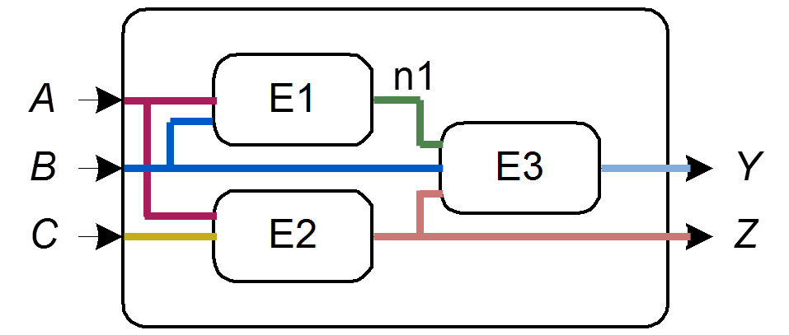
Rules of Combinational Composition
Every circuit element is itself combinational
Every node of the circuit is either
designated as an input to the circuit or
connects to exactly one output terminal of a circuit element
The circuit contains no cyclic paths: every path through the circuit visits each circuit node at most once
Example: (If E1-3 combinational)

Slide 35
Boolean Equations
Functional specification of outputs in terms of inputs
Example (full adder – more later):
S = F(A, B, C_{in})
C_{out} = G(A, B, C_{in})

Slide 36
Boolean Algebra
Set of axioms and theorems to simplify Boolean equations
Like regular algebra, but in some cases simpler because variables can have only two values (1 or 0)
Axioms and theorems obey the principles of duality:
stay correct if ANDs and ORs interchanged and 0’s and 1’s interchanged
Examples:
0 =
B ∙ B =

Slide 37
Boolean Algebra
Set of axioms and theorems to simplify Boolean equations
Like regular algebra, but in some cases simpler because variables can have only two values (1 or 0)
Axioms and theorems obey the principles of duality:
stay correct if ANDs and ORs interchanged and 0’s and 1’s interchanged
Examples:
dual
0 = 1
1 = 0
B ∙ B = 0
B + B = 1

Slide 38
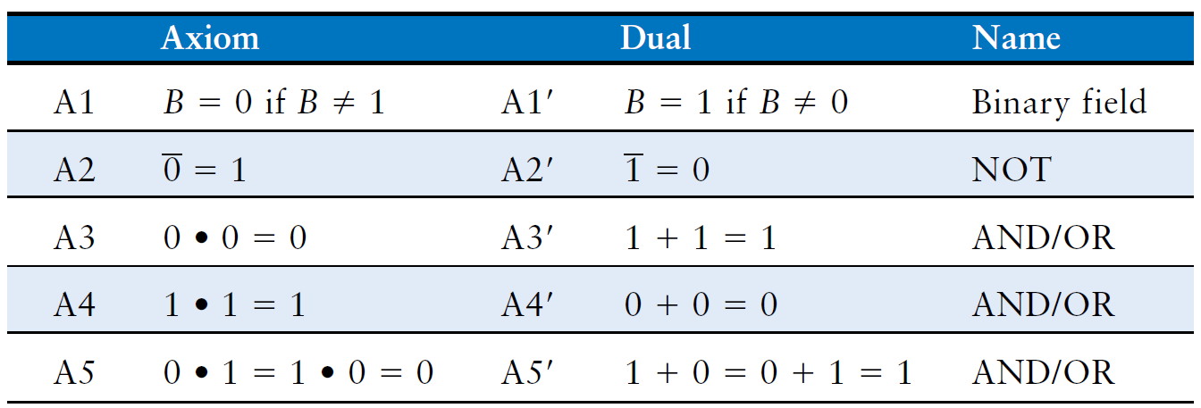
Boolean Axioms
Duality: If the symbols 0 and 1 and the operators • (AND) and + (OR) are interchanged, the statement will still be correct.

Slide 39
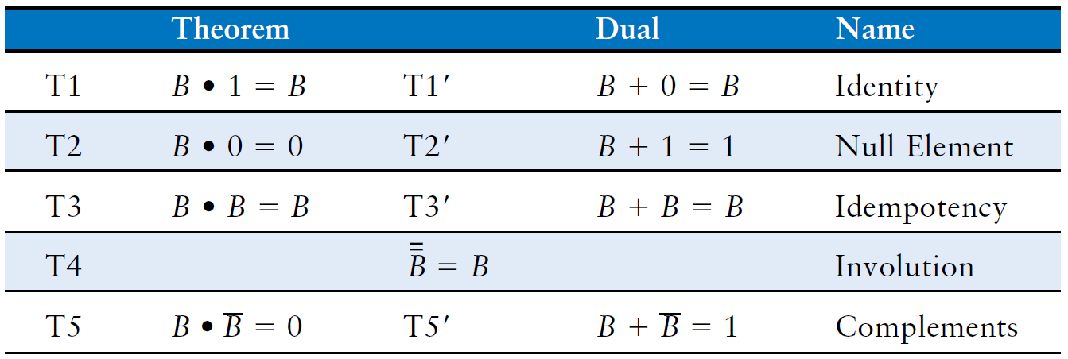
Boolean Theorems: Summary

Slide 40
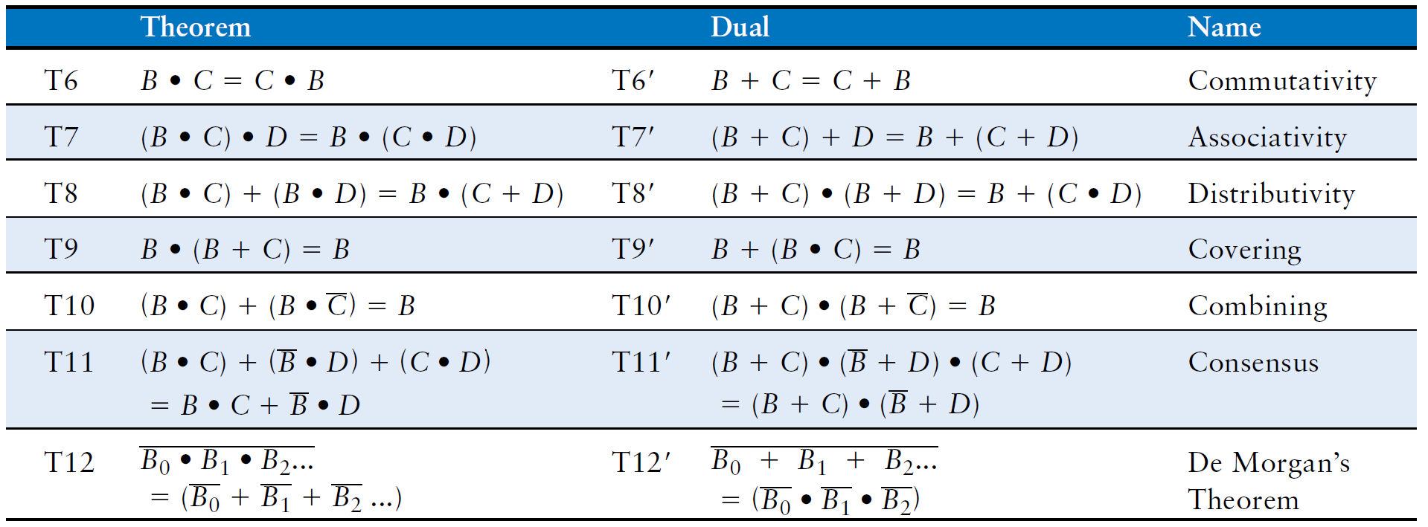
Boolean Theorems of Several Variables

Slide 41
Simplifying Boolean Expressions: Example 2
Y = A(AB + ABC)

Slide 42
Simplifying Boolean Expressions: Example 2
Y = A(AB + ABC)
= A(AB(1 + C)) T8
= A(AB(1)) T2’
= A(AB) T1
= (AA)B T7
= AB T3

Slide 43
Boolean Equations Example
You are going to the cafeteria for lunch
You won’t eat lunch $(\overline{E})$
If it is not open $(\overline{O})$ or
If they only serve cabbage $(C)$
Write a truth table for determining if you will eat lunch $(E)$
only
cabb.
open
eat

Slide 44
Some Definitions
Complement: variable with a bar over it $\overline{A}$ , $\overline{B}$ , $\overline{C}$
Literal: variable or its complement $A$ , $\overline{A}$ , $B$ , $\overline{B}$ , $C$ , $\overline{C}$
Implicant: product (AND) of literals $(A∙B∙\overline{C})$ , $(\overline{A}∙C)$ , $(B∙\overline{C})$
Minterm: product (AND) that includes all input variables $(A∙B∙\overline{C})$ , $(\overline{A}∙\overline{B}∙C)$ , $(\overline{A}∙B∙\overline{C})$
Maxterm: sum (OR) that includes all input variables $(A+\overline{B}+\overline{C})$ , $(\overline{A}+B+\overline{C})$ , $(A+B+\overline{C})$

Slide 45
Sum-of-Products (SOP) Form
$$Y=F\left(A,B\right)= ?$$
All Boolean equations can be written in SOP form
Each row in a truth table has a minterm
A minterm is a product (AND) of literals
Each minterm is TRUE for that row (and only that row)
blackboard
Formed by ORing the minterms for which the output is TRUE

Slide 46
Sum-of-Products (SOP) Form
$$Y=F\left(A,B\right)=\left(\overline{A}∙B\right)+(A∙B)$$
All Boolean equations can be written in SOP form
Each row in a truth table has a minterm
A minterm is a product (AND) of literals
Each minterm is TRUE for that row (and only that row)
blackboard
Formed by ORing the minterms for which the output is TRUE

Slide 47
From Logic to Gates
SOP (sum-of-products) leads to two-level logic
Example: $Y=\left(\overline{A}∙\overline{B}∙\overline{C}\right)+\left(A∙\overline{B}∙\overline{C}\right)+\left(A∙\overline{B}∙C\right)$

Slide 48
Combinational Building Blocks
Combinational logic is often grouped into larger building blocks to build more complex systems
Hide the unnecessary gate-level details to emphasize the function of the building block
We have already studied some building blocks
full adders
priority circuits
We now look at:
multiplexers
decoders

Slide 49
Multiplexer (Mux)
Selects between one of N inputs to connect to the output.
Needs log₂N-bit control input
2:1 Mux Example:

Slide 50
Multiplexer (Mux)
Selects between one of N inputs to connect to the output.
Needs log₂N-bit control input
2:1 Mux Example:
Compressed
version

Slide 51
Hardware Description Languages
In the beginning HDLs were developed as a ‘standard way’ of drawing circuit schematics.
Modeled the interface of circuits, described how they were connected
Allowed connections between these modules
Supported some common logic functions
AND OR NOT XOR
Multiplexers

Slide 52
Convenient Way of Drawing Schematics

Slide 53
Convenient Way of Drawing Schematics
It is standard
Everybody will interpret the schematic the same way
It is not proprietary
HDLs are not tool specific
It is machine readable
It is easier for computers to understand the circuit
Only later on additional benefits were discovered
Simulation and Synthesis

Slide 54
Two Hardware Description Languages
Verilog
developed in 1984 by Gateway Design Automation
became an IEEE standard (1364) in 1995
More popular in US
VHDL (VHSIC Hardware Description Language)
Developed in 1981 by the Department of Defense
Became an IEEE standard (1076) in 1987
More popular in Europe
In this course we will use Verilog

Slide 55
Defining a module
A module is the main building block in Verilog
We first need to declare:
Name of the module
Types of its connections (input, output)
Names of its connections

Slide 56
Defining a module
module example (a, b, c, y);
input a;
input b;
input c;
output y;
// here comes the circuit description
endmodule

Slide 57
A question of style
The following two codes are identical
module test ( a, b, y );
input a;
input b;
output y;
endmodule
module test ( input a,
input b, output y );
endmodule

Slide 58
What if we have busses?
You can also define multi-bit busses.
[ range_start : range_end ]
Example:
input [31:0] a; // a[31], a[30] .. a[0]
output [15:8] b1; // b1[15], b1[14] .. b1[8]
output [7:0] b2; // b2[7], b2[6] .. b1[0]
input clk; // single signal

Slide 59
Basic Syntax
Verilog is case sensitive:
SomeName and somename are not the same!
Names cannot start with numbers:
2good is not a valid name
Whitespace is ignored
// Single line comments start with a //
/* Multiline comments
are defined like this */

Slide 60
Good Practices
Develop/use a consistent naming style
Use MSB to LSB ordering for busses (little-endian)
Try using “a[31:0]” and not “a[0:31]”
Define one module per file
Makes managing your design hierarchy easier
Use a file name that equals module name
i.e. module TryThis is defined in a file called TryThis.v

Slide 61
There are Two Main Styles of HDL
Structural
Describe how modules are interconnected
Each module contains other modules (instances)
… and interconnections between these modules
Describes a hierarchy
Behavioral
The module body contains functional description of the circuit
Contains logical and mathematical operators
Practical circuits would use a combination of both

Slide 62
Structural HDL: Instantiating a Module

Slide 63
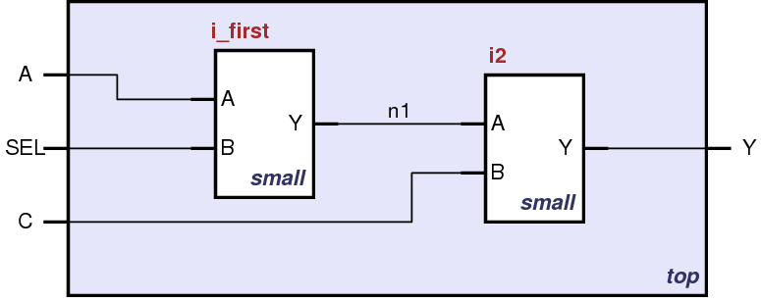
Structural HDL Example
Module Definitions
module top (A, SEL, C, Y);
input A, SEL, C;
output Y;
wire n1;
endmodule
module small (A, B, Y);
input A;
input B;
output Y;
// description of small
endmodule

Slide 64
Structural HDL Example
Module Definitions
module top (A, SEL, C, Y);
input A, SEL, C;
output Y;
wire n1;
endmodule
module small (A, B, Y);
input A;
input B;
output Y;
// description of small
endmodule

Slide 65
Structural HDL Example
Wire definitions
module top (A, SEL, C, Y);
input A, SEL, C;
output Y;
wire n1;
endmodule
module small (A, B, Y);
input A;
input B;
output Y;
// description of small
endmodule

Slide 66
Structural HDL Example
Instantiate first module
module top (A, SEL, C, Y);
input A, SEL, C;
output Y;
wire n1;
// instantiate small once
small i_first ( .A(A),
.B(SEL),
.Y(n1) );
endmodule
module small (A, B, Y);
input A;
input B;
output Y;
// description of small
endmodule

Slide 67
Structural HDL Example
Instantiate second module
module top (A, SEL, C, Y);
input A, SEL, C;
output Y;
wire n1;
// instantiate small once
small i_first ( .A(A),
.B(SEL),
.Y(n1) );
// instantiate small second time
small i2 ( .A(n1),
.B(C),
.Y(Y) );
endmodule
module small (A, B, Y);
input A;
input B;
output Y;
// description of small
endmodule

Slide 68
Structural HDL Example
Short Instantiation
module top (A, SEL, C, Y);
input A, SEL, C;
output Y;
wire n1;
// alternative
small i_first ( A, SEL, n1 );
/* Shorter instantiation,
pin order very important */
// any pin order, safer choice
small i2 ( .B(C),
.Y(Y),
.A(n1) );
endmodule
module small (A, B, Y);
input A;
input B;
output Y;
// description of small
endmodule

Slide 69
What Happens with HDL code?
Automatic Synthesis
Modern tools are able to map a behavioral HDL code into gate-level schematics
They can perform many optimizations
… however they can not guarantee that a solution is optimal
Most common way of Digital Design these days
Simulation
Allows the behavior of the circuit to be verified without actually manufacturing the circuit
Simulators can work on behavioral or gate-level schematics

Slide 70
Behavioral HDL: Defining Functionality
module example (a, b, c, y);
input a;
input b;
input c;
output y;
// here comes the circuit description
assign y = ~a & ~b & ~c |
a & ~b & ~c |
a & ~b & c;
endmodule

Slide 71
Behavioral HDL: Synthesis Results

Slide 72
Behavioral HDL: Simulating the Circuit

Slide 73
Bitwise Operators
module gates(input [3:0] a, b,
output [3:0] y1, y2, y3, y4, y5);
/* Five different two-input logic
gates acting on 4 bit busses */
assign y1 = a & b; // AND
assign y2 = a | b; // OR
assign y3 = a ^ b; // XOR
assign y4 = ~(a & b); // NAND
assign y5 = ~(a | b); // NOR
endmodule

Slide 74
Bitwise Operators: Synthesis Results

Slide 75
Reduction Operators
module and8(input [7:0] a,
output y);
assign y = &a;
// &a is much easier to write than
// assign y = a[7] & a[6] & a[5] & a[4] &
// a[3] & a[2] & a[1] & a[0];
endmodule

Slide 76
Reduction Operators: assign y = &a;

Slide 77
Conditional Assignment
module mux2(input [3:0] d0, d1,
input s,
output [3:0] y);
assign y = s ? d1 : d0;
// if (s) then y=d1 else y=d0;
endmodule
? : is also called a ternary operator as it operates on three inputs:
s
d1
d0.

Slide 78
Conditional Assignment: y = s ? d1: d0;

Slide 79
More Conditional Assignments
module mux4(input [3:0] d0, d1, d2, d3
input [1:0] s,
output [3:0] y);
assign y = s[1] ? ( s[0] ? d3 : d2)
: ( s[0] ? d1 : d0);
// if (s1) then
// if (s0) then y=d3 else y=d2
// else
// if (s0) then y=d1 else y=d0
endmodule

Slide 80
Even More Conditional Assignments
module mux4(input [3:0] d0, d1, d2, d3
input [1:0] s,
output [3:0] y);
assign y = (s == 2’b11) ? d3 :
(s == 2’b10) ? d2 :
(s == 2’b01) ? d1 :
d0;
// if (s = “11” ) then y= d3
// else if (s = “10” ) then y= d2
// else if (s = “01” ) then y= d1 // else y= d0
endmodule

Slide 81
How to Express numbers ?
N’Bxx
8’b0000_0001
(N) Number of bits
Expresses how many bits will be used to store the value
(B) Base
Can be b (binary), h (hexadecimal), d (decimal), o (octal)
(xx) Number
The value expressed in base, apart from numbers it can also have X and Z as values.
Underscore _ can be used to improve readability

Slide 82
Number Representation in Verilog
Verilog | Stored Number | Verilog | Stored Number
4’b1001 | 1001 | 4’d5 | 0101
8’b1001 | 0000 1001 | 12’hFA3 | 1111 1010 0011
8’b0000_1001 | 0000 1001 | 8’o12 | 00 001 010
8’bxX0X1zZ1 | XX0X 1ZZ1 | 4’h7 | 0111
‘b01 | 0000 .. 0001 | 12’h0 | 0000 0000 0000

Slide 83
What have seen so far:
Describing structural hierarchy with Verilog
Instantiate modules in an other module
Writing simple logic equations
We can write AND, OR, XOR etc
Multiplexer functionality
If … then … else
We can describe constants
But there is more:

Slide 84
Precedence of operations in Verilog
Highest
~ | NOT
*, /, % | mult, div, mod
+, - | add,sub
<<, >> | shift
<<<, >>> | arithmetic shift
<, <=, >, >= | comparison
==, != | equal, not equal
&, ~& | AND, NAND
^, ~^ | XOR, XNOR
|, ~| | OR, NOR
?: | ternary operator
Lowest

Slide 85
Example: Comparing two numbers
An XNOR gate
An AND gate
module MyXnor (input a, b,
output z);
assign z = ~(a ^ b); //not XOR
endmodule
module MyAnd (input a, b,
output z);
assign z = a & b; // AND
endmodule

Slide 86
Example: Comparing Two Numbers
module compare (input a0, a1, a2, a3, b0, b1, b2, b3,
output eq);
wire c0, c1, c2, c3, c01, c23;
MyXnor i0 (.A(a0), .B(b0), .Z(c0) ); // XNOR
MyXnor i1 (.A(a1), .B(b1), .Z(c1) ); // XNOR
MyXnor i2 (.A(a2), .B(b2), .Z(c2) ); // XNOR
MyXnor i3 (.A(a3), .B(b3), .Z(c3) ); // XNOR
MyAnd haha (.A(c0), .B(c1), .Z(c01) ); // AND
MyAnd hoho (.A(c2), .B(c3), .Z(c23) ); // AND
MyAnd bubu (.A(c01), .B(c23), .Z(eq) ); // AND
endmodule

Slide 87
Example: Comparing Two Numbers
module compare (input a0, a1, a2, a3, b0, b1, b2, b3,
output eq);
wire c0, c1, c2, c3, c01, c23;
MyXnor i0 (.A(a0), .B(b0), .Z(c0) ); // XNOR
MyXnor i1 (.A(a1), .B(b1), .Z(c1) ); // XNOR
MyXnor i2 (.A(a2), .B(b2), .Z(c2) ); // XNOR
MyXnor i3 (.A(a3), .B(b3), .Z(c3) ); // XNOR
assign c01 = c0 & c1;
assign c23 = c2 & c3;
assign eq = c01 & c23;
endmodule

Slide 88
Example: Comparing Two Numbers
module compare (input a0, a1, a2, a3, b0, b1, b2, b3,
output eq);
wire c0, c1, c2, c3;
MyXnor i0 (.A(a0), .B(b0), .Z(c0) ); // XNOR
MyXnor i1 (.A(a1), .B(b1), .Z(c1) ); // XNOR
MyXnor i2 (.A(a2), .B(b2), .Z(c2) ); // XNOR
MyXnor i3 (.A(a3), .B(b3), .Z(c3) ); // XNOR
assign eq = c0 & c1 & c2 & c3;
endmodule

Slide 89
Example: Comparing Two Numbers
module compare (input a0, a1, a2, a3, b0, b1, b2, b3,
output eq);
wire [3:0] c; // bus definition
MyXnor i0 (.A(a0), .B(b0), .Z(c[0]) ); // XNOR
MyXnor i1 (.A(a1), .B(b1), .Z(c[1]) ); // XNOR
MyXnor i2 (.A(a2), .B(b2), .Z(c[2]) ); // XNOR
MyXnor i3 (.A(a3), .B(b3), .Z(c[3]) ); // XNOR
assign eq = &c; // short format
endmodule

Slide 90
Example: Comparing Two Numbers
module compare (input [3:0] a, input [3:0] b,
output eq);
wire [3:0] c; // bus definition
MyXnor i0 (.A(a[0]), .B(b[0]), .Z(c[0]) ); // XNOR
MyXnor i1 (.A(a[1]), .B(b[1]), .Z(c[1]) ); // XNOR
MyXnor i2 (.A(a[2]), .B(b[2]), .Z(c[2]) ); // XNOR
MyXnor i3 (.A(a[3]), .B(b[3]), .Z(c[3]) ); // XNOR
assign eq = &c; // short format
endmodule

Slide 91
Example: Comparing Two Numbers
module compare (input [3:0] a, input [3:0] b,
output eq);
wire [3:0] c; // bus definition
assign c = ~(a ^ b); // XNOR
assign eq = &c; // short format
endmodule

Slide 92
Example: Comparing Two Numbers
module compare (input [3:0] a, input [3:0] b,
output eq);
assign eq = (a == b) ? 1 : 0; // really short
endmodule

Slide 93
What is the BEST way of writing Verilog
Quite simply IT DOES NOT EXIST!
Code should be easy to understand
Sometimes longer code is easier to comprehend
Hierarchy is very useful
In the previous example it did not look like that, but for larger designs it is indispensible
Try to stay closer to hardware
After all the goal is to design hardware

Slide 94
Parameterized Modules
module mux2
#(parameter width = 8) // name and default value
(input [width-1:0] d0, d1,
input s,
output [width-1:0] y);
assign y = s ? d1 : d0;
endmodule
We can pass parameters to a module

Slide 95
Parameterized Modules: Instantiating
module mux2
#(parameter width = 8) // name and default value
(input [width-1:0] d0, d1,
input s,
output [width-1:0] y);
assign y = s ? d1 : d0;
endmodule
// If parameter is not given, default is assumed (here 8)
mux2 i_mux (d0, d1, s, out);
// The same module with 12-bit bus width:
mux2 #(12) i_mux_b (d0, d1, s, out);
// More verbose version:
mux2 #(.width(12)) i_mux_b (.d0(d0), .d1(d1),
.s(s), .out(out));

Slide 96
Manipulating Bits
// You can assign partial busses
wire [15:0] longbus;
wire [7:0] shortbus;
assign shortbus = longbus[12:5];
// Concatenating is by {}
assign y = {a[2],a[1],a[0],a[0]};
// Possible to define multiple copies
assign x = {a[0], a[0], a[0], a[0]}
assign y = { 4{a[0]} }

Slide 97
Z floating output
module tristate(input [3:0] a,
input en,
output [3:0] y);
assign y = en ? a : 4'bz;
endmodule

Slide 98
Truth Table for AND with Z and X
& |  | A
 |  | 0 | 1 | Z | X
B | 0 | 0 | 0 | 0 | 0
 | 1 | 0 | 1 | X | X
 | Z | 0 | X | X | X
 | X | 0 | X | X | X

Slide 99
What About Timing ?
It is possible to define timing relations in Verilog
These are ONLY for Simulation
They CAN NOT be synthesized
They are used for modeling delays in simulation
‘timescale 1ns/1ps
module simple (input a, output z1, z2);
assign #5 z1 = ~a; // inverted output after 5ns
assign #9 z2 = a; // output after 9ns
endmodule

Slide 100
Next Steps
We have seen an overview of Verilog
Discussed behavioral and structural modeling
Showed combinational logic constructs
Still to come: (later)
Sequential circuit description in Verilog
Developing testbenches for simulation

