Slide 1
Security of Wireless Networks
Lecture 2
Srdjan Čapkun
Department of Computer Science
ETH Zurich

Slide 2
Broadcast Jamming-Resistant Communication
– keys, some keys, no keys –
Physical Layer Security

Slide 3
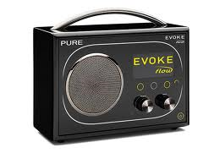

Broadcast Communication
Broadcast communication
One sender, many receivers
Open system
  New receivers may join,
  receivers may withdraw
  Any receiver can listen
  (in contrast to multicast)
                Examples:
                radio (audio) broadcast
                (AM, FM, …)
                navigation signals: satellite-based (GPS), terrestrial (LORAN)
broadcast
A
D
B
C
multicast
A
D
B
C

Slide 4
Attacks on Broadcast Communication
For pairwise (unicast) communication we only consider external (outsider) attackers
A and B are mutually trusted
Attacker uses only public information
Broadcast communication
High and unknown number of receivers
Receivers are potentially untrusted and may be colluding
We need to consider external attackers
and internal (insider) attackers
(can be more efficient)
Group keys?
J
A
B
A
B
…
D
C
E

Slide 5
External Attackers on SS Techniques
External attacker
  Does not know the spreading code / hopping sequence
  Partial-band attacker can still jam. Example: FHSS
  p_{j} = Probability that the packet is jammed
  = 1 – (1 – c_{j} /c )^{nj}
Min. jamming
c = # frequency channels
c_{j} = # channels the jammer jams
n_{j} = # jamming cycles per packet
(given by min. jamming
period, packet length, and
jammer capabilities)
Packet
c
c_{j}
Typical computation
of jamming probability
via the inverse

Slide 6
Internal Attackers on SS Techniques
Internal attacker
  Legitimate receiver: can decode the broadcast signal, i.e. knows the used spreading code and its synchronization
  Can misuse the spreading code and synchronization for jamming to disable other receivers to get the signal
  Group keys do not prevent this attack!
  We need a better solution!
Key K
A
K
B
…
D
C
E
K
K
K

Slide 7
Anti-jamming Broadcast
Side remark: Generally,
anti-jamming (AJ) = jamming-resistant
Problem: Base station (BS) needs to broadcast an
(authenticated / confidential) message to a large
number of receivers in an anti-jamming manner
broadcast
J
A
m, sig(m)
D
B
C
Desirable properties:
Detect / prevent jamming
Support a flexible number of receivers
Tolerate a certain fraction of malicious receivers
Some solutions based on keys shared between sender and receivers:
Desmedt et al.: FHSS-based – each receiver listens to a subset of frequencies on which the sender transmits
Chiang, Hu: DSSS-based – codes assigned to each receiver

Slide 8
Broadcast Anti-jamming Systems [Desmedt et al.] - I
Broadcast anti-jamming based on frequency hopping (FHSS)
Coding method provides protection against malicious receivers
  Base station transmits the same signal simultaneously on multiple frequencies
  Each receiver listens to a subset of these frequencies at a given time
  Threshold scheme: provides protection against up to
  j – 1 colluding receivers
Based on secret information
c

Slide 9
Broadcast Anti-jamming Systems [Desmedt et al.] - II
Public Channel Allocation Table
  Defines the subset of channels
  where each receiver R_{i} is listening
  Known to every receiver
  j–1 receivers do not cover all
  channels of any other receiver
  Set coverage problem
Secret Frequency Allocation Table
  The actual frequencies are secret
  Created and updated via a pseudo-noise generator
[Snapshot of the frequency allocation table, the complete table is only known to the base station]

Slide 10
Broadcast Anti-jamming Systems [Desmedt et al.] - III
System Description:
  Channels C = {c₁, c₂, ..., c_{m}}
  Receivers R = {R₁, R₂, ..., R_{l}}
  Subsets of channels CR = {C₁, C₂, ..., C_{l}}
Theorem: If |C_{i}| ≥ 1 + (j – 1)d for all 1 ≤ i ≤ l and |C_{i}∩ C_{k}| ≤ d for all i ≠ k, then (C, CR) is a Broadcast Anti-Jamming System.
Sufficient but not necessary condition
Example: C = {1,2,3,4,5,6}, R = {B₁,B₂,B₃,B₄},
CR= {{1,2}, {2,3}, {4,5}, {5,6}}
  Resistant to j = 3 jammers, i.e., j – 1 = 2
  m = 6, l = 4, |C_{i}∩ C_{k}| ≤ d = 1
  Yet |C_{i}| = 2, not the required |C_{i}| ≥ 1 + (j – 1)d = 3

Slide 11
Broadcast Anti-jamming Systems [Desmedt et al.] - IV
The Desmedt broadcast anti-jamming system works if
  the group of colluders consists of j – 1 or fewer members and hence each receiver is always left with at least one free (= unjammed) channel
  the assigned frequencies can be distributed over a broad, non-continuous frequency band
However, this scheme requires secret information to be shared between the base station and each participating receiver multicast solution

Slide 12
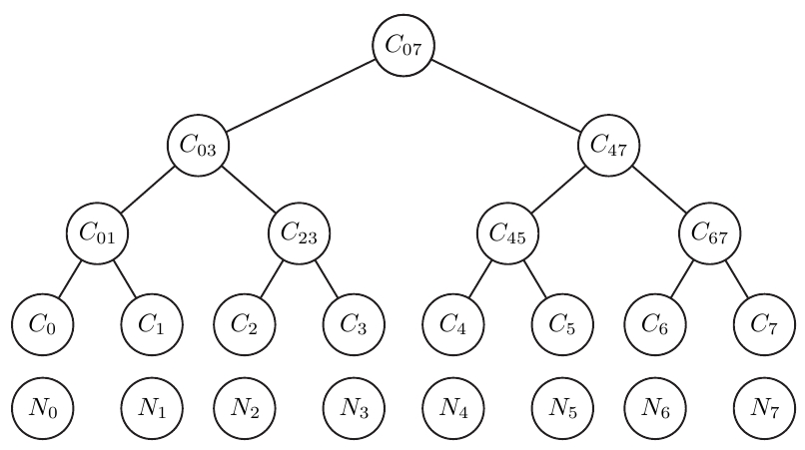
Dynamic Jamming Mitigation [Chiang and Hu] – I
Broadcast anti-jamming based on DSSS
Counteract jamming by using a balanced binary key tree
  Each node corresponds to a spreading code
  Each user N_{i} is assigned to a leaf and knows all codes on the path from the root
The base station transmits on ...
  a disjoint cover of codes, i.e., all users
  can decode using exactly one code
  a set of test codes
If a user receives a message
on a test code but not on
the corresponding
detectable code,
it reports jamming

Slide 13
Dynamic Jamming Mitigation [Chiang and Hu] – II
Jamming detection and mitigation
Detection and mitigation rely on feedback
Splitting and reforming the tree allows the transmitter to send each transmission on ≤ 2j+1 codes, where j is the (expected upper) number of jammers (details omitted)

Slide 14
Dynamic Jamming Mitigation [Chiang and Hu] – III
Requires highly flexible base station (sending and receiving on a potentially large number of codes) and feedback channels
  Not applicable to unidirectional broadcast
Requires secrets to be shared between the base station and the receivers
  Each receiver knows the codes on its path to the root but no other codes
  Number of required secrets grows with the number of receivers

Slide 15
Looking back …
Introduction to broadcast systems
Group keys are not a solution against jamming
Two solutions based on secrets shared between the base station and the receivers:
  FH-based by Desmedt et. al
  DSSS-based by Chiang et. al
Can we achieve jamming-resistant communication without shared secrets?

Slide 16
Broadcast Anti-Jamming Techniques
Without Shared Secrets
Physical Layer Security

Slide 17
Anti-jamming Broadcast Without Shared Keys
Problem: BS needs to broadcast an (authenticated) message to a large number of unknown/untrusted receivers in an anti-jamming manner.
broadcast
PK_{A}
J
A
m, sig(m)
D
B
Applications: alarm broadcast,
navigation signals, etc …
C
PK_{A}
PK_{A}
PK_{A}
But …
Anti-Jamming communication relies on shared secret keys
In anti-jamming broadcast we cannot rely on shared keys
(unknown/untrusted receivers)
The prior schemes (Desmedt, Chiang) do not work for unknown receivers
Public-key crypto does not help

Slide 18
Anti-Jamming Key Establishment
Problem:
A and B want to establish
a shared secret key in
the presence of a jammer J
Assumptions:
  A and B do not share any secrets
  The clocks of A and B are
  loosely synchronized O(s)
  Each node has a public/private key pair and a certificate binding its identity to the public key
  CA (Certification Authority) is trusted by all nodes; it may be
  off-line or unreachable by the nodes at the time of communication
(offline)
CA
Cert_{CA}(A)
Cert_{CA}(B)
A
B
J

Slide 19
Anti-Jamming / Key-establishment Dependency
Key establishment depends on
jamming-resistant communication
Common anti-jamming techniques
require a shared secret key (code)
Leads to an anti-jamming/
key-establishment dependency cycle

Slide 20
Two Solutions: UFH and UDSSS
Basic idea:
If you cannot coordinate the sender and the receiver – Don’t!
Sender uses random hopping sequences / spreading codes unknown to the receiver (public set)
Two solutions:
  Uncoordinated Frequency Hopping Spread Spectrum (UFH)
  Uncoordinated Direct Sequence Spread Spectrum (UDSSS)
Rationale:
The attacker cannot predict which channels will be used (neither can the receiver)
Equivalent to FH in jamming protection (but not in throughput)
Throughput can be improved by using broadband receivers (c_{t}, c_{r})
(UFH)

Slide 21
Attacker Model
Attacker goal: to prevent communication!
Attacker actions: Jam, Insert, Modify
Attacker types: Responsive, Sweep, Random, …
Attacker strength (channels/time to jam/sense): c_{s} / t_{s}, c_{j} / t_{j}
Power to insert, jam, and overshadow: P_{t}, P_{j}, andP_{o}
P_{T}: total signal strength that attacker J can achieve at the receiver B
Given the number of frequency channels on which the attacker inserts (c_{t}), jams (c_{j}), and overshadows (c_{o}),
c_{t}P_{t} + c_{j}P_{j} + c_{o}P_{o}≤ P_{T}

Slide 22
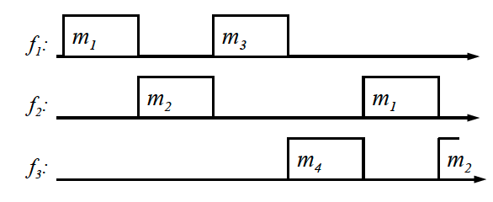
Uncoordinated Frequency Hopping (transmitter)
Fragmentation
Fragment linking
(protects against insertion)
Packet Encoding (ECC)
(protects against jamming)
Repeated transmission
M := m, sig(m), …
M₁
M₂
M₃
M_{l}
M₁
M₂
…
M_{l}
m₁
m₂
m_{l}

Slide 23
Uncoordinated Frequency Hopping (receiver)
Receiving packets
Packet decoding
Ordering and linking
Message reassembly
and signature verification
m₁
m₃
f₁:
f₂:
m₂
m₁
M₁
M₁
M₁
M₁
M₁
M₁
M₁
M₂
…
M_{l}
M₁
M₂
…
M_{l}
M₁
M₂
M₃
M_{l}
M := m, sig(m), …

Slide 24
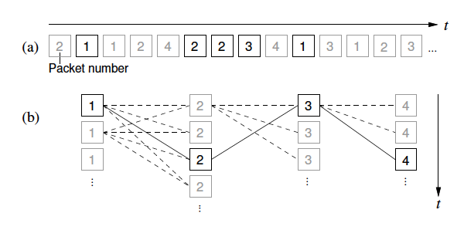
Security analysis: Fragment linking
Problem: Fragments are not individually authenticated (pollution attacks)
(I+1)^{l}
Signature verification at each candidate message (after reassembly)
In the best case, I=1 … (depends on attacker’s # of channels, power …)
but l is large; l = (>20)
Result: Attacker performs a DoS attack on the logical level instead on
the physical
message size
slot size

Slide 25
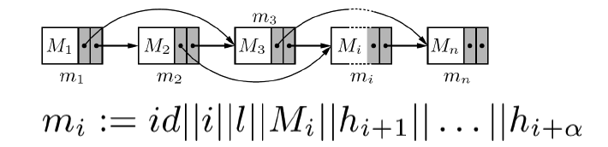
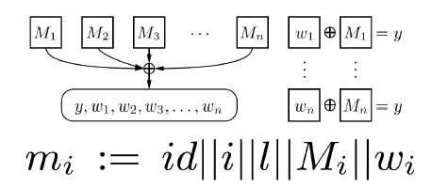

Security analysis: Fragment linking
Problem: Fragments are not individually authenticated (pollution attacks)
Solution: Cryptographically link fragments (no reliance on shared key)
to achieve message integrity
Hash linking
One-way Accumulators
Short signatures
Min 1 hash
1 witness
1 short signature

Slide 26
Security analysis: Fragment linking
Gain: Instead of (I+1)^{l} signature verifications, reduction to (I+1)l hash/acum/signature verifications + (I+1) signature verifications
Signatures and accumulators better than hash linking
Possible extensions:
Use linking with erasure codes, e.g., Fountain codes.
Reconstruct the message from any k fragments.

Slide 27
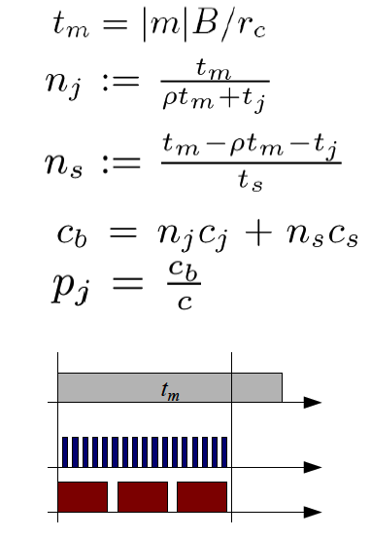
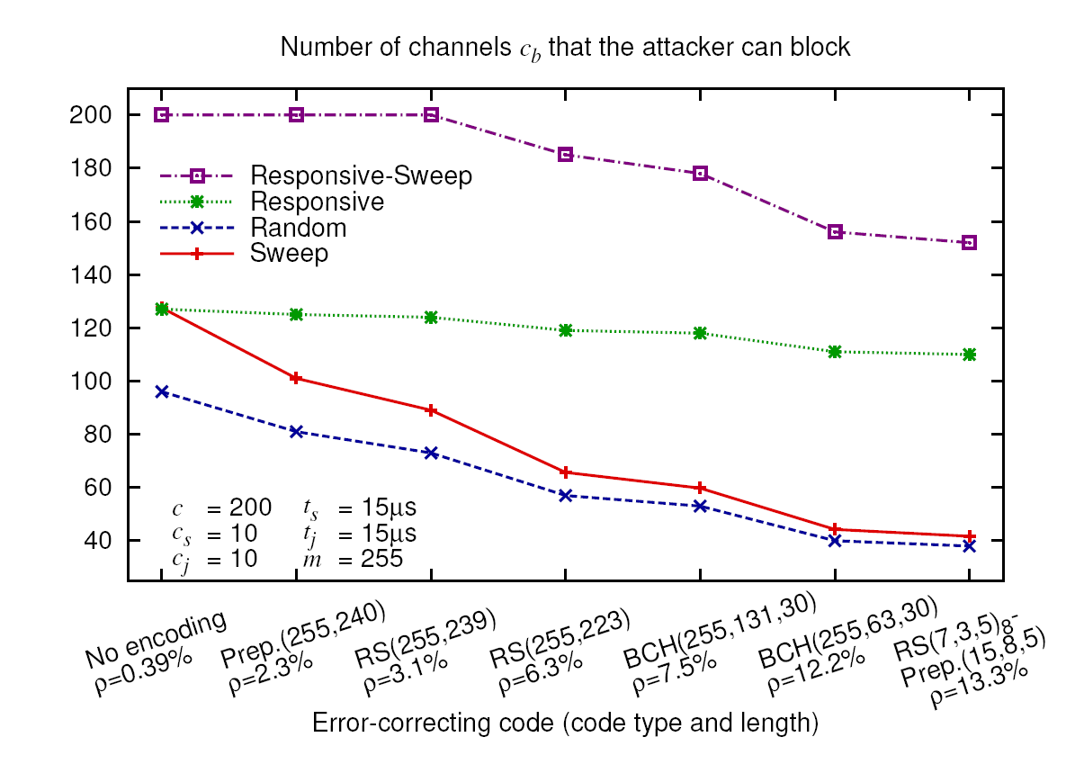
Security analysis: Packet Encoding
Defined by the jamming resistance ρ and coding rate r_{c}
Packet transmission time:
#channels that the attacker can
(blindly) jam during the transmission:
#channels that the attacker can
scan during the transmission:
#channels that the attacker can
block during the transmission

Slide 28
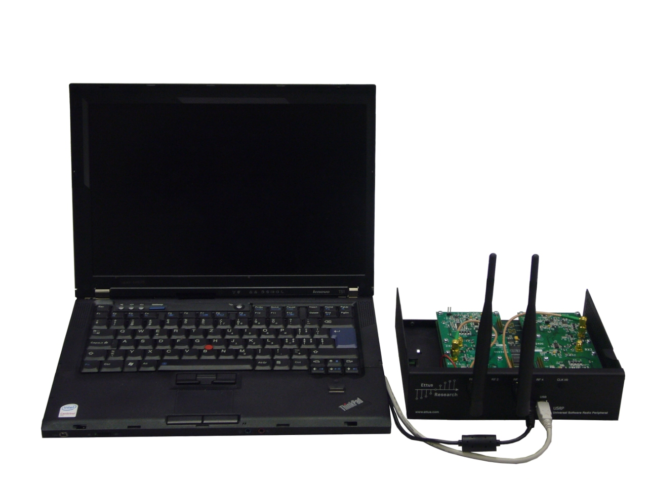
Performance Results
Optimal # of channels (c*=2c_{b})
Some results (c=200, 1MBit/s, 1600 hops/s, ECC signature, |M=2176|, l=13)
  Throughput: 1000x slower than FH
  Latency: 2 – 100s (different attacker strengths)

Slide 29
Two Solutions: UFH and UDSSS
Basic idea:
If you cannot coordinate the sender and the receiver – Don’t!
Sender uses random hopping sequences / spreading codes unknown to the receiver (public set)
Two solutions:
  Uncoordinated Frequency Hopping Spread Spectrum (UFH)
  Uncoordinated Direct Sequence Spread Spectrum (UDSSS)
Rationale:
The attacker cannot predict which spreading codes are used by the sender (neither can the receiver)
UDSSS has reduced latency compared to DSSS
Throughput can be improved by using parallelization
(UFH)

Slide 30
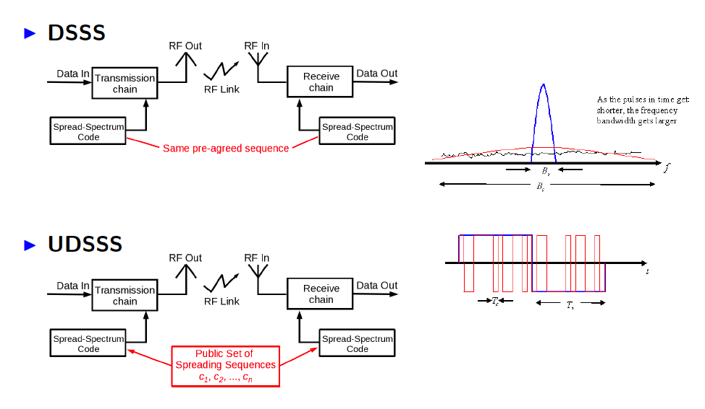
Uncoordinated Direct Sequence Spread Spectrum

Slide 31
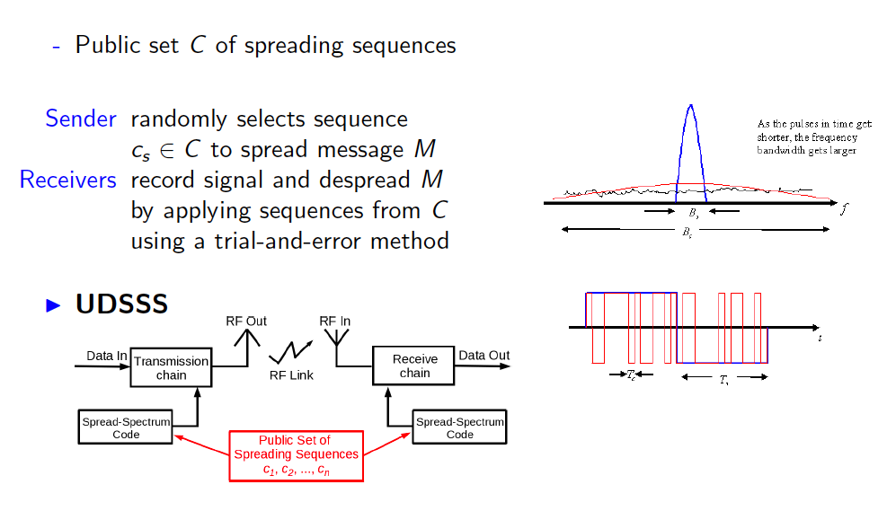
Uncoordinated Direct Sequence Spread Spectrum

Slide 32
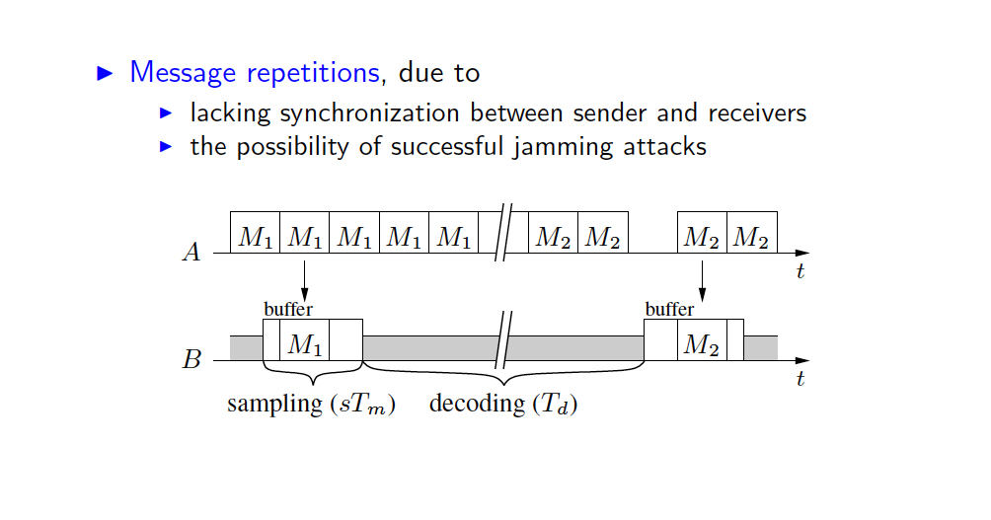
Uncoordinated Direct Sequence Spread Spectrum

Slide 33
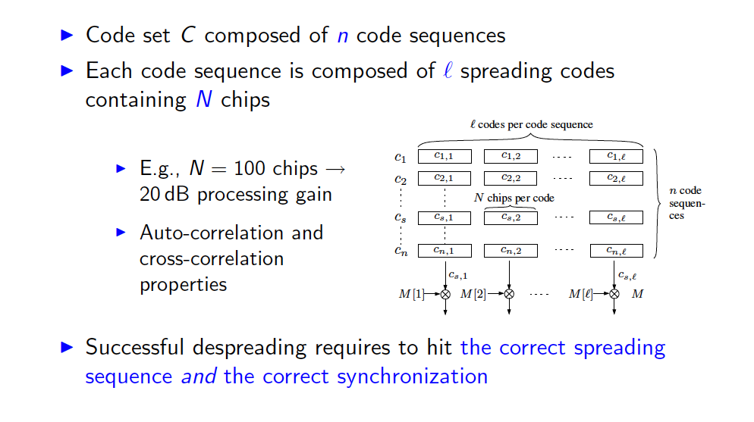
Uncoordinated Direct Sequence Spread Spectrum

Slide 34
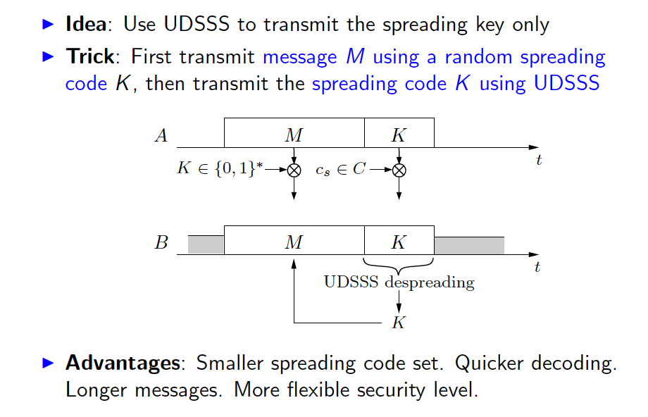
UDSSS: Optimization

Slide 35
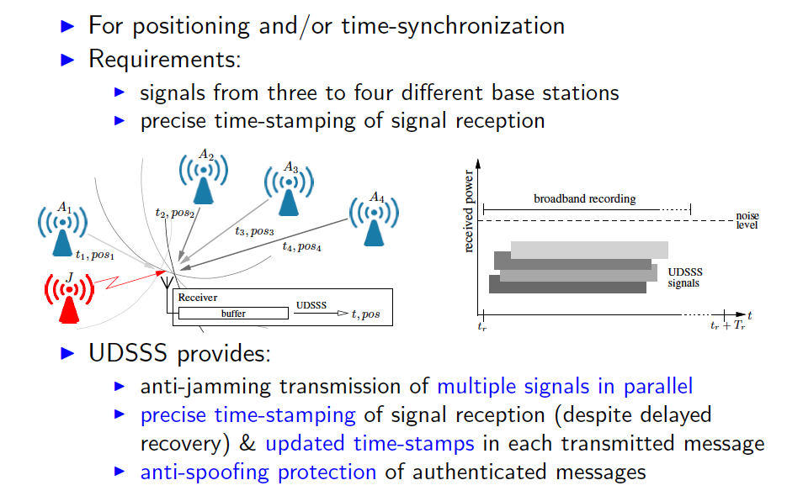
UDSSS: Example Application

Slide 36
Summary
Anti-jamming – key-establishment circular dependency
Broadcast anti-jamming problem
UDSSS and UFH
New attacker models
Applications
A
D
B
C

Slide 37
Application of (Broadcast)
Anti-Jamming Techniques to Key Establishment
Physical Layer Security

Slide 38
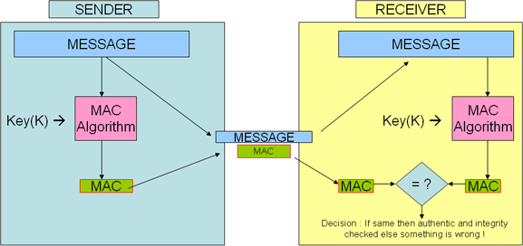
Applications for Shared Keys in Wireless Networks
Secret keys are required / used for:
  Communication techniques (DSSS, Frequency Hopping)
  Encryption of messages
  Integrity protection of messages (MACs = Message Authentication Codes)
  Authentication / authorized access
  …
[www.answers.com]

Slide 39
The Problem with Key Establishment
Key establishment is a challenge
Pre-sharing Symmetric Keys
  A Trusted Third Party (TTP) pre-loads the keys
  Efficient (+)
  Suffers from network dynamics problems (–):
    new nodes joining, key revocation, key compromise
Key Establishment
  Based on public-key (asymmetric) cryptography
  Prominent examples: RSA, Diffie-Hellman (DH)
    Based on computational hardness of the factorization (RSA) or discrete logarithm (DH) problem
  Requires reliable communication

Slide 40
DH Key Establishment
Nodes A and B do not share any secrets, but possess certificates of their public keys
Authenticated Diffie-Hellman Protocol (using signatures)
Conventional SS-Techniques cannot be used for the communication due to the missing shared secret
gª mod p
A
B
g^{b} mod p, sig_{B}(g^{b},gª)
sig_{A}(gª,g^{b})
K_{AB}=(g^{b})ª mod p
K_{AB}=(gª)^{b} mod p
public keys
A B
☺
Trusted Third Party
= Certification Authority (CA)
Notes:
40
Summarized, key establishment depends on jamming-resistant communication,
which, in turn, depends on shared secret key that is shared prior to the start of
the communication
This dependency precludes a spontaneous key establishment
between unpaired devices and leads to what we call the
anti-jamming/key-establishment dependency cycle
To put it bluntly: with current solutions, jamming brings us back
to the pre-Diffie-Hellman area where the secrets have to be pre-loaded.

Slide 41
Anti-jamming / Key-establishment dependency
Key establishment (e.g. using DH)
depends on jamming-resistant
communication
Common anti-jamming techniques
require a shared secret key (code)
Leads to an anti-jamming/
key-establishment dependency cycle
Key idea: break the dependency cycle by using Uncoordinated Frequency Hopping (UFH)
A
5
11
t
B
1
5
36
11
28
t
Notes:
41
Summarized, key establishment depends on jamming-resistant communication,
which, in turn, depends on shared secret key that is shared prior to the start of
the communication
This dependency precludes a spontaneous key establishment
between unpaired devices and leads to what we call the
anti-jamming/key-establishment dependency cycle
To put it bluntly: with current solutions, jamming brings us back
to the pre-Diffie-Hellman area where the secrets have to be pre-loaded.

Slide 42
Key Establishment Protocol: Sender/Receiver
ECC-based Station-to-Station Diffie-Hellman
- Plies on elliptic curve E(F_{q}), CA = Certification Authority
- PK_{A}= A's public key, Sig_{A}= A's signature, r_{A}P= A's key contribution
Elliptic Curve Cryptography (ECC) enables to reduce the key length while maintaining the level of security
- E.g., 128-bit security level [NIST] →256 bit prime fields on elliptic
curves and 512 bit keys (vs. 3072-bit key for RSA)
Use UFH to transmit the messages
Notes:
But first things first, let’s start on top with the key establishment protocol
In our work we propose the usage of an ECC-based Station-to-Station Diffie-Hellman
protocol, but our UFH scheme does not rely on it
All that is required is that the exchanged messages are authenticated
Since these messages are the smallest entity that can be verified by the receiver, we cannot trust lower-layer acknowledgments and thus A keeps on sending it message until it receives a valid response from B
To identify duplicates and counter replay attacks, we use timestamps along with a short-term history buffer

Slide 43


What to remember?
What are broadcast systems?
Applications for broadcast
Approaches for enabling jamming-resistant broadcast despite internal attackers
Jamming-resistant communication
without shared secrets
Anti-jamming/Key-establishment dependency
A
t
B
t

