Slide 1
ETH Mobility Initiative Project MI-01-19
Empirical use and Impact analysis of MaaS (EIM)
5th Partnership Council – ETH Mobility Initiative
December 2021
Henry Martin¹, Daniel Reck², Kay W. Axhausen² und Martin Raubal¹
¹Institute of Cartography and Geoinformation, ETH Zürich
²Institute for Transport Planning and Systems, ETH Zürich

Slide 2

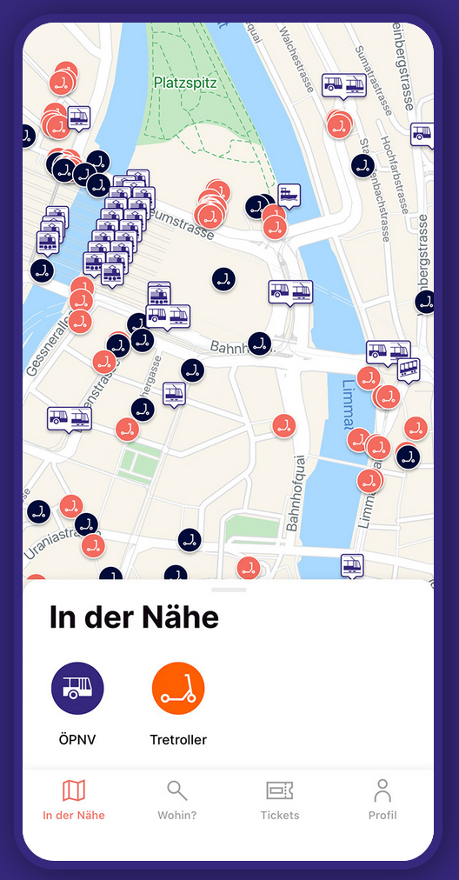
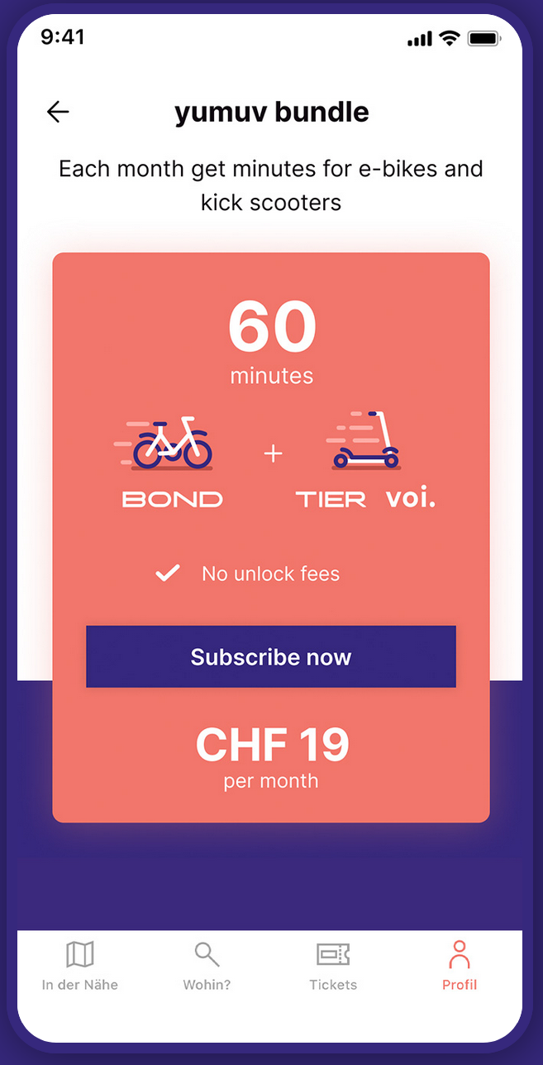









Empirical use and Impact Analysis of MaaS
Goals:
Advance understanding of MaaS mobility bundles’ impact on human mobility behavior
Create application that generalizes over different datasets using an integrated representation of mobility, booking and context data and machine learning.
Yumuv.ch
Notes:
The project was designed around the launch of yumuv; a new MaaS product offered by SBB and PT providers from Basel, Bern and Zürich.
Yumuv is an app that allows you to book several shared modes of transportation such as e-scooter or e-bikes via a single app and with a single registration.
Additionally, yumuv offers so called mobility bundles (shown on the right screenshot) that further simplify the user experience e.g., by offering 60 minutes mobility per month independent of the mode of transport or provider.
We designed a user study around the launch of yumuv to answer the question about how bundles impact human mobility behavior and
and to create machine learning applications that are tailored to the needs of such novel mobility applications . Notably the possibility to combine many different data sources while being memory and computationally efficient.
90 sec

Slide 3
WP1: Data elicitation – study design
Treatment group (TG)
Tracking
Survey 1
Survey 2
Access to YUMUV bundles
Control group (CG)
Tracking
Jul 2020
Aug 2020
Sep 2020
Tracking data | Control group | Treatment group
Nb of users | 672 (427) | 148 (71)
Triplegs | 371’000 | 112’000
Staypoints | 248’000 | 65’000
Labels | Mode of transport + activity label
Tracking time | 3 - 4 months
Total km tracked | 3.9 M km | 1.5 M km
Other data sources
MSP availability
App booking data
Weather
Survey data
Preprocessing methods are open source:
https://github.com/mie-lab/trackintel
Notes:
The project was divided into several work packages. I will now present the main outcomes of each of them.
I start with work package 1: data elicitation
The study was divided into several phases and participants were divided into two groups. The treatment group who got access to the yumuv app and the control group who did not get access to the yumuv app.
The study started with a survey that participants had to fill in. After completing the survey, the participants had to install a tracking app on their phone that recorded they movement behavior.
After 1 month of pre-tracking the TG got access to the yumuv app and to the yumuv bundles. It was mandatory to buy at least 1 bundle. After another 2 month of tracking participants had to fill in another survey and if they completed all requirements they got remunerated.
In the bottom part I have collected some statistics about the data we have collected. The core of the study is the collected tracking data which quickly grows to a considerable amount. In total we had 672 and 148 participants that installed the tracking app but only the number in parantheses fulfilled all requirements.
Apart from tracking data we collected data from various other sources such as the survey data, the available of shared mobility tools such as e-scooters and context data such as weather information. We are very proud that we could make most of our preprocessing methods open source and published them in the trackintel python library that is available online.

Slide 4
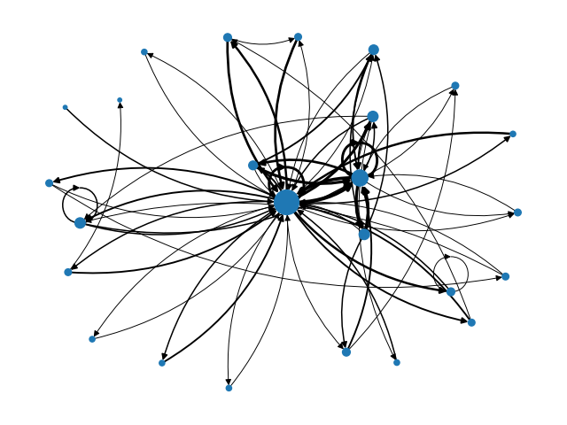
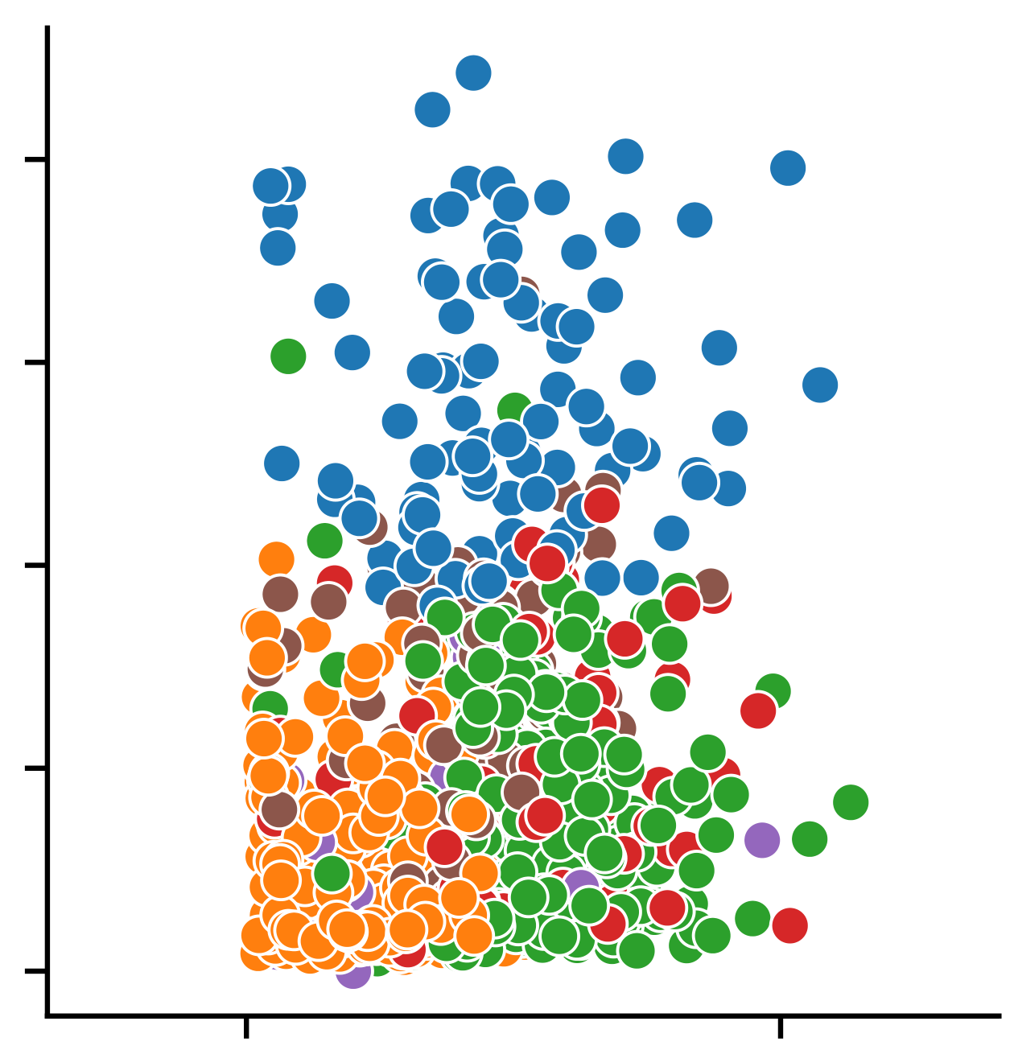
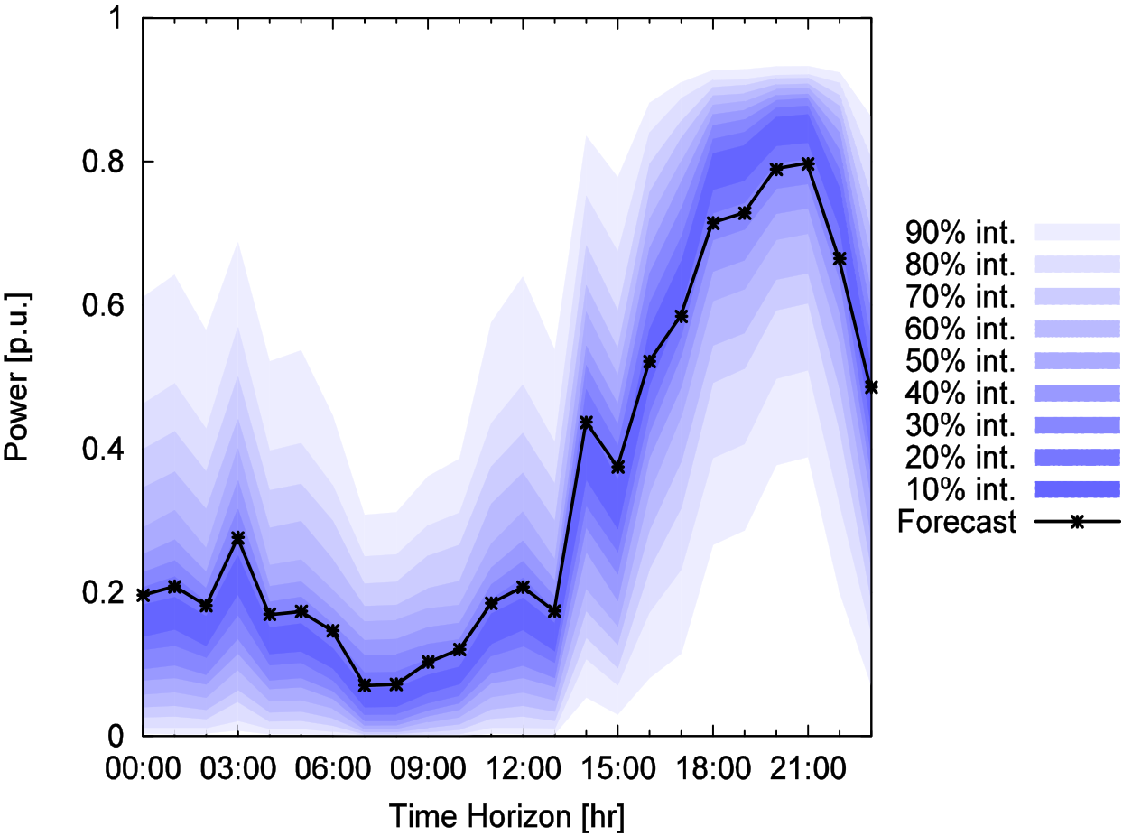
Current project results by work package
Development of a graph representation of individual mobility
Effect of yumuv bundles on transport mode choice:
  e-scooters (++); public transport (+)
  own e-bike (--); Own bicycle (-)
  No significant effect:
  Private vehicle; shared e-bikes; own e-scooter
  Efficient
  Privacy friendly
  Little dataset specific assumptions
WP 2
WP 3
WP 4
Reck, D.J., Martin, H., Raubal, M., Axhausen, K.W., 2021. How do MaaS bundles influence travel behavior? Empirical evidence from the yumuv trial. (in preparation)
Martin, H., Perez-Cruz, F. Raubal, M., 2021. A graph-based representation for human mobility data. (in preparation)
Method to identify user groups with similar mobility behavior
Graph based mobility prediction is planned for 2022
Martin, H., Wiedemann, N. Reck, D.J., Raubal, M., 2021. Graph based mobility profiling for longitudinal and cross-sectional tracking studies. (in preparation)
Notes:
In work package 2 we have developed a graph representation of individual mobility that is Efficient, Privacy friendly and has little dataset specific assumptions which means that it can be used independent of tracking data sets which allows to either merge datasets or to create results that generalize to different datasets.

Slide 5
Summary
Collection of the most comprehensive empirical MaaS dataset that currently exists.
Collected data was used to address several research questions:
  How does MaaS impact mobility behavior?
  How can we represent individual mobility independent of specific datasets?
  How can we perform dataset independent analyses? (continues in 2022)
Novel modes of collaboration with industry partner:
  Close collaboration during organization of the user study.
  Data preprocessing performed in joint team directly on infrastructure of industry partner.
Notes:
Vorteile
(SBB) Intensiver Wissenstransfer
(SBB) Daten bleiben SBB intern mit vollständiger Zugangskontrolle
(ETH) Nachhaltigere Verwendung von Projektmethoden und Ergebnissen
Zielgenauere Forschung durch enge Zusammenarbeit
Nachteile
(ETH) Zusätzlicher Aufwand durch Arbeit auf SBB Infrastruktur
(SBB) Zusätzlicher Aufwand und Kosten durch Bereitstellung der Infrastruktur
(SBB) Prototyping durch Doktoranden auf eigener Infrastruktur
(ETH) Abfluss von geistigem Eigentum
Anforderungen
Relevante Beteiligung aller Parteien bei Datenaufbereitung
Flexibilität bei Veröffentlichung von Methoden und Ergebnissen

Slide 6
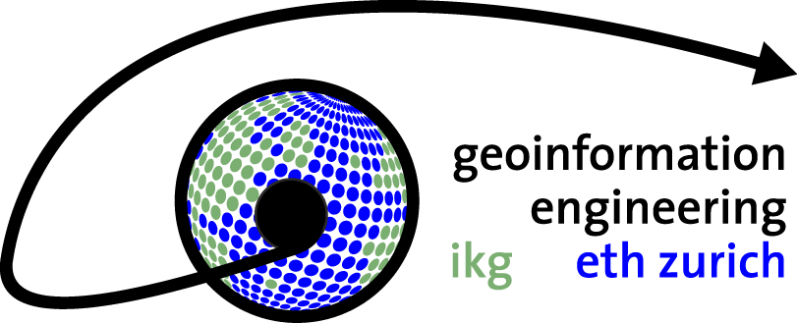


Henry Martin
martinhe@ethz.ch
Institute of Cartography and Geoinformation, ETH Zürich
Mobility Information Engineering (MIE) Lab, ETH Zürich
Institute for Advanced Research in Artificial Intelligence (IARAI)
gis.ethz.ch; mie-lab.ethz.ch; iarai.ac.at

