Slide 1
Long-Range Obstacle Detection for ADAS
Cornelius von Einem, Florian Tschopp, Andrei Cramariuc, Cesar Cadena, Prof. Roland Siegwart
Autonomous Systems Lab, ETH Zurich

Slide 2
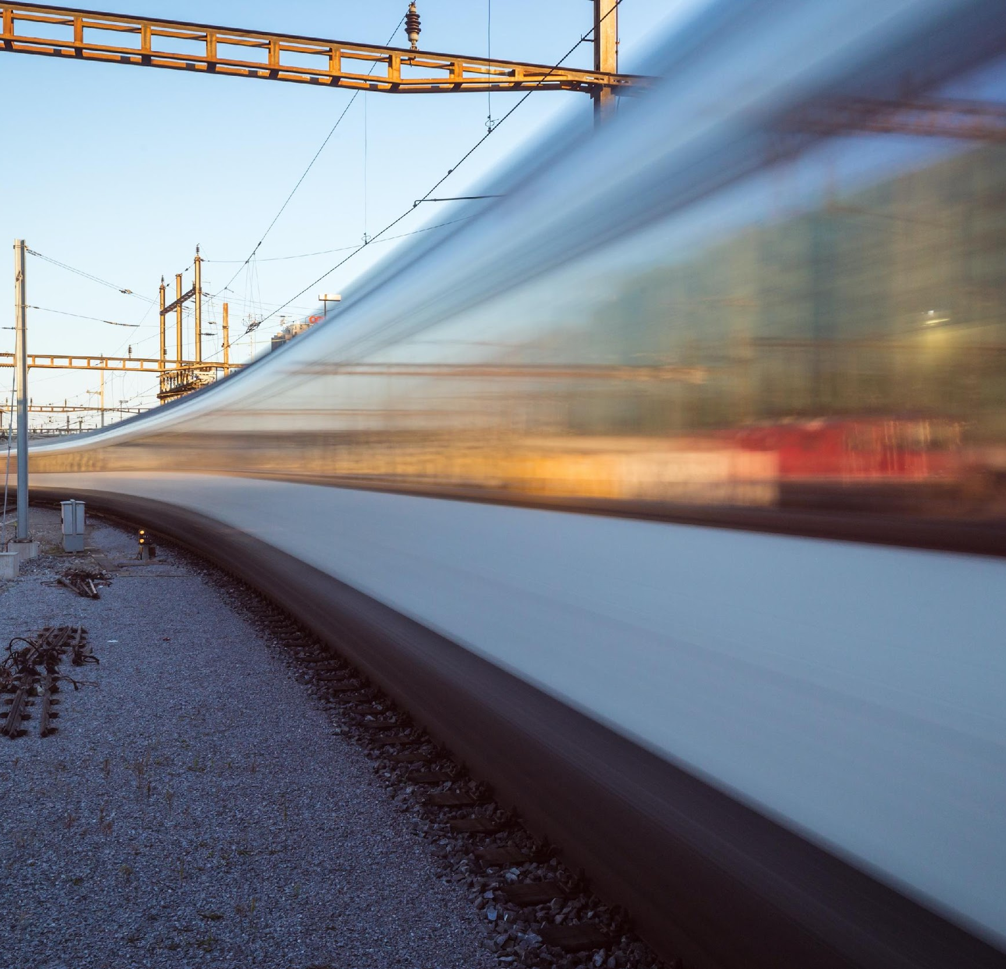
Motivation
Increasing railway traffic
Rising vehicle speeds
Development of autonomous vehicles
New and more advanced safety systems could help for accident prevention (People, infrastructure, trees, other objects)

Slide 3
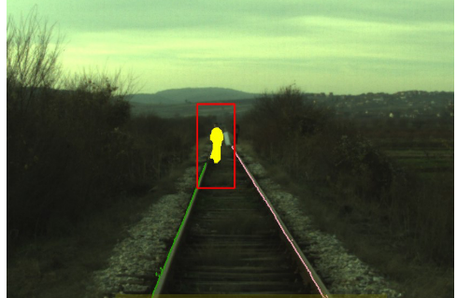
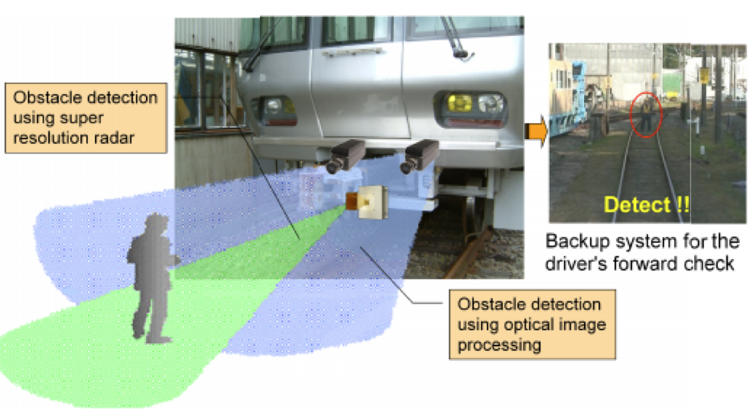
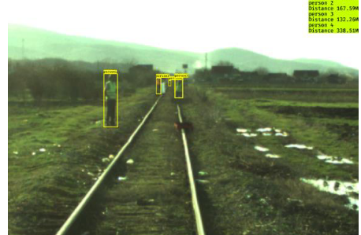
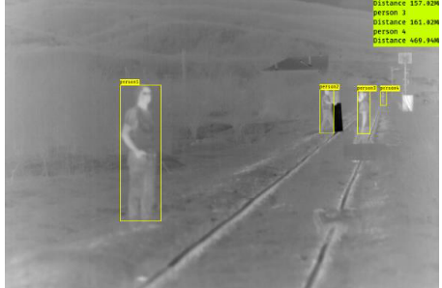
Related work
Sparse long-range LiDARs
Ultra-sonic sensors
Standard LiDARs
Braking distance @ > 100 km/h
< 20m
< 300m
> 500m
< 1000m
Stereo Vision and dense Lidar (<100m)
RGB and Radar (<300m)
Monocular RGB and thermal camera (<500m)
Durrant, D. R., Haseeb, M. A., Emami, D., & Gräser, A. (2018). Multimodal Sensor Fusion for Reliable Detection of Obstacles on Railway Tracks. 3(2),
Smart Automation of Rail Transport Obstacle Detection System Requirements and Specification. (2019).
Haseeb, M. A., & Gräser, A. (n.d.). Long-range obstacle detection from a monocular camera.

Slide 4
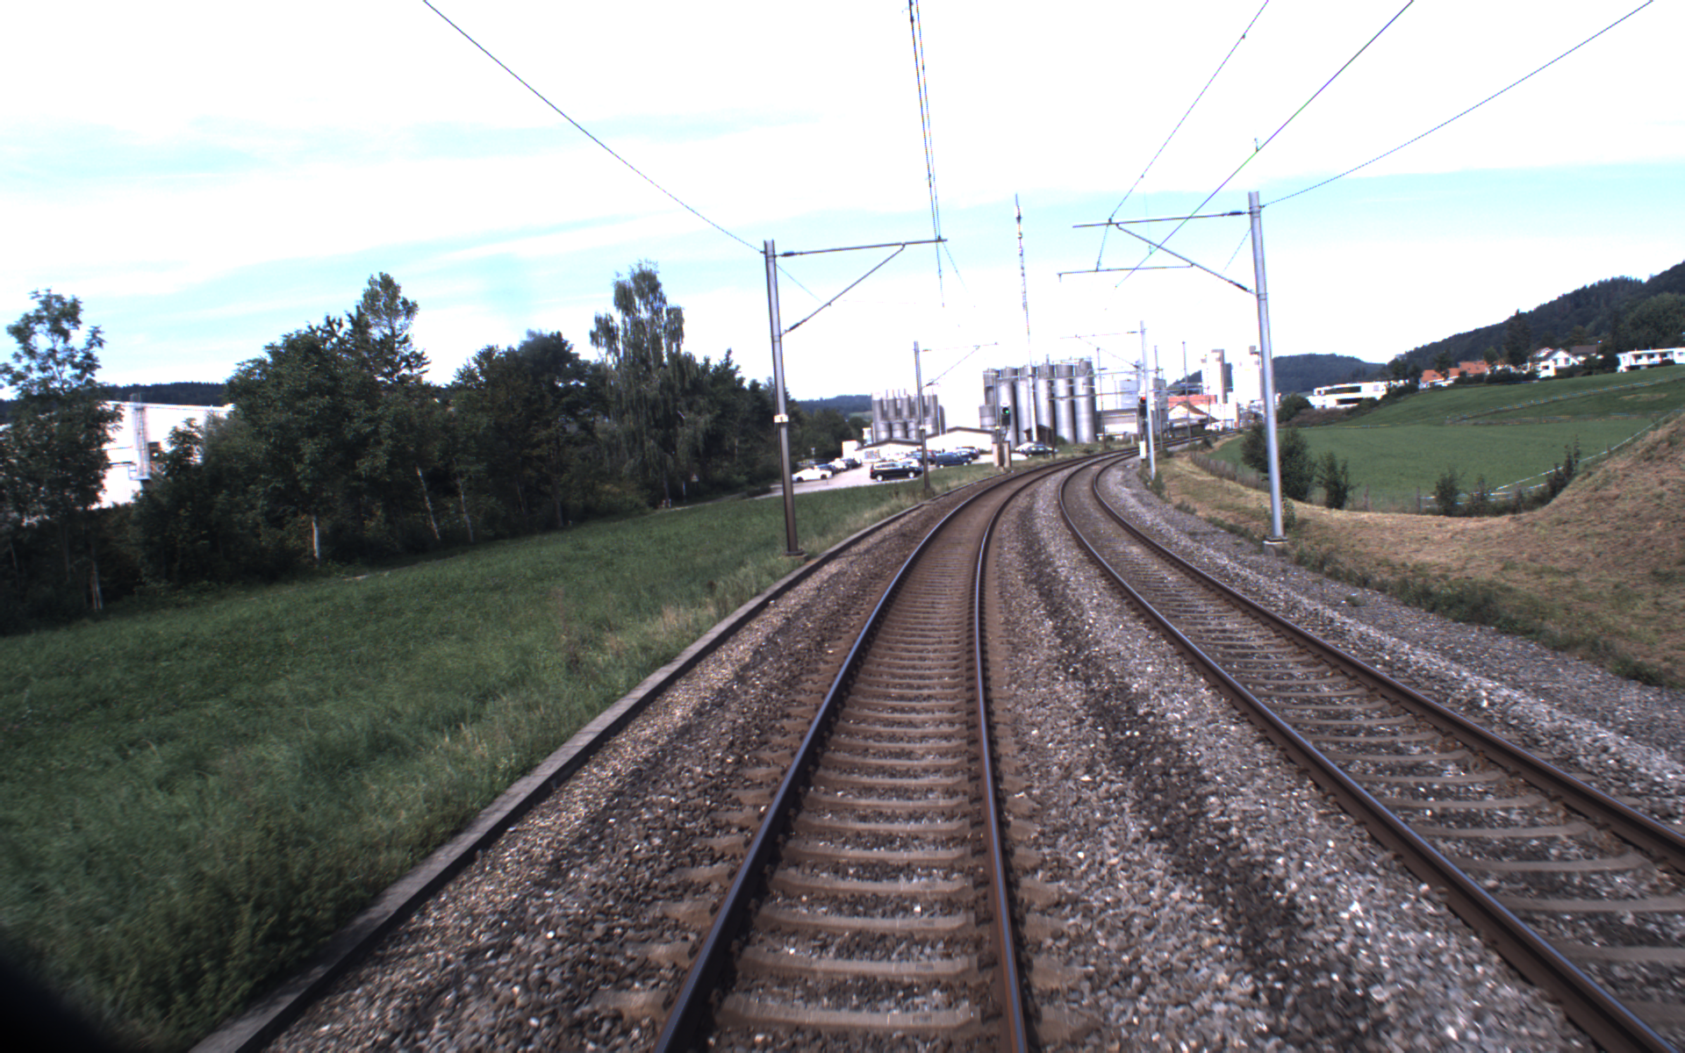
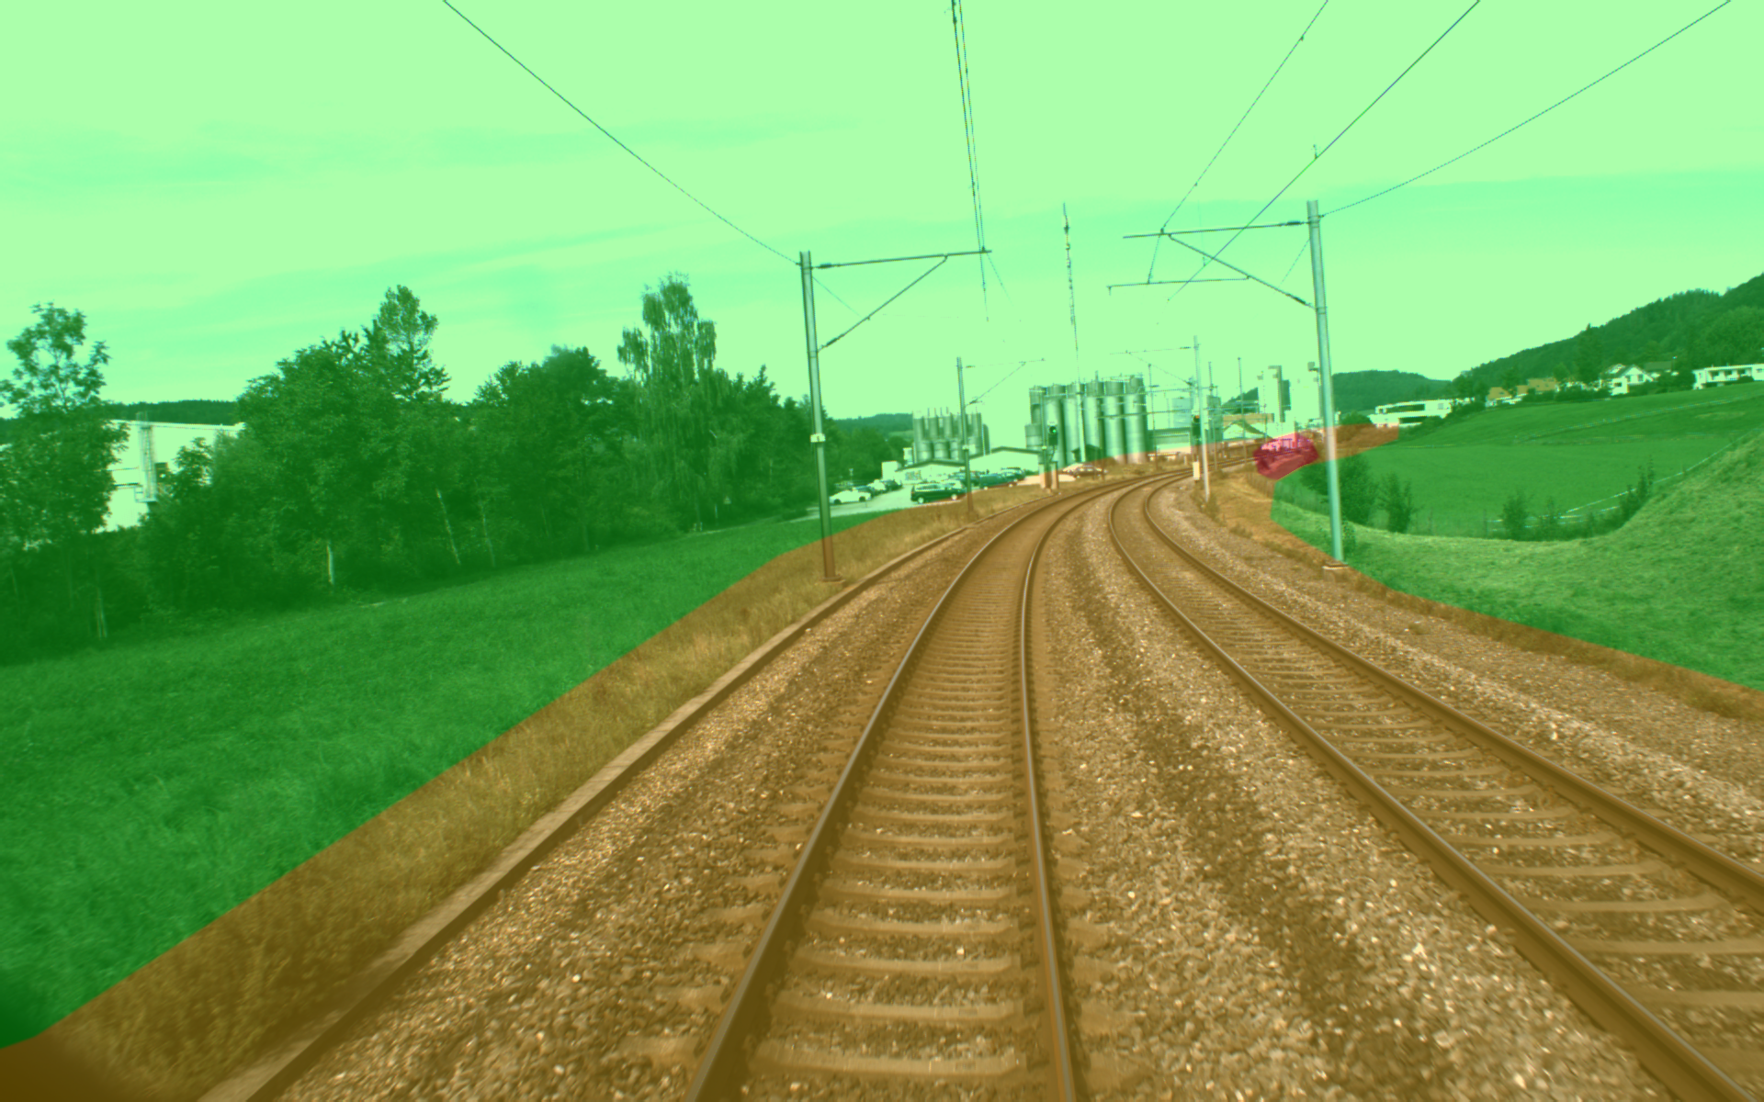
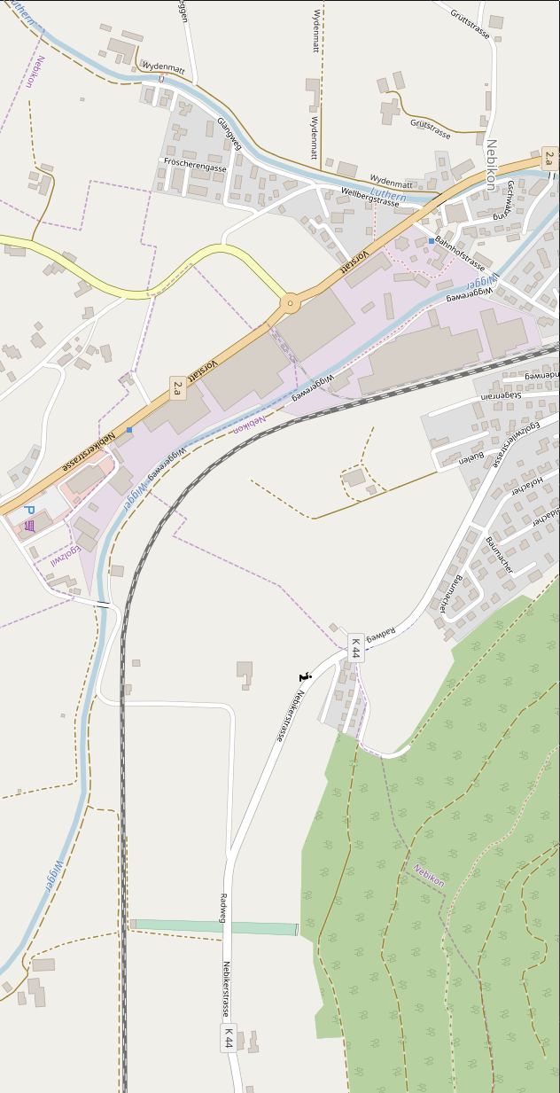
Approach

Slide 5
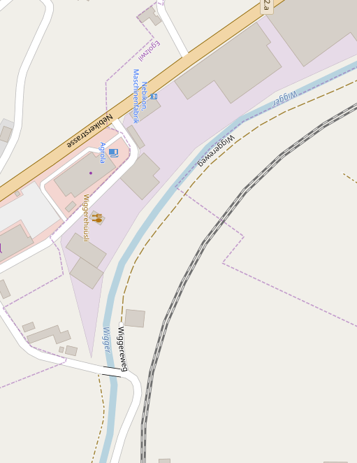
Approach
Obstacle detection
Sparse distance measurements
Overview image
Detail image

Slide 6
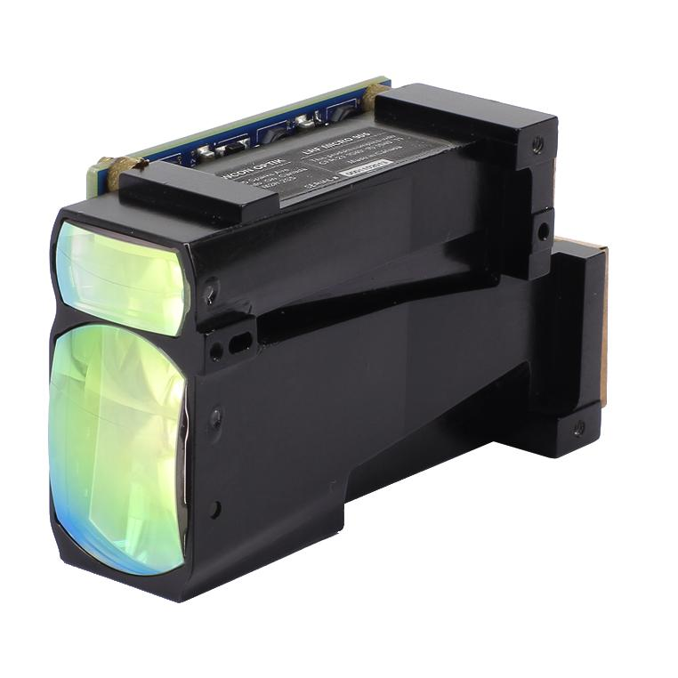
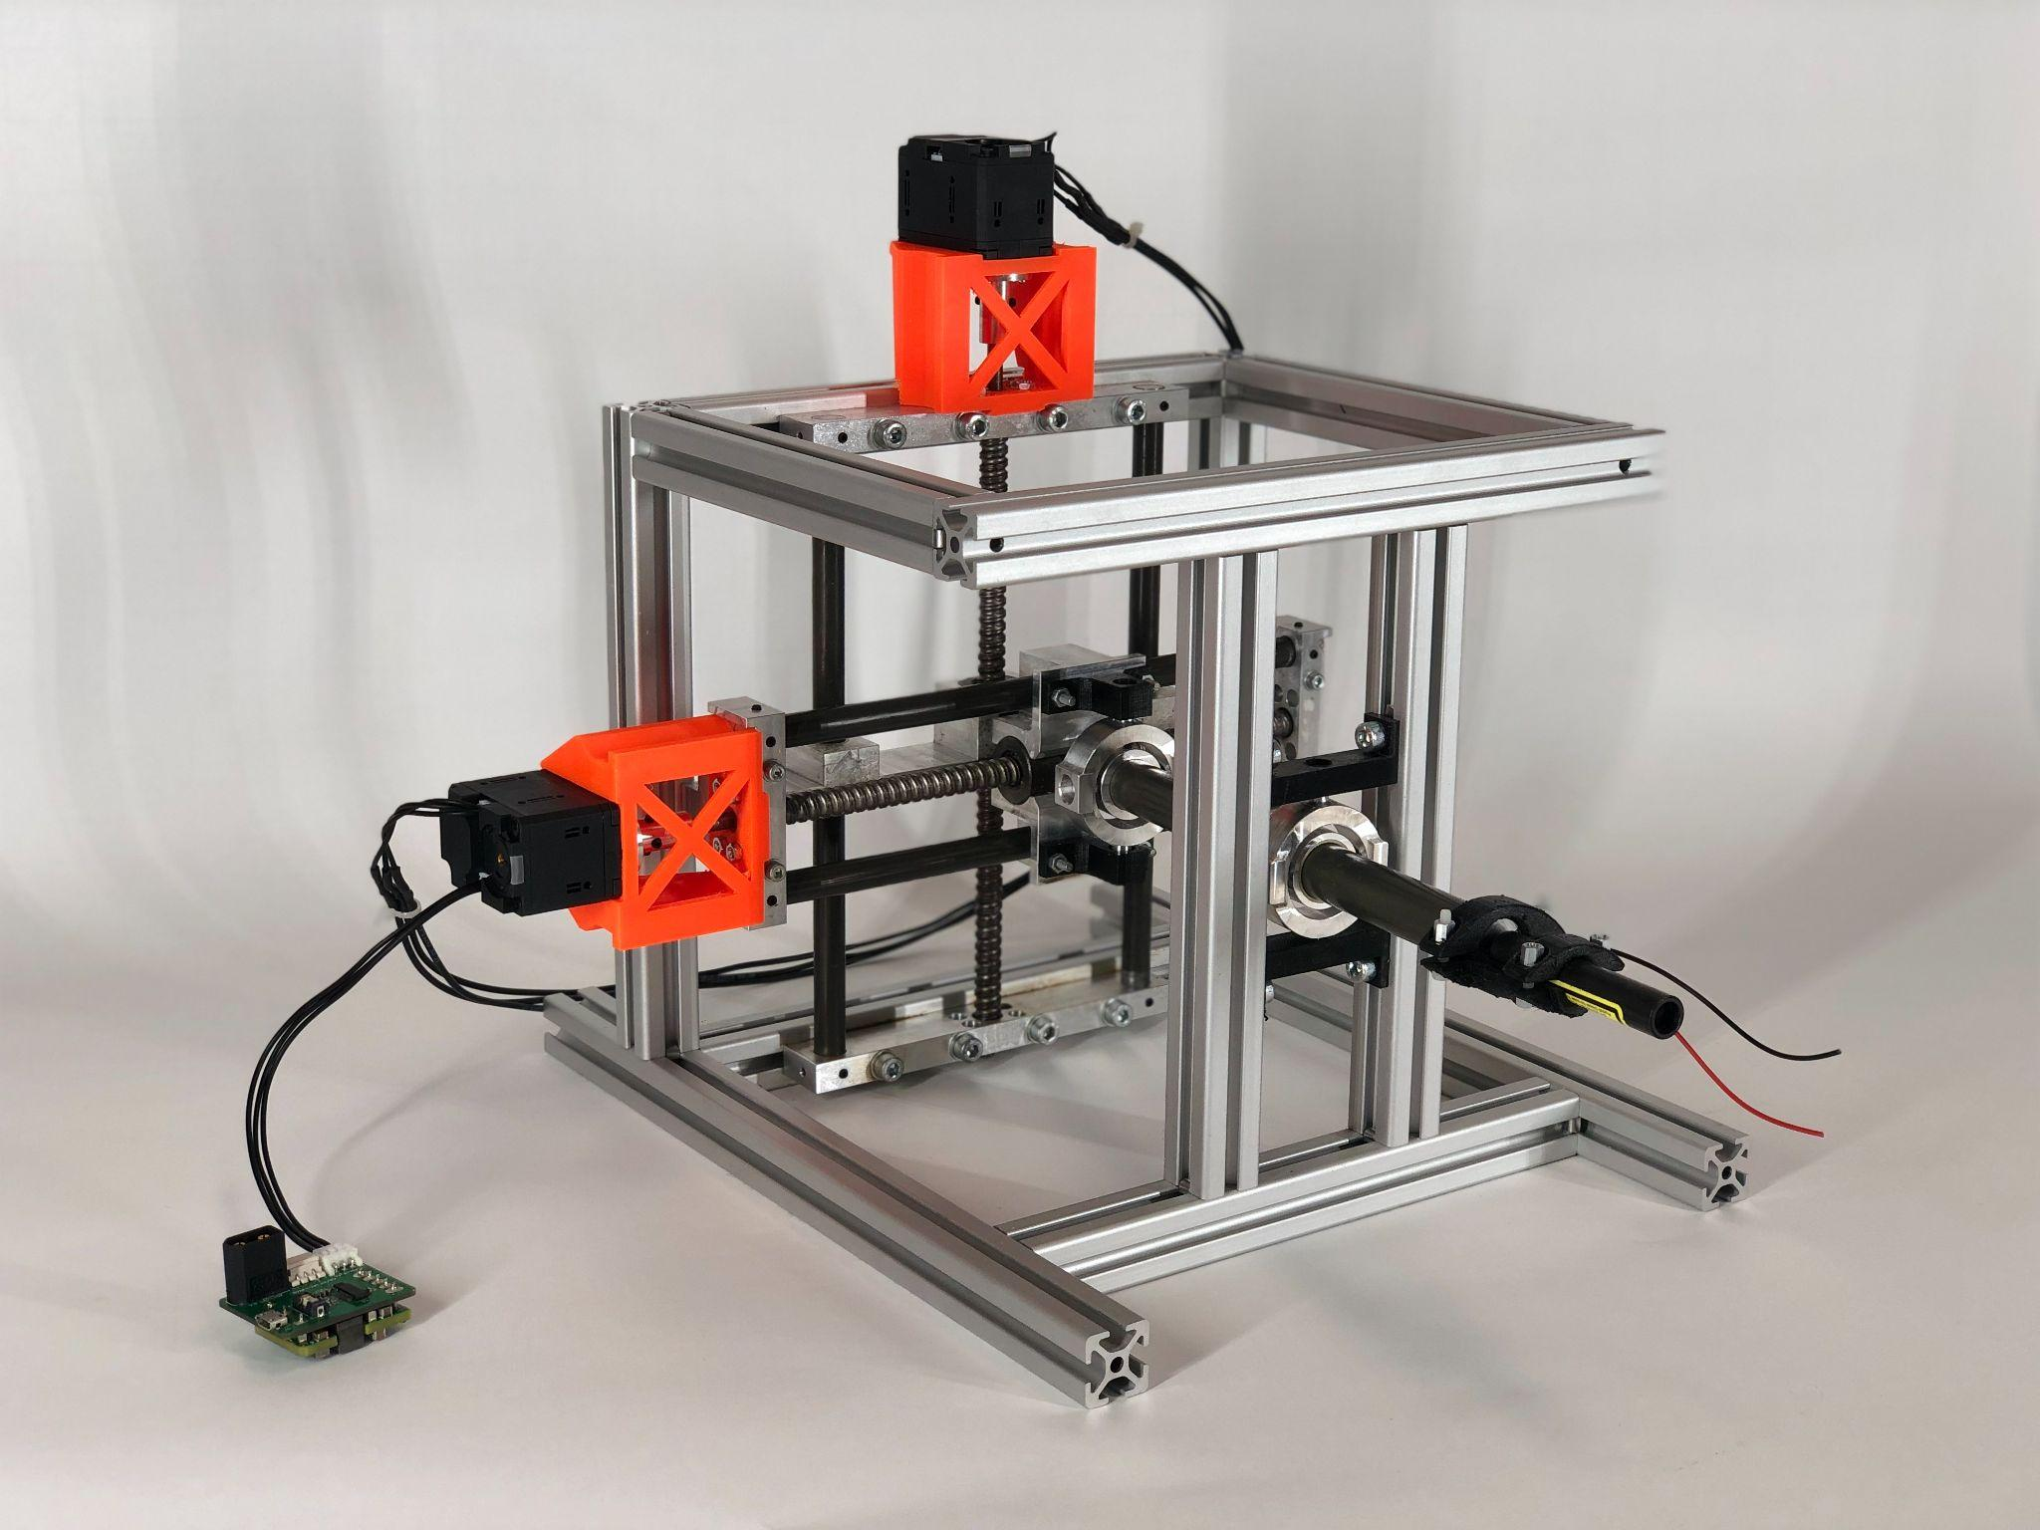
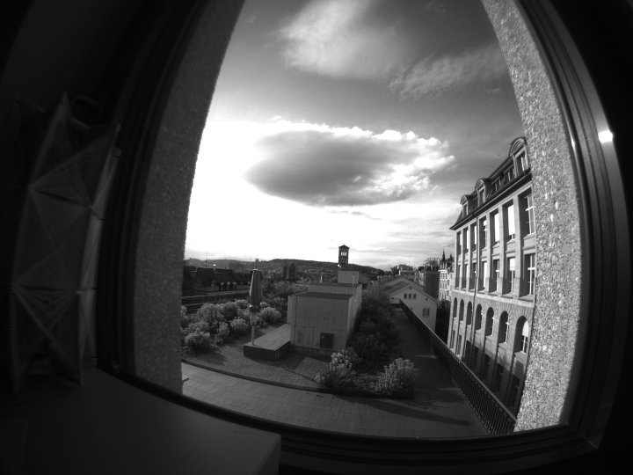
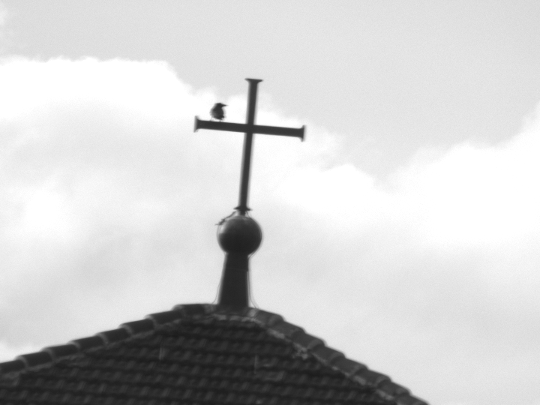
Hardware Selection and development
Optics: FLIR cameras commonly used in robotics; Various lenses and use of active vision
Depth perception: 1D Laser range finder; needs to be eye-safe and have a range of >1000m
Pointing mechanism:
Tested commercial solutions
Development of our own system

Slide 7
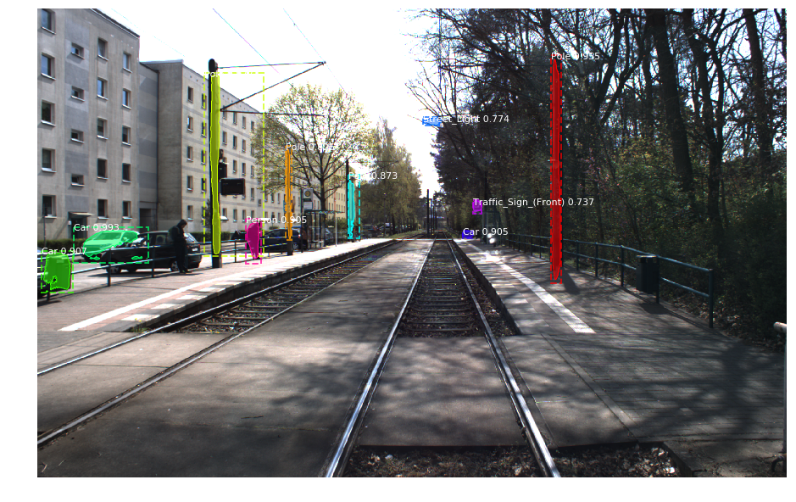
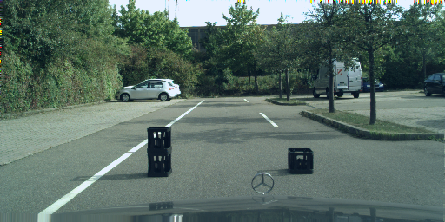
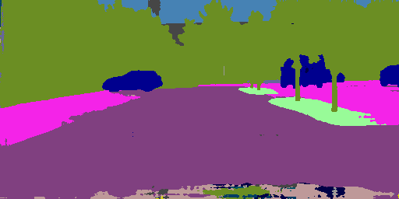
Perception
Recognizing the known:
Trained algorithms for detecting humans, cars, etc.
Detecting the unknown:
Anomaly detection for everything out of the ordinary

Slide 8
Cornelius von Einem
PhD Student
cornelius.voneinem@mavt.ethz.ch
ETH Zurich
Autonomous Systems Lab
LEE J301
Leonhardstrasse 21
8092 Zürich, Switzerland
www.asl.ethz.ch

