Slide 1

RailPower: Power and Energy for the future railways
Prof. Francesco Corman, Prof. Gabriela Hug
ETH Mobility Initiative - 5th Partnership Council
02.12.2021
Michael Nold
Georgia Pierrou

Slide 2
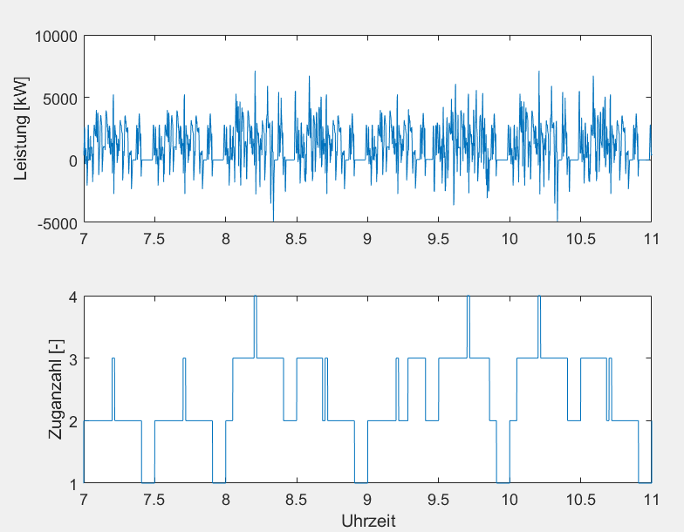
WP1 - Results
Power consumption of a series of different trains inside a feeding-section of a railway-network, which are operating according a timetable.
railway-network
feeding-section

Slide 3
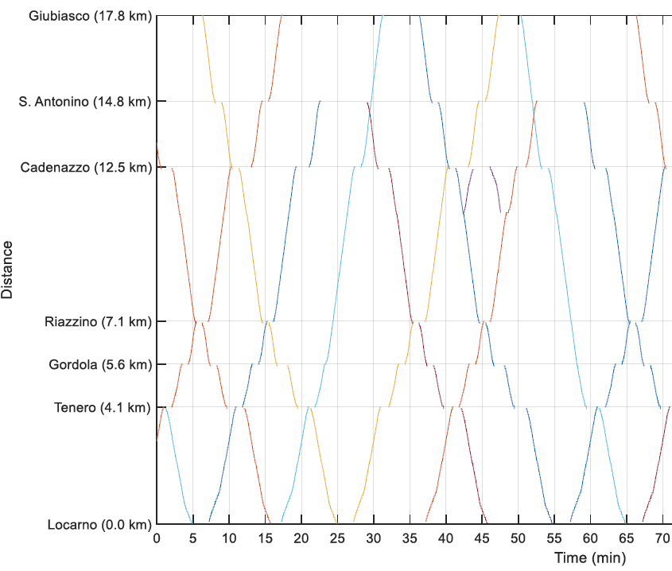
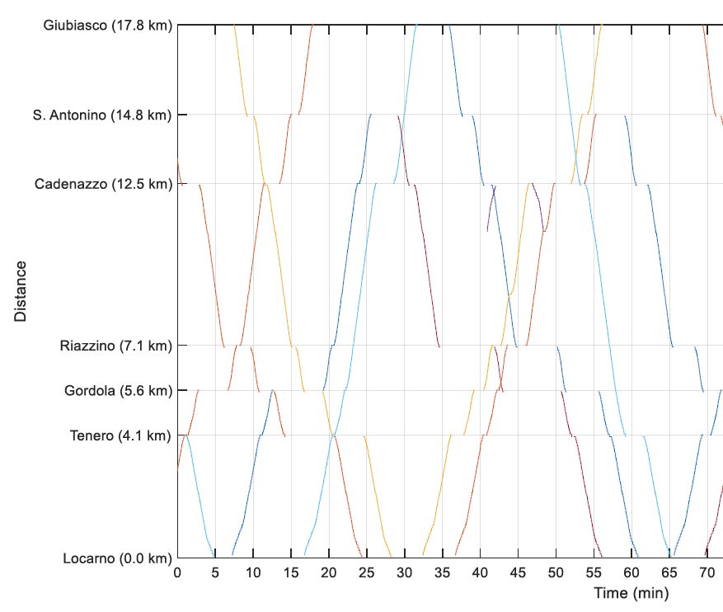
WP 1 / 2 Results and ongoing work
Tasks
Considering the operation influences and seek out connection between delays
Approaches
Monte Carlo Simulation
Seek out connection with big data analyses
No delay Delays
punctually
delayed

Slide 4
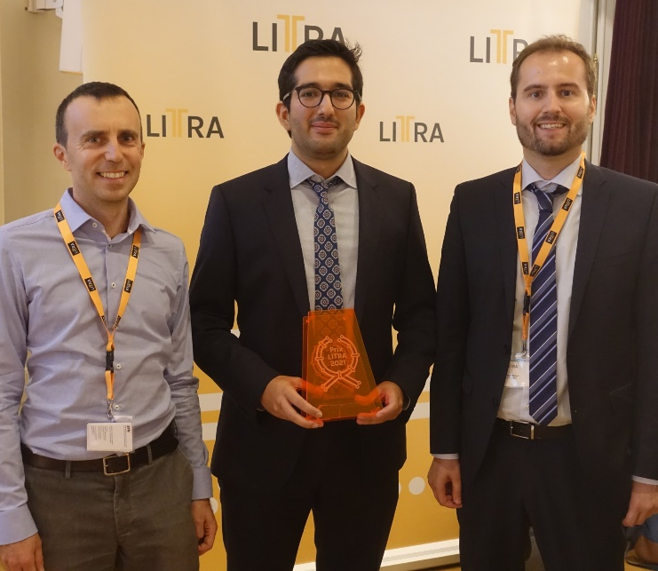
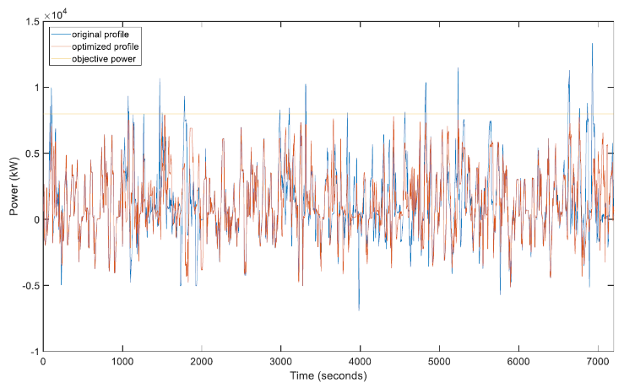
Prix LITRA 2021
Quantification and reduction of power peaks in railway networks
Working steps
Simulation of rail operation in a network, on a signal level and track occupation level
Expansion with energy data and simulation of the power consumption in a feeding section
Including of stochastic delays and Monte Carlo Simulation of the power consumption
Deduction of peak and comparison of two approach's to reduce the peaks
No delay Delays

Slide 5
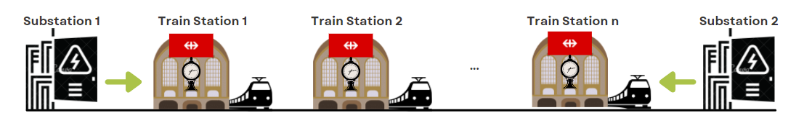
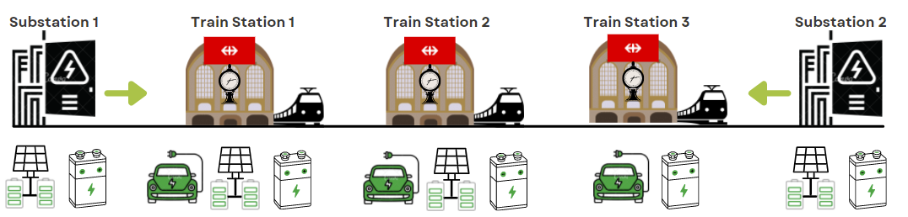
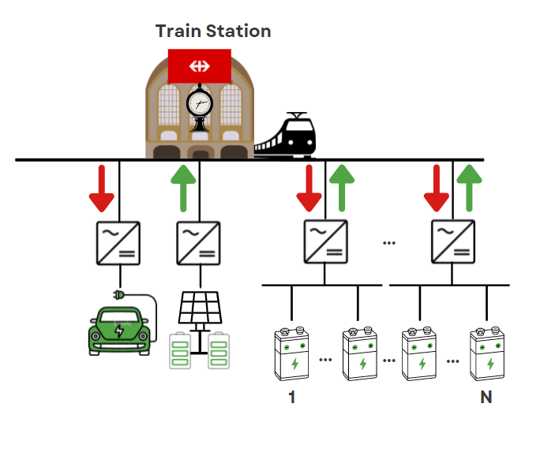
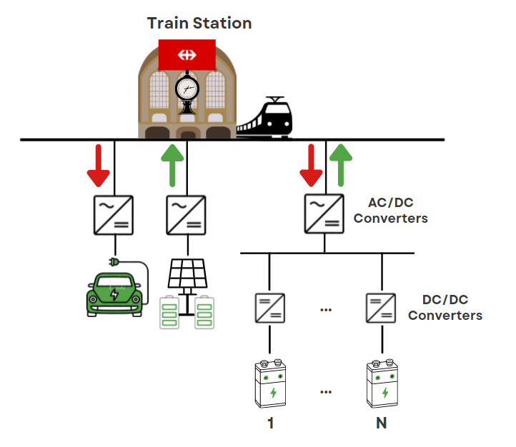
WP4/WP5: Design of Electric Infrastructure
Potential connection alternatives
AC Railway Microgrid
(ARMG)
Hybrid ARMG
Daily Data
  Train demand
  Solar radiation
  EV charging
Optimization model
  Minimize total investment
  and operating cost
Number, size, type
  AC/DC, DC/DC converters
  Storage systems (batteries/ultracapacitors)

Slide 6






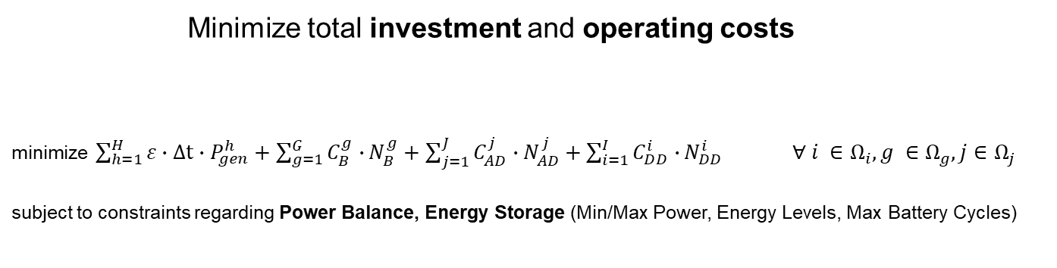
WP4/WP5: Design of Electric Infrastructure
  Minimize total investment and operating costs
minimize $\sum_{h=1}^{H}{{ε∙Δt∙P}_{gen}^{h}}+\sum_{g=1}^{G}{C_{B}^{g}∙}N_{B}^{g}+\sum_{j=1}^{J}{C_{AD}^{j}∙}N_{AD}^{j}+\sum_{i=1}^{I}{C_{DD}^{i}∙}N_{DD}^{i} ∀ i ∈Ω_{i},g ∈Ω_{g}, j∈$ $Ω_{j}$
subject to constraints regarding Power Balance, Energy Storage (Min/Max Power, Energy Levels, Max Battery Cycles)
 | Original (no AC/DC, DC/DC) | ARMG (AC/DC) | Hybrid ARMG (AC/DC, DC/DC)
Total Cost € | 5765.18 | 5556.56 | 5558.63
Investment Cost (€/day) | 0 | 20.03 | 21.49
Operating Cost (€/day) | 5765.20 | 5536.53 | 5537.14
Cost Savings (%) | - | 3.62 | 3.58
Feasibility Study
(economic + technical)
Optimal converter and energy storage sizing
Accurate modeling for studying power flow/voltages
Coordination of EVs, PV and train demand
for optimal operation

