Slide 1
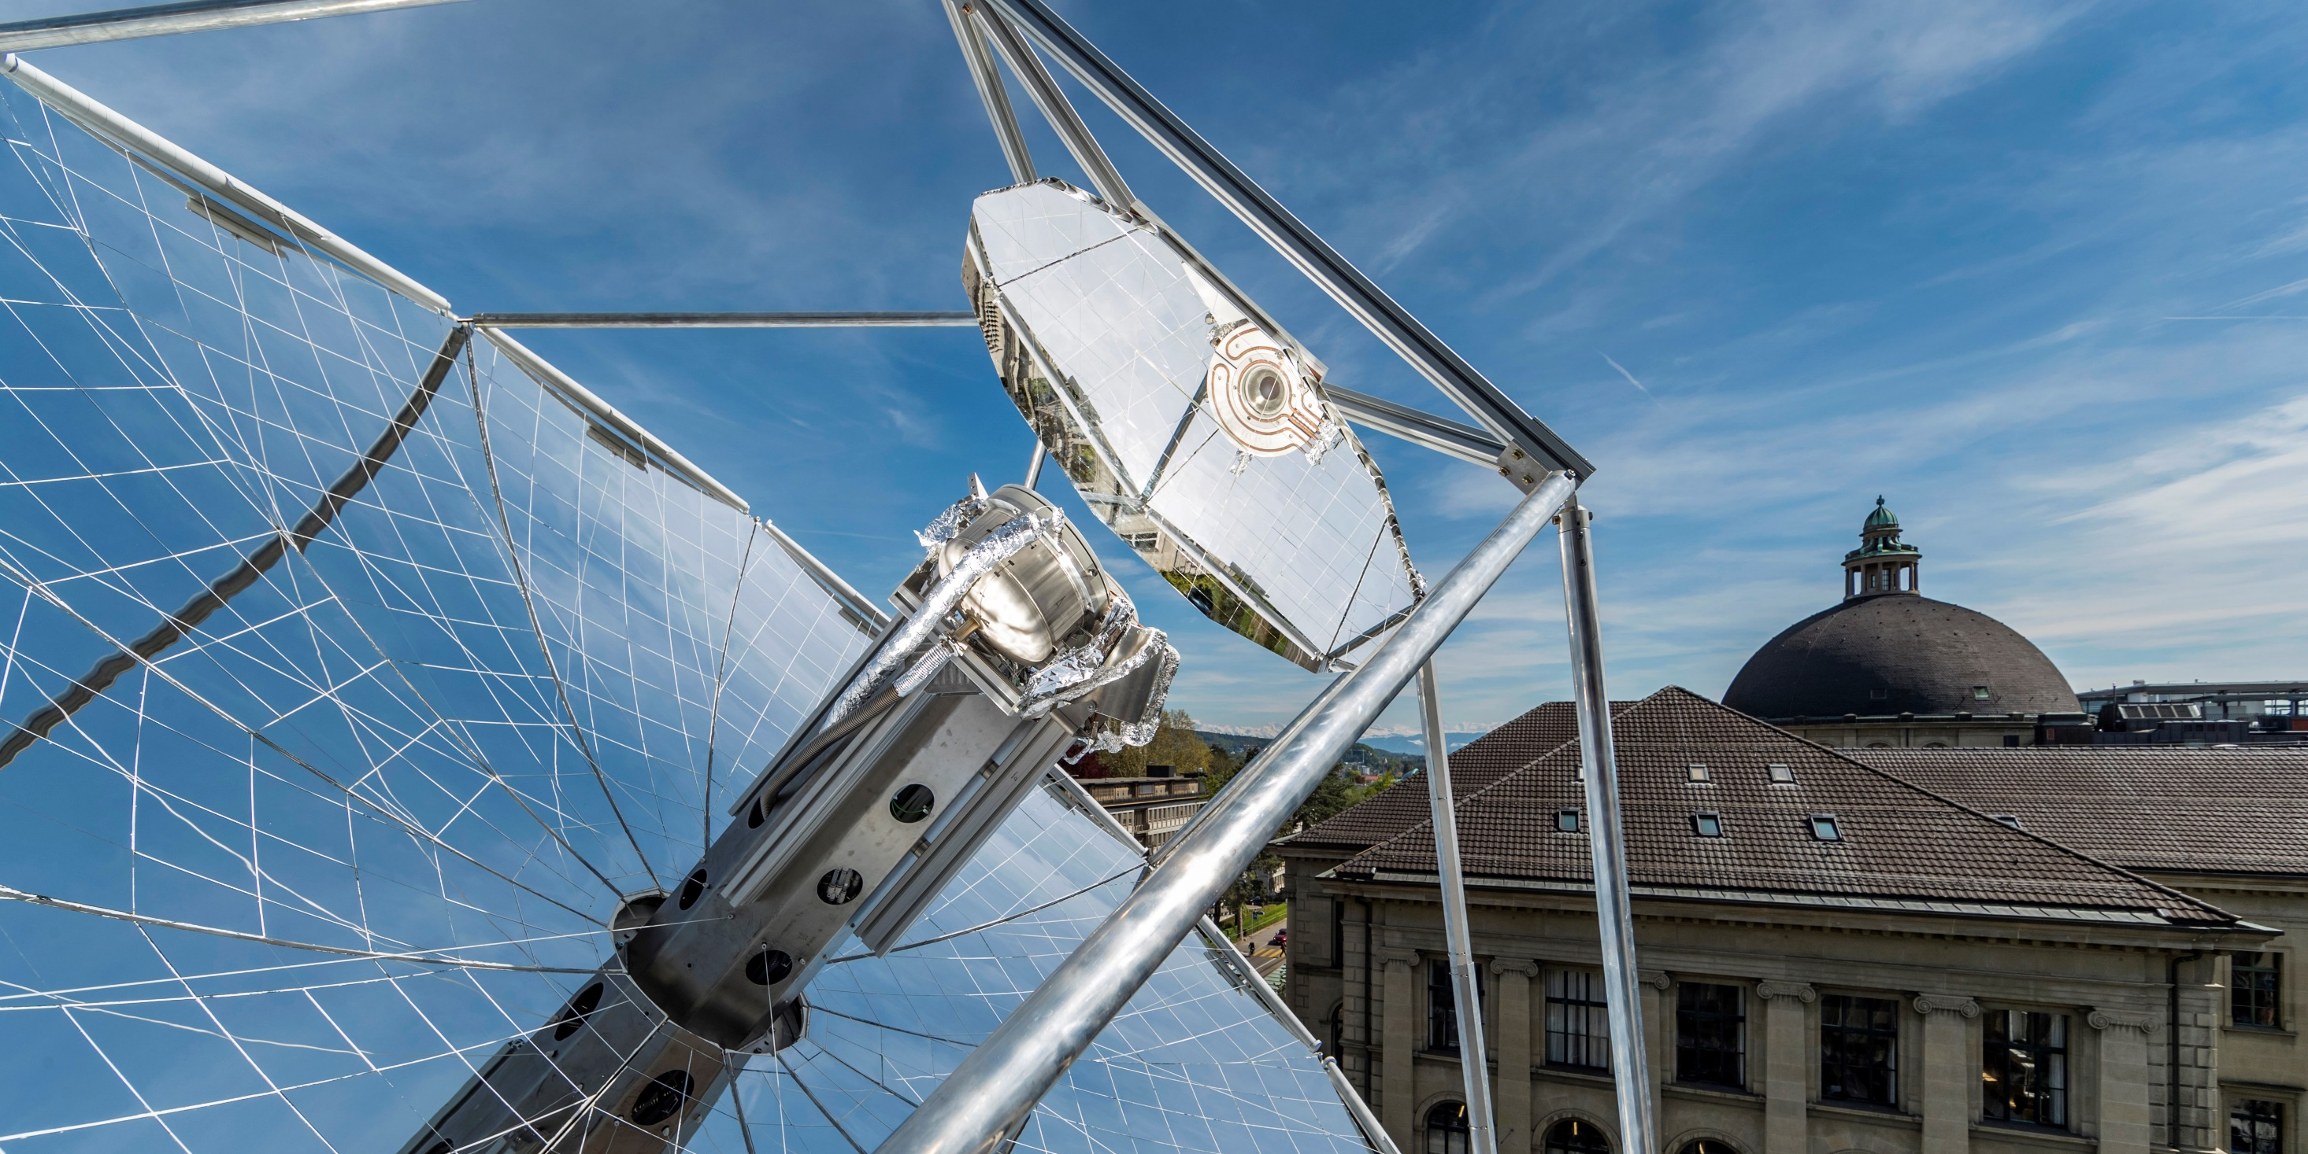
SUNFUELS: Towards commercial solar thermochemical production of sustainable drop-in fuels
Anthony Patt & Aldo Steinfeld
Partners
Synhelion
SBB
AMAG

Slide 2
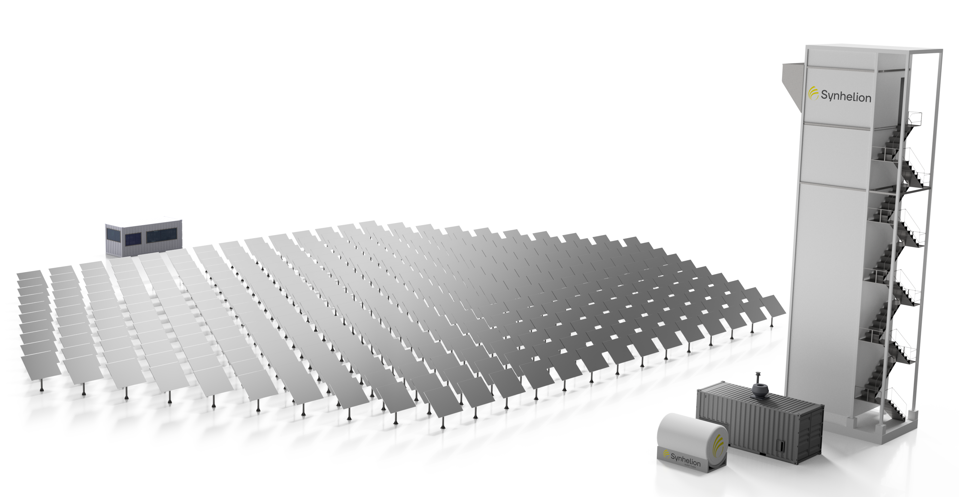

Solar Tower
Solar Receive/Reactor/TES
Solar Energy
Syngas
H₂ + CO
Sun-tracking
Heliostat Field
Control Room
GTL
H₂O + CO₂
CO₂ Source
Bio/DAC
Solar
Drop-in Fuels
Gas-to-Liquid Unit
Solar Fuel Tank

Slide 3
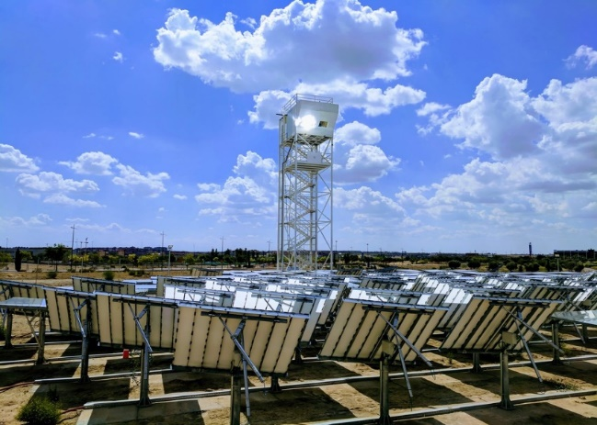
EU-project SUN-to-LIQUID

Slide 4
OBJECTIVES
Determine the techno-economic feasibility of the industrial-scale production of drop-in transportation fuels using concentrated solar energy.
Determine the performance map and energy conversion efficiency of each component of the production chain and of the overall integrated system.
Evaluate the scalability of the system, identify irreversibilities, and elucidate the R&D needs.
Quantify the specific fuel cost as well as the specific CO2_{equivalent} emissions.
Compare alternative pathways for the production of carbon-neutral drop-in fuels.
Assess policy frameworks and mechanisms to accelerate commercial implementation.

