Slide 1
In-SErvice diagnostics of the cateNary/panTograph and wheelset axle systems through INtELligent algorithms: SENTINEL
Paolo Tiso | Institute for Mechanical Systems | Chair of Nonlinear Dynamics
Olga Fink | Institute of Construction and Infrastructure Management |
Chair of Intelligent Maintenance Systems

Slide 2
Background and Scope
Continuous, rough environmental conditions weaken several physical properties of driving components and even lead to failure of vehicles and associated infrastructure between periodical technical checks.
To prevent incident and guarantee safety hazards, SBB must take today trains periodically out of service for condition checks and maintenance.
Taking trains out of service reduces the availability of the train and increases the costs for the whole fleet over its entire life cycle.
Today SBB is almost unable to detect permanent changes in the condition of drive components on a train in operation.
We aim at developing diagnostic techniques for assessing the condition of critical components of train vehicles, relying on use of monitoring data that is extracted in-service.

Slide 3
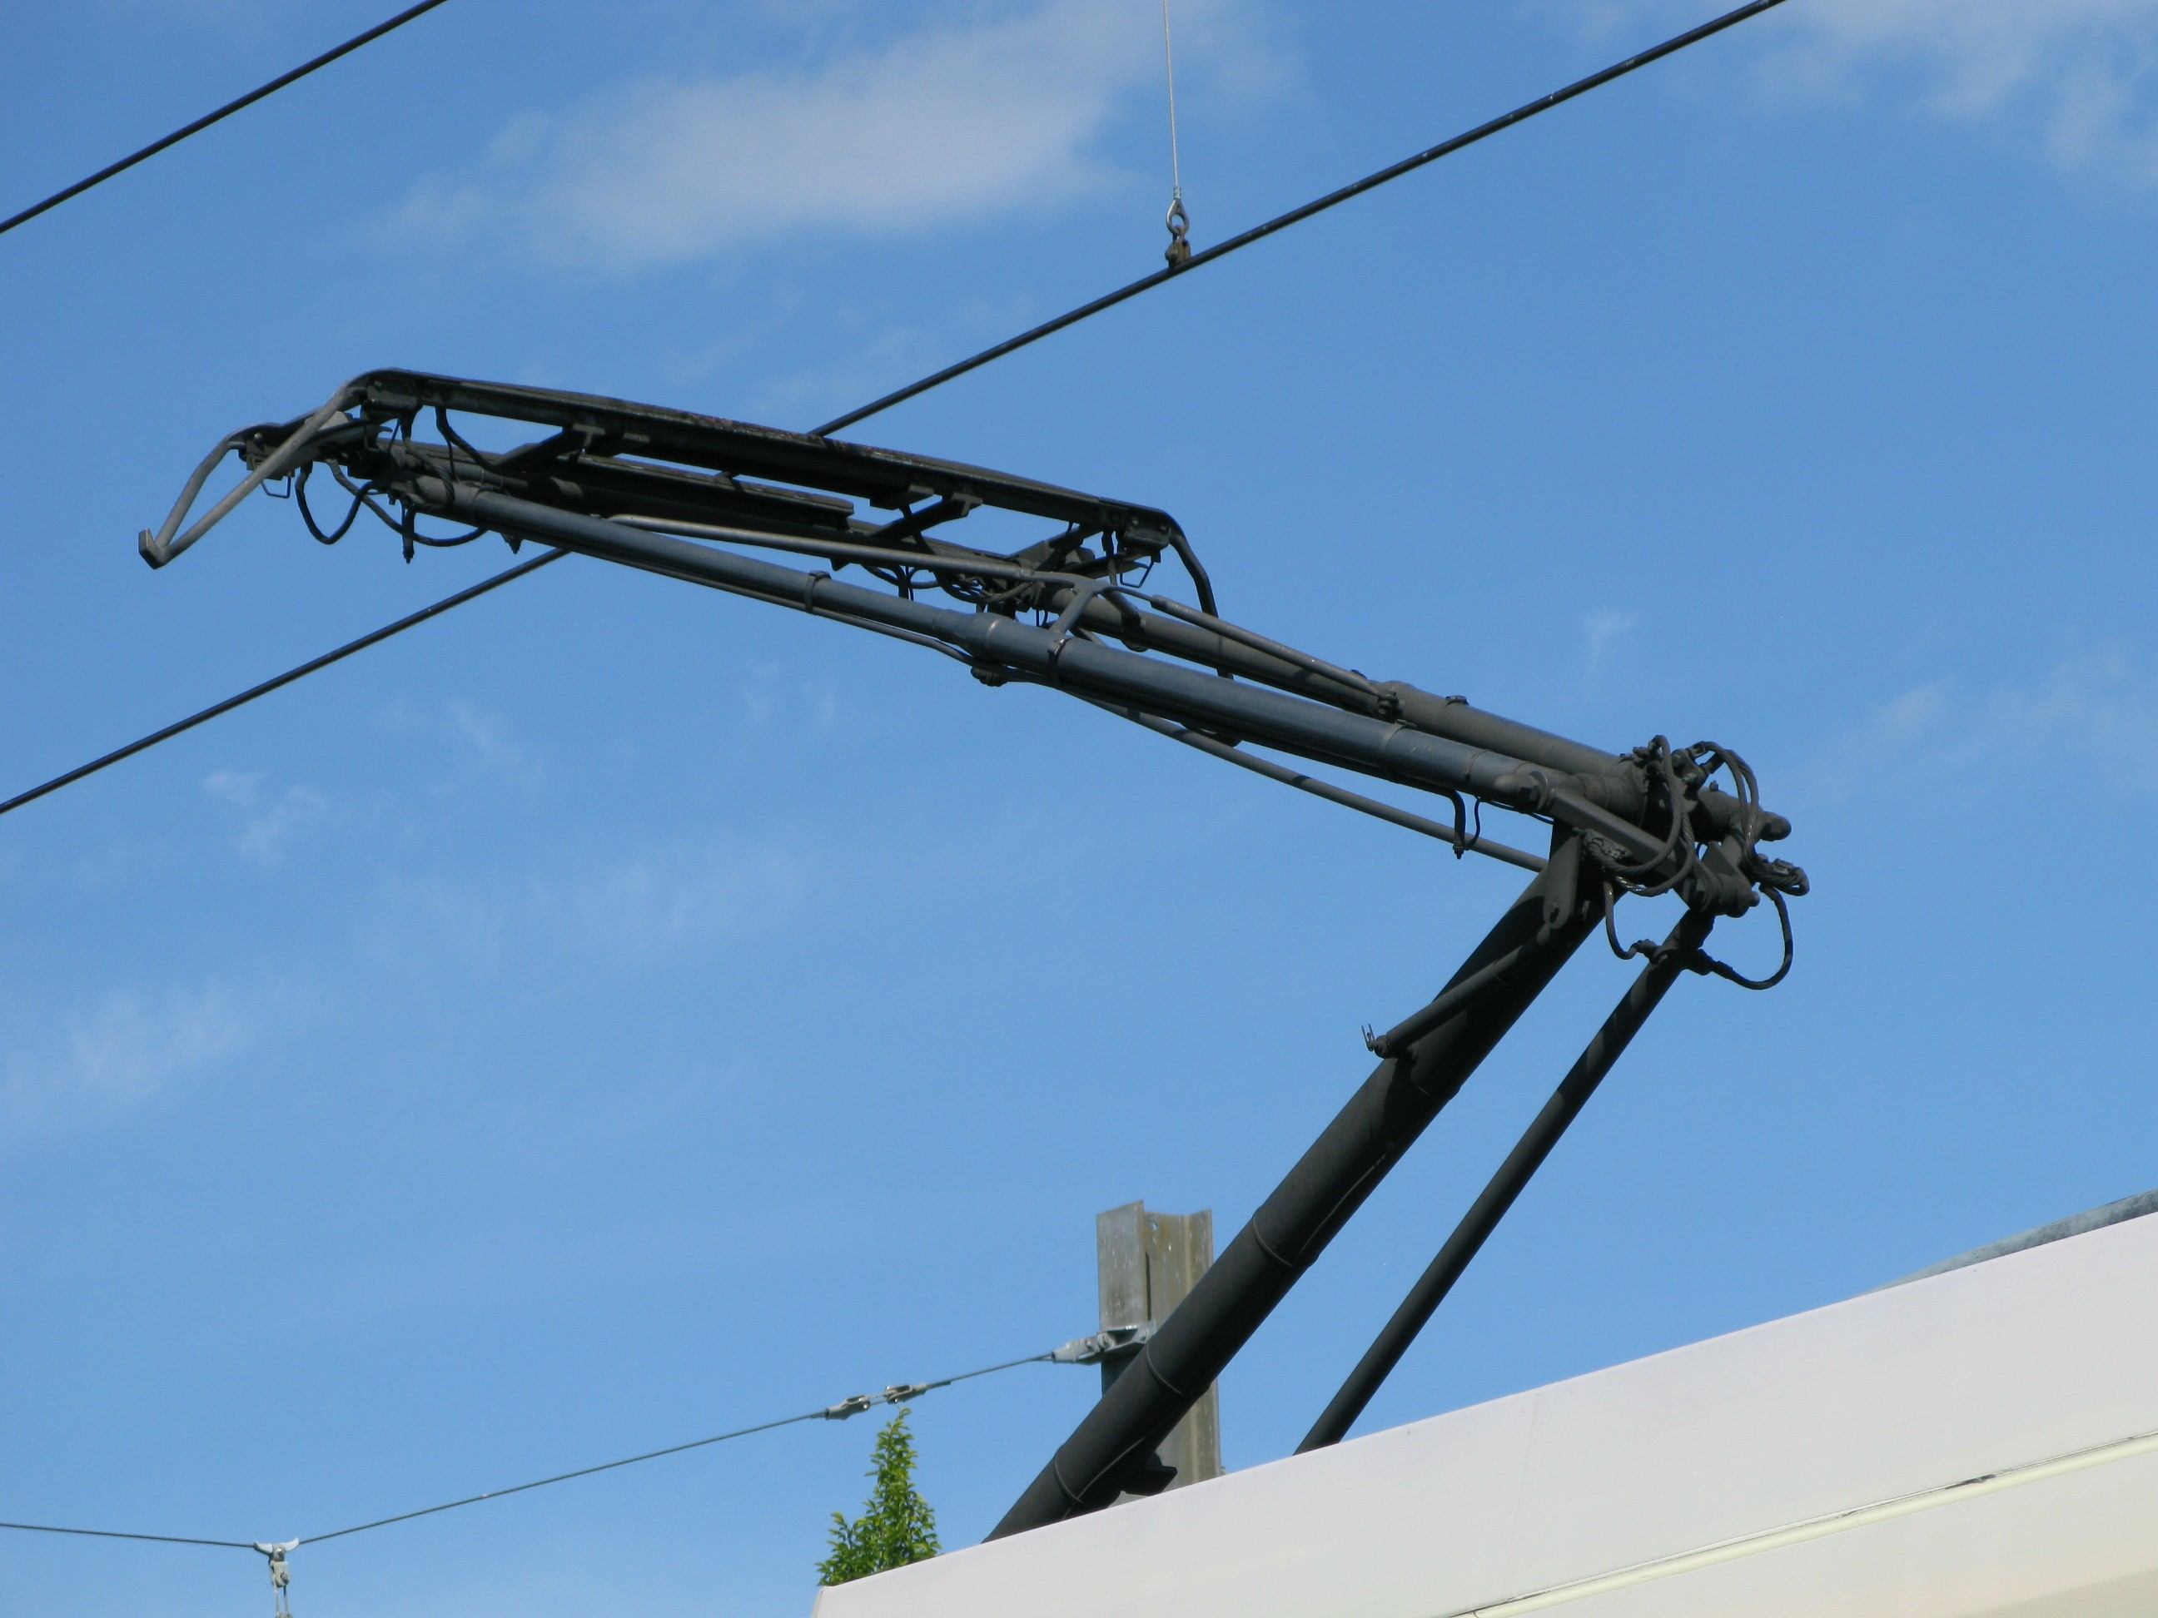
Methods
The project relies on two pillars, namely
model-based assessment, by means of parametrized reduced order models (ROMs) of the components at hand
System identification strategies for early detection of damage and/or malfunctioning.
Machine Learning based assessment (health monitoring)
Hybrid detection:
We fuse ROMs with data for fault detection on wheel set/axle/shaft of the bogie.
Data-driven detection:
No physical model employed, rely only pantograph–catenary contact force signals and fusion of contact/vibration-based/optical sensing) for automated fault detection
Pantograph
Boogie shaft

Slide 4
Work Packages
Task 1.1 Multi-modal learning.
Task 1.2 Domain generalization algorithms robust to different operating conditions
Task 1.3 Monitoring of the system health and prediction of its evolution in time based on automatic processing of high frequency data
Task 1.4 Pattern discovery and matching for temporal and spatial interrelationships
Data-driven
detection:
Task 2.1: Design an appropriate monitoring system
Task 2.2: Reduced Order Model
Task 2.3: Hybrid Scheme: Crack Detection and Characterization
Task 2.4: Prognosis: Remaining Useful Life Assessment.
Hybrid detection

Slide 5
For whom would the results be relevant?
SBB/SIEMENS:
Significant improvement in the availability and safety of the railroad system
reduction in the direct consequential costs of restoration and the indirect costs of operational failure.
Scientific Challenges and Impact:
Advances in Parametrized Reduced Order Models (ROMs) for damage detection, with (near) real-time capabilities
Integration of ROMs with data driven techniques
Robust ML schemes for damage detection in rough environments
Optimal sensor selection for diverse components

Slide 6
Methods
Suitable parametrization of cracks with advanced, mesh-independent techniques
ROM construction: assessment of competing techniques as:
Global basis with POD and Greedy methods
Clustering of etherogeneous training samples
Hyper-reduction
Manifold interpolation within parameter space
Optimal integration with available data in operation (sensor placement, sensing rate, data filtering, etc.)
System identification and damage detection critera
Hybrid detection
Analyse the data from existing monitoring devices
Evaluate different combinations of additional sensors: accelerometers, thermal scanning, high resolution digital camera, laser scanning
Develop multi-modal machine learning algorithms → learn to transfer the information between the modalities
Develop robust ML algorithms that are invariant towards different environmental conditions
From early detection to prediction?
Data-driven
detection:

Slide 7
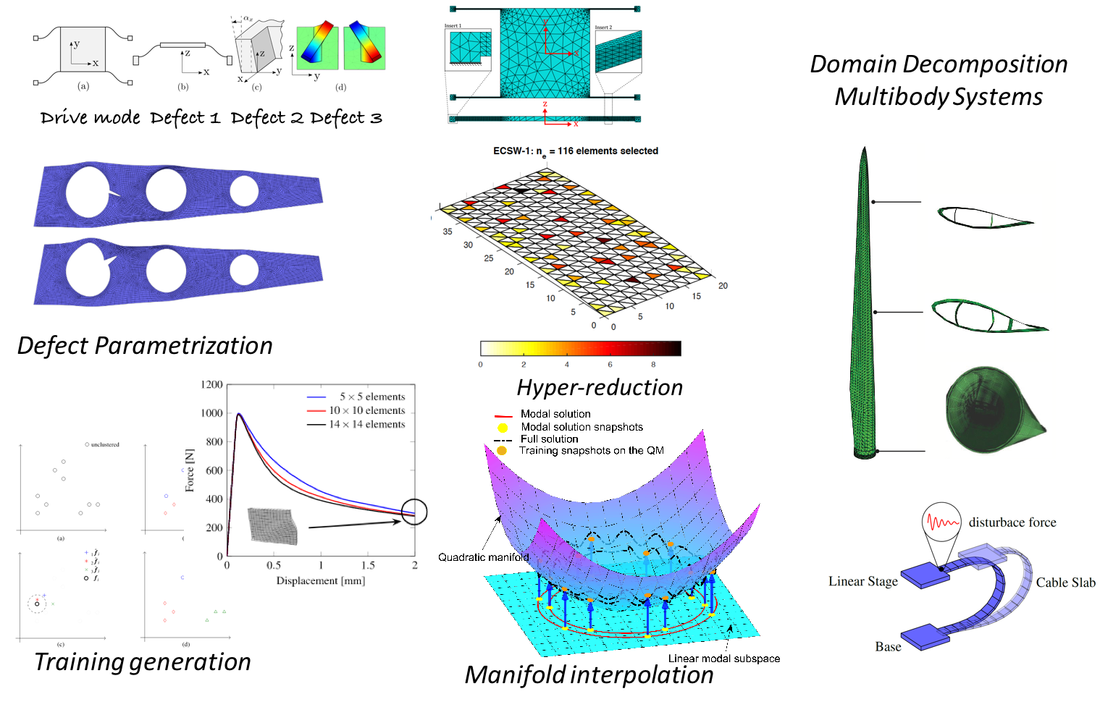
Expertise
Reduced Order Models - Dr. P. Tiso/ Prof. E. Chatzi
Data-driven assessment - Prof. Olga Fink
On-board sensoring and data acquisition Tm 232 Mr. Martin Lottaz/ Mr. Dominic Fried
System Identification - Prof. E. Chatzi

