Slide 1
Module 11
Quality Control

Slide 2
Quality Control (QC)
Control – the activity of ensuring conformance to requirements and taking corrective action when necessary to correct problems
Importance
Daily management of processes
Prerequisite to longer-term improvements

Slide 3
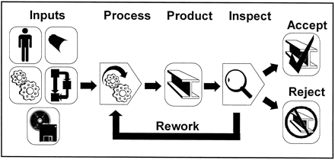
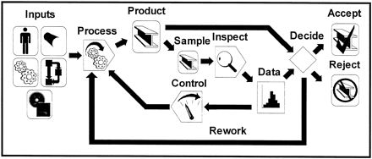
Designing the QC System
Quality Policy and Quality Manual
Contract management, design control and purchasing
Process control, inspection and testing
Corrective action and continual improvement
Controlling inspection, measuring and test equipment (metrology, measurement system analysis and calibration)
Records, documentation and audits
Hinckley, C. (1997). Defining the best quality-control systems by design and inspection. Clinical Chemistry. Vol. 43(5) 873-879.

Slide 4
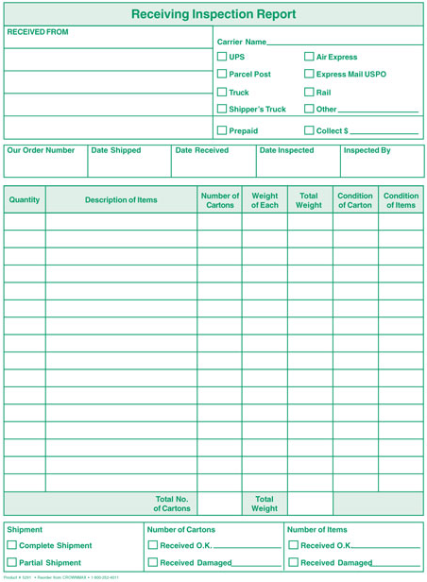
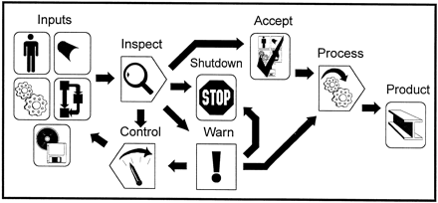
Inspection/Testing Points
Receiving inspection
In-process inspection
Final inspection

Slide 5
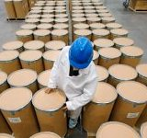
Receiving Inspection
Spot check procedures
100 percent inspection
Acceptance sampling
Exercise:
Pens & Paper clips

Slide 6
Why not 100% Inspection?
Problems with 100% inspection
Very expensive
Can’t use when product must be destroyed to test
Handling by inspectors can induce defects
Inspection must be very tedious so defective items do not slip through inspection

Slide 7
A Lot-by-lot Sampling Plan
Specify the plan (n, c) given N
For a lot size N, determine
the sample size n, and
the acceptance number c.
Reject lot if number of defects > c
Specify course of action if lot is rejected

Slide 8
Pros and Cons of Acceptance Sampling
Arguments for:
Provides an assessment of risk
Inexpensive and suited for destructive testing
Requires less time than other approaches
Requires less handling
Reduces inspector fatigue
Arguments against:
Does not make sense for stable processes
Only detects poor quality; does not help to prevent it
Is non-value-added
Does not help suppliers improve
Type I Error

Slide 9
In-Process Inspection
What to inspect?
Key quality characteristics that are related to cost or quality (customer requirements)
Where to inspect?
Key processes, especially high-cost and value-added
How much to inspect?
All, nothing, or a sample

Slide 10
Human Factors in Inspection
complexity
defect rate
repeated inspections
inspection rate
*Inspection should never be a means of assuring quality. The purpose of inspection should be to gather information to understand and improve the processes that produce products and services.

Slide 11
Gauges and Measuring Instruments
Variable gauges (Provides deviation level)
Fixed gauges (Provides measurement level)
Coordinate measuring machine (Physical geometric characteristics)
Vision systems (High-speed imagery, self-contained)

Slide 12
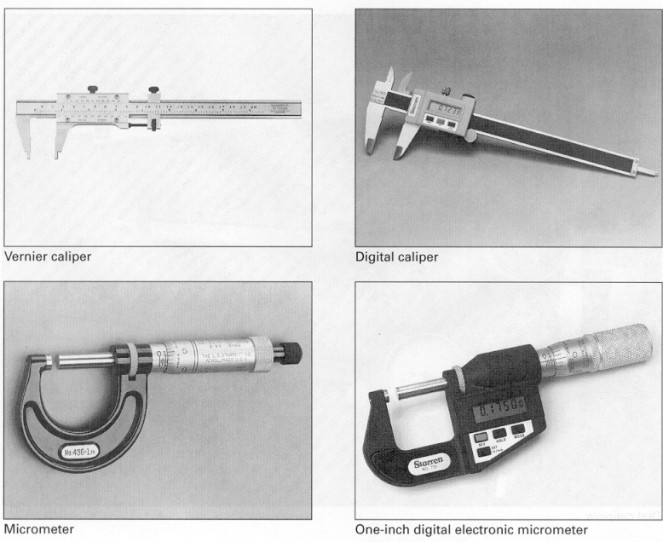
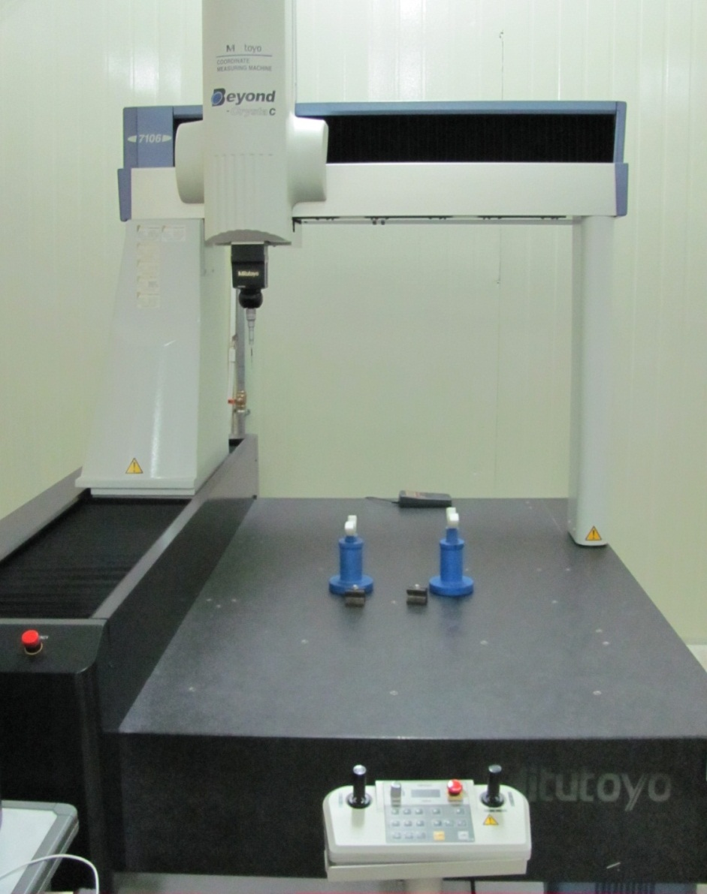
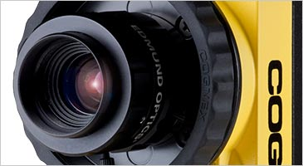
Examples of Gauges

Slide 13
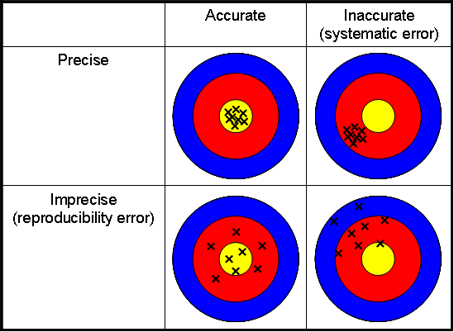
Metrology - Science of Measurement
Accuracy - closeness of agreement between an observed value and a standard
Precision - closeness of agreement between randomly selected individual measurements

Slide 14
Repeatability and Reproducibility
Repeatability (equipment variation) – variation in multiple measurements by an individual using the same instrument.
Reproducibility (operator variation) - variation in the same measuring instrument used by different individuals

Slide 15
Repeatability and Reproducibility Studies
Quantify and evaluate the capability of a measurement system
Select m operators and n parts
Calibrate the measuring instrument
Randomly measure each part by each operator for r trials
Compute key statistics to quantify repeatability and reproducibility

Slide 16
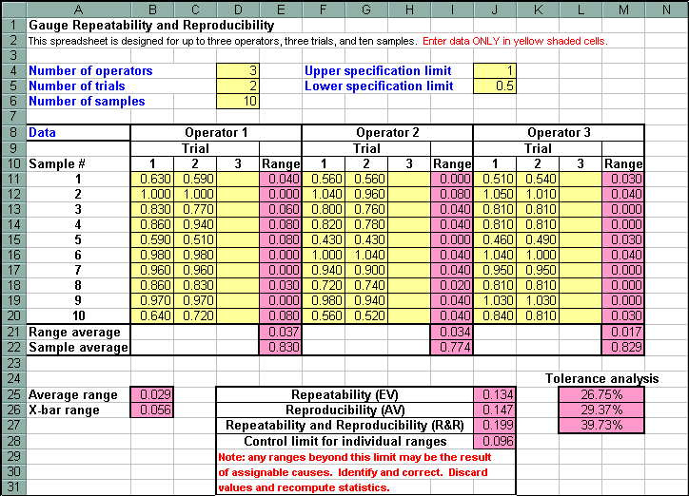

Slide 17
Range Measurement for each Sample:
Average Measurement for each Operator:
Average Difference:
$${\overline{x}}_{D}= \max_{i}{{(\overline{x}}_{i})}− \min_{i}{({\overline{x}}_{i})}$$
Average Range for each Operator:
Overall Range:
Where: n = #of samples, r = #of trials, m = #of operators;
i = operator, j = sample, k = trial

Slide 18
Equipment Variation (EV):
Operator Variation (OV):
Repeatability and Reproducibility (R&R):

Slide 19
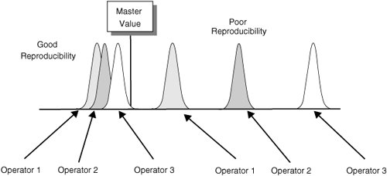
R&R Evaluation
Under 10% error - OK
10-30% error - may be OK
over 30% error - unacceptable

Slide 20
Debriefing
What happened in the first experiment? (Rubber band length)
…and the second?
What could be done to improve the measurement process?
…and the analysis process?

Slide 21
Calibration
Calibration - comparing a measurement device or system to one having a known relationship to national standards
Traceability to national standards maintained by NIST, National Institute of Standards and Technology (e.g. atomic clock)
https://www.youtube.com/watch?v=z-jE7DXy1x0#t=268

Slide 22
Example of QC: HACCP System
Hazard analysis
Critical control points
Preventive measures with critical limits for each control point
Procedures to monitor the critical control points
Corrective actions when critical limits are not met
Verification procedures
Effective record keeping and documentation

Slide 23
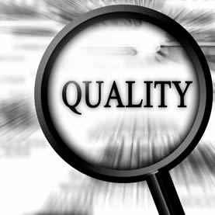
Quality Control in Services
Identify important quality characteristics
Time, errors, behavior
Measure and collect data using check sheets, check lists, or other means
Take corrective action

