Slide 1
Module 9 & 10
Quality Improvement

Slide 2
Quiz (Review)
If you don’t measure results,
you can’t tell success from failure
If you can’t see success,
you can’t reward it –
and if you can’t reward success,
you are probably rewarding failure
If you can’t recognize failure,
you can’t correct it

Slide 3
Statistical Thinking
All work occurs in a system of interconnected processes
Variation exists in all processes
Understanding and reducing variation are the keys to success

Slide 4
Sources of Variation in Production Processes
Measurement
Instruments
Operators
Methods
Materials
INPUTS
PROCESS
OUTPUTS
Tools
Human
Inspection
Performance
Machines
Environment

Slide 5
Variation
Many sources of uncontrollable variation exist (common causes)
Special (assignable) causes of variation can be recognized and controlled
Failure to understand these differences can increase variation in a system

Slide 6
Importance of Understanding Variation
time
PREDICTABLE
?
UNPREDECTIBLE

Slide 7
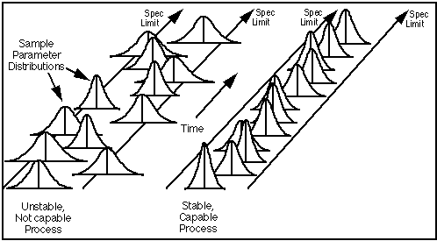
Process Capability
The range over which the natural variation of a process occurs as determined by the system of common causes
Measured by the proportion of output that can be produced within design specifications

Slide 8
Process Capability
(a)
(b)
specification
specification
natural variation
natural variation
(c)
(d)
specification
specification
natural variation
natural variation

Slide 9
Types of Capability Studies
Peak performance study - how a process performs under ideal conditions
Process characterization study - how a process performs under actual operating conditions
Component variability study - relative contribution of different sources of variation (Force variability into the study, examine corrective actions)

Slide 10
Process Capability Study
Choose a representative machine or process
Define the process conditions
Select a representative operator
Provide the right materials
Specify the gauging or measurement method
Record the measurements
Construct a histogram and compute descriptive statistics: mean and standard deviation
Compare results with specified tolerances

Slide 11
Process Capability Index
UTL - LTL
6σ
Estimates what the process is capable of producing if the process mean were to be centered between the specification limits. Assumes process output is approximately normally distributed.
C_{p} =
UTL - μ
3σ
C_{pu} =
μ - LTL
3σ
C_{pl} =
C_{pk} = min{
C_{pl}, C_{pu} }

Slide 12
Process Capability Index Cont.

Slide 13
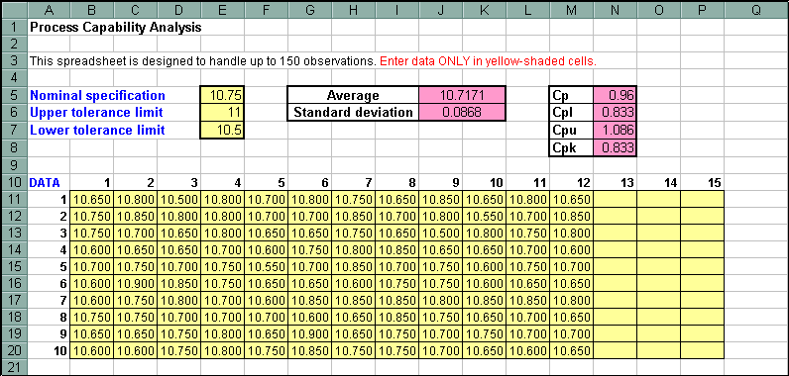
Process Capability Example

Slide 14
Two Fundamental Management Mistakes
Treating as a special cause any fault, complaint, mistake, breakdown, accident or shortage when it actually is due to common causes
Attributing to common causes any fault, complaint, mistake, breakdown, accident or shortage when it actually is due to a special cause

Slide 15
Traditional Economic Model of Quality of Conformance
Total cost
Cost due to nonconformance
Cost of quality assurance
100%
“Optimal level” of quality

Slide 16
Modern Economic Model of Quality of Conformance
Total cost
Cost due to nonconformance
Cost of quality assurance
100%

Slide 17
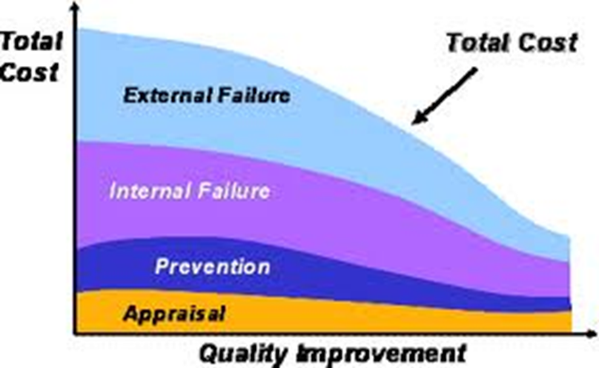
Modern Economic Model of Quality of Conformance (Cont.)
External and Internal failure costs are expensive!

Slide 18
Problem Solving
Problem: any deviation between what “should be” and what “is” that is important enough to need correcting
Structured (Well-Defined Existing/Desired State, Methods)
Semi-structured
Ill-structured (Unclear Existing/Desired State, Methods)
Problem Solving: the activity associated with changing the state of what “is” to what “should be”

Slide 19
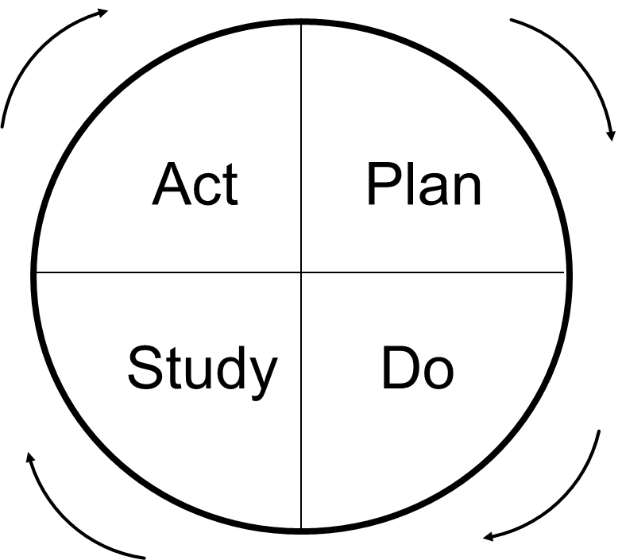
Problem Solving Process
Redefining and analyzing the problem
Generating ideas
Evaluating and
selecting ideas
4. Implementing ideas

Slide 20
Quality Problem Types
Conformance problems
Unstructured performance problems
Efficiency problems
Product design problems
Process design problems

Slide 21
Bethesda Hospital Model
Start
Review
current
situation
Describe
process
Explore
cause theories
Collect and
analyze data
Improvement?
Generate solutions
Plan
Do
Check
Improvement?
Act
no
no
yes
yes

Slide 22
Crosby Quality Improvement Program
Management commitment
Quality improvement team
Quality measurement
Cost of quality evaluation
Quality awareness
Corrective action
Zero defect committee
Supervisor training
Zero defects day
Goal setting
Error cause removal
Recognition
Quality councils
Do it over again

Slide 23
Creative Problem Solving
Mess Finding – identify symptoms
Fact Finding – gather data; operational definitions
Problem Finding – find the root cause
Idea Finding – brainstorming
Solution Finding – evaluate ideas and proposals
Implementation – make the solution work

Slide 24
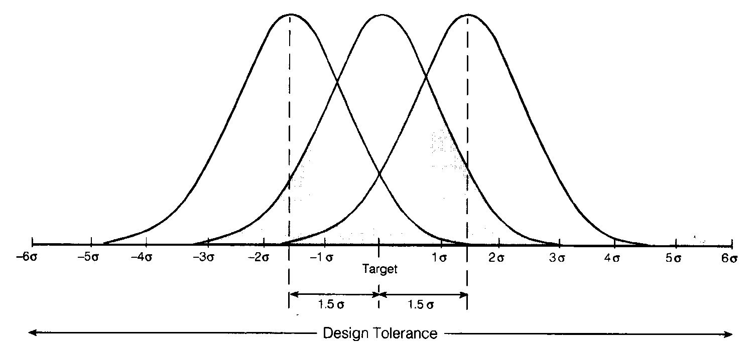
Six-Sigma Quality
Ensuring that process variation is half the design tolerance (Cp = 2.0) while allowing the mean to shift as much as 1.5 standard deviations.

Slide 25
Six-Sigma Metrics
Defects per unit (DPU) = number of defects discovered ÷ number of units produced
Defects per million opportunities (dpmo) = DPU × 1,000,000 ÷ opportunities for error
1.5 sigma shift = accounts for process variation (drifts) over time (short/long term), fudge factor for unexplained movements or special causes of variation over time.

Slide 26
DPU Example
A dpu might be bags lost per customer. If the average number of bags per customer is 1.6 and the airline recorded 3 lost bags for 8000 passengers in one month then:
dpmo = $\frac{3}{8000∗1.6}∗1,000,000=234.375$

Slide 27
k-Sigma Quality Levels
Six sigma results in at most 3.4 defects per million opportunities
What is my sigma level?
=NORMSINV(1-(#defects/#opportunities))+SigmaShift
or
=NORMSINV(1-(dpmo/1,000,000))+ SigmaShift
Back to the airline example:
We lost 3 bags per 1.6*8,000; so, 12,800 opportunities.
=NORMSINV(1-(3/12,800))+1.5 = 4.998 or 5 sigma

Slide 28
Six-Sigma Implementation
Emphasize dpmo as a standard metric
Provide extensive training
Focus on on corporate sponsor support
Create qualified process improvement experts
Ensure identification of appropriate metrics
Set stretch objectives

Slide 29
GE’s Six-Sigma Problem Solving Approach
Define
Measure
Analyze
Improve
Control
DMAIC

Slide 30
DMAIC
The “D” (Define) in the DMAIC process focuses on selecting high-impact projects and understanding which underlying metric(s) will reflect project success.

Slide 31
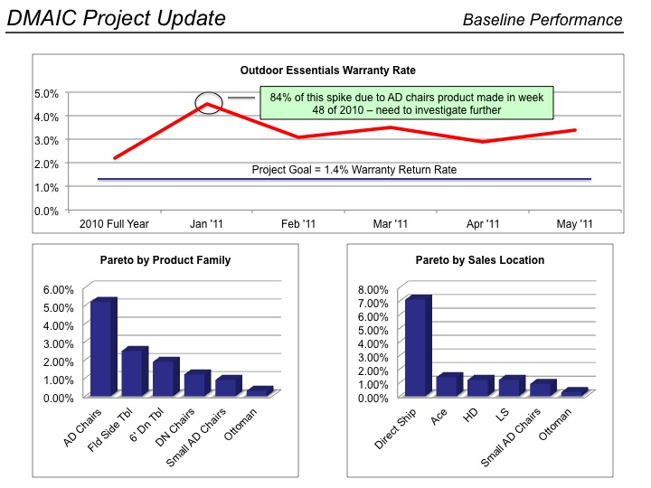
DMAIC
The “M” (Measure) in DMAIC is about documenting the current process, validating how it is measured, and assessing baseline performance.

Slide 32
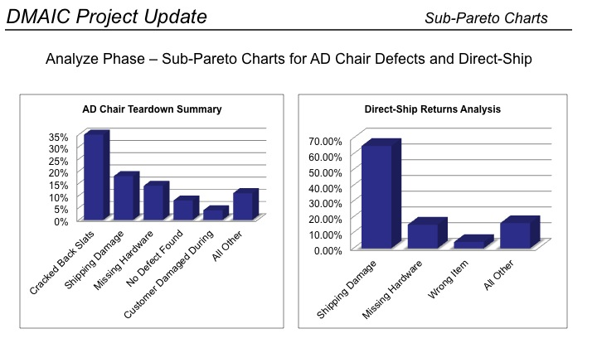
DMAIC
The Analyze phase in DMAIC isolates the top causes behind the metric or CTQ that the team is tackling.

Slide 33
DMAIC
The Improve phase focuses on fully understanding the top causes identified in the Analyze phase, with the intent of either controlling or eliminating those causes to achieve breakthrough performance.
The overall theme for the Improve phase is process redesign, and Six Sigma tools are commonly used in this phase.

Slide 34
DMAIC
DMAIC’s Control phase is about sustaining the changes made in the Improve phase to guarantee lasting results. The best controls are those that require no monitoring (irreversible product or process design changes).
But oftentimes there are process settings, setup procedures, etc., that require employees to follow specific requirements in daily operations – these items are typically documented in a control plan.

Slide 35
Tools for Six-Sigma and Quality Improvement
Elementary statistics
Advanced statistics
Product design and reliability
Measurement
Process control
Process improvement
Implementation and teamwork

Slide 36
Control Chart
Focuses attention on detecting and monitoring process variation over time
Distinguishes special from common causes of variation
Serves as a tool for on-going control
Provides a common language for discussion process performance
* *
*
* *
*
*

Slide 37
Poka-Yoke (Mistake-Proofing)
An approach for mistake-proofing processes using automatic devices or methods to avoid simple human or machine error, such as forgetfulness, misunderstanding, errors in identification, lack of experience, absentmindedness, delays,
or malfunctions

