Slide 1
Towards next generation fundamental precision measurements with muons
Kim Siang Khaw
Institute for Particle Physics (IPP)
ETH Zurich
Research Techniques Seminar, FNAL
August 5, 2014

Slide 2
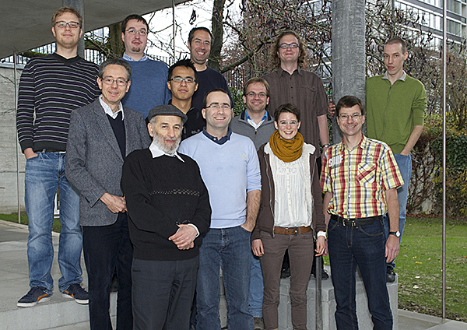
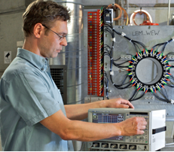
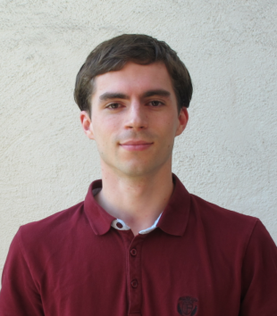
Collaborators
ETH Zurich: Aldo Antognini, Ivana Belošević, Paolo Crivelli, Andreas Eggenberger, *Klaus Kirch, Franz Kottmann, Florian Piegsa, David Taqqu and Gunther Wichmann
Paul Scherrer Institute (PSI): Wilhelm Bertl, Yu Bao, Malte Hildebrandt, Andreas Knecht, Elvezio Morenzoni, Angela Papa, Claude Petitjean, Thomas Prokscha, Stefan Ritt, Zaher Salman, Kamil Sedlak and Alexey Stoykov * group leader
All the work is supported by the SNSF grant 129600 and 146902.

Slide 3
Motivations
What is muonium and what can we do with it?

Slide 4
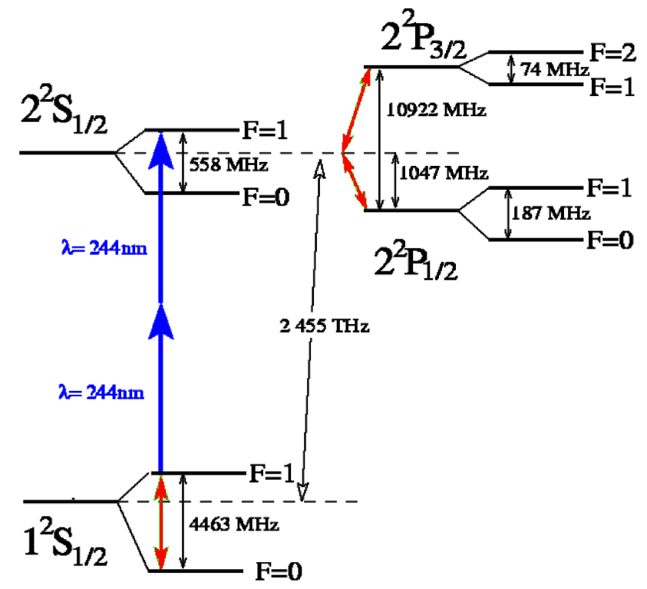
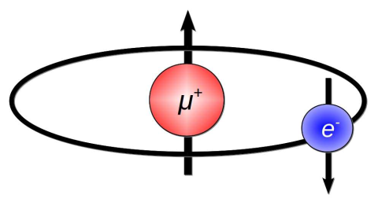
What is muonium (M)?
Courtesy K. Jungmann
Hydrogen-like atom!
Pure leptonic bound-state of μ⁺ and e⁻, 2.2 μs lifetime
The 1S-2S transition frequency and the ground state HFS were measured to very high precision (4 ppb and 12 ppb)
Being used since 1960s extensively to
study μ-e interactions
test QED bound state theory
determine and extract fundamental constants (m_{μ}/m_{e}, μ magnetic moment, q_{μ}/q_{e})
probe physics beyond the standard model (LFV, etc ...)

Slide 5
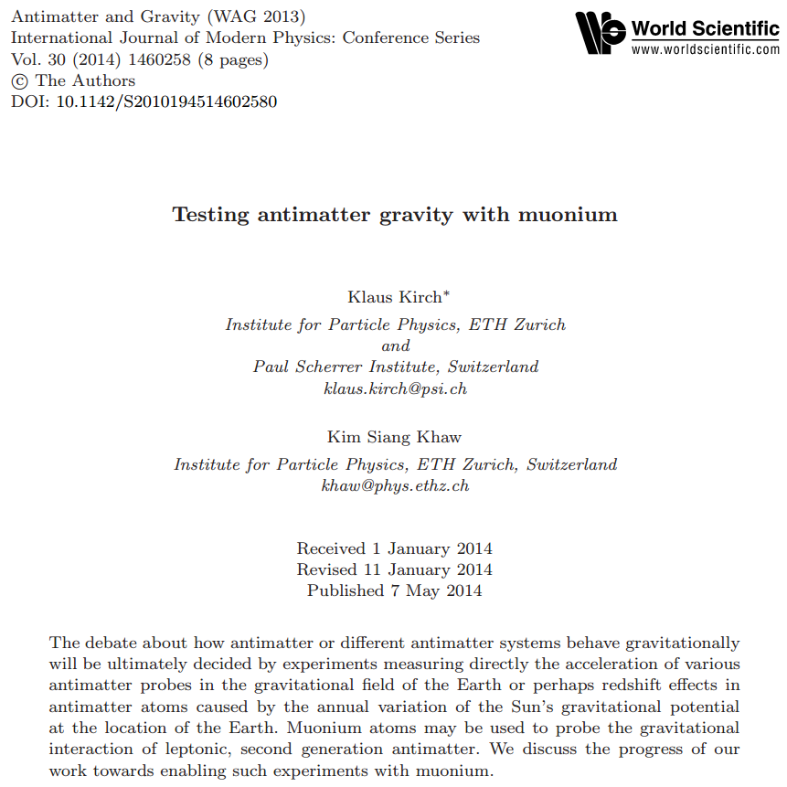
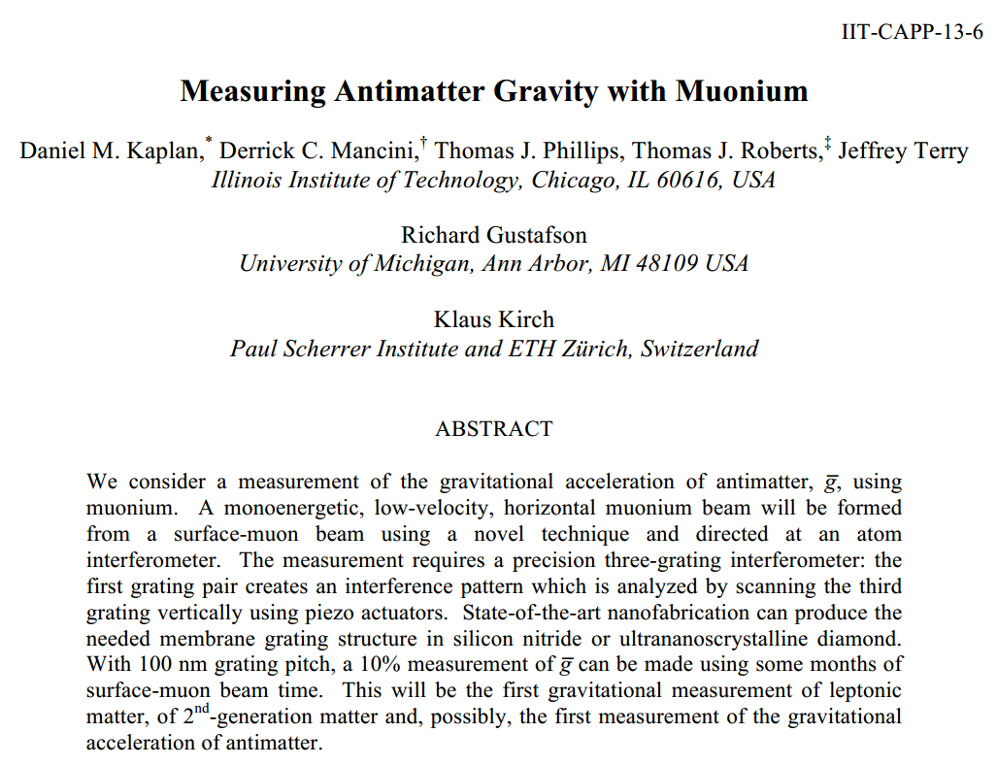
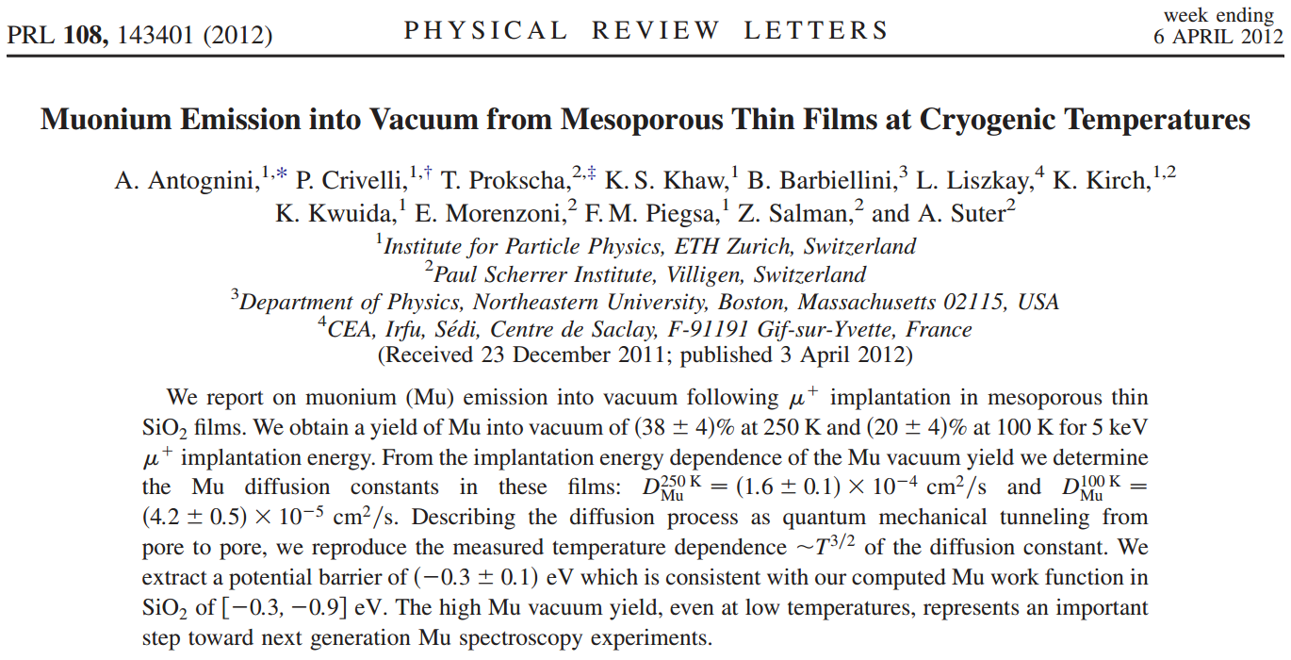
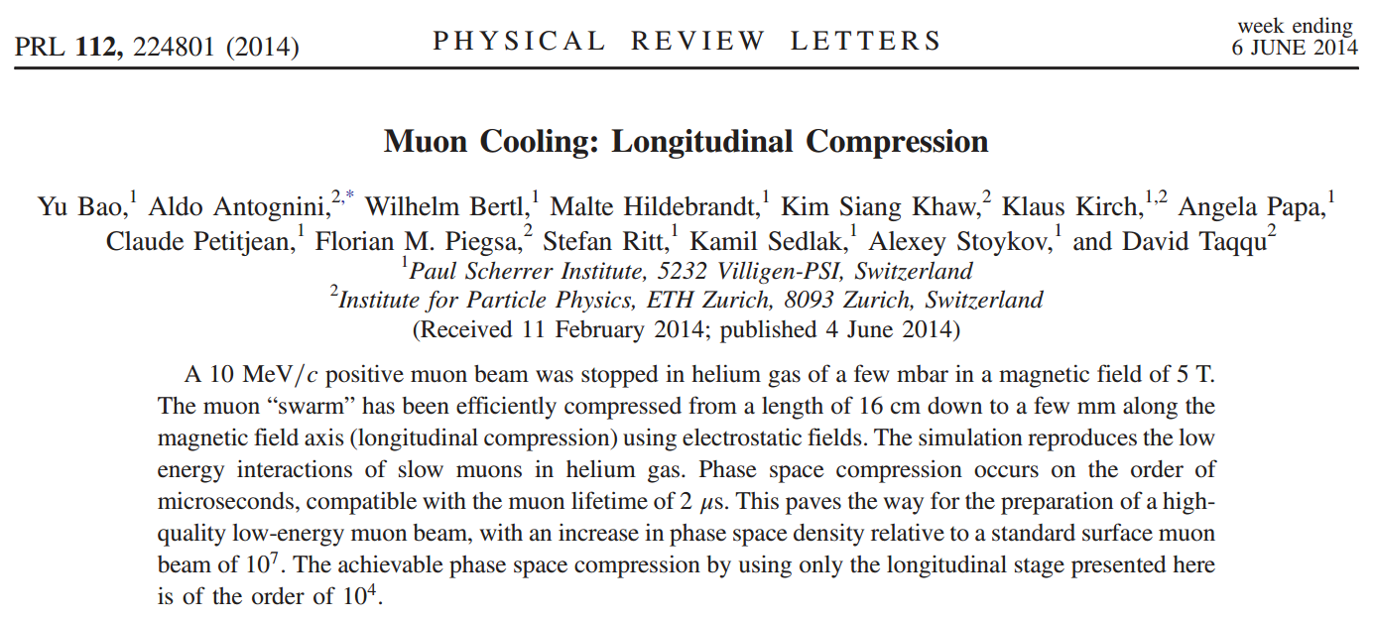
Motivation
Improve fundamental precision measurements with muon (μ⁺) and muonium (M), which are mostly limited by statistics and beam quality. Two straight forward ways available are:
Optimizing μ⁺ to M conversion rate [Antognini et al., PRL 108]
Porous silica material
Developing a high quality slow muon beam line [Bao et al., PRL 112]
Phase space compression of 10¹⁰
Sub-eV energies
Sub-mm beam size
High efficiency (10⁻³)
Several next generation experiments can be conceived with new μ⁺ and M beams
Higher precision M spectroscopy, search for M-antiM oscillations
μ_{EDM}, (g-2)_{μ}, etc or even antimatter gravity [Kaplan et al., arXiv:1308.0878]!
Can probe energy scales of up to 1000 TeV (complementary to HEP)

Slide 6
Muonium production
Optimizing μ⁺ to M conversion rate using porous silica
6

Slide 7
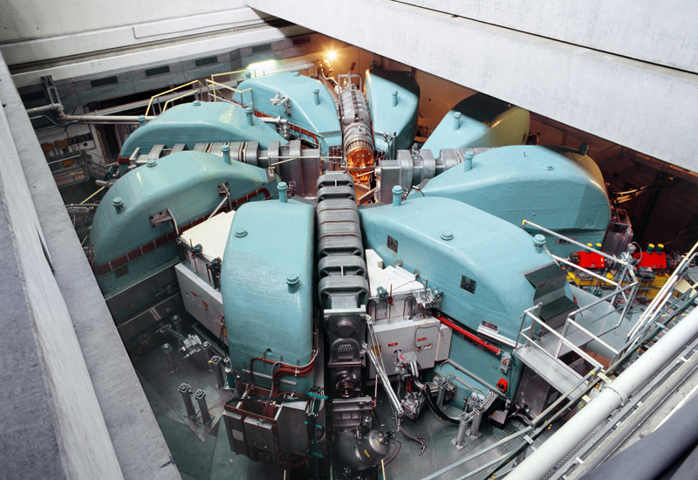
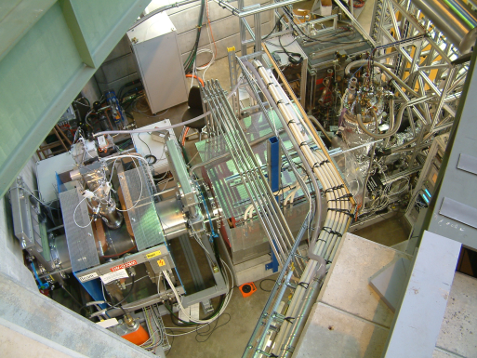
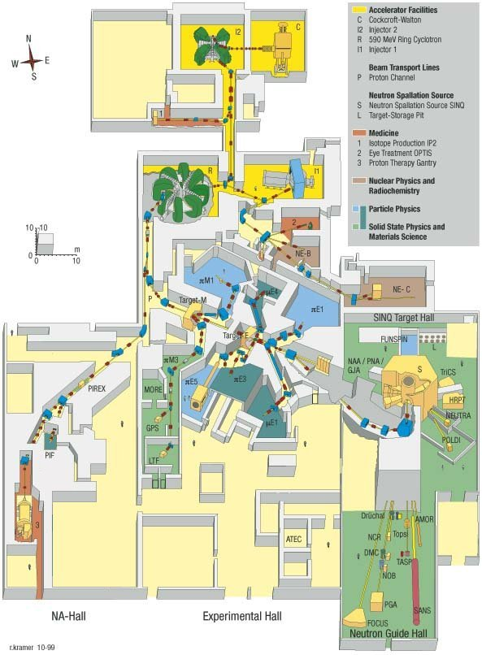
PSI Experimental hall
590 MeV
Cyclotron
I = 2 mA
(1.2 MW)
μE4 beam line
Muonium production
from porous silica
μ⁺ rate: 4.2 x 10⁸/s
πE1 beam line
Phase space compression
of muon beam
μE4 beam line

Slide 8
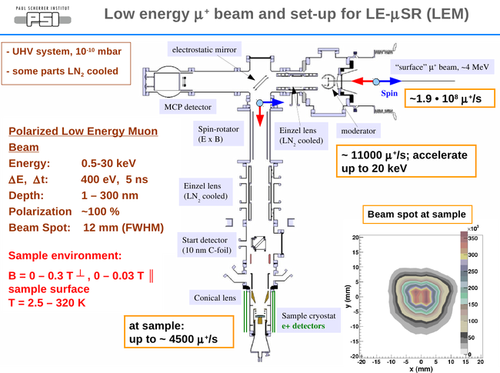
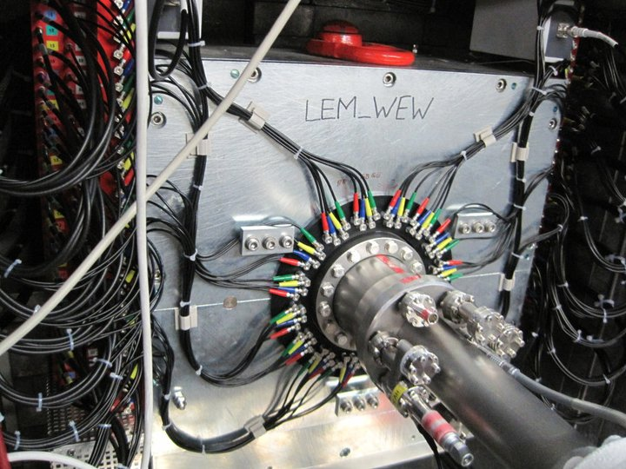
Details of LEM
Courtesy PSI LEM group

Slide 9
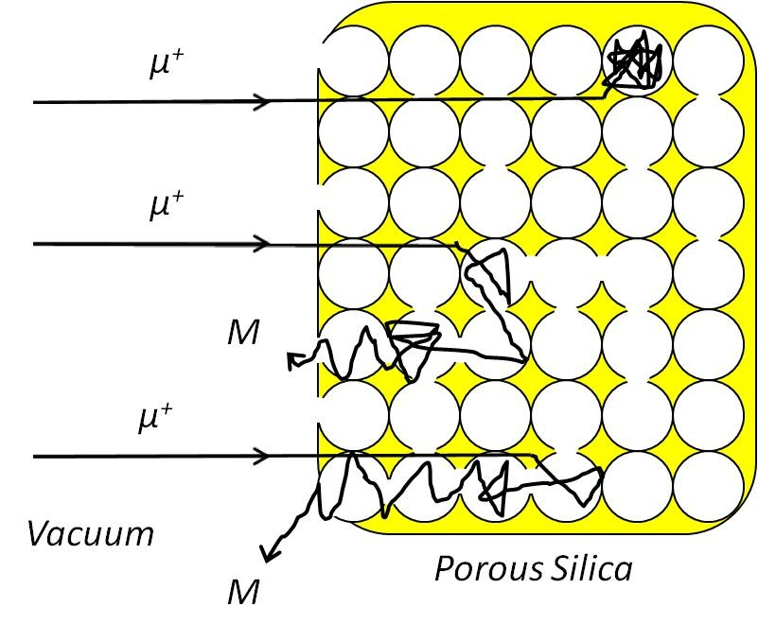
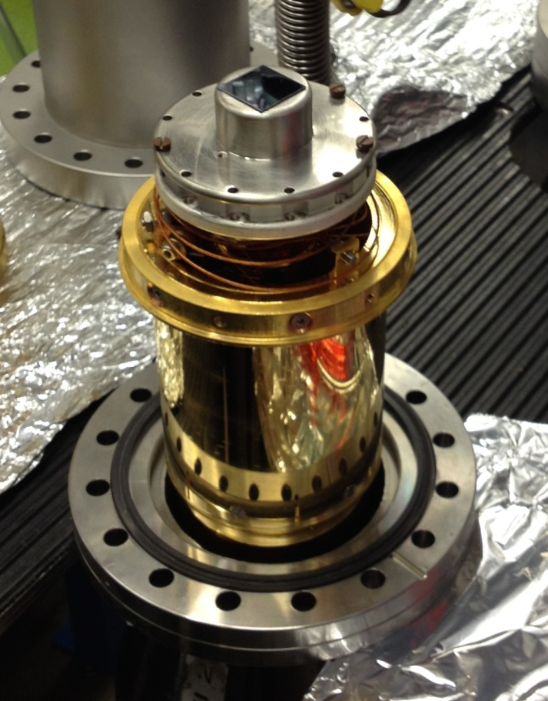
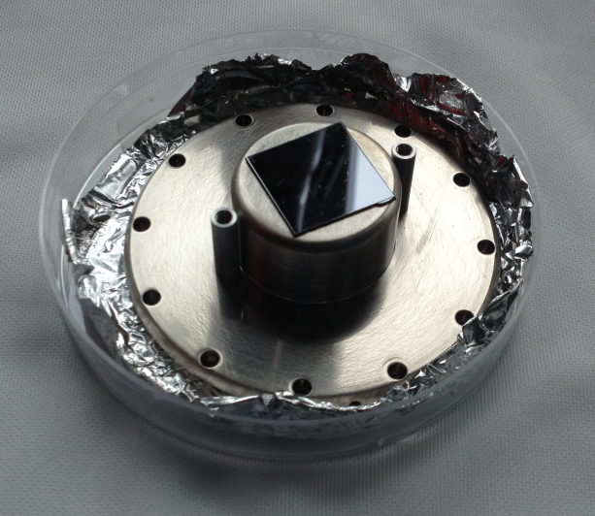
Muonium production – Porous silica
Bulk silica - high M production rate but no emission outside the target
Silica with structured pore-network (porous silica) - lower formation rate but a high fraction of M diffuses out
Muon spin rotation technique to extract M formation probability
Positron shielding technique to extract M emission into vacuum

Slide 10
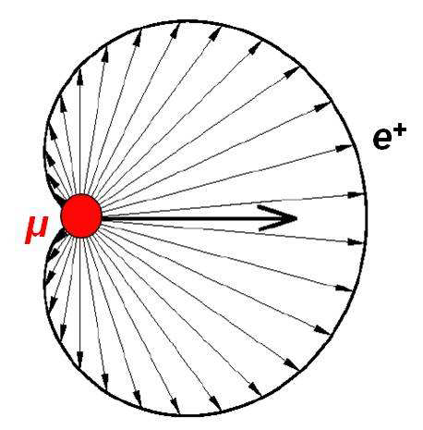
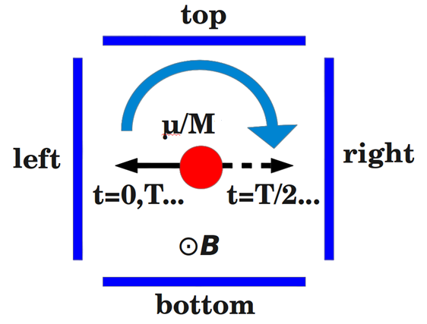
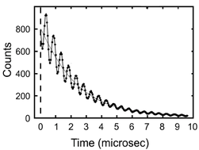
Muon Spin Rotation technique (μSR)
B = 100 G
Monitor the evolution of μ⁺ spin after implantation, under external magnetic field
Larmor precession frequency of M = 103 times of μ⁺
Can distinguish if an implanted μ⁺ remains unbound and forms M
Decay positron emitted preferentially in the direction of μ⁺ spin due to the parity violation of weak interaction
With a segmented positron detector, M formation rate can be determined from the precession amplitude

Slide 11
Results from μSR technique
The time spectra measured in each individual segment is given by
The Mu formation probability can be calculated by comparing μ⁺ precession amplitude, A_{μ} of different samples.
We obtained 60% Mu formation probability for porous silica.

Slide 12
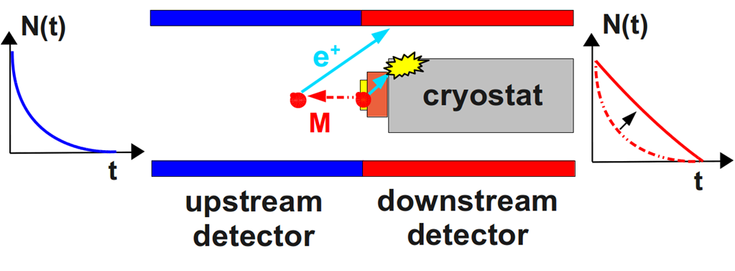
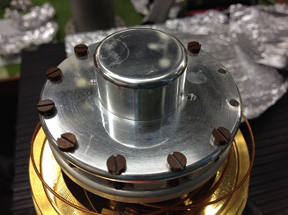
Positron shielding technique (PST)
Al coated copper plate
No M emission into vacuum → exponential decay
M emission into vacuum → deviation from exponential function for the downstream detectors
Increase in count rate when M decaying outside of the sample
GEANT4 simulation for 0% (F₀) and 100%(F₁₀₀)
Fit the data with F_{fit} = aF₁₀₀ + (1-a)F₀

Slide 13
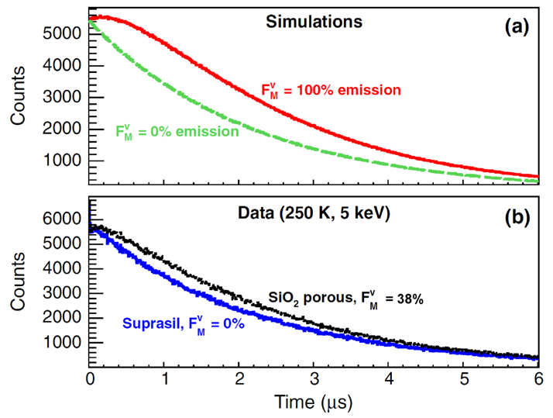
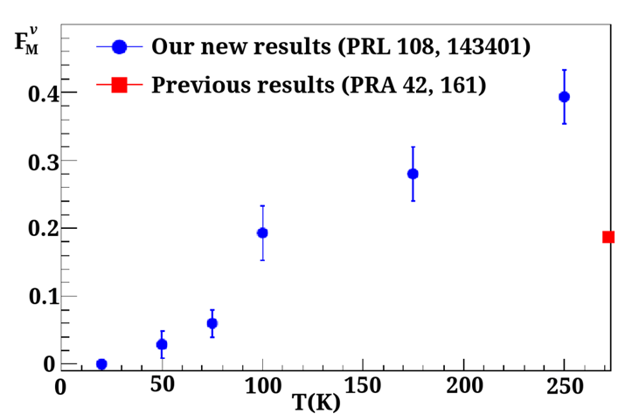
Emission of M into vacuum
Optimization of emission of M into vacuum
measurements with different pore sizes and temperatures
extract emission probabilities and velocity distributions
best results so far (5 nm pore size, 20% at 100 K and 40% at 250 K, Boltzmann velocity distribution)
More than 10 times improvement of M 1S-2S with current systems (μ⁺ beam, M yield in vacuum, CW laser)

Slide 14
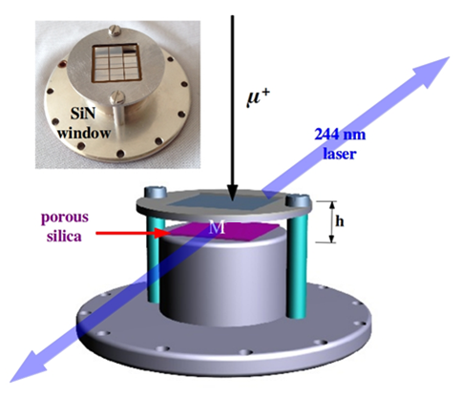
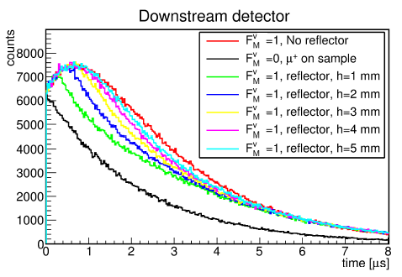
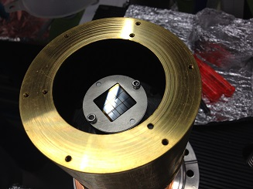
Towards M 1S-2S – a trapping cell
To increase the laser-M interaction time
Different spectra when M is “trapped”
Tested at beam time July 2014

Slide 15
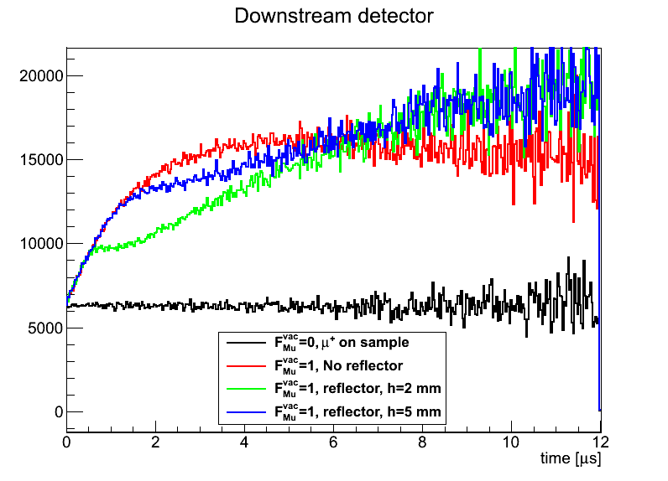
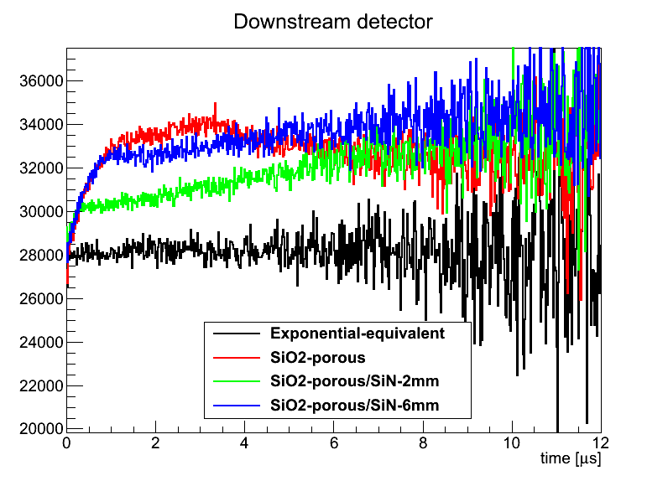
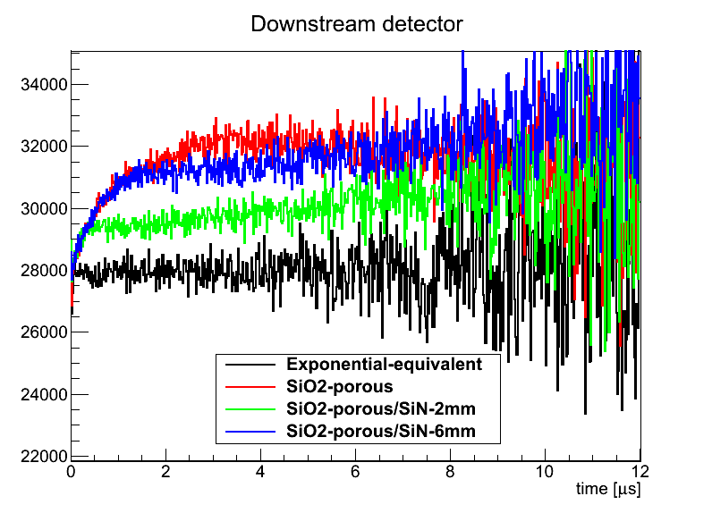
Preliminary results
MC, 100 K
Data, 250 K
Data, 100 K
Similar shapes in the MC and in the data
Increase in the “count rate” at later time → M is coming out after travelling a long path → high reflectivity from the SiN window
Quantitative analysis ongoing
Trapping of thermal M atom is realized → big step towards M 1S-2S spectroscopy!

Slide 16
Phase space compression
Developing a high quality slow muon beam line
16

Slide 17
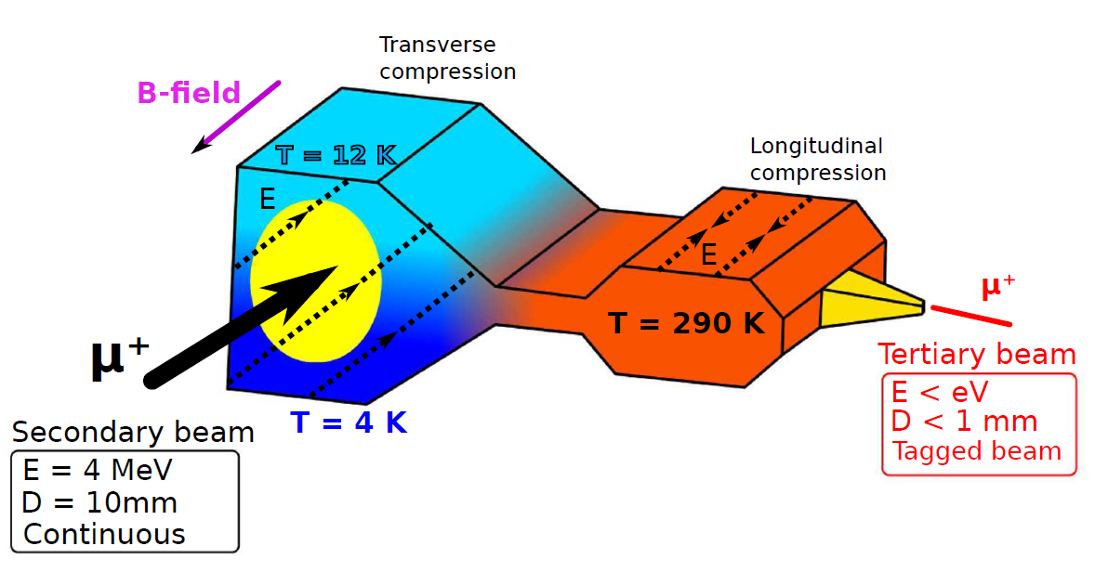
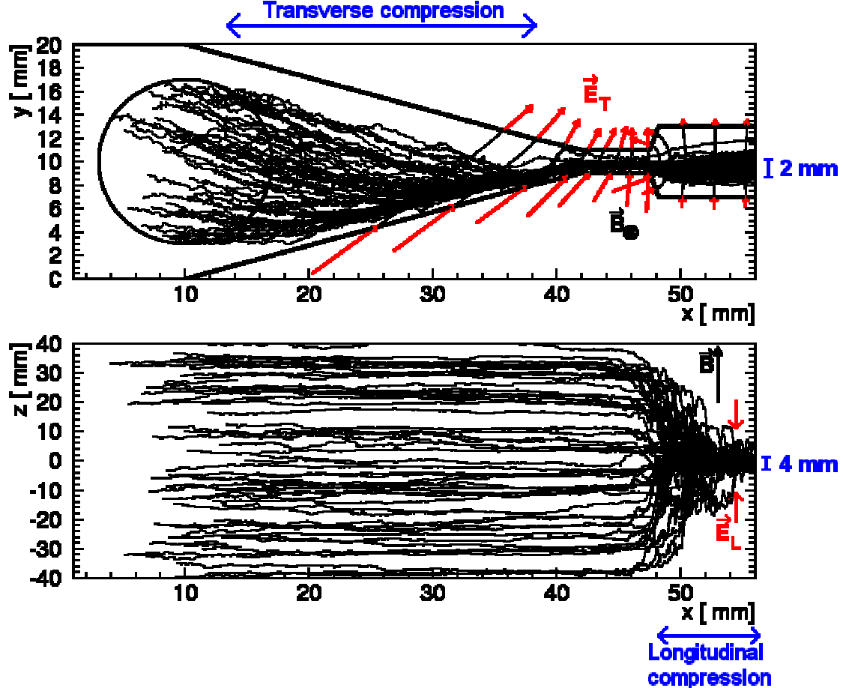
Slow muon beam program at PSI
D. Taqqu, PRL 97
position-dependent μ⁺ drift velocity in helium gas (density gradient)
Phase space compression (10¹⁰), sub-mm size and sub-eV energy
3 stages of compression : transverse compression, longitudinal compression and extraction of the μ⁺ beam
Estimated efficiency of about 10⁻³

Slide 18
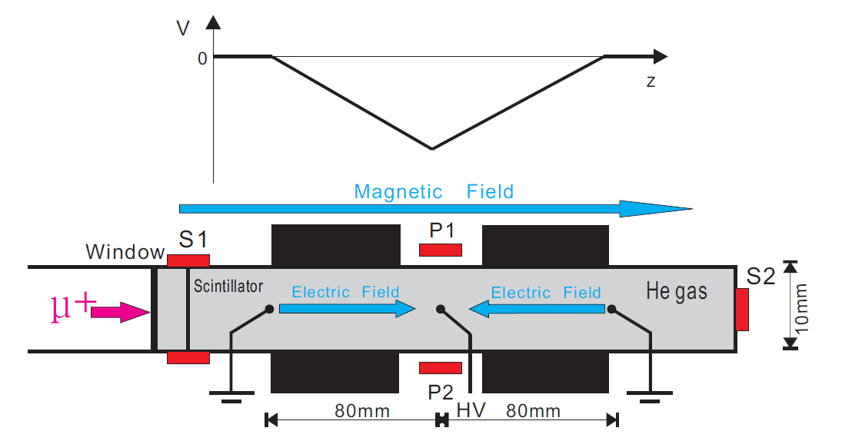
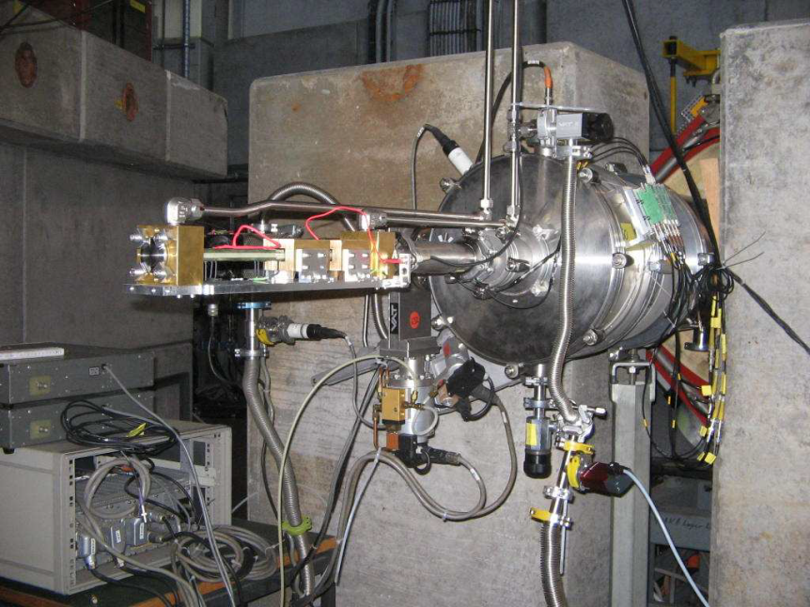
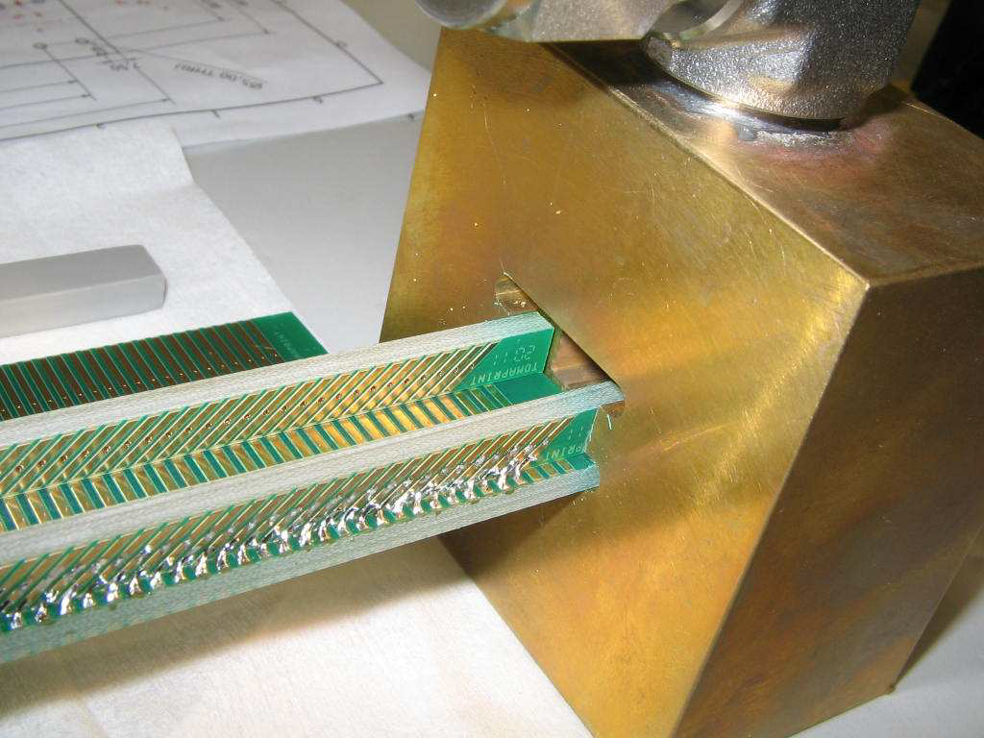
Testing longitudinal compression at PSI
Feasibility test done at πE1 at PSI (2 × 10⁴ μ⁺ /s @ 10 MeV/c)
30 μm thick plastic scintillator (S1 – start)
PCB with metallic strips to define potential (-550 V to + 550 V)
2 scintillators to tag e⁺ from μ⁺ decay (P1, P2 – stop)
Helium gas pressure was varied from 5 mbar to 12 mbar

Slide 19
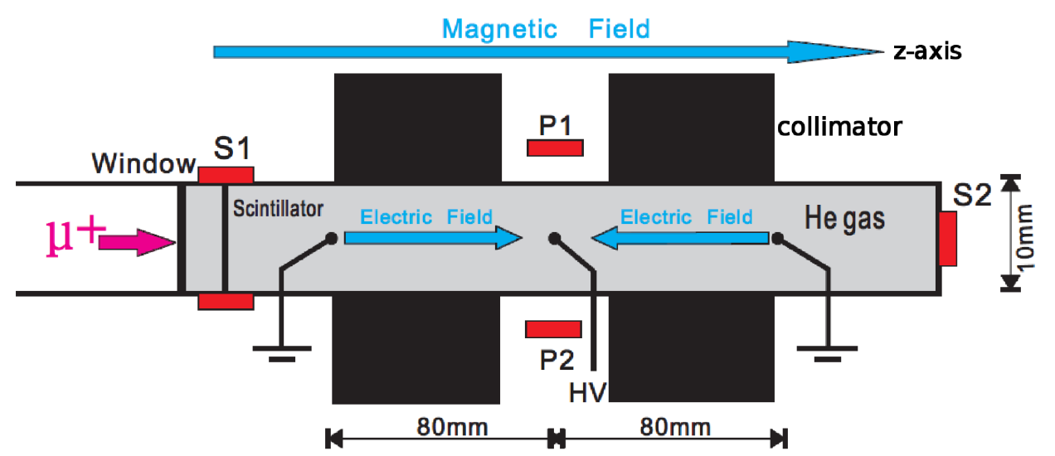
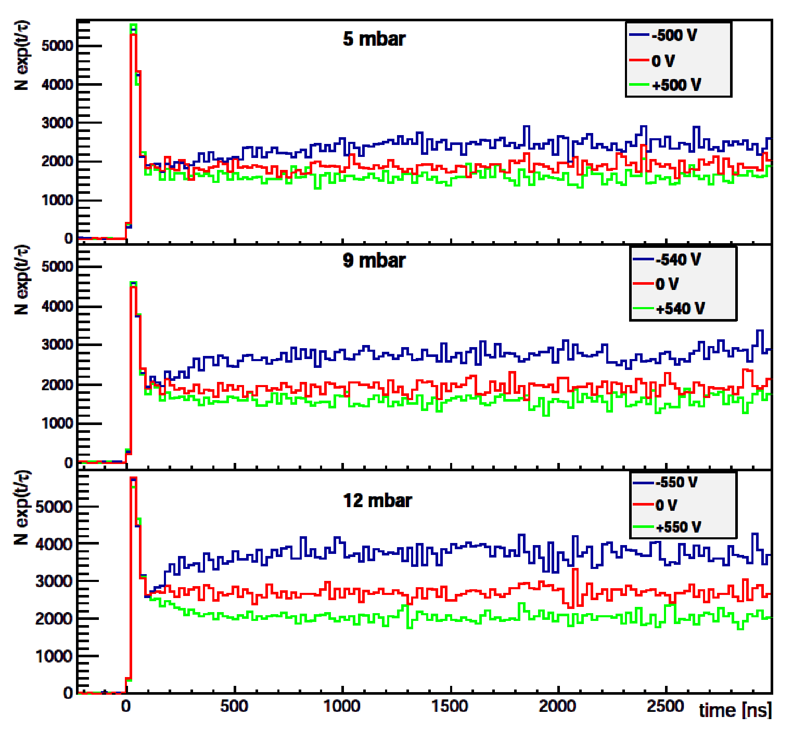
Raw data
The histograms are scaled with e^{t/τ} to remove μ⁺ decay effect
The prompt peaks are coming from high energy μ⁺ decaying in flight
-HV: μ⁺ are being attracted to P1 and P2
+HV: μ⁺ are being pushed away from P1 and P2

Slide 20
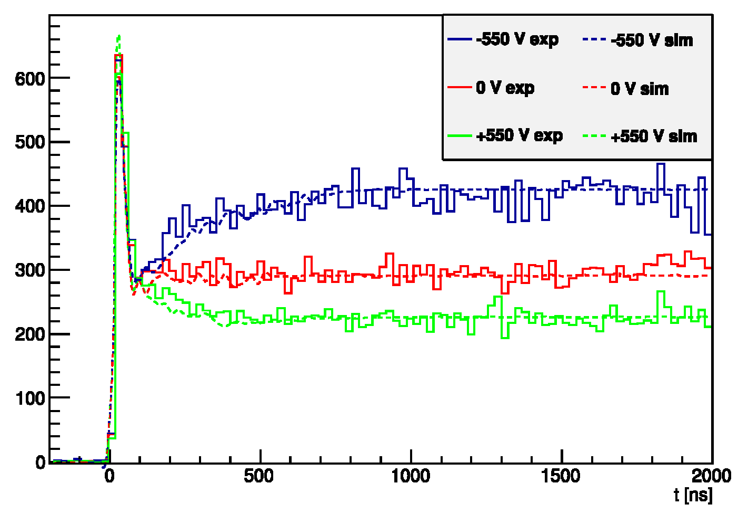
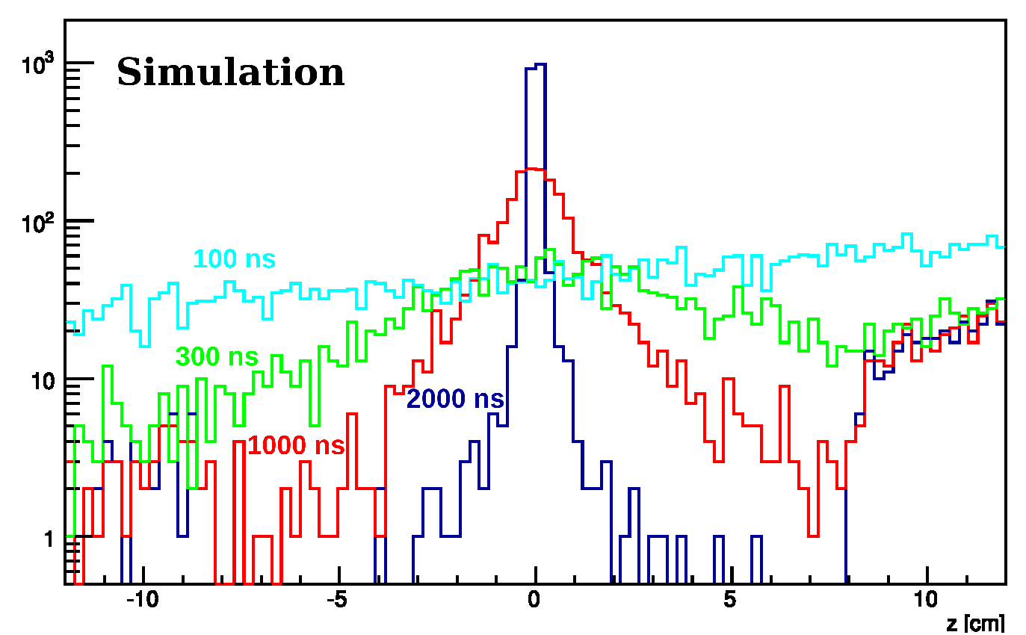
Results
Y. Bao et al., PRL 112
Implementation of low energy μ⁺ elastic collision physics and M formation in He gas into GEANT4 down to 0.1 eV energy
Good agreements between MC and data
Starting from an approximately flat stop distribution, the muons are compressed in the center in less than 2 μs → feasible!

Slide 21
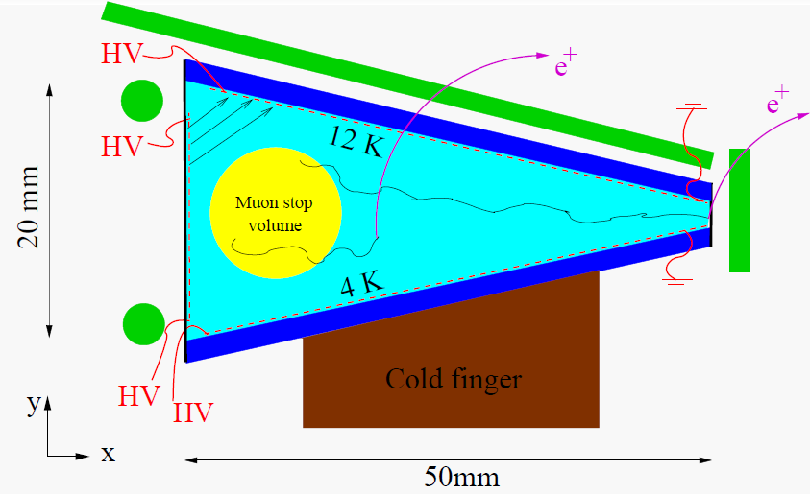
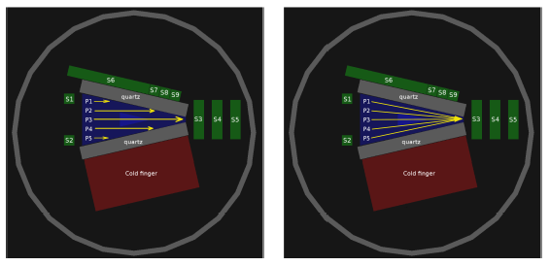
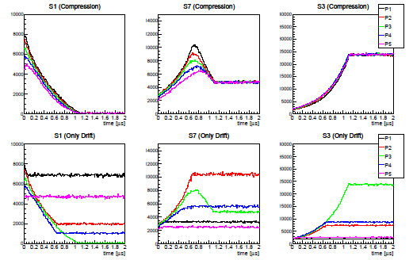
Testing transverse compression
Upcoming test of the
transverse compression
at PSI in December 2014
Expected time spectra when
the E or B field is switched off
or without gas density gradient

Slide 22
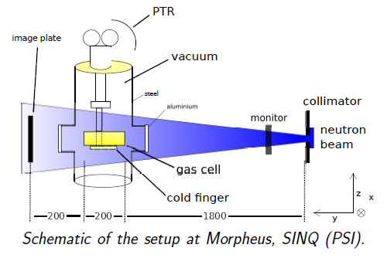
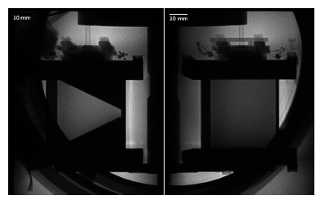
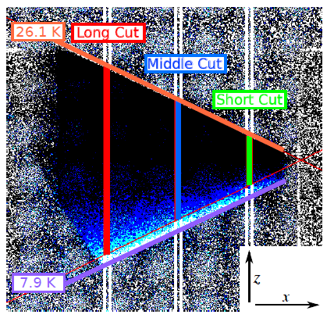
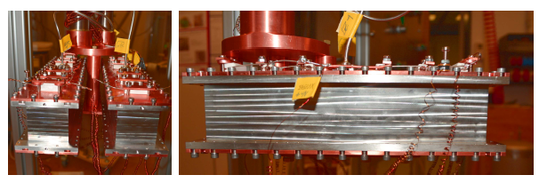
Neutron radiography of ³He gas density
Courtesy A. Eggenberger, F. Piegsa and G. Wichmann

Slide 23
Courtesy A. Eggenberger

Slide 24
Summary
Muonium production
Ongoing efforts to increase laser and muonium interaction time
Measurement of the muonium 1S-2S is possible within 5 years.
Muon beam phase space compression
Transverse compression will be tested by end of this year.
Full compression scheme could be realized within the next 2-5 years.
Together with my colleagues and collaborators, we are opening up new possibilities in the next generation muon and muonium precision measurements.

