Slide 1
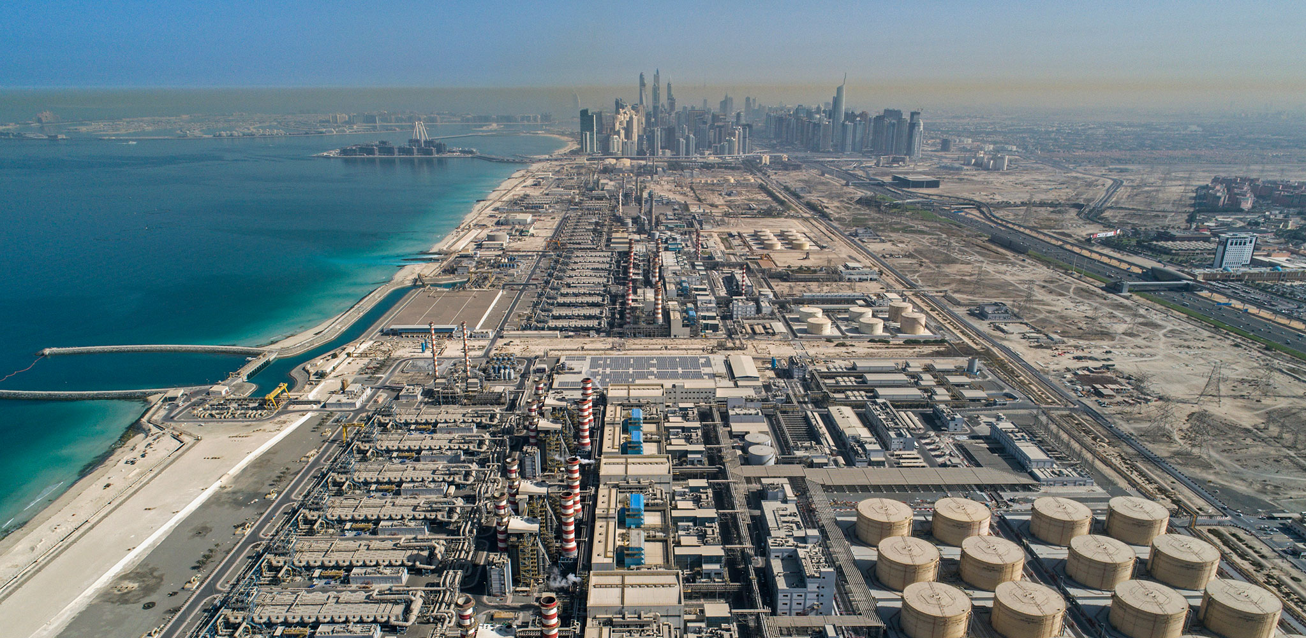
Final Results:
Decarbonisation of Desalination Plant
Industry Sponsor: MAN Energy Solutions
Coach: Gaurav Singh
Giuseppe Nappi Heidi Macek
Bruno Gelfort Emma Laub
Georg Odermatt Jeehyeong Lee
Industry Partner: MAN Energy Solutions
Coach: Gaurav Singh
Giuseppe Nappi Heidi Macek
Bruno Gelfort Emma Laub
Georg Odermatt Jeehyeong Lee
Notes:
Image source: https://constructionreviewonline.com/news/egypt/egypt-to-construct-47-desalination-plants-in-the-next-5-years/
Hi everyone, thank you for being here. We are group 3, and we are thrilled to be here to present the final results of our case study which was the decarbonisation of desalination plants.

Slide 2

Agenda
Problem Recap
Case Study: Jeddah, Saudi Arabia
HP-MED Model
Results in Context
Notes:
In the next 15 minutes we'll give you a reminder of our initial problem and what we did in the first semester, we will go over what we've been up to in this semester, then we'll present a case study we've conducted as well as the results that came of it.

Slide 3
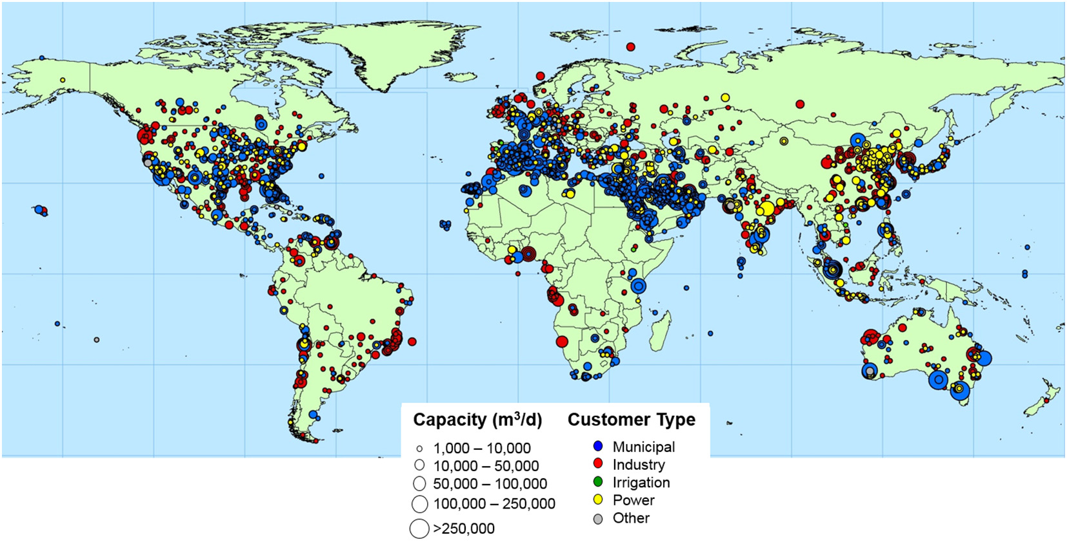
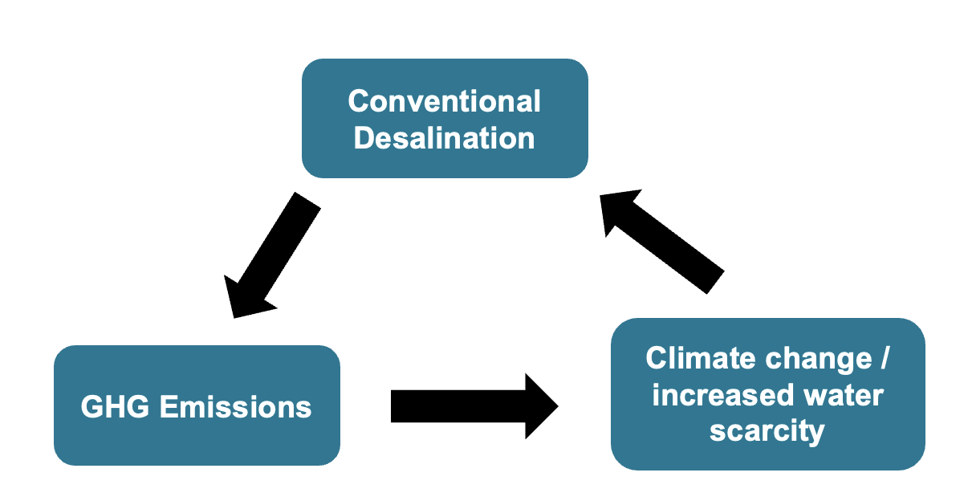
1st Semester Recap: Problem Analysis
Desalination challenges
Desalination global installed capacity: 95.37 million m³/day
High GHG emissions
High cost per unit of water
Notes:
What problem were we initially tackling?
Well, currently 1/3 of global urban population experiences water scarcity and this value is only expected to grow
A current solution to freshwater scarcity is the desalination of saltwater. There are about 17 000 plants globally for a total installed capacity of just under 100 million m^3 freshwater/day
However, this presents its own significant challenges. For one, the desalination technologies are very energy intensive and are still heavily reliant on fossil fuels. This causes the following feedback loop, where desalination causes GHG emissions, which contribute to climate change, causing water scarcity, increasing the need for desalination and so on (5-24 kg CO2eq/ m^3 of water). Lastly, desalination is quite costly, mainly due to high energy demand of the current desalination technologies. In fact, the price of freshwater produced by desalination can be up to twice as much as conventional sources of water.

Slide 4

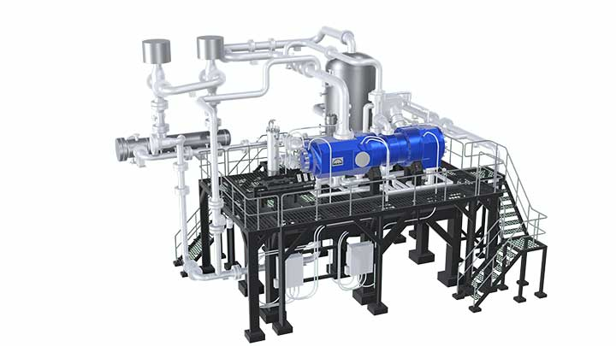

1st Semester Recap: Solution Identification
Renewable Technologies
MAN Heat Pump
Thermal technologies
+
+
CO₂ refrigerant
Notes:
In response to these challenges, we came up with the following solution:
The first thing we decided on was to power our system with renewable energy. This would significantly decrease the GHG emissions associated with the energy-intensive desalination technologies
This renewable energy would then power a CO2-based heat pump from MAN Energy Solutions, which would be coupled with a thermal desalination technology.
After a lengthy analysis, it was decided that Humidification-dehumidification and multiple effect desalination were the 2 best options. And we then decided to focus on MED, as it is already more developed than HDH.

Slide 5



What have we been up to?
Techno-Economic Model
Case Study
Notes:
So after all that, you're probably asking yourself what we've been up to this past semester?
We have developed a techno-economic model that can help us evaluate and calculate the optimal desalination capacity, as well as levelized cost of water. This model can be applied to any context by simply modifying the input parameters. However, to demonstrate the feasibility of the entire system, we've decided to apply it to a specific location

Slide 6

Case Study: Jeddah, Saudi Arabia
SA: 50-150 mm rainfall/year
World leader in desalination
Jeddah: ~ 40 mm rainfall/year
Desalination plants supply 98% of the city's water
~ 25% population growth by 2050
Proximity to Red Sea
Notes:
We've chosen to evaluate the model in Jeddah, Saudi Arabia. The reason for this is that Saudi Arabia is an extremely dry country, having only 50-150 mm rainfall per year. For reference, Switzerland experiences an average of 1000 to 1500 mm of yearly rainfall. Due to this, SA is a world leader in desalination as it relies solely on desalinated technologies and a bit of groundwater to meet their water demand. This demand is quite high, in fact Saudi Arabia's per capita water consumption is more than double the world averages. The population is also expected to grow by 25% by 2050, which implies an even greater water demand. Within this population, 85% is located in urban areas.
This led us to choosing to evaluate our model within a city, and we chose Jeddah, which is the 2nd most populous city in SA. Amid the very dry Saudi Arabia, it's one of the driest cities, as can be seen on the graph here. In fact, it is so dry that the city relies on desalination technologies for 98% of its total water demand. Finally, Jeddah is located directly on the red sea, which is quite important since desalination requires a source of saltwater.
Seawater quality can be harmful for the operation of RO plants, in some cases (e.g. algal blooms) forcing plant shutdown
The average of monthly water provided for Jeddah City is about 31.5 Mio m3

Slide 7

Case Study: Jeddah, Saudi Arabia
SA goal: net zero by 2060
50% energy from renewables by 2030
600 MW solar PV under construction
Notes:
Sources:
https://www.greeninitiatives.gov.sa/about-sgi/sgi-targets/reducing-emissions/reduce-carbon-emissions/
Saudi Arabia has committed to decarbonising its electricity grid, aiming to have 50% of its energy mix powered by renewable resources. In Jeddah alone, there are two new solar PV farms of 300 MW each under development. Beyond the country's electricity grid, this shows potential for green power purchase agreements, and a potential to fully decarbonise the desalination plant.
Seawater quality can be harmful for the operation of RO plants, in some cases (e.g. algal blooms) forcing plant shutdown
The average of monthly water provided for Jeddah City is about 31.5 Mio m3

Slide 8
MED System Coupled With MAN Heat Pump
Electricity
Input
Heat Input
Water Output
Notes:
The heat pump can be integrated into various cooling services. 2 that stood out throughout our research were district and data center cooling. District cooling is a centralised production of cooling services and is more energy efficient than individual cooling. However, generally, the extracted heat from cooling is discarded, such as in Paris, where it is rejected into the Seine river. Pairing a heat pump-operated desalination plant with district cooling could be promising, however its profitability is very location-dependent, meaning that the plant would not only need to be located in densely populated city, but also one with a convenient street grid. Otherwise, heat losses due to the pipe lengths would be too high to make this a plausible solution.
Another promising cooling sector is the data industry. Data centers are exponentially rising their total data creation, predictions state that in a 15 year period, from 2010 to 2025, there will be almost a 150 time increase in data production. These data centers rely on server racks that are densely packed and that depend on good cooling for optimal performance. With the knowledge that as of 2018, data centers contribute to approximately 2% of the EU's total waste heat generation, we can be certain that the cooling demand for these centers is already high and will only continue rising. The only constraint being that the desalination plant must be located near a data center, this is a very plausible solution.
*24/7 cooling need
Liquid cooled
150 MW

Slide 9
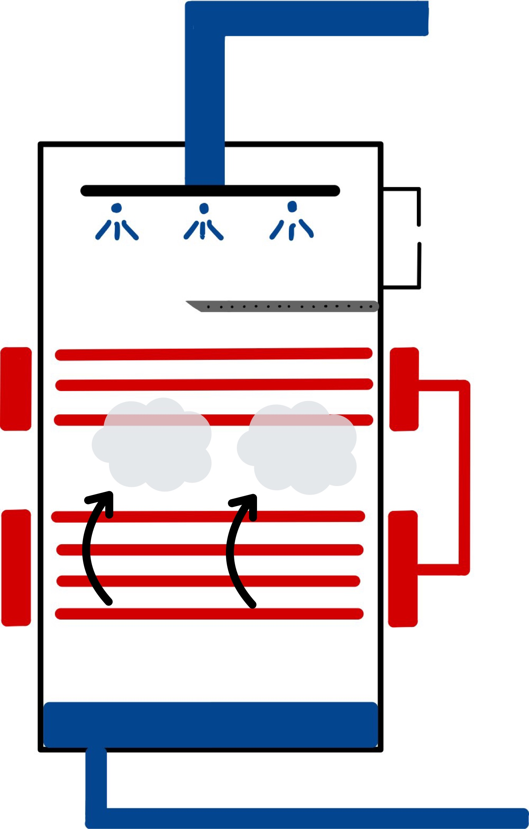
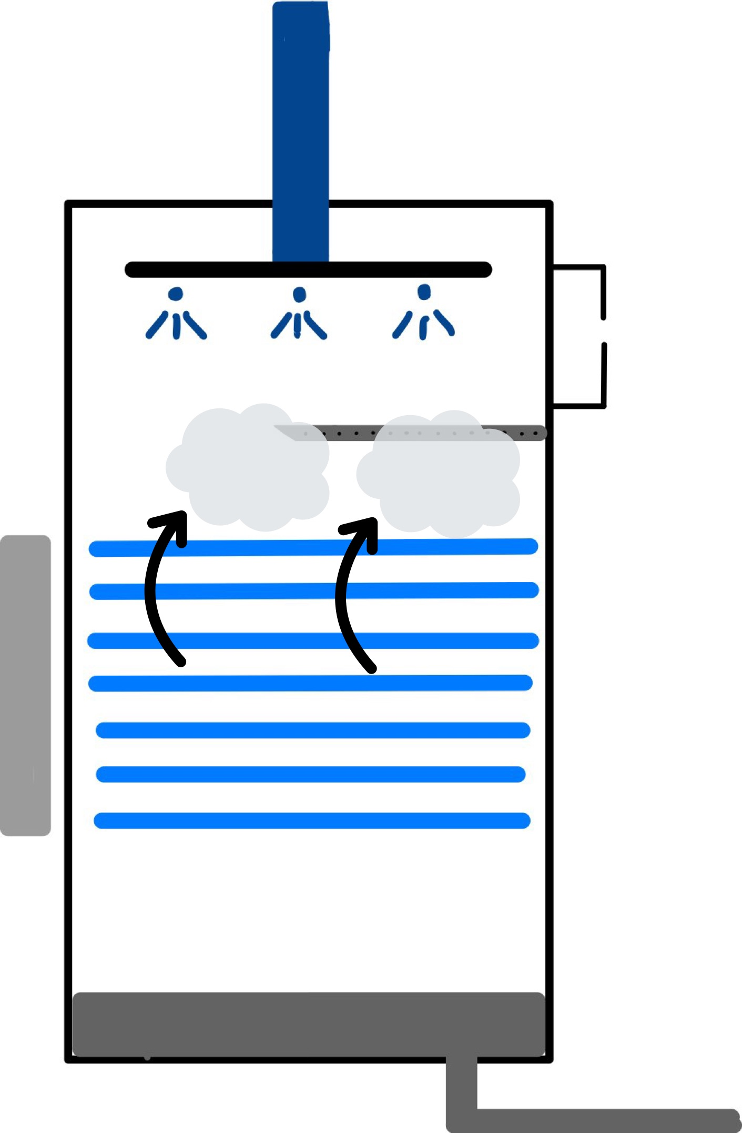
MED System Coupled With MAN Heat Pump
Feedwater
ΔT between stages = 3ºC
Feedwater
Distillate vapor
Distillate vapor
0 ppm salinity
Distillate vapor from previous stage
CO₂ from heat pump
Top brine temperature = 70ºC
Condensate vapor to distillate tank,
Brine to second stage
Final brine salinity = 70 000 ppm
Brine to next stage
Notes:
The heat pump can be integrated into various cooling services. 2 that stood out throughout our research were district and data center cooling. District cooling is a centralised production of cooling services and is more energy efficient than individual cooling. However, generally, the extracted heat from cooling is discarded, such as in Paris, where it is rejected into the Seine river. Pairing a heat pump-operated desalination plant with district cooling could be promising, however its profitability is very location-dependent, meaning that the plant would not only need to be located in densely populated city, but also one with a convenient street grid. Otherwise, heat losses due to the pipe lengths would be too high to make this a plausible solution.
Another promising cooling sector is the data industry. Data centers are exponentially rising their total data creation, predictions state that in a 15 year period, from 2010 to 2025, there will be almost a 150 time increase in data production. These data centers rely on server racks that are densely packed and that depend on good cooling for optimal performance. With the knowledge that as of 2018, data centers contribute to approximately 2% of the EU's total waste heat generation, we can be certain that the cooling demand for these centers is already high and will only continue rising. The only constraint being that the desalination plant must be located near a data center, this is a very plausible solution.
*24/7 cooling need
Liquid cooled
150 MW

Slide 10
System Operation: Summer Case
Heat Pump Operation
Heat production
64 MW
Power required
14 MW
COP_{HOT}
4.57
Cooling production
50 MW
Seawater Temperature 35°C
Total Freshwater production ≈ 11 900 m³/day
Notes:
The heat pump can be integrated into various cooling services. 2 that stood out throughout our research were district and data center cooling. District cooling is a centralised production of cooling services and is more energy efficient than individual cooling. However, generally, the extracted heat from cooling is discarded, such as in Paris, where it is rejected into the Seine river. Pairing a heat pump-operated desalination plant with district cooling could be promising, however its profitability is very location-dependent, meaning that the plant would not only need to be located in densely populated city, but also one with a convenient street grid. Otherwise, heat losses due to the pipe lengths would be too high to make this a plausible solution.
Another promising cooling sector is the data industry. Data centers are exponentially rising their total data creation, predictions state that in a 15 year period, from 2010 to 2025, there will be almost a 150 time increase in data production. These data centers rely on server racks that are densely packed and that depend on good cooling for optimal performance. With the knowledge that as of 2018, data centers contribute to approximately 2% of the EU's total waste heat generation, we can be certain that the cooling demand for these centers is already high and will only continue rising. The only constraint being that the desalination plant must be located near a data center, this is a very plausible solution.
*24/7 cooling need
Liquid cooled
150 MW

Slide 11
System Operation: Winter Case
Heat Pump Operation
Heat production
68 MW
Power required
14 MW
COP_{HOT}
4.89
Cooling production
54 MW
Seawater Temperature 19°C
Total Freshwater production ≈ 12 600 m³/day
Notes:
The heat pump can be integrated into various cooling services. 2 that stood out throughout our research were district and data center cooling. District cooling is a centralised production of cooling services and is more energy efficient than individual cooling. However, generally, the extracted heat from cooling is discarded, such as in Paris, where it is rejected into the Seine river. Pairing a heat pump-operated desalination plant with district cooling could be promising, however its profitability is very location-dependent, meaning that the plant would not only need to be located in densely populated city, but also one with a convenient street grid. Otherwise, heat losses due to the pipe lengths would be too high to make this a plausible solution.
Another promising cooling sector is the data industry. Data centers are exponentially rising their total data creation, predictions state that in a 15 year period, from 2010 to 2025, there will be almost a 150 time increase in data production. These data centers rely on server racks that are densely packed and that depend on good cooling for optimal performance. With the knowledge that as of 2018, data centers contribute to approximately 2% of the EU's total waste heat generation, we can be certain that the cooling demand for these centers is already high and will only continue rising. The only constraint being that the desalination plant must be located near a data center, this is a very plausible solution.
*24/7 cooling need
Liquid cooled
150 MW

Slide 12


Comparison of Two Extreme Cases
Heat power: 68
Cooling power: 54
COP: 4.89
Outlet water temperature from HP evaporator
Heat power: 64
Cooling power: 50
COP: 4.57
7°C
15°C
Exact range required for district cooling
Notes:
The heat pump can be integrated into various cooling services. 2 that stood out throughout our research were district and data center cooling. District cooling is a centralised production of cooling services and is more energy efficient than individual cooling. However, generally, the extracted heat from cooling is discarded, such as in Paris, where it is rejected into the Seine river. Pairing a heat pump-operated desalination plant with district cooling could be promising, however its profitability is very location-dependent, meaning that the plant would not only need to be located in densely populated city, but also one with a convenient street grid. Otherwise, heat losses due to the pipe lengths would be too high to make this a plausible solution.
Another promising cooling sector is the data industry. Data centers are exponentially rising their total data creation, predictions state that in a 15 year period, from 2010 to 2025, there will be almost a 150 time increase in data production. These data centers rely on server racks that are densely packed and that depend on good cooling for optimal performance. With the knowledge that as of 2018, data centers contribute to approximately 2% of the EU's total waste heat generation, we can be certain that the cooling demand for these centers is already high and will only continue rising. The only constraint being that the desalination plant must be located near a data center, this is a very plausible solution.
*24/7 cooling need
Liquid cooled
150 MW

Slide 13
Model: Economic Analysis
Economic Input Parameters
Economic Analysis Output
Discount rate | --
Operation time | y
Construction time | y
Decommissioning time | y
CAPEX of MED | USD/m³
CAPEX of HP | USD/MW
Cost of heat exchanger | USD/MW
O&M of MED | USD/m³
O&M of HP | USD/y/MW
Local electricity price | USD/kWh
Electricity demand of HP | MW
Electricity demand of MED | kWh/m³
Decommissioning Cost | USD
LCOW
USD/m³

Slide 14
Case Study: Jeddah, Saudi Arabia
Economic Input Parameters
Economic Analysis Output
Discount rate | -- | 0.025
Operation time | y | 30
Construction time | y | 1
Decommissioning time | y | 1
CAPEX of MED | USD/m³ | 0.29
CAPEX of HP | USD/MW | 551'970
Cost of heat exchanger | USD/MW | 165'712.5
O&M of MED | USD/m³ | 0.11
O&M of HP | USD/y/MW | 11'039
Local electricity price | USD/kWh | 0.048
Electricity demand of HP | MW | 14
Electricity demand of MED | kWh/m³ | 0.95
Decommissioning Cost | USD | 0
LCOW
Winter:
2.57 USD/m³
Summer:
2.66 USD/m³

Slide 15
The HP MED system LCOW is higher than competing desalination prices
HP MED System LCOW
Competing Desalination Prices
Winter:
2.57 USD/m³
Summer:
2.66 USD/m³
Contract for Jeddah's King Abdulaziz International Airport:
0.92 USD/m³
Record low bid in Saudi Arabia:
0.412 USD/m³
*Both prices are for sea water RO desalination
Notes:
Airport – contract signed in 2007, is for 20 yrs.

Slide 16
Why consider the HP MED system over conventional desalination?
MED Desalination
Heat
Cold
Electricity
The actual LCOW may be lower than our estimate
Limited data on costs
Potential for coupling
District Cooling
Renewable energy storage
Frequency control
MAN ETES Heat Pump
District Cooling
Renewable Energy Source
Frequency Control

Slide 17

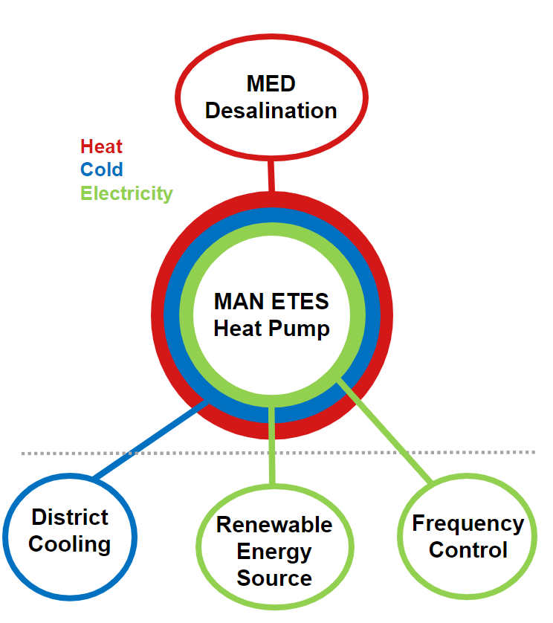
Conclusion
Techno-Economic Model
Case Study
Future Work
Notes:
Map source: https://www.chinadailyhk.com/article/149083

Slide 18
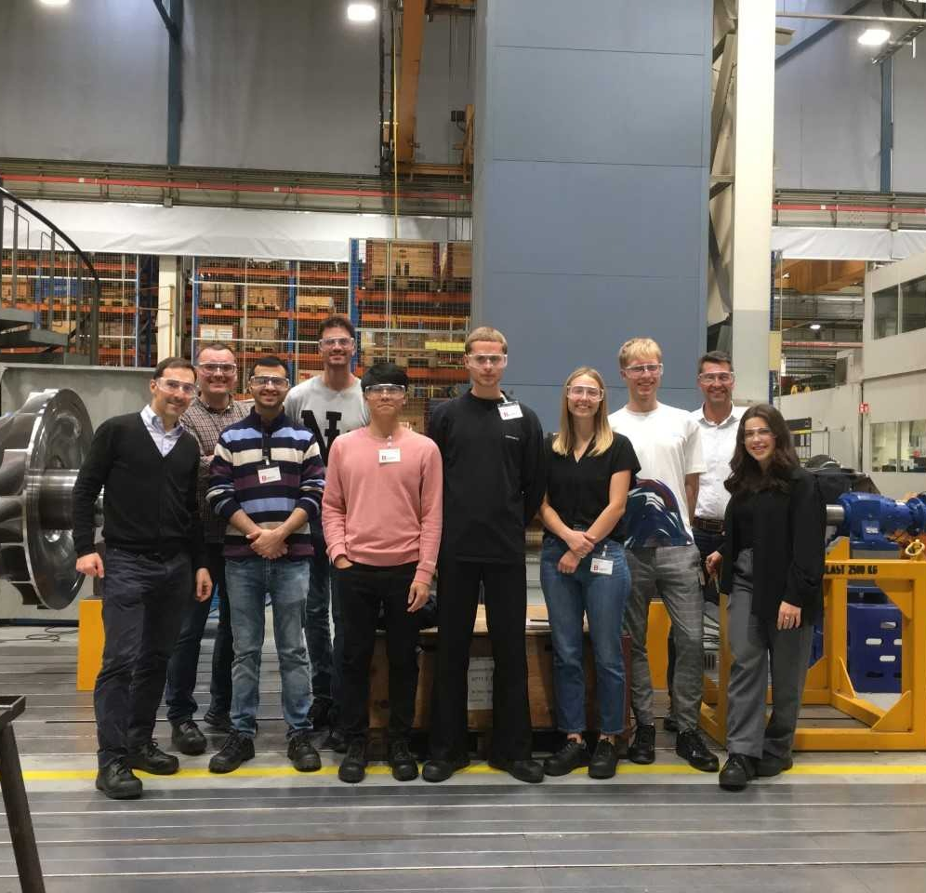
Acknowledgements
MAN Energy Solutions Schweiz AG
  Emmanuel Jacquemoud
  Raymond Decorvet
  David Kodz
Gaurav Singh
ETH Zürich ESC

Slide 19
BACK-UP SLIDES

Slide 20
Increasingly, people are turning to desalination as a solution to water scarcity
Global installed capacity: 95.37 million m³/day
Feed water types: sea, brackish, river, pure, waste, brine
Uses: municipal, industry, power stations, irrigation, military, etc.
E. Jones, et al., “The state of desalination and brine production: A global outlook,” 2019
Notes:
~17,000 plants globally
Exponential growth in the past 20 years

Slide 21
MAN ETES heat pump
CO₂ refrigerant
COP ~ 3
50 MW heat
30 MW cold
High range -9 < T < 150°C
High pressure: 180 bar
Esjberg: District heating
Notes:
https://www.man-es.com/energy-storage/solutions/energy-storage/electro-thermal-energy-storage

Slide 22
Unfortunately, there are challenges associated with desalination
Conventional Desalination
Brine disposal
High cost per unit of water
High GHG emissions
Climate change / increased water scarcity
GHG Emissions
The vicious cycle of fossil fuel-based desalination
Notes:
Brine – high salinity, temperature, pH, presence of chemicals and heavy metals
High cost – largely due to the high energy demand of desalination. Can be twice as much as conventional sources of water. Mention san diego example
5-24 kg CO2eq/ m^3 of water

Slide 23
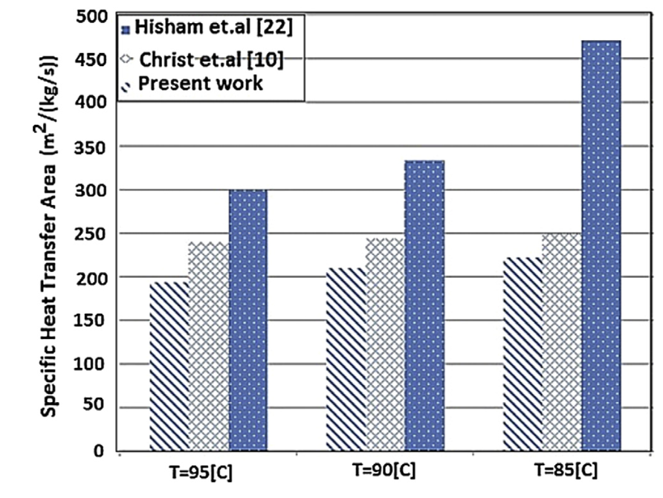
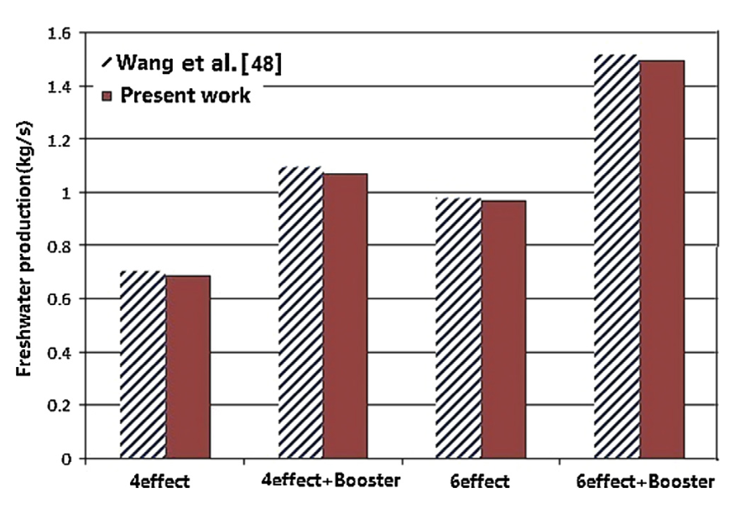
Sector coupling with a MAN Heat Pump
Notes:
The heat pump can be integrated into various cooling services. 2 that stood out throughout our research were district and data center cooling. District cooling is a centralised production of cooling services and is more energy efficient than individual cooling. However, generally, the extracted heat from cooling is discarded, such as in Paris, where it is rejected into the Seine river. Pairing a heat pump-operated desalination plant with district cooling could be promising, however its profitability is very location-dependent, meaning that the plant would not only need to be located in densely populated city, but also one with a convenient street grid. Otherwise, heat losses due to the pipe lengths would be too high to make this a plausible solution.
Another promising cooling sector is the data industry. Data centers are exponentially rising their total data creation, predictions state that in a 15 year period, from 2010 to 2025, there will be almost a 150 time increase in data production. These data centers rely on server racks that are densely packed and that depend on good cooling for optimal performance. With the knowledge that as of 2018, data centers contribute to approximately 2% of the EU's total waste heat generation, we can be certain that the cooling demand for these centers is already high and will only continue rising. The only constraint being that the desalination plant must be located near a data center, this is a very plausible solution.
*24/7 cooling need
Liquid cooled
150 MW

Slide 24
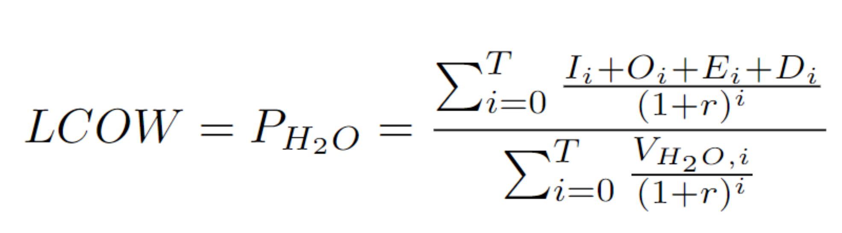
Model: Economic Analysis
LCOW = Total Cost of Fresh Water Production (USD) / Total Volume of Fresh Water Produced (m3)

Slide 25
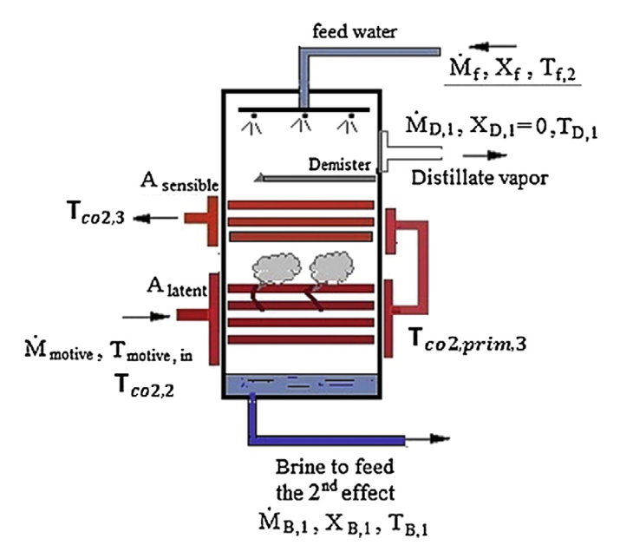
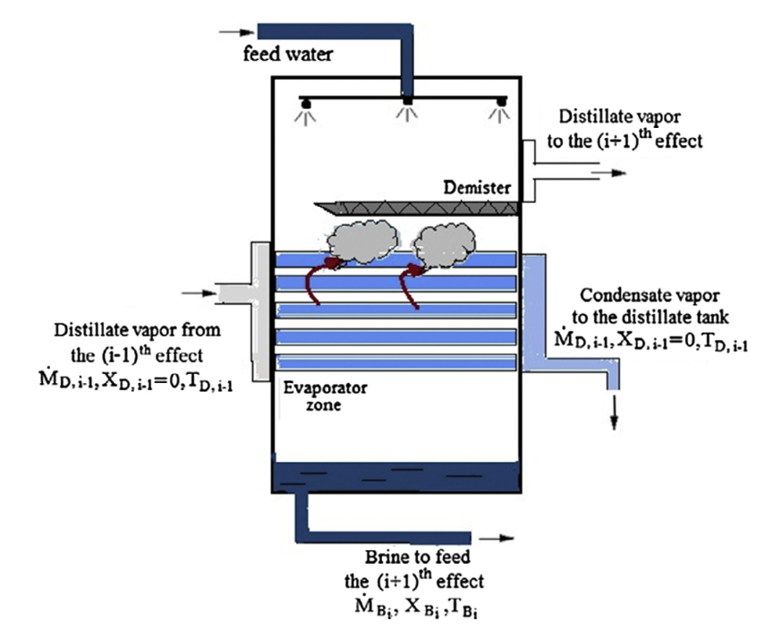
Assumptions and hypothesis of the model
Top Brine Temperature (TBT)
70°C
Delta T between stages
3°C
Brine salinity after stage
70000 ppm
Salinity of freshwater produced
0 ppm
First stage and booster module
Second to sixth stage
Notes:
The heat pump can be integrated into various cooling services. 2 that stood out throughout our research were district and data center cooling. District cooling is a centralised production of cooling services and is more energy efficient than individual cooling. However, generally, the extracted heat from cooling is discarded, such as in Paris, where it is rejected into the Seine river. Pairing a heat pump-operated desalination plant with district cooling could be promising, however its profitability is very location-dependent, meaning that the plant would not only need to be located in densely populated city, but also one with a convenient street grid. Otherwise, heat losses due to the pipe lengths would be too high to make this a plausible solution.
Another promising cooling sector is the data industry. Data centers are exponentially rising their total data creation, predictions state that in a 15 year period, from 2010 to 2025, there will be almost a 150 time increase in data production. These data centers rely on server racks that are densely packed and that depend on good cooling for optimal performance. With the knowledge that as of 2018, data centers contribute to approximately 2% of the EU's total waste heat generation, we can be certain that the cooling demand for these centers is already high and will only continue rising. The only constraint being that the desalination plant must be located near a data center, this is a very plausible solution.
*24/7 cooling need
Liquid cooled
150 MW

Slide 26




Sector coupling with a MAN Heat Pump
District Cooling
Hydrogen production
Data Center Cooling
Grid stabilisation
Grid Stabilisation
Notes:
The heat pump can be integrated into various cooling services. 2 that stood out throughout our research were district and data center cooling. District cooling is a centralised production of cooling services and is more energy efficient than individual cooling. However, generally, the extracted heat from cooling is discarded, such as in Paris, where it is rejected into the Seine river. Pairing a heat pump-operated desalination plant with district cooling could be promising, however its profitability is very location-dependent, meaning that the plant would not only need to be located in densely populated city, but also one with a convenient street grid. Otherwise, heat losses due to the pipe lengths would be too high to make this a plausible solution.
Another promising cooling sector is the data industry. Data centers are exponentially rising their total data creation, predictions state that in a 15 year period, from 2010 to 2025, there will be almost a 150 time increase in data production. These data centers rely on server racks that are densely packed and that depend on good cooling for optimal performance. With the knowledge that as of 2018, data centers contribute to approximately 2% of the EU's total waste heat generation, we can be certain that the cooling demand for these centers is already high and will only continue rising. The only constraint being that the desalination plant must be located near a data center, this is a very plausible solution.
*24/7 cooling need
Liquid cooled
150 MW

