Slide 1
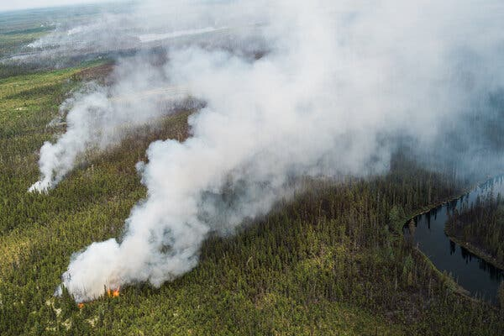
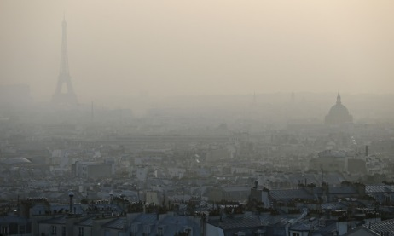
Atmospheric Chemistry Group
New at ETH since Jan 2024!
Information about our research & MSc projects:
https://atmoschem.ethz.ch
Prof. Colette Heald
Project Tutors:
Dr. Yumin Li
Dr. Florence Brown
Dr. Clara Nussbaumer
Dr. Uli Kreiger Cynthia Antossian

Slide 2
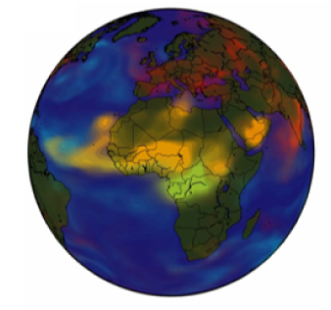
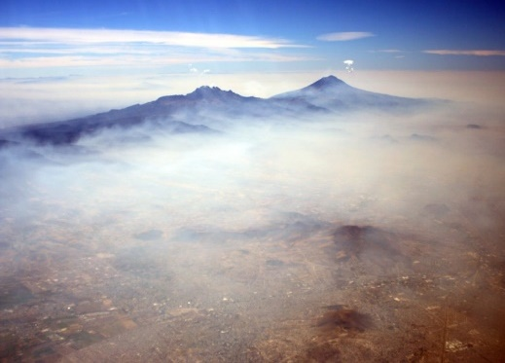
Atmospheric Chemistry Research @ ETH
We focus on global atmospheric chemistry, often at the intersection of global change
(emissions, climate, land use change).
We use models of atmospheric composition to interpret observations (surface, airborne, satellite) and improve our understanding of key processes controlling the formation, loss, impacts of atmospheric constituents.
Atmospheric Aerosols
Formation and impacts of PM
Biosphere-Atmosphere Interactions
Biosphere as a source/sink of particles/gases
How pollution impacts vegetation/agriculture
Tropospheric Chemistry
Ozone formation
OH reactivity
Nitrogen cycling

Slide 3
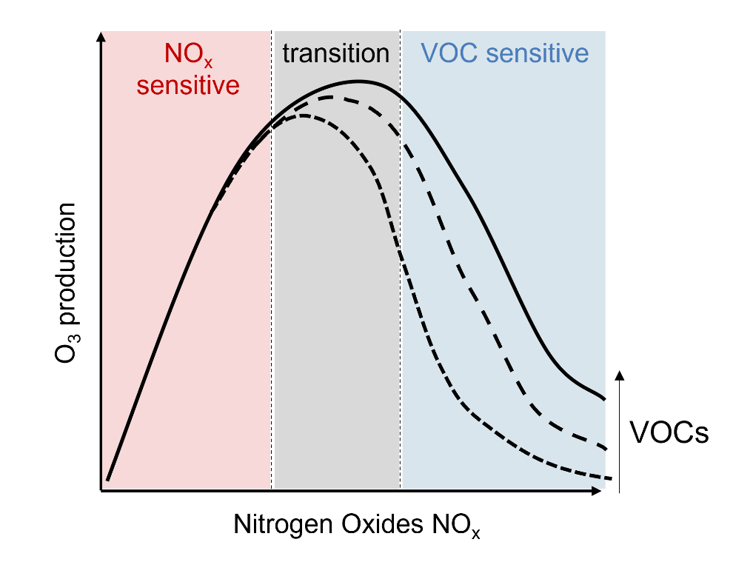
Drivers of ozone formation across Europe:
How do emission reductions impact our air quality?
Motivation
Tropospheric ozone (O₃) is a harmful pollutant affecting poor air quality and premature mortality
O₃ formation is non-linear: increase or decrease possible in response to changes in nitrogen oxides (NO_{x}), an important precursor
Goals
Investigate decadal trends in O₃ and NO_{x} from ground-based observation networks in Europe (European Air Quality Portal: https://aqportal.discomap.eea.europa.eu/),
Compare impacts of emission reductions in rural / urban & traffic / background locations
Implications for air quality
Requirements
General interest in atmospheric chemistry and air quality
Coding skills (matlab or python) advantageous
vs
Interested?
Contact: Clara Nussbaumer, Colette Heald (clara.nussbaumer@usys.ethz.ch)

Slide 4
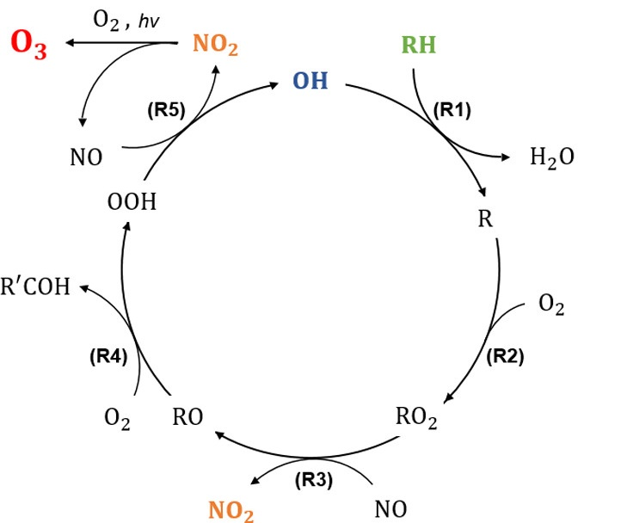
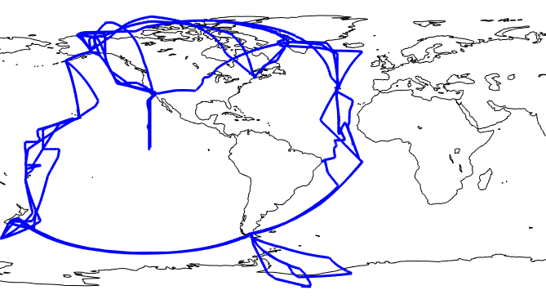
Ozone formation efficiency over the remote oceans
Motivation
Tropospheric ozone (O₃) is a greenhouse gas, majorly impacting global warming
Nitric oxide (NO) is a precursor to O₃ via the catalytic HO_{x} cycle
HO_{x} cycle
Goals
How many O₃ molecules can one NO molecule form? How is this impacted by altitude and location?
Investigate O₃ formation versus sinks of NO (NO_{z}) throughout the troposphere (0-13 km altitude) based on airborne observations during the Atmospheric Tomography mission (ATom) 2016-18: https://daac.ornl.gov/ATOM/campaign/
Implications for chemistry and climate
Adapted from Environ. Sci. Technol. 2020, 54, 24, 15652-15659
Requirements
General interest in atmospheric chemistry
Coding skills (matlab or python) advantageous
ATom flight tracks 2016 - 2018
Contact: Clara Nussbaumer, Colette Heald (clara.nussbaumer@usys.ethz.ch)
Interested?

Slide 5
O₃ in the Congo: understanding air pollution in the forest
Motivation:
O₃ damages vegetation and reduces their CO₂ uptake
In the Congo, fires are the main source of pollution
Continuous O₃ profiles have been measured in the Congo for the first time ever!!
√
Goal:
Understand trends and variability in O₃ at the Congo site
Relate air pollution events to fires
Requirements: Coding skills preferred
Contact: Flossie Brown, Colette Heald
(florencealice.brown@env.ethz.ch)

Slide 6
O₃ in the Amazon: understanding uptake through the canopy
Motivation:
O₃ damages vegetation after it enters plants through their stomata
Models estimating O₃-plant damage do not consider how uptake varies through the canopy
Goal:
Use a canopy model to simulate O₃ uptake at different canopy layers
Relate uptake to above canopy concentrations of O₃ and meteorology
O₃
Requirements: Coding skills
Contact: Flossie Brown, Colette Heald
(florencealice.brown@env.ethz.ch)

Slide 7
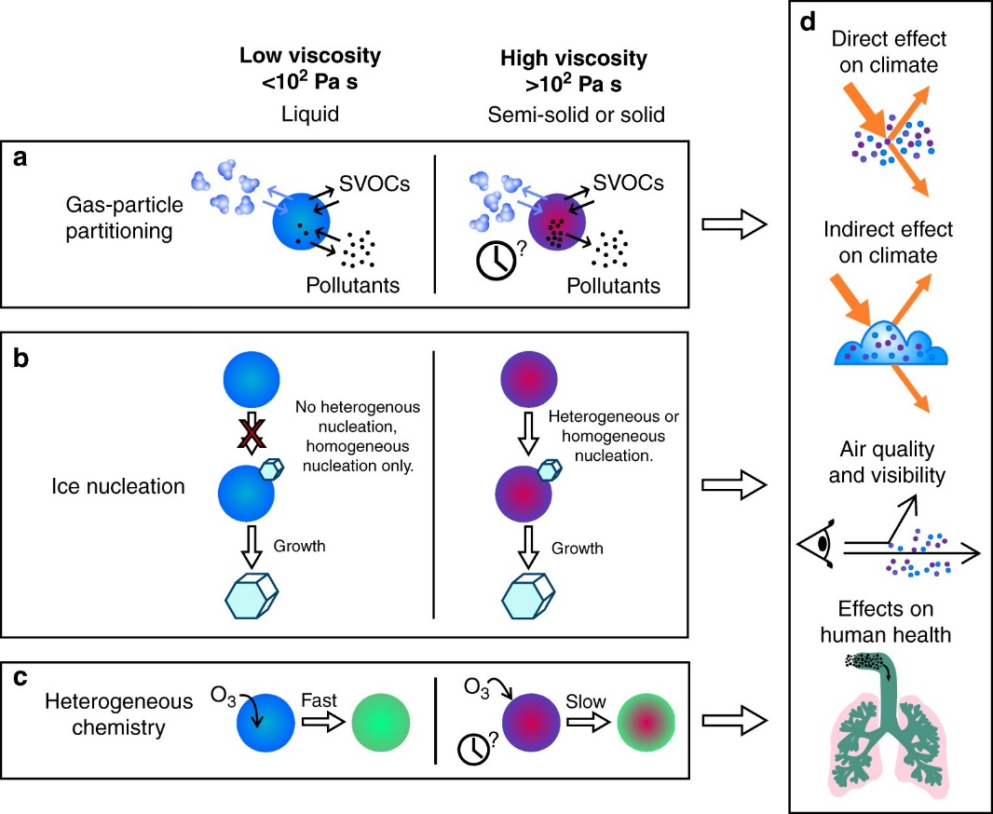
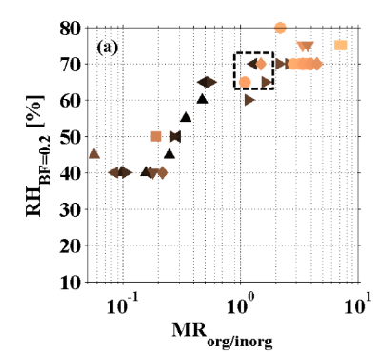
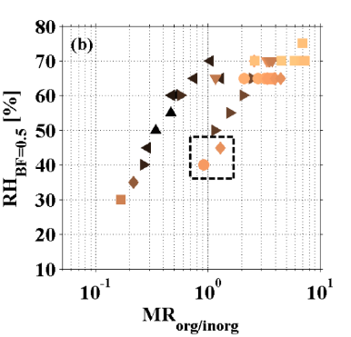
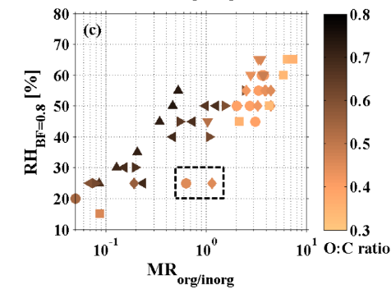
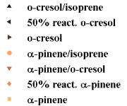
Phase state of organic aerosol: mixing state effect
Liquid phase
Solid phase
Motivation:
Secondary organic aerosol (SOA) are a large source of uncertainly in understanding air quality and climate
The phase state of SOA, which is important in affecting the chemical evolution, is poorly characterized
Goal:
Investigate the influence of mixing with inorganic species on the phase state of SOA (Gordon–Taylor-approach)
Use 3D model output to test various assumptions in the literature
Requirements:
$T_{g}\left(w_{2}, w_{3}, …w_{n}\right)= \frac{w_{1}T_{g1}+\frac{1}{k_{GT,2}}w_{2}T_{g2}+\frac{1}{k_{GT,3}}w_{3}T_{g3}+…+\frac{1}{k_{GT,n}}w_{n}T_{gn}}{w_{1}+ \frac{1}{k_{GT,2}}w_{2}+\frac{1}{k_{GT,3}}w_{3}+…+\frac{1}{k_{GT,n}}w_{n}}$
Interested in atmospheric chemistry and numerical simulations
Coding skills (Python)
Contact:
Yumin Li (yumin.li@env.ethz.ch), Colette Heald

Slide 8
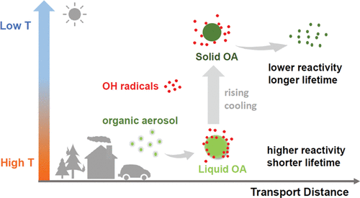
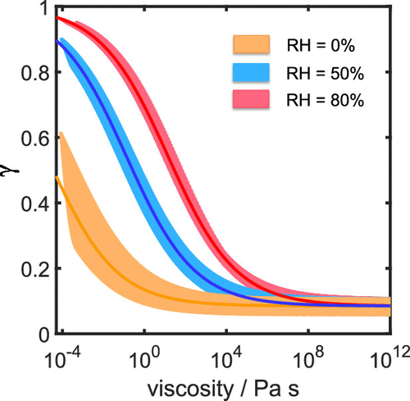
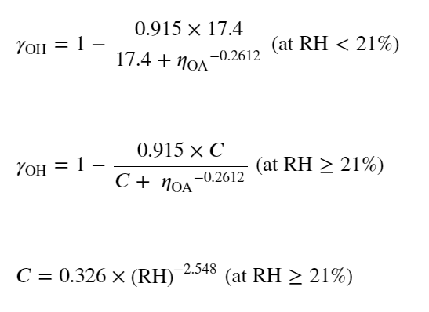
Phase state of organic aerosol: effect on OH oxidation
Motivation:
Organic aerosol (OA) is important for air quality and climate.
Prediction of the chemical evolution lifetime of OA depends on its reactivity with atmospheric oxidants such as the OH radical.
Increased viscosity of OA can slow down oxidation
Goal:
Investigate the chemical evolution lifetime of OA affected by phase state-dependent OH oxidation.
Use a box model to perform idealized calculations under different viscosity conditions
Requirements:
Interested in atmospheric chemistry and numerical simulations
Coding skills (Python)
Contact:
Yumin Li (yumin.li@env.ethz.ch), Colette Heald

Slide 9
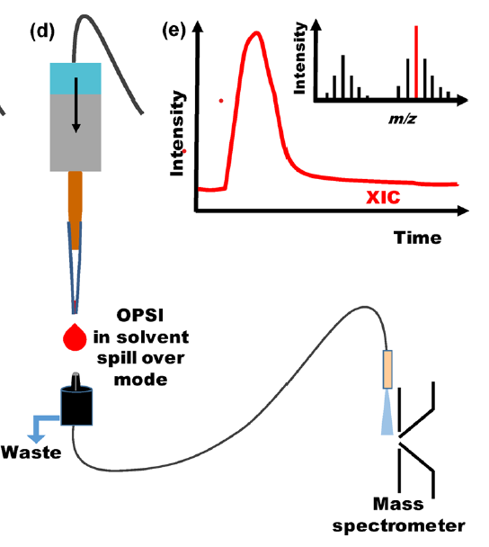
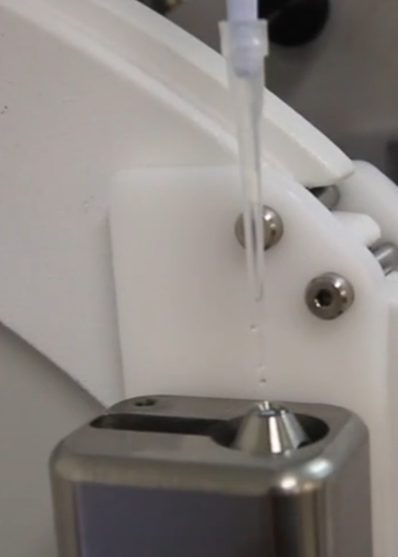
Testing an open port sampling interface (OPSI) for analyzing particulate matter filter extracts
Key Problem
Atmospheric particulate matter extracted from filters yield only milligrams or less of material. This makes mass spectrometry sample preparation challenging.
Key Question
Can we use an OPSI as a simple noncontact method to analyze nL-to-µL-Volume samples?
Key Tasks
Evaluate newly developed OPSI using state-of-the-art mass spectrometry, data analysis of extracted filter samples, e.g. “brown carbon”.
Contacts
Ulrich Krieger, Cynthia Antossian
ulrich.krieger@env.ethz.ch

