Slide 1
Modelling Course in Population and Evolutionary Biology
Introduction
The Course
Level 1 Modules
Level 2 Modules
The Final Presentation
Sample Session (optional)
5-16 June 2023

Slide 2
1. The Course

Slide 3
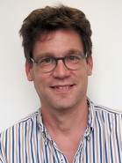
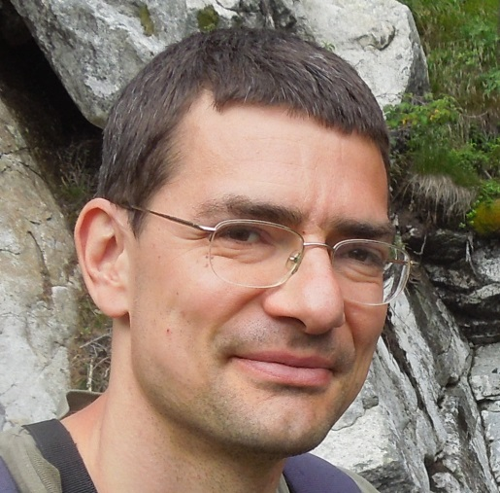

People
Prof. Sebastian Bonhoeffer
Course Director
Viktor Müller
Course Instructor
Daniel Angst
Course Instructor

Slide 4
People: module developers
Martin Ackermann
Tobias Bergmiller
Sebastian Bonhoeffer
Lucy Crooks
Florence Debarre
Nicole Freed
Roger Kouyos
Dusan Misevic
Viktor Müller
Roland Regoes
Olin Silander

Slide 5
Goals
To get familiar with basic approaches in the modelling of biological processes
To learn to appreciate the excitement and utility of computational modelling in biology
To obtain conceptual insight into interesting biological questions
To learn team work
To see a project through from beginning to end
Notes:
A nice opportunity to try out the life of a computational biologist or bioinformatician.

Slide 6
Focus: how to make these transitions?
Foreground: modelling
Background: biology + math
computer
implementation
biological
problem
math model/
algorithm
interpretation of model results
Notes:
The ”translation” involved in the first arrow is ”art”: a specific skillset is needed, and that is the focus of the course. The second transition (to computer implementation) is more or less automatic.

Slide 7
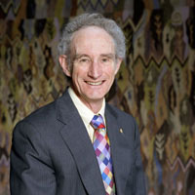
Thinking clearly
“Mathematics is no more, but no less, than a way of thinking clearly.”
-- Lord May of Oxford

Slide 8
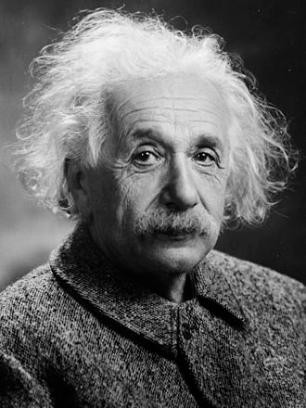
Walking the fine line
Everything should be made as simple as possible …
but not simpler.
Notes:
Details on the authenticity of the quote: http://quoteinvestigator.com/2011/05/13/einstein-simple/
Einstein was professor of theoretical physics at the ETH between 1912-1914.

Slide 9
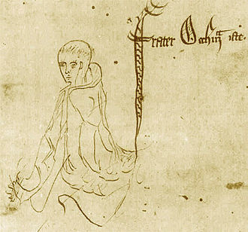
Walking the fine line
Everything should be made as simple as possible …
but not simpler.
Occam’s Razor: Non sunt multiplicanda entia sine necessitate)
Loosely translates to: do not overcomplicate things without good reason
Notes:
Wikipedia: „Occam's razor (also Ockham's razor or Ocham's razor (Latin: novacula Occami); further known as the law of parsimony (Latin: lex parsimoniae)) is the problem-solving principle that essentially states that "simpler solutions are more likely to be correct than complex ones." When presented with competing hypotheses to solve a problem, one should select the solution with the fewest assumptions. The idea is attributed to English Franciscan friar William of Ockham (c. 1287–1347), a scholastic philosopher and theologian. „

Slide 10
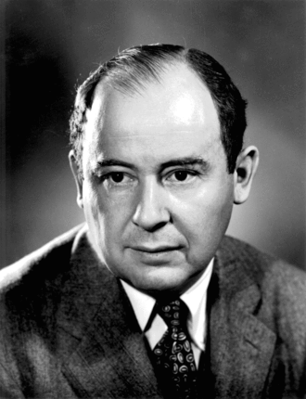
As simple as possible
With four parameters I can fit an elephant and with five I can make him wiggle his trunk.
-- John von Neumann

Slide 11
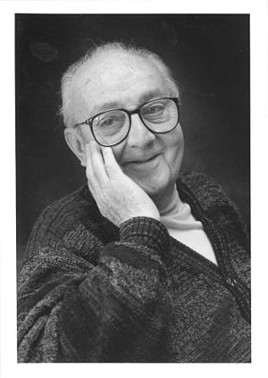
The limitations of modeling
All models are wrong, but some are useful.
-- George E. P. Box
Notes:
British statistician. The quote is from 1978.
https://en.wikipedia.org/wiki/George_E._P._Box

Slide 12
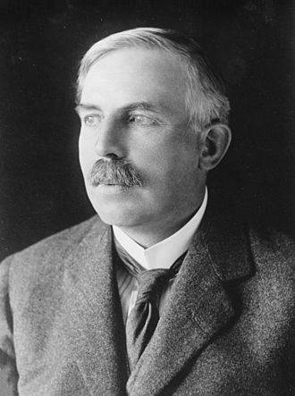
Physicists on biology
All science is either physics or stamp collecting.
-- Ernest Rutherford
Notes:
The „father of nuclear physics”; Nobel Prize winner. https://en.wikiquote.org/wiki/Ernest_Rutherford

Slide 13

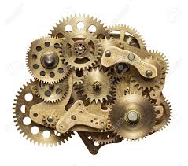
Biology vs. everything
Notes:
The ability of a watch to show the time is pretty hard to derive from the characteristics of its parts…

Slide 14
Time table
Shift?
Daily schedule:
9-13 Work on modules
scheduled tutoring sessions per group
13-14 Lunch break
14-18 Work on modules
Viktor: all day
Daniel: “on demand”
Last day (16 June): presentations in the afternoon
NOTES:
Please, report your absence in advance.
Stay in touch with your teammates.
daniel.angst@env.ethz.ch
Breakdown
10 days total
Introduction/setup: ½ day
Module 1: ~2 days
Module 2: ~6.5 days
Finalizing presentations: 1/2 day
Presentations: 1/2 day
Recommendation:
Switch to Module 2 around Wed.
Prepare slides on the fly.
flexible

Slide 15
Team and module choice
In the selection of teammates, try to avoid great differences in prior knowledge.
The same module can be chosen by several teams.
Extensive development of a level 1 module may be accepted as level 2 at the instructor’s decision.
Notes:
One possible strategy is to choose a module which is close to your research interest, and then the methods you learn and the results you obtain can be immediately relevant for your research. An alternative strategy is to choose a topic far from your interest to broaden your horizon, or a method you are not familiar with to expand your technical repertoire. New results often arise from adapting a method from one field to another. Thus, both strategies have advantages.

Slide 16
Team work
Discuss the problems.
Consult about the implementation.
Discuss the results.
BUT: write code independently (as well)
Keep a working script for the solution of each exercise and a record of the results to help us check and discuss your progress.
Instructors help as needed

Slide 17
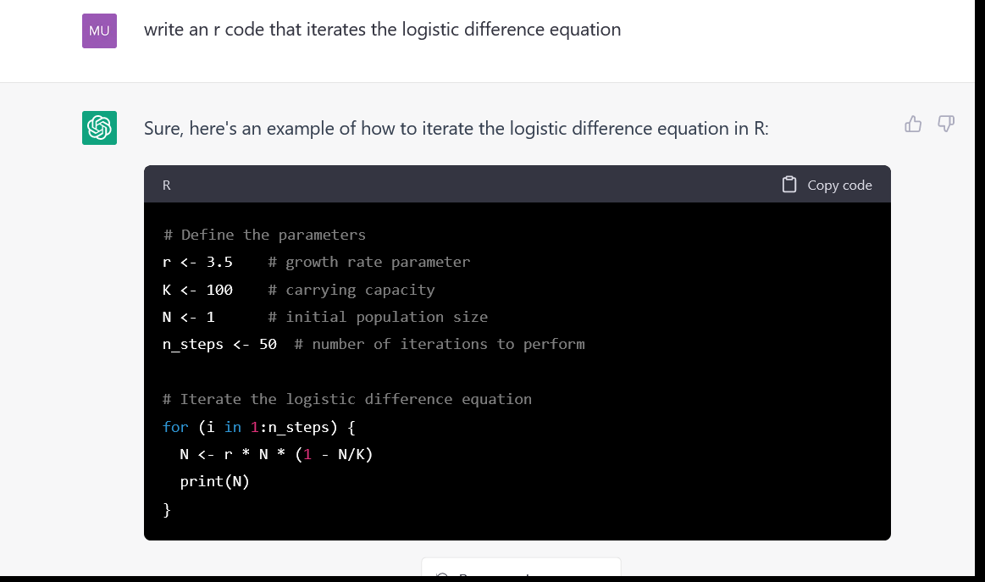
chatGPT
Notes:
Mention also Github Copilot.

Slide 18
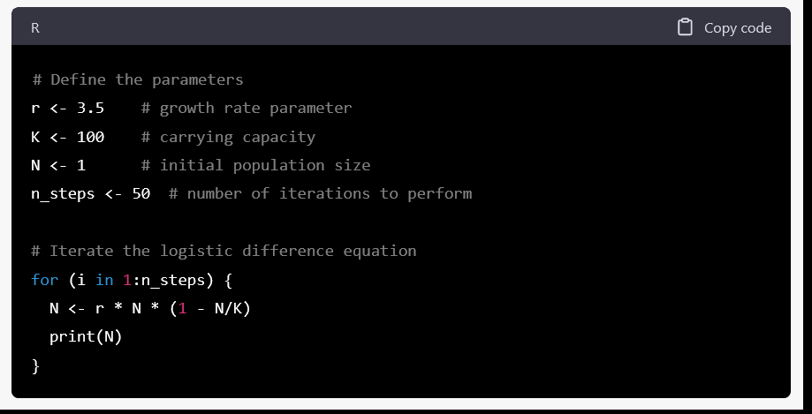
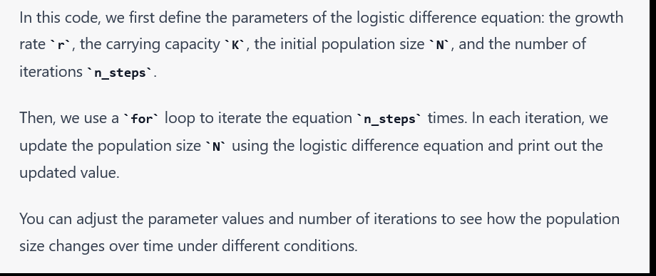

Slide 19
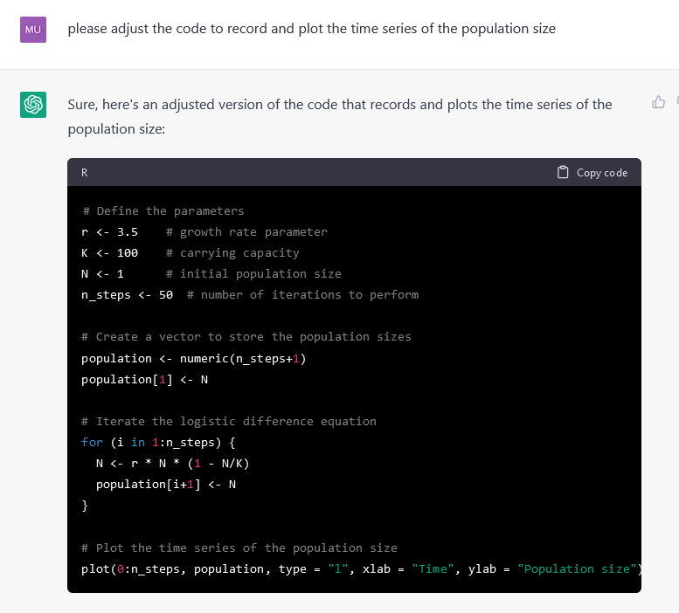

Slide 20
chatGPT
Fine to use, but
be transparent about it
make sure you understand the produced code.
Notes:
I perceive the following major problem. Even before AI, the trickiest bug involved code that worked (i.e., it did not stop, or produce error messages), but in a different way from what its coder aimed at and assumed. With AI assistance, you can effortlessly generate code that works, but how can you be sure it works that way you intended? As we have discussed, computer code is unambiguous. However, the specification you give to the AI is formulated in human language, which tends to be ambiguous. As I see it, the main application of AI assisted coding can be to produce simpler chunks of code that you are able to verify. That is, the assistance cannot increase the level of complexity you can achieve (without risking errors), but it can speed up your coding substantially. As for the relevance of this course in the AI age: luckily, our emphasis has always been on modelling, rather than on coding. Any assistance in the latter can only increase the fun you are having with the former.

Slide 21
Evaluation
Marks will be based on
performance during the course
  instructors monitor progress
completion of modules
  model design, questions (creativity)
  implementation (functionality of R code)
  “scientific” results
final presentation
  ppt or pdf slideshow on level 2 module results
  get the message across
Important note: to enable individual evaluation, each team member should be given responsibility for particular tasks and participate in the final presentation.
Students with little prior knowledge of R should also be able to achieve the highest mark.
Notes:
We will discuss the requirements and format of the final presentations later during the week when you switch to the Level 2 module.
It is useful to have your latest results ready in some presentable form for your time slot with me.

Slide 22
Webpage
http://www.tb.ethz.ch/education/learningmaterials/modelingcourse.html
modules
R resources
practical information

Slide 23
The organization of modules
Webpage: brief description + links for download
Reader (PDF)
  biological and modelling background
  instructions to develop the model
  exercises (basic + advanced/additional)
Starting R script (not all modules)
Glossary
Literature & Weblinks (optional reading)
  use the Internet wisely
Unless otherwise stated in the reader, completion of a module requires solving all basic exercises.
Notes:
Use the Internet wisely: it is a useful resource of information, but too much searching can spoil the fun.

Slide 24
Note
“Completion” of a module is defined flexibly: you are free to deviate from the pre-defined exercises and work on your own ideas. Consult the instructor.
See the “Big Picture”, do not get (overly) lost in details.
Consider the time limit.
Keep a working version of your script for each exercise.

Slide 25
Background information
Ecology and Evolution II: Populations
701-0273-00l WS (Bachelor BIOL 5th term/ Master UWIS)
by Sebastian Bonhoeffer
Notes:
This course is no longer offered, but I have an archived copy of the lecture notes linked from the course website.

Slide 26
Modelling Course in Population and Evolutionary Biology
Introduction
The Course
Level 1 Modules
Level 2 Modules
The Final Presentation
5-16 June 2023

Slide 27
The logistic difference equation and the route to chaotic behaviour
Basic problem:
  Many species have non-overlapping generations and may therefore be described better in discrete time
  Logistic growth: self-limitation
  Discrete steps allow for overshooting ➔ oscillations, chaos
General approach: iterate difference equation
Concepts
  Chaos
  Periodic behaviour
  Bifurcations

Slide 28
The logistic difference equation and the route to chaotic behaviour
Methods
  time plots
  phase diagrams
  bifurcation diagrams
Questions
  What types of behaviour are possible in the LDE?
  What defines chaotic behaviour?
  Analyse bifurcation diagram
  Introduce space

Slide 29
SIR models of epidemics
Basic problem: what factors govern the spread of infectious diseases?
General approach
  numerical integration of ODE model
  compartment model
Concepts
  basic reproductive ratio
  herd immunity
Methods
  time plot
  phase portrait

Slide 30
SIR models of epidemics
Questions
  What are the conditions for the outbreak of an epidemic?
  What fraction of a population is going to be infected?
  Can partial vaccination be protective?
  Model treatment, drug resistance, birth-death dynamics, specific diseases

Slide 31
Stochastic effects on the genetic structure of populations
Basic problem
  Genetic drift can destroy variation, counteract selection and build up associations between loci.
General approach
  Simple population genetic models with mutation, selection, recombination and random sampling of offspring
Concepts & methods
  Iteration of discrete time population genetics model
  Interplay of selection and drift
  Benefits of recombination
  Sampling from binomial/multinomial distribution
Questions
  How does drift reduce the diversity that mutation builds up?
  How does drift affect the elimination of detrimental alleles through selection?
  How do bottlenecks affect the diversity at neutral and selected loci?
  What do effective population sizes tell about the magnitude of stochastic effects?

Slide 32
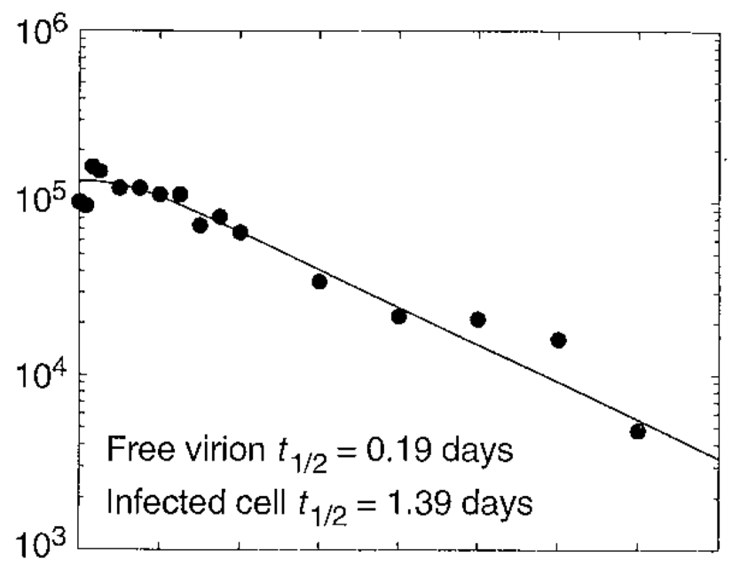
Within-host HIV dynamics #1: estimation of parameters
Basic problem
  The apparent latency of HIV infection conceals a highly dynamic steady state. Perturbation by drug treatment reveals the dynamics.
General approach
  Estimation of decay parameters by fitting simple ODE models to real and simulated treatment data.

Slide 33
Within-host HIV dynamics #1: estimation of parameters
Concepts & methods
  Model fitting – Parameter estimation by non-linear minimization.
  Lesson: no such thing as an “objective” estimate.
  Numerical simulation of ODEs.
Questions
  What factors influence the quality of parameter estimation?
  How does random noise (measurement error) affect the estimation?
  What if treatment is not 100% effective?
  What is the effect of long-lived virus-producing cells?
Notes:
Important: fitting does not give strong validation to a model. (von Neumann: ”With four parameters I can fit an elephant and with five I can make him wiggle his trunk”). Rather, it interprets (quantitates) the observations in the framework of the model.

Slide 34
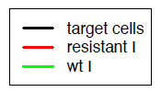
Within-host HIV dynamics #2: the emergence of drug resistance
Basic problem
  Mutations in the enzymes of HIV can render the virus resistant to drugs.
General approach
  ODE models to simulate wild-type and mutant virus.

Slide 35
Within-host HIV dynamics #2: the emergence of drug resistance
Concepts & methods
  Numerical simulation of ODEs
  Mutation-selection equilibrium
Questions
  What are the conditions for the emergence of drug resistance?
  How does the efficacy of the drugs affect the time to the emergence of resistance?
  Resistance mutations can exist in a mutation-selection equilibrium even before treatment: how does this affect the emergence of resistance under therapy?
  What is the advantage of administering a combination of different drugs?
  Devise optimal treatment strategy

Slide 36
Modelling Course in Population and Evolutionary Biology
Introduction
The Course
Level 1 Modules
Level 2 Modules
The Final Presentation
5-16 June 2023

Slide 37
Unstable oscillations and spatial structure: The Nicholson-Bailey model of host-parasitoid dynamics
Basic problem
  A discrete-time model of host-parasite interactions is unstable. Can the implementation of space stabilize the system?
General approach
  Model host-parasite interactions and dispersal on a 2D lattice.

Slide 38
Unstable oscillations and spatial structure: The Nicholson-Bailey model of host-parasitoid dynamics
Concepts & methods
  Simulation of simple two-species difference equations
  Simulate spatial structure and observe emerging patterns
Questions
  Why is the simple NB model unstable?
  What is the effect of spatial structure?
  What is the effect of lattice size and boundary conditions?
  Do initial conditions affect the outcome?
  Can parasitoids facilitate the coexistence of different host types?

Slide 39
Spatial cooperation games
Basic problem: altruistic behaviour decreases the fitness of the actor. So how can it evolve and be maintained?
General approach: simulate iterated cooperation games in unstructured and spatially structured populations.
Concepts
  Game theory: Prisoner’s dilemma and snowdrift games.
  Spatial structure and the evolution of cooperation.
Methods
  Spatially explicit simulation of population interactions on a lattice
  Cellular automaton

Slide 40
Spatial cooperation games
Questions
How does spatial structure affect the evolution of cooperation?
What is the effect of the payoff parameters (cost, benefit)?
Investigate the effects of:
  neighbourhood size (3,4,6)
  updating scheme (synchronous vs. asynchronous; pair-wise vs. multiple competitions)
  population size (500, 1000, 2000)
  heterogeneous environment
… on the evolution of cooperation and the significance of spatial structure.

Slide 41



Rock-paper-scissors dynamics in space
Basic problem: can intransitive fitness interactions facilitate the maintenance of diversity?
General approach: model local competition in a cellular automaton
Concepts
  intransitive interaction: A<B, B<C, C<A
  density dependent selection
<
<
<

Slide 42
Rock-paper-scissors dynamics in space
Questions:
How does the maintenance of diversity depend on
  the type and strength of fitness interactions
  initial population size and species frequencies
  The distance over which organisms interact/disperse?
What factors affect the magnitude of population fluctuations?
How do the dynamics of the system change when there are greater numbers of species interacting?
What is the effect of disturbance (e.g. local fires) on the maintenance of diversity?

Slide 43
Stability and complexity in model ecosystems
Basic problem: Does complexity help stability?
General approach: study stability of randomly generated multi-species Lotka-Volterra systems.
Concepts & methods
  Connectivity, diversity and stability of an ecosystem/network
  Numerical simulation of (large) systems of ordinary differential equations
Questions
  How does ecosystem stability depend on the size (i.e. number of species) and connectivity of the ecosystem?
  What are useful measures of ecosystem stability?
  Does the coexistence of a set of species depend on the order in which they were introduced into an ecosystem?
  How does the ecosystem respond to the removal or invasion of a species?
  How does stability change if some interactions are predatory?

Slide 44
Evolution of the sex ratio
Basic problem: why is the typical sex ratio 1:1?
General approach
  Simulate a population of males and females
  Sex ratio of offspring determined by a diploid locus in the mother
  Introduce sex ratio mutants and run until evolutionary equilibrium
Concepts & methods
  Evolutionary optimization
  Individual-based modelling
  Stochastic simulation
Questions
  Optimal sex ratio for various inheritance schemes of the SR gene
  What happens if the sexes have different survival or cost?
  What if the SR gene is located on a sex chromosome?

Slide 45
Stochastic simulation of epidemics
Basic problem
  Introduce stochasticity and discrete populations into the SIR model
General approach
  Stochastic modelling with the Gillespie algorithm
Concepts & methods
  Comparison of deterministic and stochastic models
  Basic reproductive ratio, herd immunity etc
Questions
  What is the extinction probability of the infection for different values of R₀?
  Does the average dynamics of the stochastic model differ from the deterministic SIR model?
  Are population sizes across runs normally distributed?
Notes:
Everything that can be studied in the original ODE version of the SIR model, can also be studied here.

Slide 46
Network models of epidemics
Basic problem
  Many infectious diseases require close contact for transmission: this is not so in simple models.
General approach
  Implement a contact network.
  Let the infection spread over contacts.

Slide 47
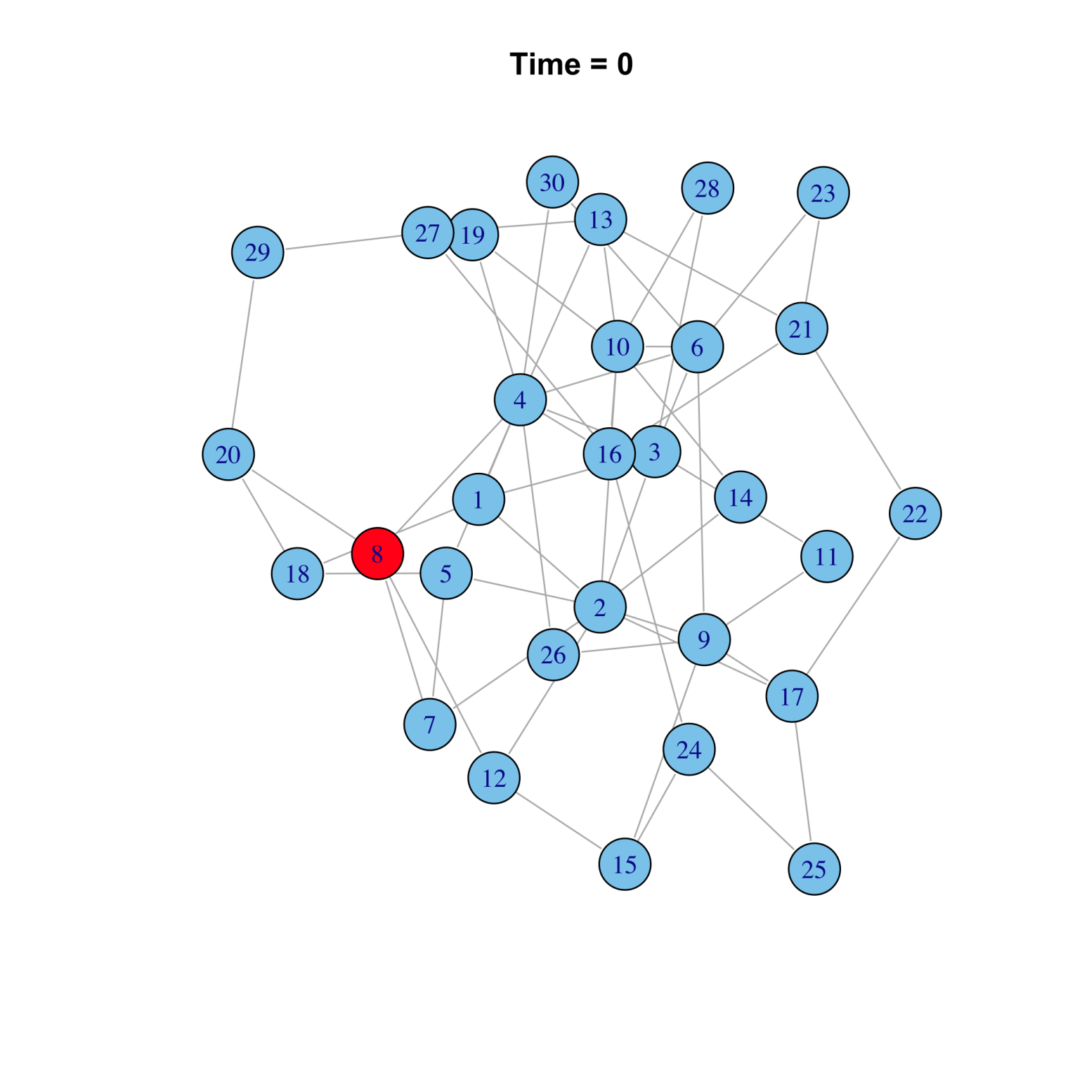

Slide 48
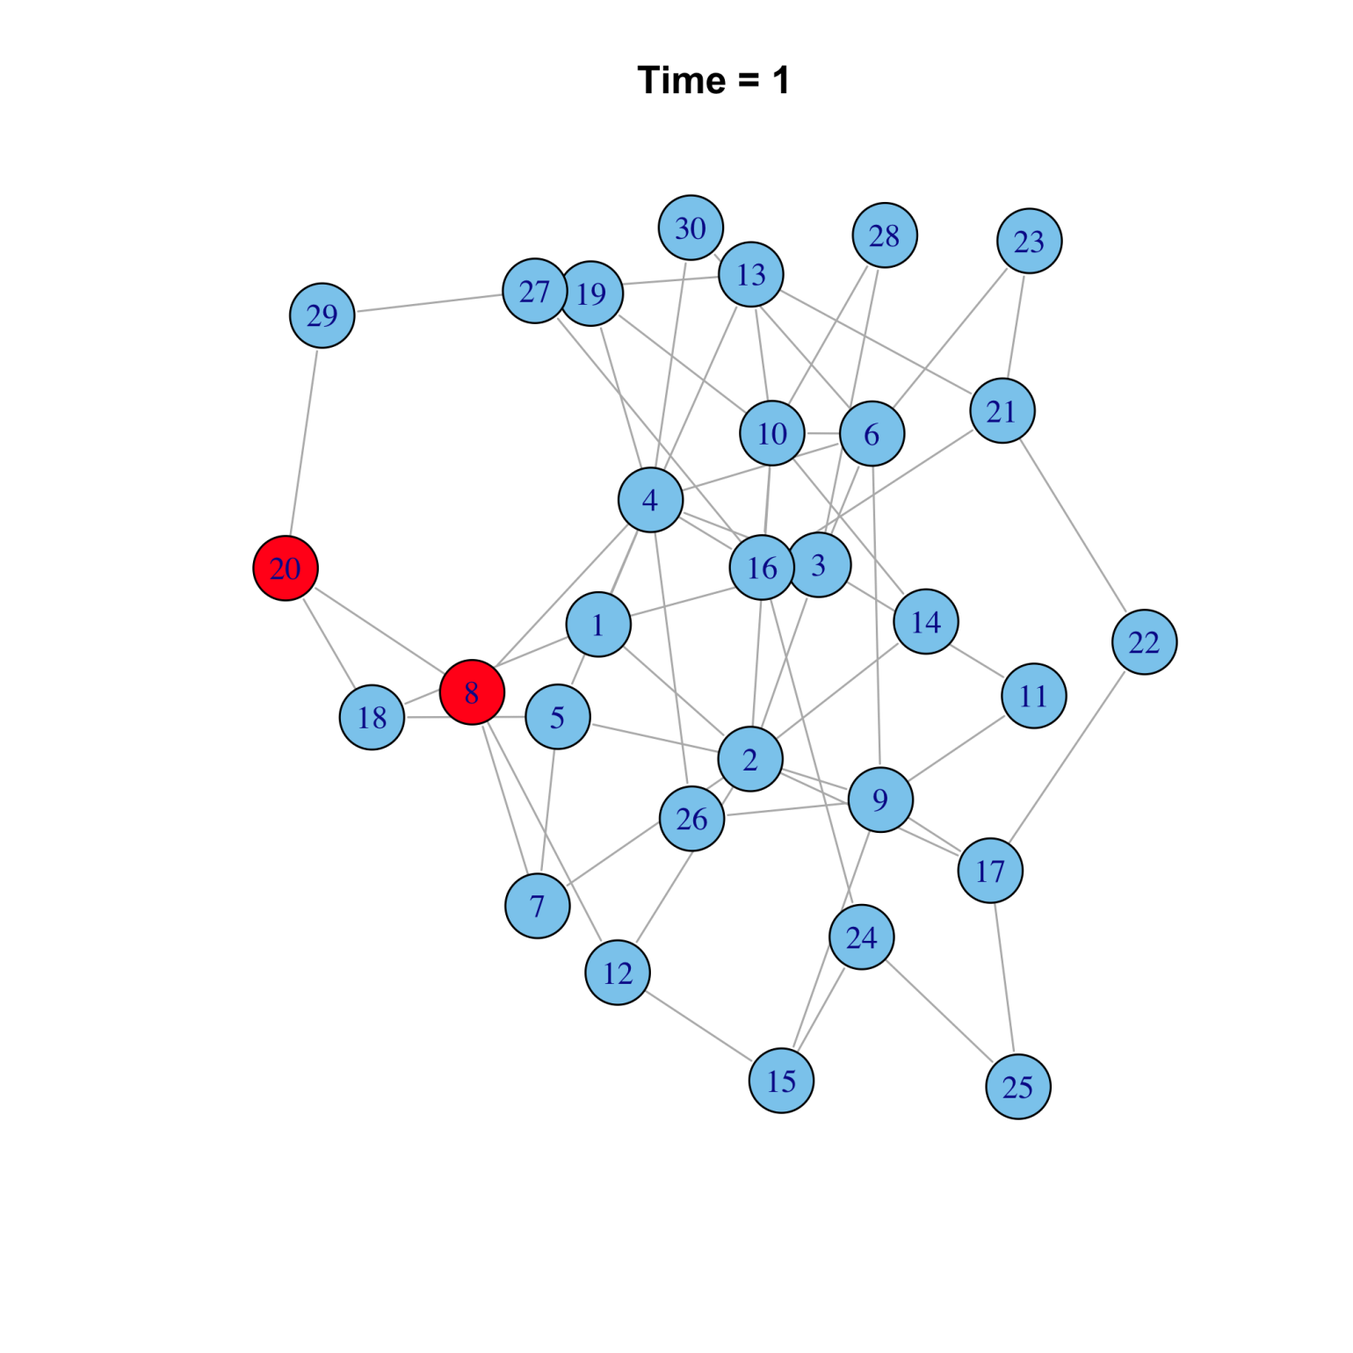

Slide 49
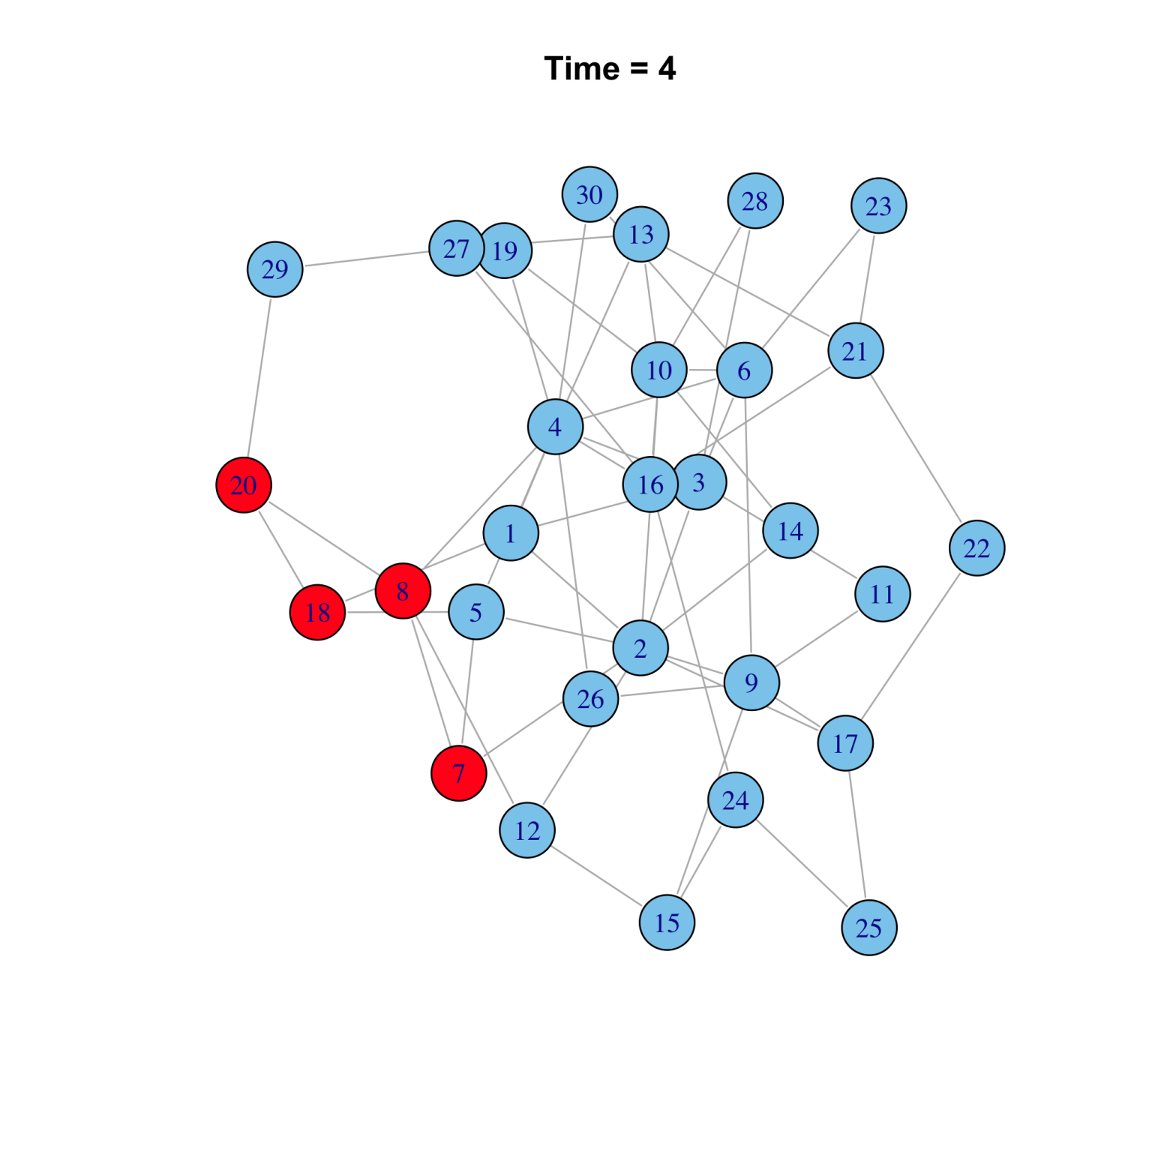

Slide 50
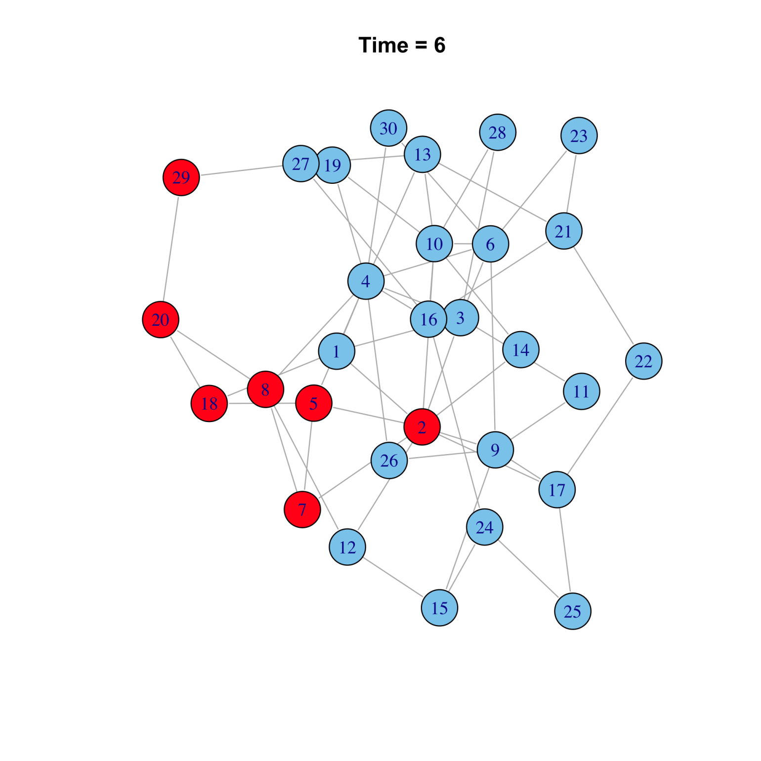

Slide 51
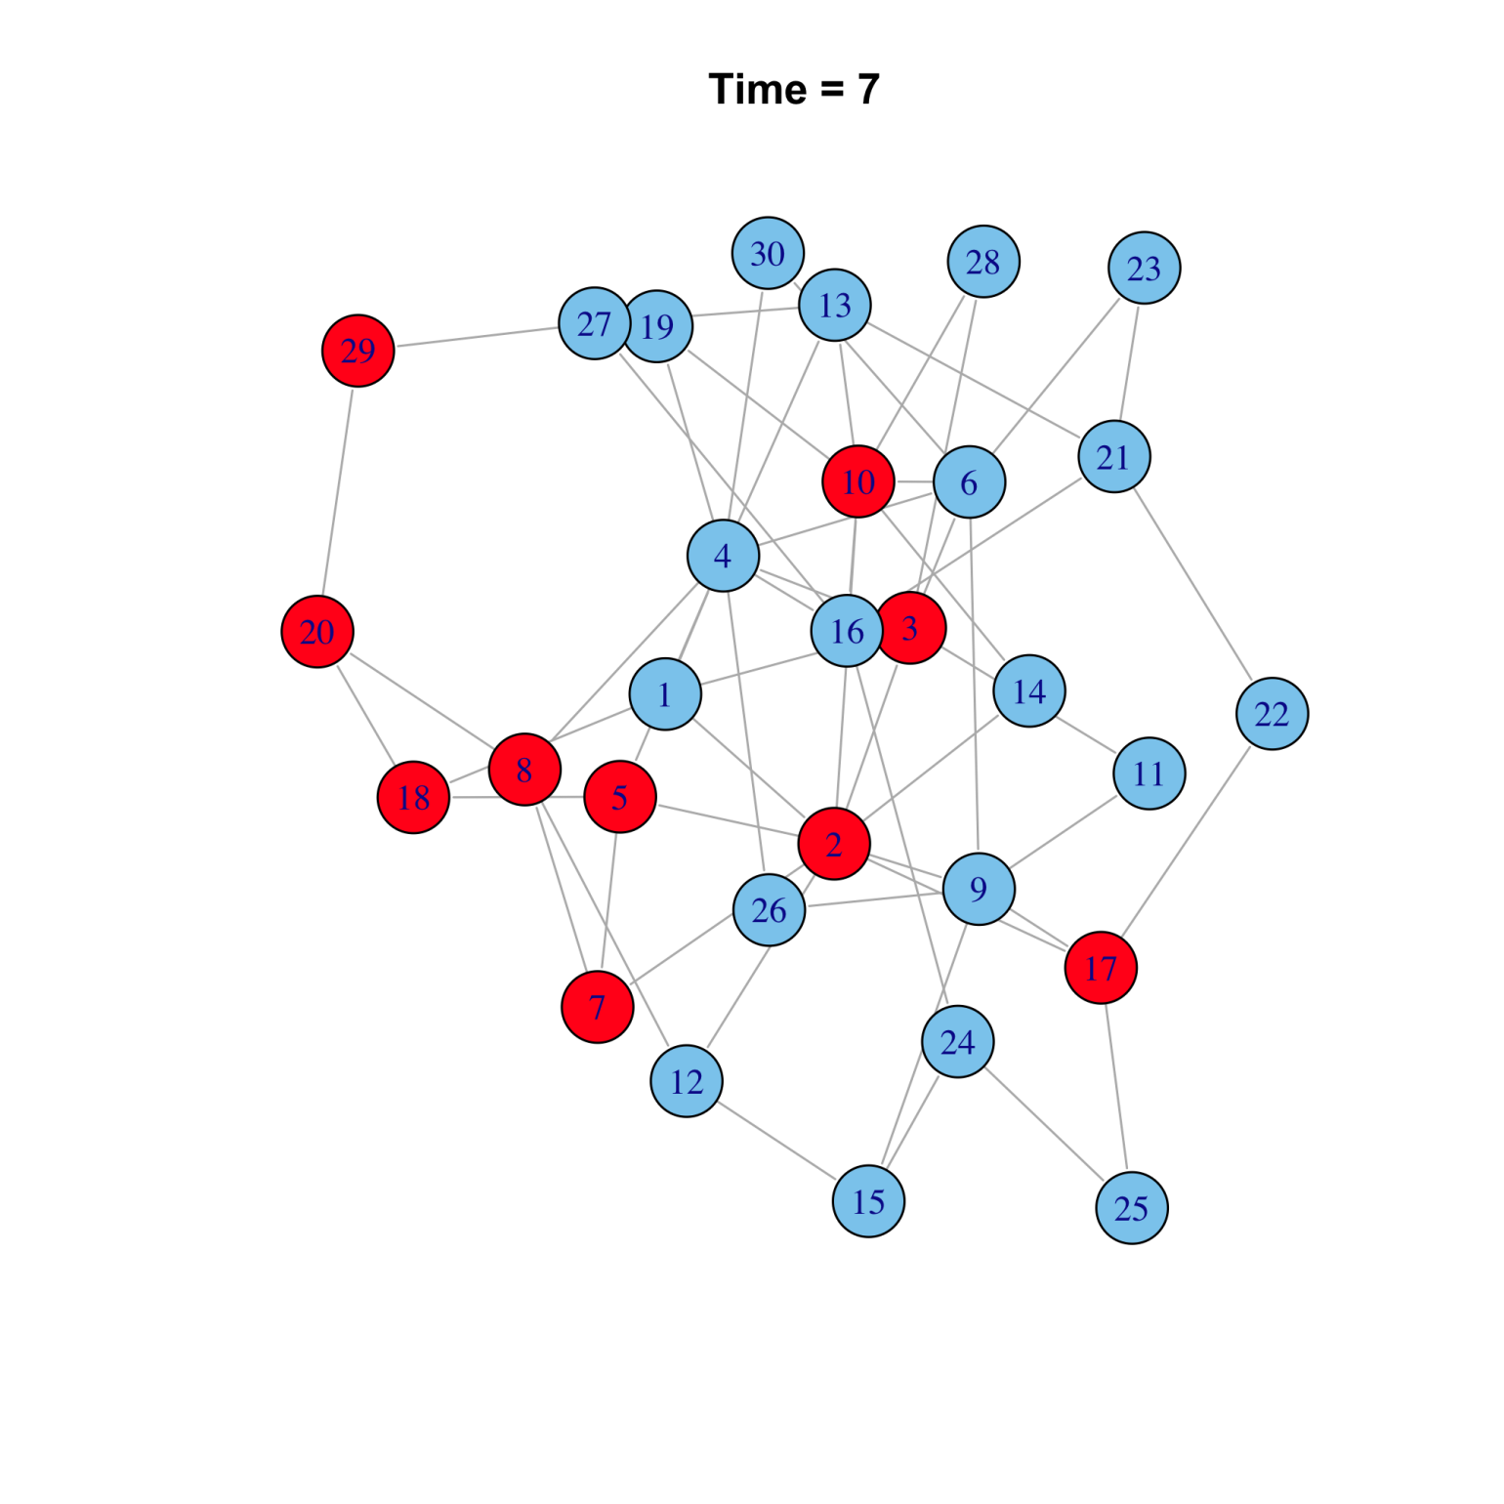

Slide 52
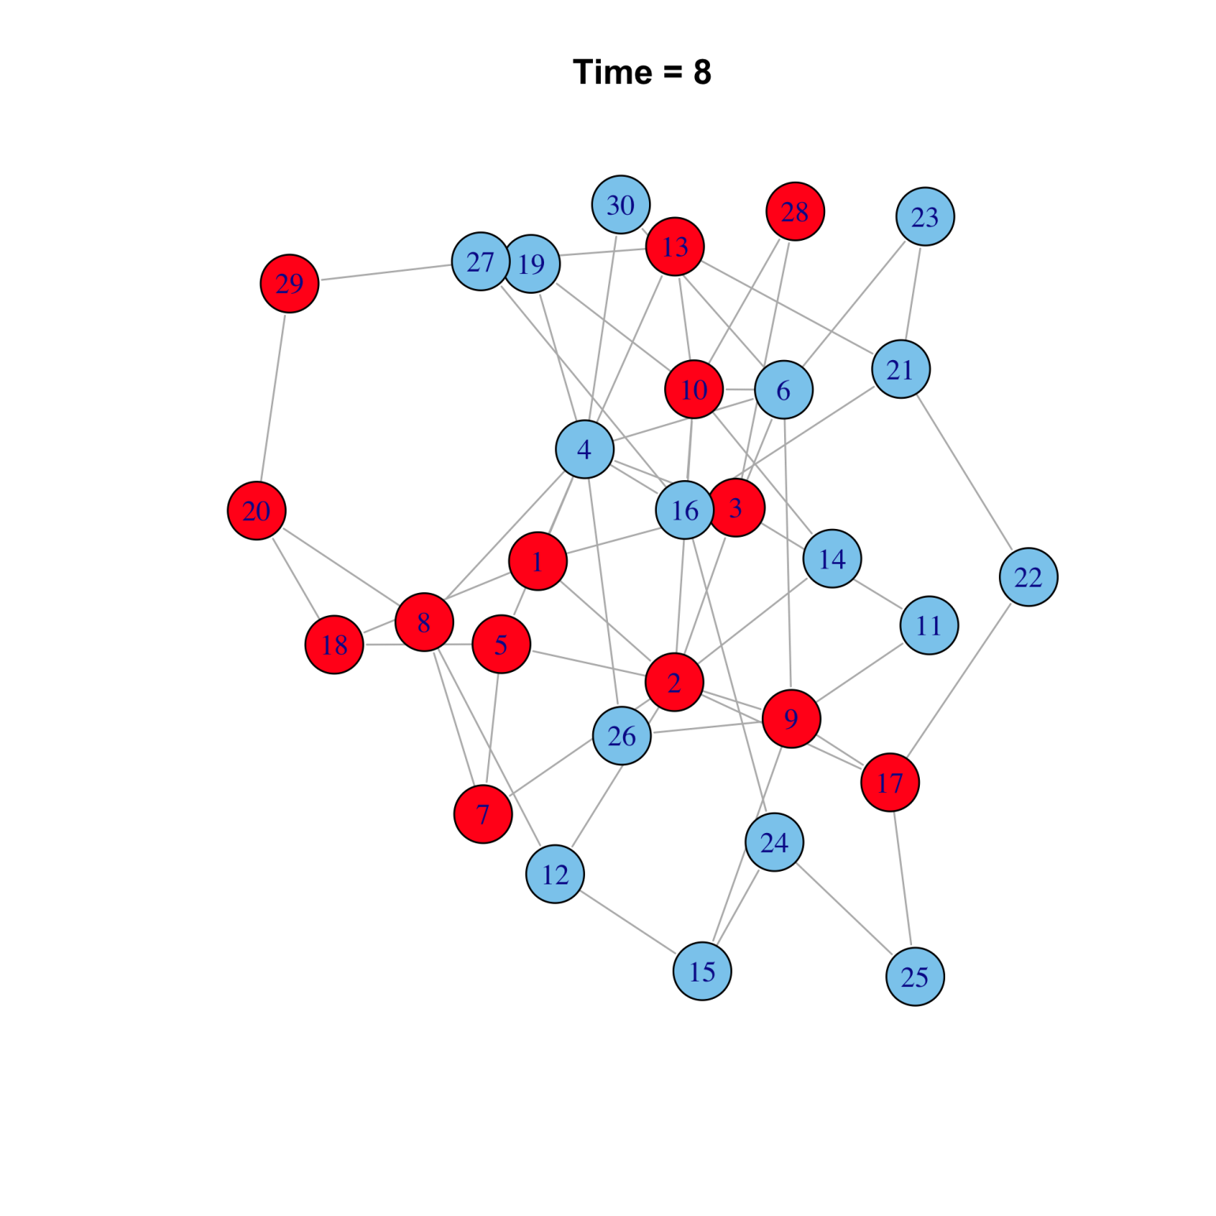

Slide 53
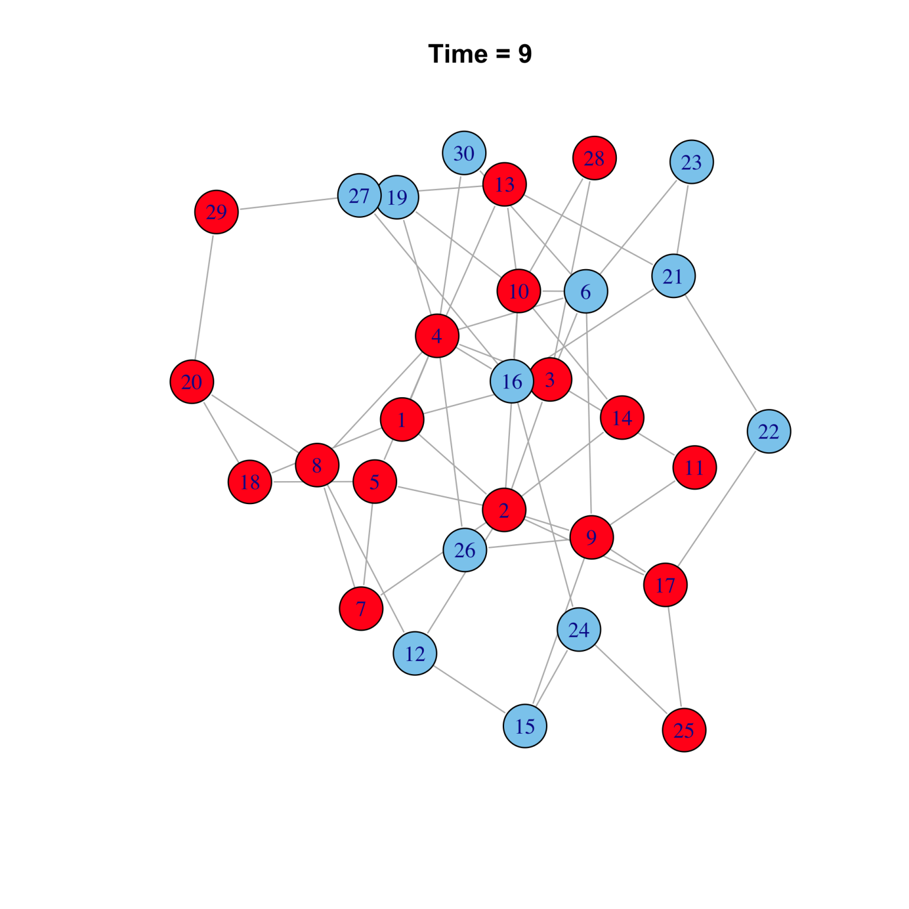

Slide 54
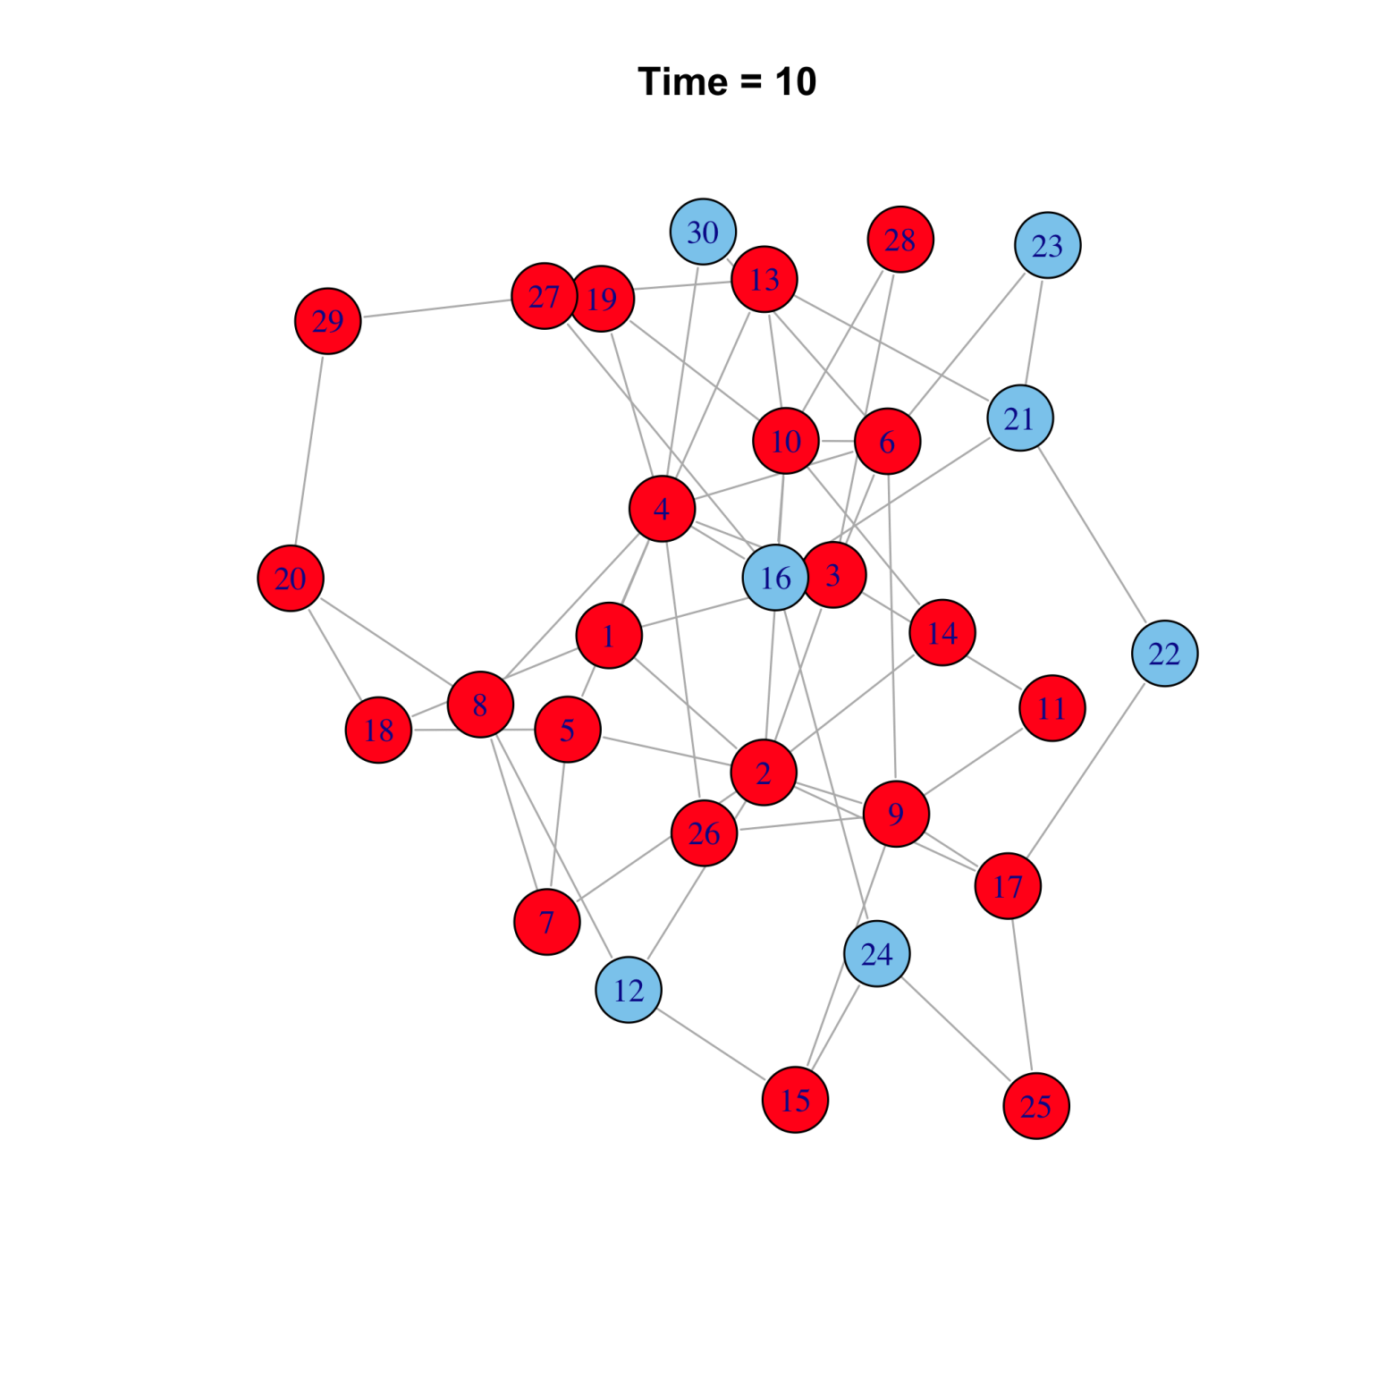

Slide 55
Network models of epidemics
Concepts & methods
  Individual-based models
  Simulation and analysis of networks (graphs)
Questions
  How does network structure affect epidemic spread?
  What is the optimal treatment or vaccination strategy over a network?
  How do networks change over time?
  “Asexual” and sexual contact networks
  Network structure and the evolution of virulence

Slide 56
Modelling Course in Population and Evolutionary Biology
Introduction
The Course
Level 1 Modules
Level 2 Modules
The Final Presentation
5-16 June 2023

Slide 57
Structure of the presentation
Scientific presentation!
Introduction:
  Biological background
  Define the problem. Why is it important?
  Outline the methods (model structure).
Results & Discussion:
  Interpret the model results: relevance?
  Limits of the results (assumptions)
Conclusions:
  Summarize the main points.
Target audience:
  The interested non-specialist.
Notes:
Make sure you explain what you are about to present: what was the question and why is it relevant.
Make sure you understand all of your figures. If you show a result, e.g. output X increases with factor A, explain what you think causes this effect, or otherwise be prepared that we are going to ask it, anyway.

Slide 58
Technical notes
Schedule:
  Prepare until Friday, 13.00. (plan your time!)
  Presentations: 14–
25/30 minutes for groups of 3/4; suggested breakdown:
  4 min intro, 6 min results/person, 2 min conclusions
Rule of thumb: 1 slide per minute
Everyone should present (but: 1 file/group).
  Select appropriate font size!!!
Feel free to ask questions during the talks.
ppt(x) or pdf

